Slide 1

CashPlease®
Union Financial
Executive Review • July 2026
Notes:
Source: CashPleaseSummaryV1_990101_000000.xlsx, tab '999-Union Financial' (report generated 7/31/2026 7:00:00 AM). Cover for client 999 Union Financial. No figures. The period label is the workbook's own generation date (July 2026) rather than a month: CashPlease is a weekly snapshot and always uses the most recent workbook (Aaron, 2026-09-01), so a month label would misstate what the figures cover.

Slide 2

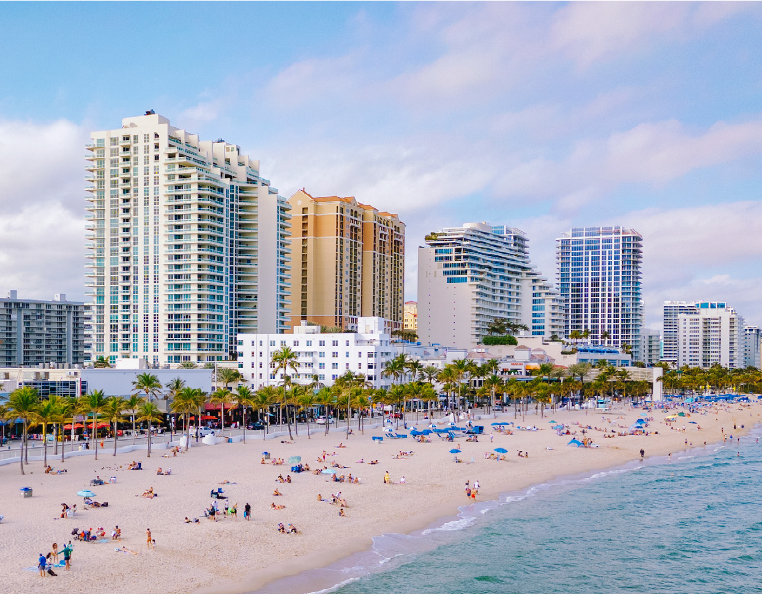




Executive Summit is an action-packed event!
Fort Lauderdale, FL November 4-5, 2026
The Executive Summit brings select banking and credit union leaders together to explore real-world strategies for growth, resilience, and innovation. Get an inside look at how your peers tackle complex challenges with bold ideas, modern technology, and the right partners. We’ll cover all this and more:
Account Acquisition
Retail Performance
Driving Deposits
Better Onboarding
Responsible Overdraft
Consumer Liquidity
Leveraging Core Data
Monetizing Debit
Engaging Consumers
Driving Transactions
Account Reacquisition
Lending
These events are complimentary to qualified attendees, including airfare (up to $600), hotel and meals.
©2026 CSI. All Rights Reserved
Notes:
Source — Executive Summit slide, build/assets/summit_slide.pptx (Fort Lauderdale, FL November 4-5, 2026). Standing front matter, identical in every deck; carries no client data.

Slide 3
Agenda
1
CashPlease®
Loan volume, portfolio status & peer comparison
2
Questions & Discussion
3
Notes:
Source: standard ARS Executive Review front matter (static).

Slide 4
CashPlease®
Loan Volume · Portfolio Status · Peer Comparison
Notes:
Section divider. No figures. Client 999 Union Financial.

Slide 5
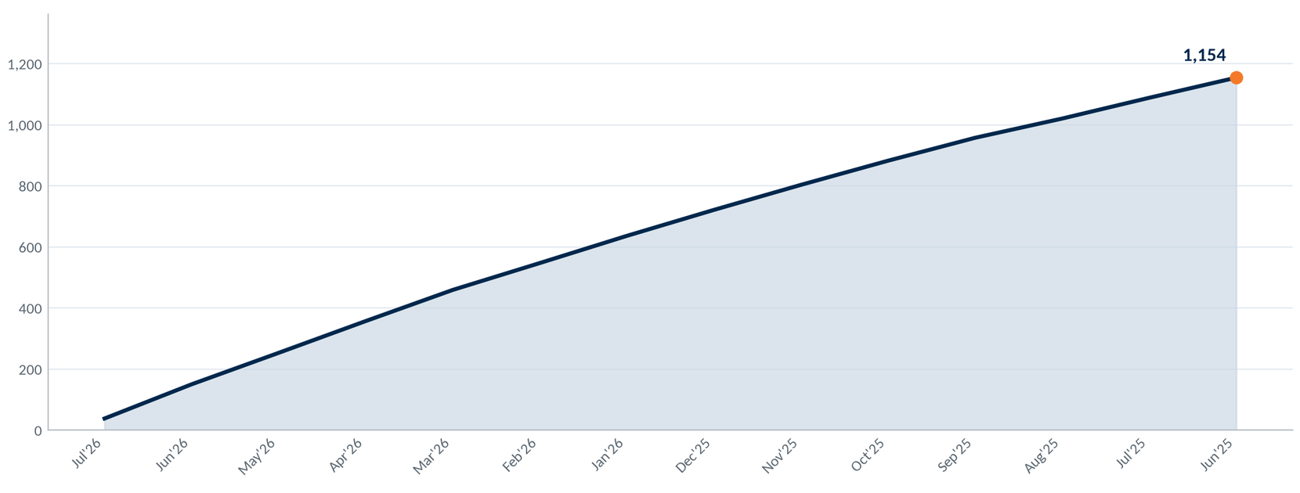
CashPlease Program Overview
PTD · July 31, 2026
All CashPlease loans booked by Union Financial, program to date.
1,794
$858K
$48K
53
42.3
Loans booked
Principal advanced
Interest earned
Loans currently funded
Loans per 1,000 DDAs, last 12 months
Cumulative loans booked, by month
Average loan size is $478, with $27 of interest per loan.
Union Financial booked 1,050 loans over 12 months against 24,800 DDA accounts — 42.3 per 1,000. That rate is 25.6 above the CashPlease client average — 42.3 against 16.7.
The charge-off rate is 1.19 points below the CashPlease client average — 5.12% against 6.31%.
Cohort: the workbook's all-clients rollup — 298,244 CashPlease loans across all 73 tabs, Union Financial included. The DDA rate uses a narrower cohort: the 51 clients with a DDA count and a full 12 months.
5
Notes:
Source: CashPleaseSummaryV1_990101_000000.xlsx, tab '999-Union Financial' (report generated 7/31/2026 7:00:00 AM). Selection: every CashPlease loan booked for client 999 program to date. Charge-off % is taken as reported on the tab (L9); it is not derivable from the tab's own totals. Peer values from the 'All Clients Summary - Loans' tab. Loans per 1,000 DDAs = loans booked over the last 12 completed months (1,050) divided by 24,800 DDA accounts, x 1,000. The DDA count is from the 'ILS Management Server DDA Count' report sent 2026-07-28, last imported 2026-07-26. The workbook also reports 'Percentage of Active Accounts with Loans' (L8) as 3.10%. It is NOT used: an account can take more than one CashPlease loan, so a loan count over an account base does not give the share of accounts that borrowed, and the workbook does not state its denominator (Aaron, 2026-09-01). The curve is the running total of the completed-month roll-up rows, all 14 of them; axis labels are sampled so a long axis stays readable, but every month is plotted.

Slide 6
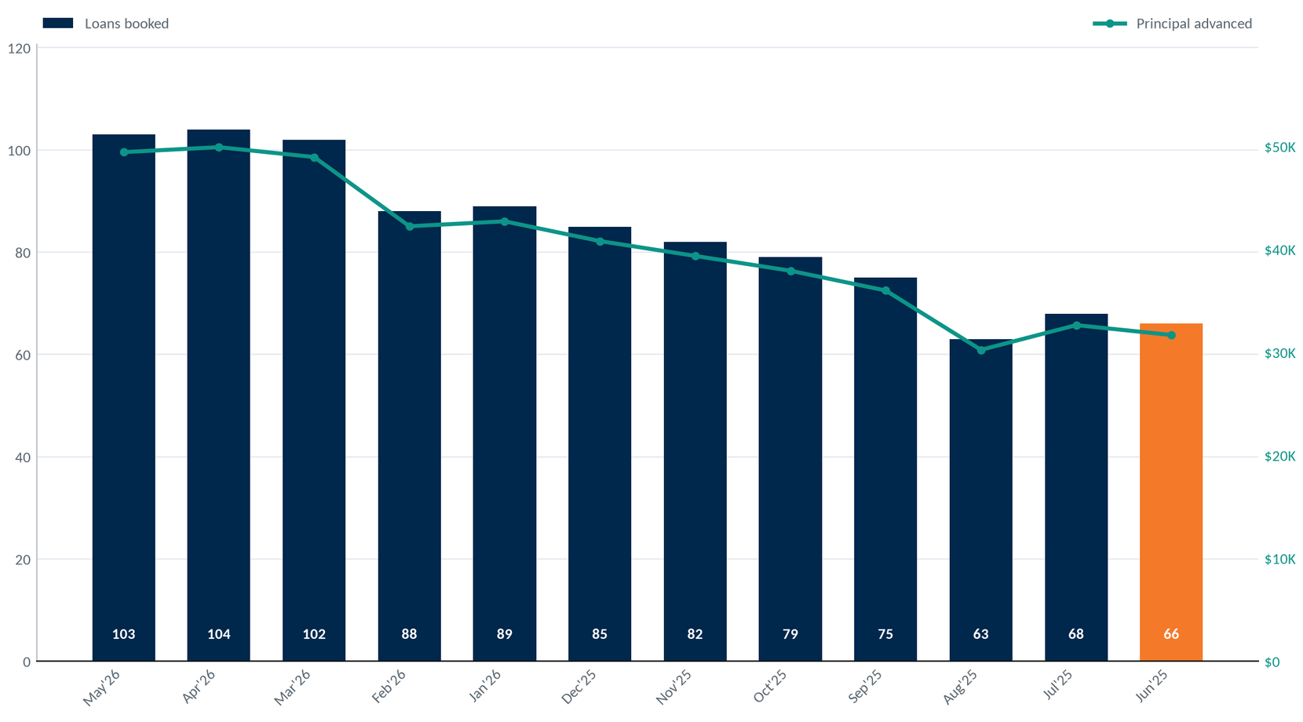
CashPlease Loan Volume by Month
PTD · July 31, 2026
Loans booked per completed month, most recent 12 months.
66
Loans booked in June 2025
$32K
Principal advanced in June 2025
6
Notes:
Source: CashPleaseSummaryV1_990101_000000.xlsx, tab '999-Union Financial', the 'Created Date' series (report generated 7/31/2026 7:00:00 AM). Selection: completed-month roll-up rows (labelled '*' on the tab), most recent 12 of 14 present. The partial bar is drawn hollow and hatched with its through-date on the chart so it cannot be read as a finished month. Bars are loan counts (left axis); the teal line is principal advanced (right axis).

Slide 7
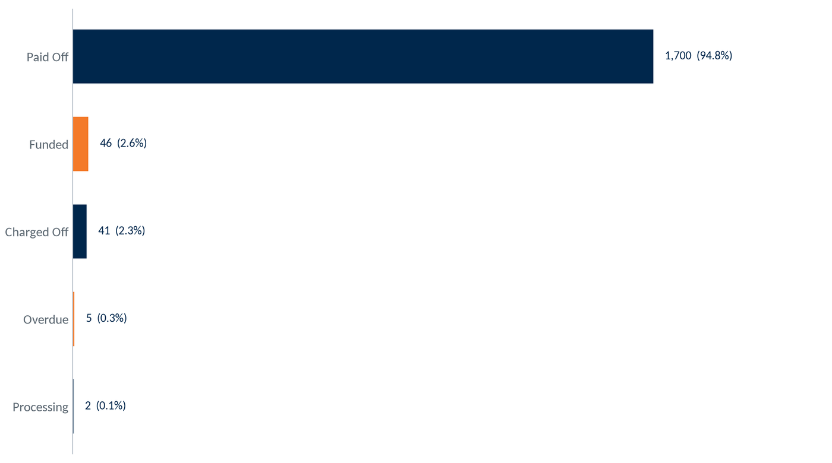
CashPlease Loan Portfolio by Status
PTD · July 31, 2026
Every loan booked by Union Financial program to date, by current status.
Status | Loans | % of Loans | Principal | Interest
Pending | 0 | 0.0% | $0 | $0
Processing | 2 | 0.1% | $900 | $40
Funded | 46 | 2.6% | $22,100 | $1,210
Paid Off | 1,700 | 94.8% | $814,032 | $45,709
Overdue | 5 | 0.3% | $2,300 | $130
Charged Off | 41 | 2.3% | $18,200 | $990
Closed | 0 | 0.0% | $0 | $0
TOTAL | 1,794 | 100.0% | $857,532 | $48,079
53
$25K
Loans funded
Principal outstanding
94.8% of loans booked have been paid off; 0.3% are overdue and 2.3% charged off.
7
Notes:
Source: CashPleaseSummaryV1_990101_000000.xlsx, tab '999-Union Financial', the 'Loans By Status' block, rows Pending through Closed plus TOTAL (report generated 7/31/2026 7:00:00 AM). Selection: all loans booked program to date. Percentages are each status's loan count over the TOTAL loan count on the same block. The charge-off % reported on the tab (L9) is a different measure and is shown on the Peer Comparison slide, not derived here.

Slide 8
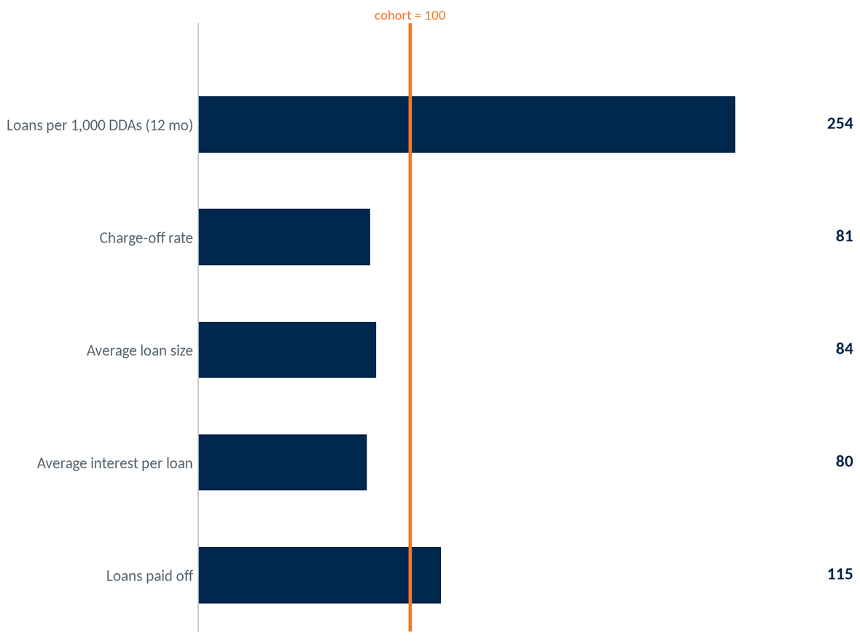
CashPlease Peer Comparison
PTD · July 31, 2026
Union Financial against the all-accounts cohort of every CashPlease client.
Cohort
Union Financial
Union Financial relative to the cohort
16.7
Loans per 1,000 DDAs (12 mo)
42.3
6.31%
Charge-off rate
5.12%
$570
Average loan size
$478
$34
Average interest per loan
$27
82.7%
Loans paid off
94.8%
Cohort: the workbook's all-clients rollup — 298,244 CashPlease loans across all 73 tabs, Union Financial included. The DDA rate uses a narrower cohort: the 51 clients with a DDA count and a full 12 months. The index reads each figure against the cohort's, so 100 is it.
8
Notes:
Source: CashPleaseSummaryV1_990101_000000.xlsx — client figures from tab '999-Union Financial', peer figures from tab 'All Clients Summary - Loans' (report generated 7/31/2026 7:00:00 AM). Selection: the all-accounts cohort is the rollup tab, verified at extract time to equal the sum of all 73 client tabs. It includes Union Financial (it is not adjusted to exclude them) and it also includes tabs no deck is built for — the internal 'enterpoints' test tab and any cancelled client — so the cohort is stated as a tab count, never as a client count. 'Charge-off rate' is a reported value (L9) on both tabs and is not derivable from the tabs' own totals. Loans per 1,000 DDAs = loans booked over the last 12 completed months (1,050) divided by 24,800 DDA accounts, x 1,000. The DDA count is from the 'ILS Management Server DDA Count' report sent 2026-07-28, last imported 2026-07-26. The workbook also reports 'Percentage of Active Accounts with Loans' (L8) as 3.10%. It is NOT used: an account can take more than one CashPlease loan, so a loan count over an account base does not give the share of accounts that borrowed, and the workbook does not state its denominator (Aaron, 2026-09-01). Average loan size and average interest per loan are the cohort's total principal / total interest divided by its loan count. The index chart plots client / cohort x 100 for each row shown; bars are one colour and the reference line carries the accent, because 'above' is not 'better' for the charge-off rate.

Slide 9
Questions & Discussion
Union Financial • July 2026
Notes:
Source: section slide (static).

Slide 10
Contact Us
Aaron Burgard
Client Service Manager
910-617-1984
aaron.burgard@csiweb.com
10
Notes:
Source: CSI / Velocity Solutions contact information (static).

