Slide 1

Invitation Checking® System
Union Financial | Executive Review • July 2026
Notes:
Title slide. No data.

Slide 2
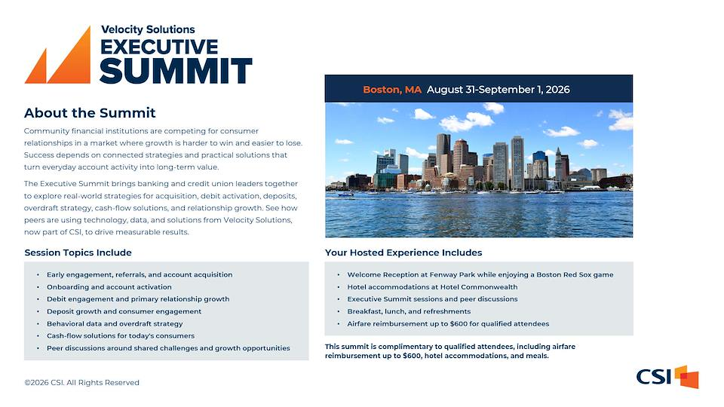

Slide 3
Invitation Checking® System
Referrals · Account Performance · Revenue
Notes:
Section divider. No data.

Slide 4
Agenda
1
The Power of Referrals
2
Referral Trend & Results by Branch
3
Performance of ICS Accounts
4
ICS Revenue & Revenue Detail
5
ICS Financial Summary
6
Comparisons
7
E-Learning & VIP Resources
8
Questions & Discussion
4
Notes:
Agenda. No data.

Slide 5
The Power of Referrals
PTD · July 15, 2026
Selection: checking referrals logged by branch staff — program-to-date and 2026 YTD.
1,212
Referrals Program-to-Date
Union Financial team members have generated 1,212 checking referrals since program inception — 205 year-to-date in 2026. June was a program high at 39.
205
2026 Year-to-Date
39
Previous Month (June)
54%
June vs Goal
5
Notes:
Source — VIP Invitation Checking® System → ICS Referral Data dashboard (Looker embed) and 999-2026.07-Union Financial-Invitation Checking Workbook v1.7.1-DM.xlsx for Union Financial (999), pulled 2026-07-15. Referrals PTD 1,212, YTD 205, June 39, monthly goal 72 (June vs goal 54%). VIP, current thru July (partial).

Slide 6
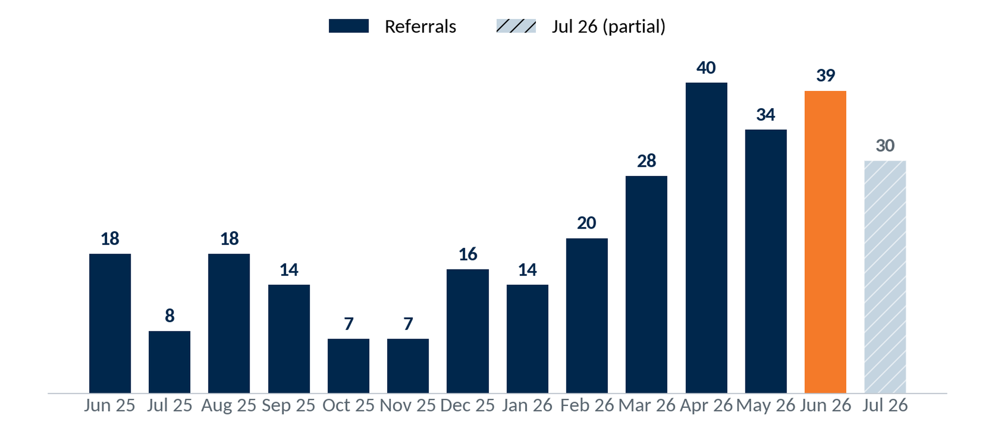
Referral Trend – Last 14 Months
PTD · July 15, 2026
Monthly checking referrals, Jun 25 – Jul 26; Jun 26 a program high at 39, Jul 26 partial. Goal 72/mo.
6
Notes:
Source — VIP Invitation Checking® System → ICS Referral Data dashboard (Looker embed) and 999-2026.07-Union Financial-Invitation Checking Workbook v1.7.1-DM.xlsx for Union Financial (999), pulled 2026-07-15. Monthly referrals vs the 72/mo goal. Bars navy, last complete month orange, partial month hatched. VIP.

Slide 7
Results by Branch – Year to Date
YTD · July 15, 2026
Branch | Referrals YTD | Goal | % of Goal
Branch 1 | 44 | 84 | 52%
Branch 2 | 39 | 48 | 81%
Branch 3 | 17 | 24 | 71%
Branch 4 | 16 | 84 | 19%
Branch 5 | 16 | 60 | 27%
Branch 6 | 16 | 84 | 19%
Branch 7 | 15 | 96 | 16%
Branch 8 | 14 | 96 | 15%
Top 8 Total | 177 | 576 | 31%
Selection: checking referrals by branch, year-to-date (top 8 branches).
7
Notes:
Source — VIP Invitation Checking® System → ICS Referral Data dashboard (Looker embed) and 999-2026.07-Union Financial-Invitation Checking Workbook v1.7.1-DM.xlsx for Union Financial (999), pulled 2026-07-15. Referrals by branch, YTD, vs each branch's YTD goal. Top branches by referrals. VIP; branch names reconciled to the Charts 'Goals' tab.

Slide 8
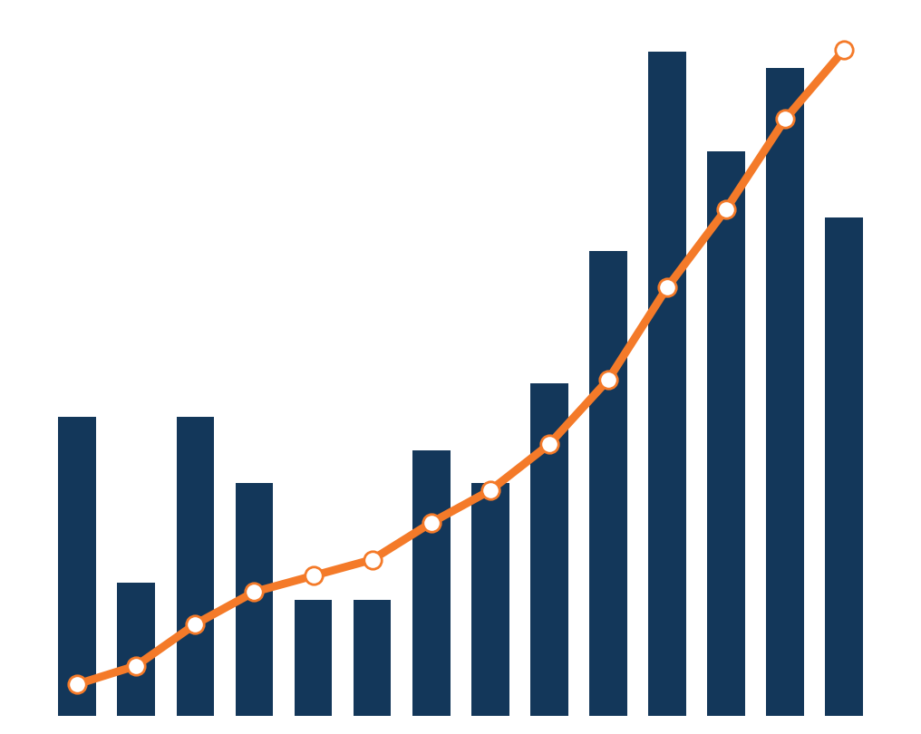
Performance of Accounts
• Drilling into the data
• Overall Profitability
• Breakdown of Revenue
• Breakdown by Month
• Comparisons
8
Notes:
Section intro to the ICS account-performance analysis (profitability, revenue breakdown, monthly detail, comparisons). Motif = monthly referrals (bars) + cumulative referrals (line), from the VIP referral trend. No figures on the slide face.

Slide 9
Performance of ICS Accounts
PTD · June 2026
Return on Investment — 8.97 to 1
$227.64
9.26 years
$2,107.95
Annual Profit Contribution per Account
Average Life of Accounts
Present Value per Account
• Accounts pay for themselves in ~12 months
• 34% longer than the 6.9-year average for all accounts
• Modeled from ICS account survival
• Using the 9.26-year modeled account life
• Acquisition Cost: $235
9
Notes:
Source — VIP Invitation Checking® System → ICS Referral Data dashboard (Looker embed) and 999-2026.07-Union Financial-Invitation Checking Workbook v1.7.1-DM.xlsx for Union Financial (999), pulled 2026-07-15. ROI recalculated (workbook ROI not used): PV/acct = annual profit $227.64 × 9.26 yr (velocity life, program <2 yr) = $2,107.95; PV total = $2,942,693; ROI = PV total ÷ ($235 × 1,396) = 8.97 : 1.

Slide 10
Program Results by Month Opened
PTD · June 2026
ICS-originated checking accounts by opening-month cohort — revenue and amortized acquisition expense.
Month Opened | Oct 25 | Nov 25 | Dec 25 | Jan 26 | Feb 26 | Mar 26 | Apr 26 | May 26 | Jun 26
Accounts Opened | 20 | 16 | 23 | 23 | 22 | 49 | 30 | 31 | 32
Avg Balance / Acct | $852 | $721 | $310 | $266 | $478 | $721 | $693 | $467 | $469
Spread on Deposits | $328 | $208 | $108 | $79 | $121 | $321 | $143 | $66 | $34
Interchange Income | $995 | $571 | $560 | $640 | $300 | $1,086 | $343 | $254 | $77
NSF / OD Fees | $384 | $768 | $1,376 | $2,112 | $512 | $2,272 | $320 | $320 | $32
Other Fees | $209 | $84 | $53 | $11 | $20 | $98 | $28 | $6 | $2
Account Profit Contribution | $1,916 | $1,631 | $2,097 | $2,842 | $952 | $3,777 | $834 | $647 | $145
Amortized Expense / Acct / Mo | $3.92 | $3.92 | $3.92 | $3.92 | $3.92 | $3.92 | $3.92 | $3.92 | $3.92
Months Open | 9 | 8 | 7 | 6 | 5 | 4 | 3 | 2 | 1
Amortized expense: $235 ÷ 60 months = $3.92 per account per month × time open.
10
Notes:
Source — VIP Invitation Checking® System → ICS Referral Data dashboard (Looker embed) and 999-2026.07-Union Financial-Invitation Checking Workbook v1.7.1-DM.xlsx for Union Financial (999), pulled 2026-07-15. Monthly Detail tab: revenue components, account profit contribution, amortized expense ($235 ÷ 60 = $3.92/acct/mo). Cohort by opening month.

Slide 11
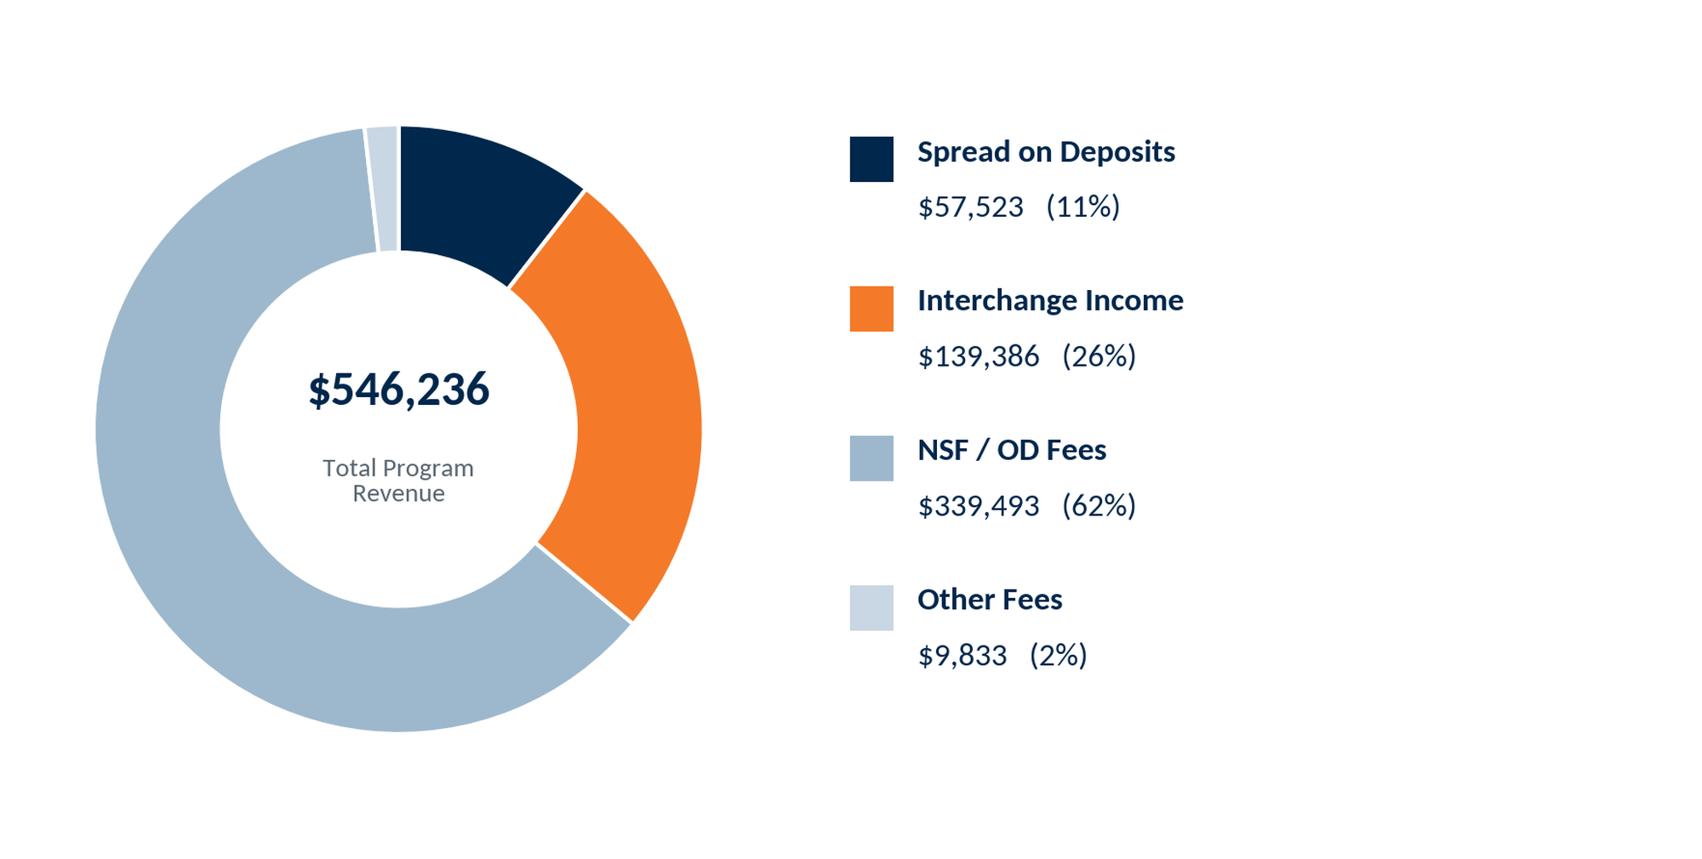
ICS Revenue
PTD · June 2026
Selection: ICS-originated checking accounts; revenue program-to-date.
11
Notes:
Source — VIP Invitation Checking® System → ICS Referral Data dashboard (Looker embed) and 999-2026.07-Union Financial-Invitation Checking Workbook v1.7.1-DM.xlsx for Union Financial (999), pulled 2026-07-15. PTD revenue by source: Spread on Deposits $57,523, Interchange Income $139,386, NSF / OD Fees $339,493, Other Fees $9,833; total $546,236. Workbook 'Monthly Detail'.

Slide 12
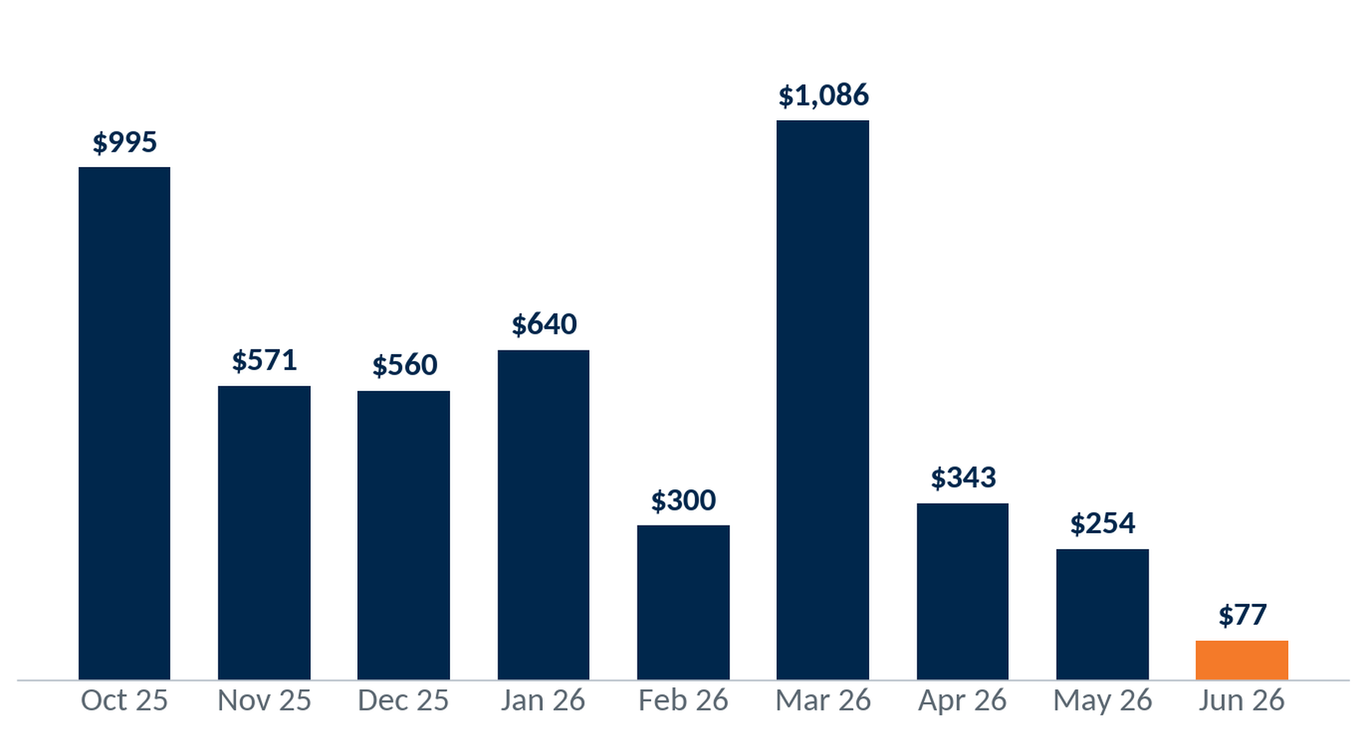
Total Interchange Revenue
Interchange revenue by cohort (opening month), program-to-date.
$4,825
Interchange PTD
1,396
ICS accounts
Interchange Income: Blended Rate × Debit Card Spend
12
Notes:
Source — VIP Invitation Checking® System → ICS Referral Data dashboard (Looker embed) and 999-2026.07-Union Financial-Invitation Checking Workbook v1.7.1-DM.xlsx for Union Financial (999), pulled 2026-07-15. Interchange revenue by cohort. Workbook 'Monthly Detail' (revenue only).

Slide 13
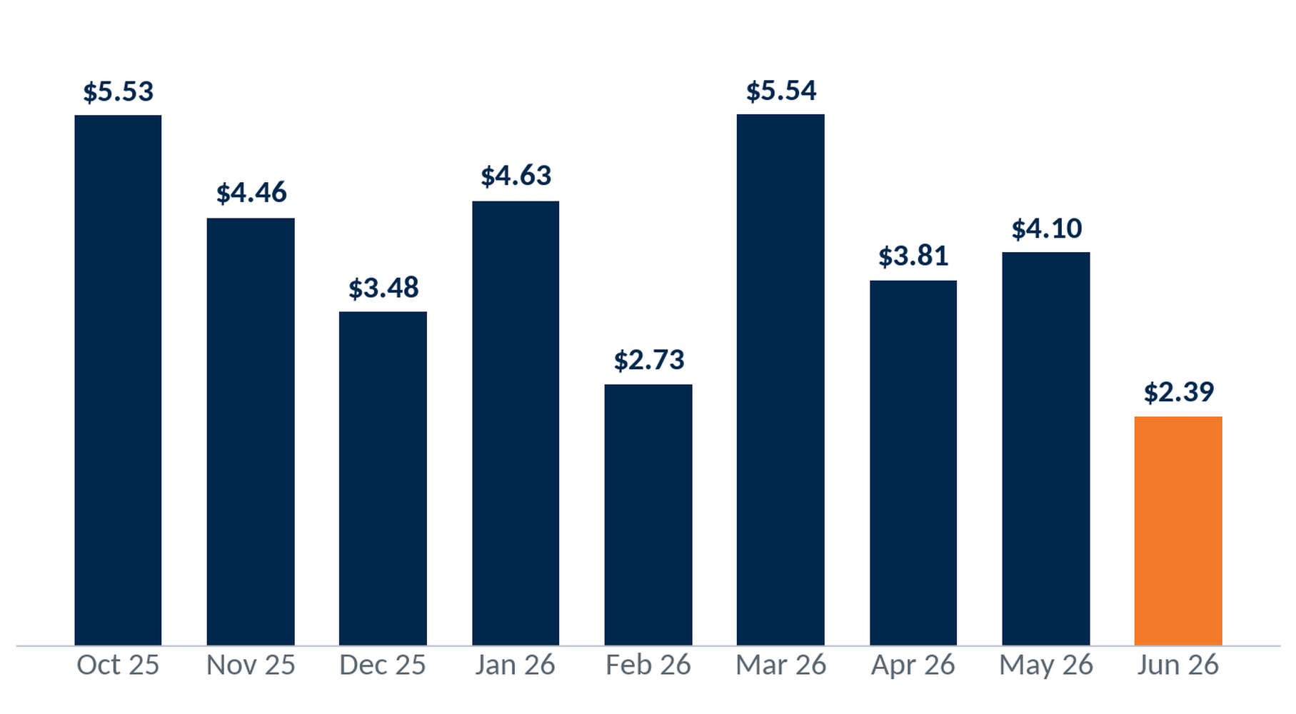
Interchange Revenue per Account per Month
Interchange revenue ÷ accounts opened ÷ months open, by cohort (e.g. Nov 25: $398.47 / 19 / 8 = $2.62).
$4.40
Blended / account / month
$3.46
Per account, life-to-date
Interchange Income: Blended Rate × Debit Card Spend
13
Notes:
Source — VIP Invitation Checking® System → ICS Referral Data dashboard (Looker embed) and 999-2026.07-Union Financial-Invitation Checking Workbook v1.7.1-DM.xlsx for Union Financial (999), pulled 2026-07-15. Interchange per account per month, cohort-normalized. Workbook 'Monthly Detail'.

Slide 14
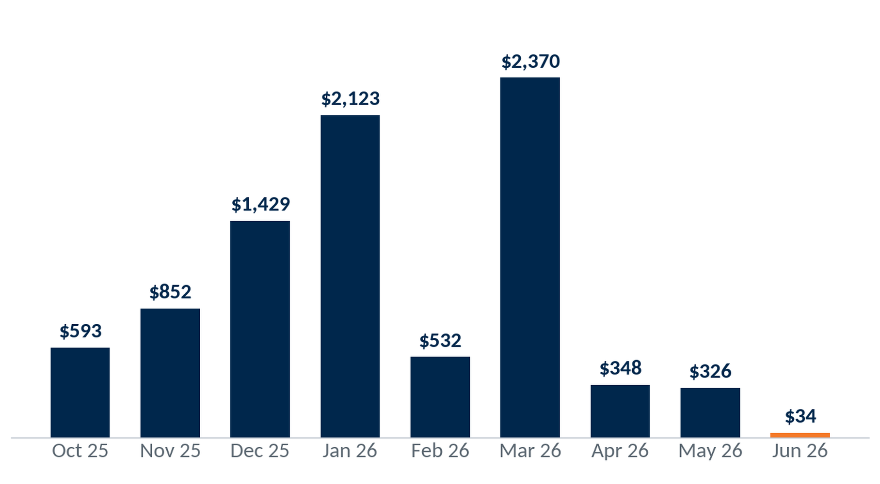
Total NSF/OD & Other Fee Revenue
NSF/OD fees plus other service charges by cohort (opening month), program-to-date. Revenue only — not item counts.
$8,607
NSF/OD & Other PTD
1,396
ICS accounts
14
Notes:
Source — VIP Invitation Checking® System → ICS Referral Data dashboard (Looker embed) and 999-2026.07-Union Financial-Invitation Checking Workbook v1.7.1-DM.xlsx for Union Financial (999), pulled 2026-07-15. NSF/OD + other service charges by cohort. Workbook 'Monthly Detail' (revenue only).

Slide 15
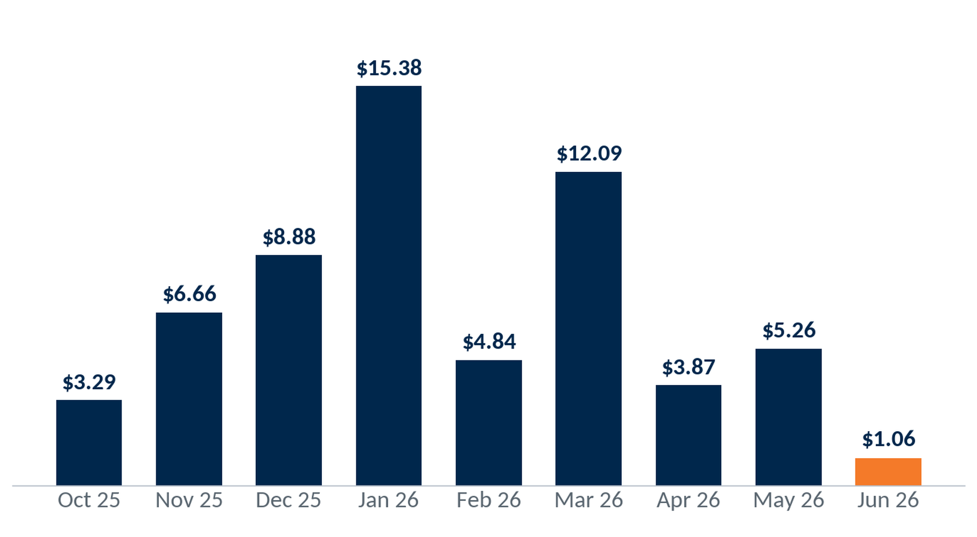
NSF/OD & Other Fees per Account per Month
(NSF/OD + other charges) ÷ accounts opened ÷ months open, by cohort (e.g. Nov 25: $593.00 / 19 / 8 = $3.90).
$7.85
Blended / account / month
$6.17
Per account, life-to-date
15
Notes:
Source — VIP Invitation Checking® System → ICS Referral Data dashboard (Looker embed) and 999-2026.07-Union Financial-Invitation Checking Workbook v1.7.1-DM.xlsx for Union Financial (999), pulled 2026-07-15. NSF/OD + other charges per account per month, cohort-normalized. Workbook 'Monthly Detail'.

Slide 16
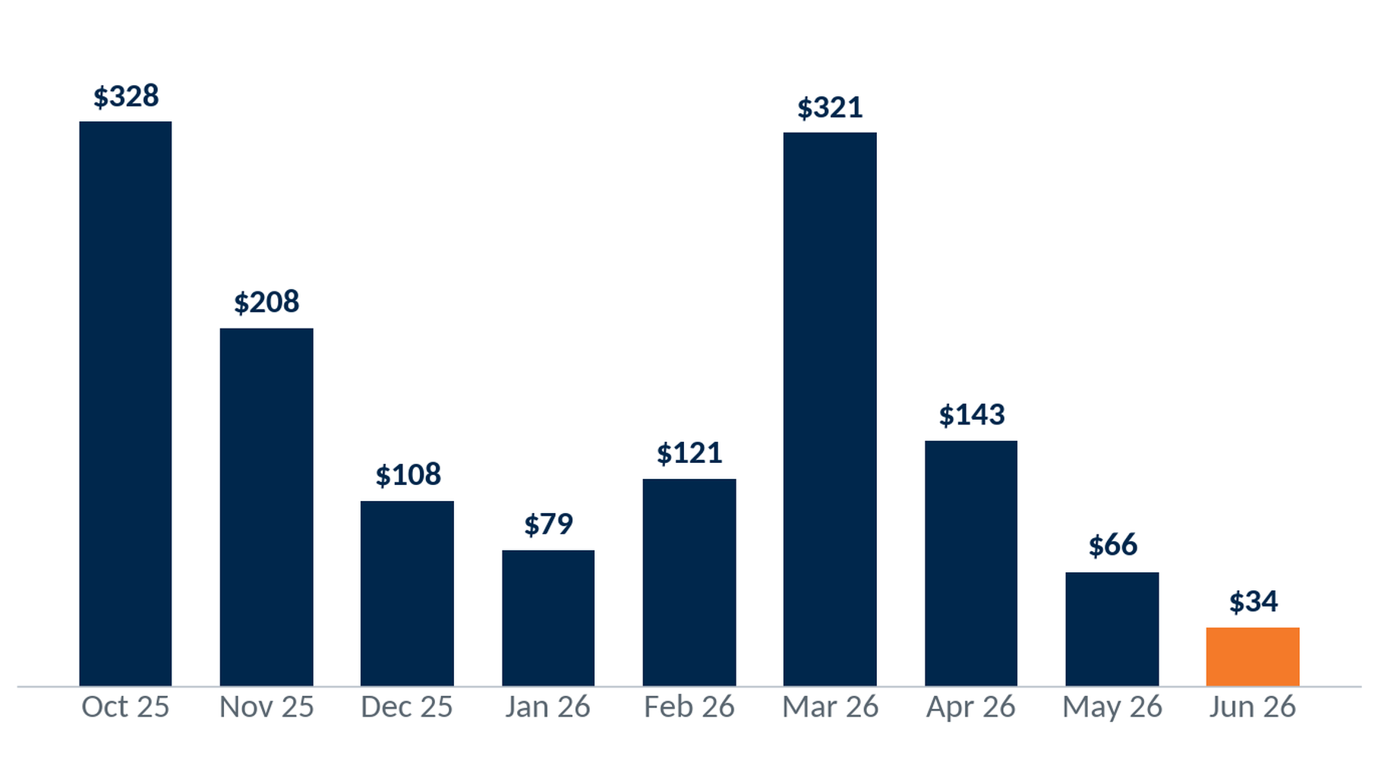
Total Spread Revenue
Spread revenue by cohort (opening month), program-to-date.
$1,409
Spread PTD
1,396
ICS accounts
Spread = 2.75% × avg month-end balance/account, summed monthly, net of interest paid.
16
Notes:
Source — VIP Invitation Checking® System → ICS Referral Data dashboard (Looker embed) and 999-2026.07-Union Financial-Invitation Checking Workbook v1.7.1-DM.xlsx for Union Financial (999), pulled 2026-07-15. Spread revenue by cohort. Workbook 'Monthly Detail'.

Slide 17
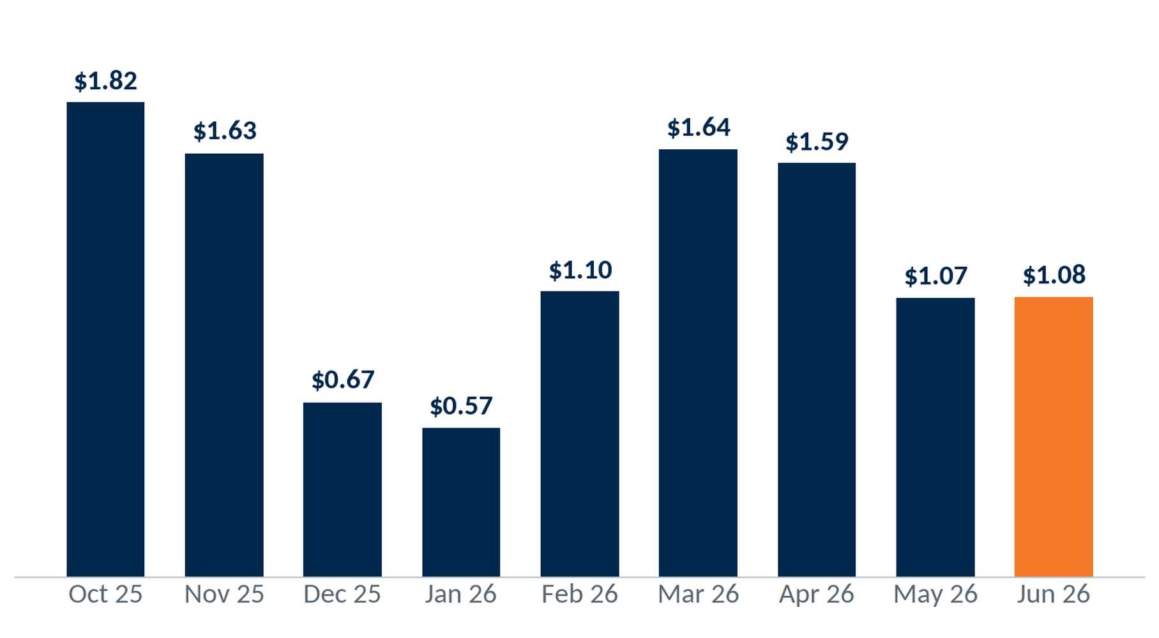
Spread Revenue per Account per Month
Spread revenue ÷ accounts opened ÷ months open, by cohort (e.g. Nov 25: $327.87 / 19 / 8 = $2.16).
$1.28
Blended / account / month
$1.01
Per account, life-to-date
Spread = 2.75% × avg month-end balance/account, summed monthly, net of interest paid.
17
Notes:
Source — VIP Invitation Checking® System → ICS Referral Data dashboard (Looker embed) and 999-2026.07-Union Financial-Invitation Checking Workbook v1.7.1-DM.xlsx for Union Financial (999), pulled 2026-07-15. Spread per account per month, cohort-normalized. Workbook 'Monthly Detail'.

Slide 18
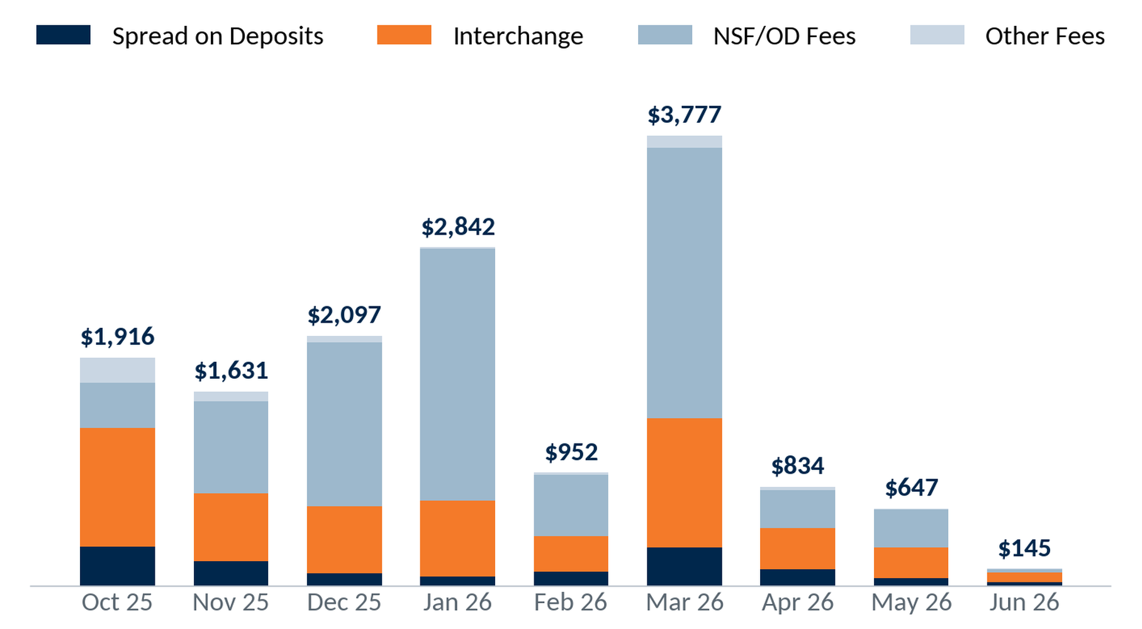
Revenue Composition by Month
Monthly revenue per referral by source: spread (net of interest), interchange, NSF/OD, other.
$14,841
Profit contribution PTD
1,396
ICS accounts
18
Notes:
Source — VIP Invitation Checking® System → ICS Referral Data dashboard (Looker embed) and 999-2026.07-Union Financial-Invitation Checking Workbook v1.7.1-DM.xlsx for Union Financial (999), pulled 2026-07-15. Monthly revenue composition by cohort. Workbook 'Monthly Detail'.

Slide 19
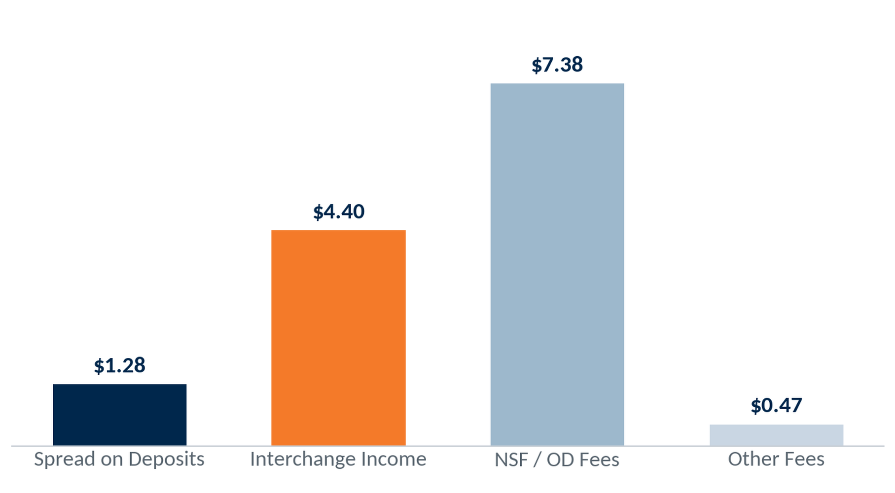
Revenue per Account per Month by Source
Blended revenue per account per month by source, life-to-date (cohort revenue ÷ account-months).
$13.53
All sources / acct / mo
1,396
ICS accounts
19
Notes:
Source — VIP Invitation Checking® System → ICS Referral Data dashboard (Looker embed) and 999-2026.07-Union Financial-Invitation Checking Workbook v1.7.1-DM.xlsx for Union Financial (999), pulled 2026-07-15. Per-account-per-month revenue compared across sources (spread, interchange, NSF/OD, other), life-to-date. Workbook 'Monthly Detail'.

Slide 20
ICS Financial Summary
PTD · June 2026
Selection: ICS-originated checking accounts; figures program-to-date.
Program to Date
1,396
ICS Accounts
$2.94M
Present Value
of New ICS Accounts
Account Profit Contribution
$546,236
Amortized Program Expense
$861
Average Balance
$115,162
Net Profit
$431,074
8.97 : 1
Return on Investment
Billed Expense for 1,396 Accounts
$328,060
Amortized expense: $235 ÷ 60 months = $3.92 per account per month × time open.
20
Notes:
Source — VIP Invitation Checking® System → ICS Referral Data dashboard (Looker embed) and 999-2026.07-Union Financial-Invitation Checking Workbook v1.7.1-DM.xlsx for Union Financial (999), pulled 2026-07-15. Contribution $546,236 − expense $115,162 = net $431,074; 1,396 accounts, avg balance $861. Present Value = $2,942,693 (annual profit × 9.26 yr × accounts); ROI 8.97:1 (recalculated, workbook ROI not used).

Slide 21
Comparisons
Velocity Clients' Average
Union Financial Data
29%
% of Total Openings
15%
$1,828
Lifetime Value
$2,108
6.7%
12 M Close Rate
0.9%
6.9 Years
Average Life of Account
9.26 Years
Note: your Non-ICS accounts' 12-month close rate = 0.9%.
21
Notes:
Source — VIP Invitation Checking® System → ICS Referral Data dashboard (Looker embed) and 999-2026.07-Union Financial-Invitation Checking Workbook v1.7.1-DM.xlsx for Union Financial (999), pulled 2026-07-15. Union Financial vs the Velocity ICS client average — openings/branch, lifetime value, 12-mo close rate (ICS 0.90% vs Non-ICS 0.90%), account life. Velocity averages are program-wide constants.

Slide 22

New in 2026: E-Learning Modules
Dynamic Learning- 5-10 minutes
Focused on one topic
On-the-go resources
Flexible schedule for lean teams
New content every quarter
22
Notes:
Program education / reference material. No client data.

Slide 23

E-Learning Library Guide
Leadership Training
  Description on Each Module
  Target Audience
  Length
  Link to Training
Invitation Checking System Training
  Description on Each Module
  Target Audience
  Length
  Link to Training
New Hire Training
  Description on Each Module
  Target Audience
  Length
  Link to Training
23
Notes:
Program education / reference material. No client data.

Slide 24
2026 New Releases
Leadership Training
Front Line Referrals
Quarter 1
How to Use the E-Learning Modules | The Power of Consistency: Driving Sustainable Referral Success
Accountability-Unlock Your Team’s Success | Same People? Turn Familiar Faces into Fresh Opportunities
Employee Engagement- Contests & More | Maximizing Referrals Through Social Media Engagement
Create A Calendar for Success | Incentive Accuracy: Avoiding Common Referral Reward Mistakes
Quarter 2
Referral Growth Strategies Outside the Branch- Who to Approach | Referral Conversations: Sales vs. Conversations
Referrals Outside the Branch- Preparation and Implementation | More Opportunities Using the 3-Steps Over the Phone
VIP-Referral Reporting Guide | Referral Quiz
Quarter 3
Coaching “THANK, ASK, OFFER” to Drive Referral Growth | The 3-Steps in Action
Just Say No- We Don’t Accept Excuses | Know the Tools: Empowering Conversations About Referrals
From Great to Greater- Coaching Your Best Performers | The Power of Personal Codes: Promotion, Usage & Results
Quarter 4
The Leadership Mirror-Leading by Example | Making Referral Flyers Work: Practical Tips for Referral Engagement
Meetings that Matter: Engaging Your Team | How Well Do You Know the Rewards Website?
Change Excuses to Excellence-Overcoming Objections | 3-Steps. Short on Time, Big on Impact: Fast Referral Promotion
24
Notes:
Program education / reference material. No client data.

Slide 25
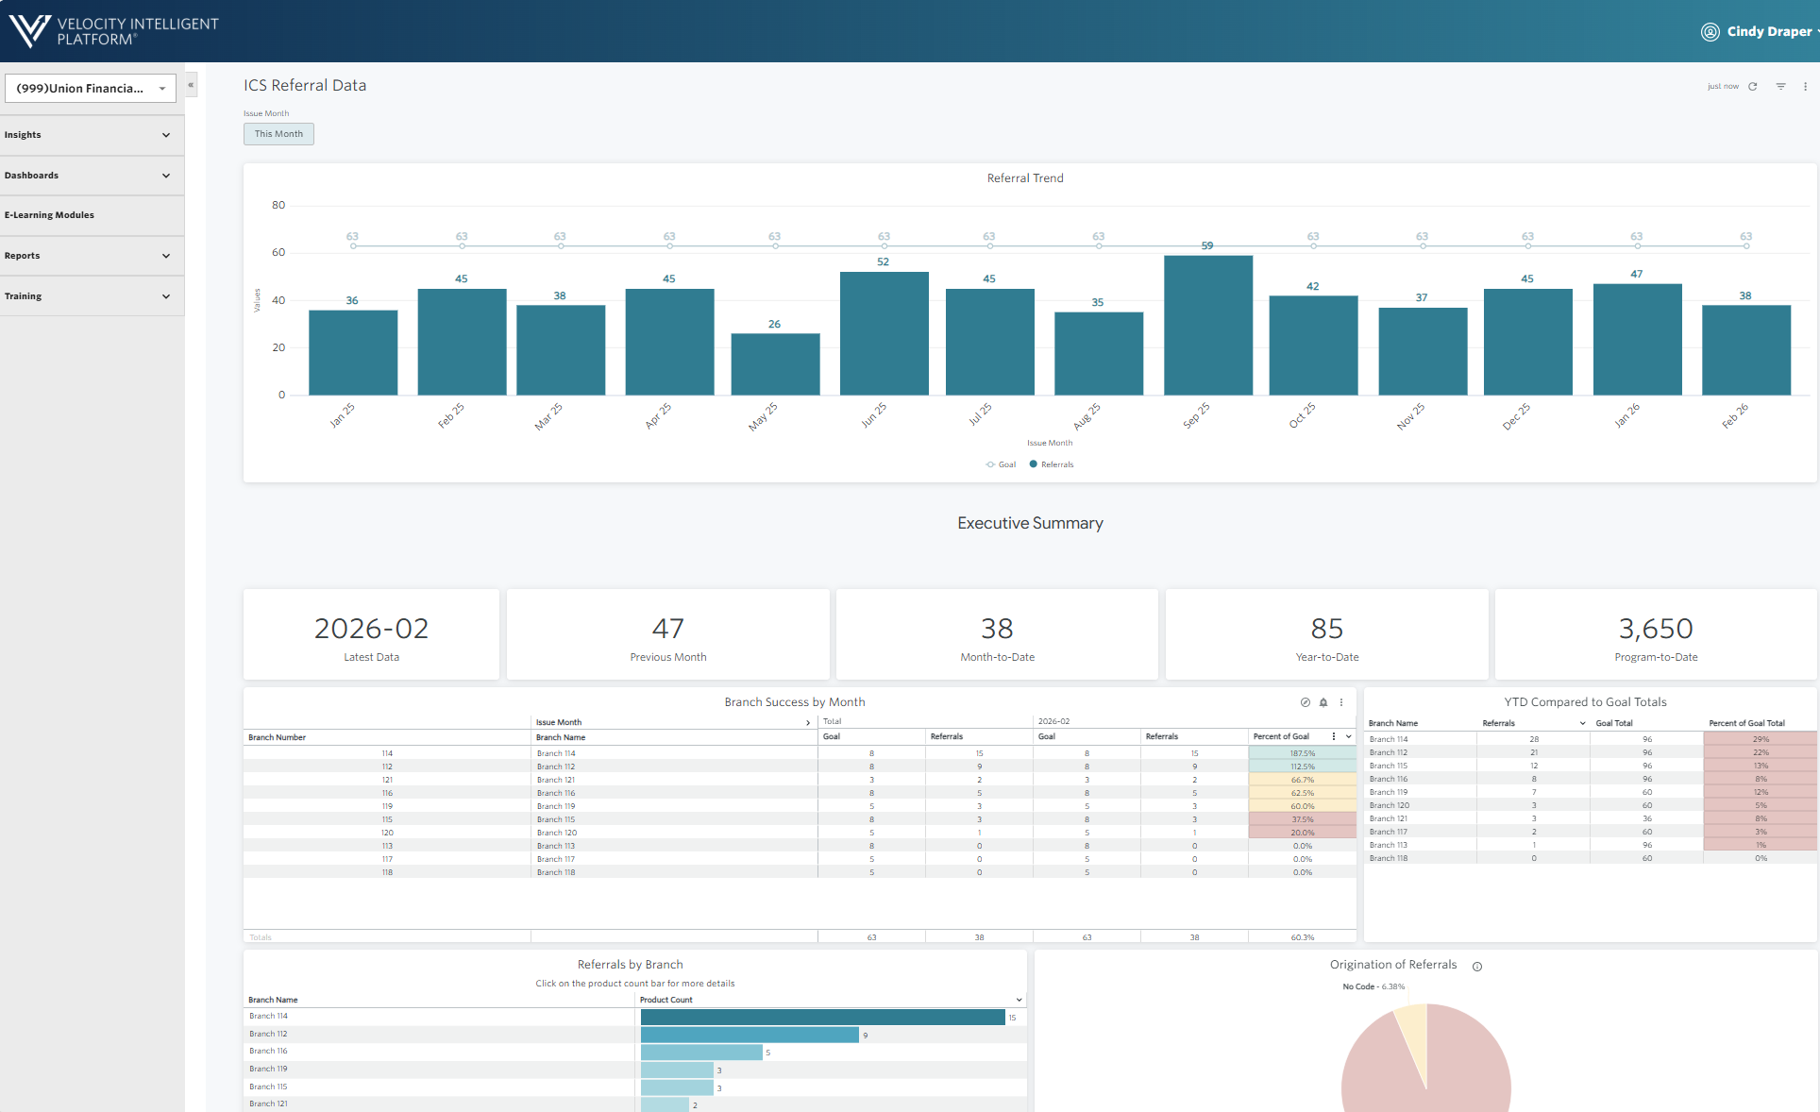
Reporting: VIP
Daily updates on referral activity
Monthly reports
Generate reports to be emailed to yourself
E-Learning Module Guides
Monthly Training Webinars/Newsletters
Reports
25
Notes:
Program education / reference material. No client data.

Slide 26
VIP Best Practices
Five habits that keep referral performance consistent across the organization.
1
Identify & Recognize Influencers
Spotlight the team members driving the most referrals.
2
Celebrate Success Across the Organization
Share wins widely to build momentum and friendly competition.
3
Reinforce Accountability
Set clear referral expectations for every branch and role.
4
Encourage Participation & Awareness
Keep the program top of mind with year-round touchpoints.
5
Conduct Periodic Audits
Review referral activity regularly and coach the gaps.
26
Notes:
Program education / reference material. No client data.

Slide 27
Questions & Discussion
Union Financial • July 2026
Notes:
Discussion slide. No data.

Slide 28
Contact Us
Aaron Burgard
Cindy Draper
Client Service Manager
Strategist and Program Manager for Invitation Checking® System
910-617-1984
910-386-8287
aaron.burgard@csiweb.com
cindy.draper@csiweb.com
28
Notes:
Contact information.

