Slide 1
Social Psychology

Slide 2
Social Thinking & Influence
Social thinking
Attribution theory
Attitudes
Social influence
Conformity
Asch (1955)
Obedience & Milgram (1963)
Group influence

Slide 3
Social Psychology
The scientific study of how we think about, influence, and relate to one another.

Slide 4
Social Thinking
Social thinking
Thinking about others, especially w/ the unexpected occurs
Answers questions including…
How do we explain other’s behavior?
Why did s/he do that?
Called…

Slide 5
Attribution Theory
Attribution
Explaining someone’s behavior by crediting either the situation or person’s disposition
Example
Argument w/ significant other?
May lead to…

Slide 6
Attribution Theory
Fundamental attribution error
Underestimate the impact of the situation & overestimate the impact of personal disposition
Another example…
Did stealing following Hurricane Katrina =

Slide 7
Attitudes
Attitudes
Feelings & beliefs that predispose responses to objects, people, & events
Can affect actions…
Political activism
Can be affected by actions…
Foot-in-the-door phenomenon

Slide 8
Social Influence
Conformity
Adjusting one’s behavior or thinking to coincide w/ a group standard
Examples
Gazing upward w/ others do
Facing the back of an elevator
Bartenders “seeding” tip containers
And…

Slide 9
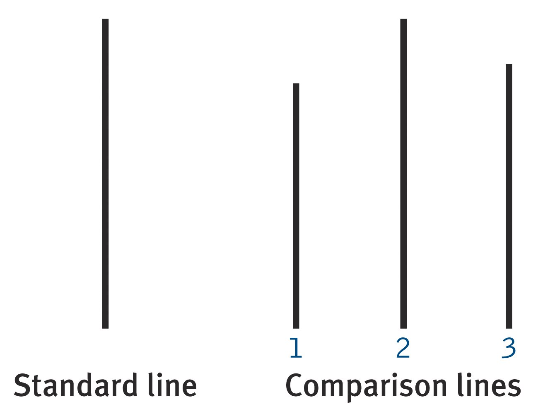
Asch (1955)
Purpose
Will group pressure prompt conformity?
Method
Participants (as members of a group) given the following task…

Slide 10
Asch (1955)
Results
75% went along w/ group at least once
All trials = 33% agreement w/ group
Factors that influence conformity
Social support
Commitment to the group
Size of the group

Slide 11
Obedience & Milgram (1963)
Purpose
Examine the effects of authority on obedience
Method
Effects of “punishment on learning”
“Learner” hooked-up to electrodes
“Teacher” asked memory questions to “learner”
Ordered to give electric shocks for wrong answers
Move up one level (higher voltage) for each wrong answer
As voltage increased “learner” began to shout, pound on wall, demanded to be let out, and sat silently

Slide 12

Obedience & Milgram (1963)
Results
Every participant delivered at least 300-volts
Labeled “intense shock” on the device
65% delivered 450-volts
Labeled “XXX” on the device
Many “teachers” showed
Signs of extreme stress
Anger at the experimenter, but..
THEY STILL CONTINUED…

Slide 13
Group Influence (The presence of others can…)
Arouse people
Social facilitation
Stronger responses on well-learned tasks in the presence of others
Diminish feelings of responsibility
Social loafing
People in a group exert less effort w/ working toward a common goal than individually
Do both…
Deindividuation
Loss of self-awareness & self-restraint in group situations that foster arousal and anonymity

Slide 14
Group Influence (Which is which?)
The failure to sing as loud in group as compared with alone in your car.
Social loafing
A magician who makes more mistakes on simple tricks when practicing alone as compared to when giving a performance.
Social facilitation
Persons who riot following a sports team’s victory.
Deindividuation

