Slide 1
Memory #2

Slide 2
Memory : Storage & Retrieval
Storage (3 memory stores)
Sensory memory
Working memory
Long-term memory
Emotion & memory
Explicit vs. implicit memory
Retrieval
Retrieval cues

Slide 3
Storage: Sensory Memory
Brief memory after the original stimulus is gone
Does not allow for rehearsal
2 types
Iconic – sensory memory of visual stimuli
Sperling’s experiments
About 0.5 s long
Echoic – sensory memory of auditory stimuli
About 3 – 4 s long

Slide 4
Storage: Working Memory
Active processing of:
Incoming sensory memory info (visual/auditory)
Information retrieved from long-term memory
Limited capacity
7±2 bits
Limited duration
About 20 s long
As duration increases, recall decreases
Increased capacity through chunking

Slide 5
Storage: Long-term Memory
Relatively permanent & limitless memory store
Estimates of 1,000 billion – 1,000,000 billion bits
Includes
Knowledge
Skills
Experience

Slide 6
Emotion & Memory
Heightened emotions = stronger memories
Stress = more amygdala activity
Higher arousal = better memory, but
Prolonged stress = memory disruption

Slide 7
Explicit vs. Implicit Memory
Explicit memory (declarative)
Memory of facts & experiences
Consciously known & declared
Processed in hippocampus
Anterograde amnesia
EX:
Facts
Events
Implicit memory (procedural)
Memory of skill, actions & conditioning effects
Retention independent of conscious recollection
Processed in cerebellum
EX:
Motor/cognitive skills
Classical conditioning

Slide 8
Retrieval
Getting information out of memory
Measures of memory
Recognition: identify items previously learned
Recall: retrieve information learned earlier using effort
Relearning: shows the amount of time saved w/learning something for a 2nd time

Slide 9
Retrieval Cues
Memories are stored through related associations
Accessed via retrieval cues
Associations that help you retrieve memories
Best associations are formed w/memory is encoded
Priming
Activation of associations in memory

Slide 10
Stored Memory - Example
water
smell
hose
Fire Truck
fire
smoke
truck
heat
red

Slide 11

Retrieval Cues
Context effects
context where you experienced something =
better memory retrieval
EX:
Going back to your old school,
old neighborhood, etc.

Slide 12
Another Context Effect
Déjà vu
Sense that you have experienced something before
Related to cues from the current situation
Most commonly
Sense of recollection is strong, but
Circumstances of the “previous” experience are uncertain

Slide 13
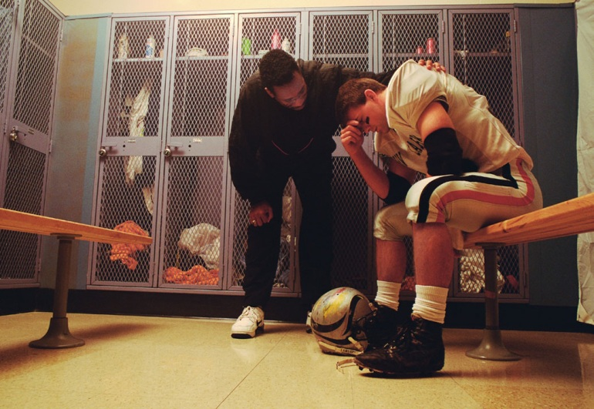

Memory & Mood
Mood-congruent memories
Tendency to recall experiences consistent w/current good or bad mood
When sad = EVERYTHING is bad
When happy = EVERYTHING is good
vs.

