Slide 1
Memory #3

Slide 2
Forgetting, Memory Construction & Improvement
Forgetting
Encoding failure
Storage decay
Retrieval failure
Memory construction
Misinformation & imagination
Loftus et al.
Repressed or constructed?
Tips for memory improvement

Slide 3
Encoding Failure
Encoding failure
We can’t remember w/we don’t encode
Info does not enter LTM
FOR EXAMPLE…

Slide 4
Encoding Failure

Slide 5
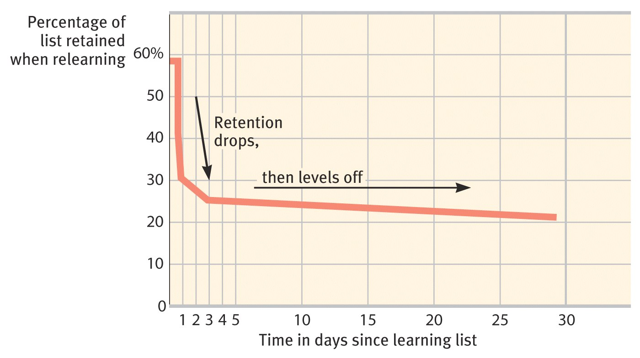
Storage Decay
Memory traces fade w/time
Forgetting curve

Slide 6
Retrieval Failure
Can’t access stored info
2 forms of interference
Proactive
Previous learning disrupts recall of new info
EX: going to where you parked yesterday
Retroactive
New learning disrupts recall of previous info
EX: learning new names disrupts recall of previous names

Slide 7
Forgetting is due to…
Encoding failure
(information was never acquired)
Storage decay
(information was discarded)
Retrieval failure
(information can’t be accessed)

Slide 8

Repressed Memories
Freudian defense mechanism
anxiety-arousing memories forcibly blocked from consciousness
motivated forgetting
BUT, DO THEY EXIST??
Stay tuned…

Slide 9
Memory Construction
Misinformation effect
Incorporate misleading info. into memory
Fill in memory gaps w/guesses & assumptions
MISINFORMATION = MISREMBERING
Misinformation, an example…

Slide 10
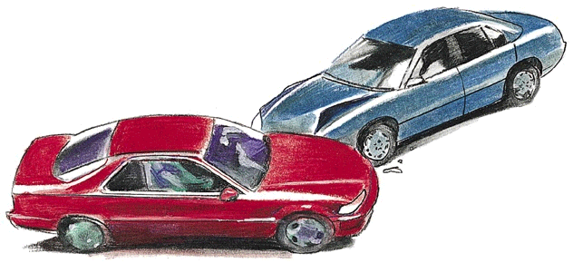
Loftus et al. & misinformation
Eyewitness memory reconstruction

Slide 11
Loftus et al. continued
Group A
How fast were the cars going when they hit each other?
Group B
How fast were the cars going when they smashed into each other?
1 week later…
Was there any broken glass?

Slide 12
Repressed or constructed?
Child abuse IS REAL, but
So are false accusations based on memory
Clinicians & memory “recovery”
Memory Work vivid recollections
SO, do repressed memories exist?

Slide 13
Professional Societies Agree
Sexual abuse happens
Recovered memories happen, but
Memories “recovered” under hypnosis or drugs are UNRELAIBLE
Memories before age 3 are UNRELIABLE
Most traumatic experiences are remembered vividly, not repressed

Slide 14

So, how can understanding memory help you?

Slide 15
Tips for Memory Improvement
Study repeatedly
Spend time rehearsing & actively thinking
Make the material personally meaningful
Use mnemonic devices
Use retrieval cues
Recall events while they are fresh
Minimize interference
Test yourself

