Slide 1
Learning #1

Slide 2
Learning
How do we learn?
Early behaviorism
Classical conditioning
Pavlov’s work
5 major conditioning processes
Ex of classical conditioning
Taste aversion
Watson & Little Albert

Slide 3
How do we learn?
Learning
Relatively permanent change in behavior due to experience
HOW???
By association
Stimulus-stimulus learning (classical)
Response-consequence learning (operant)

Slide 4

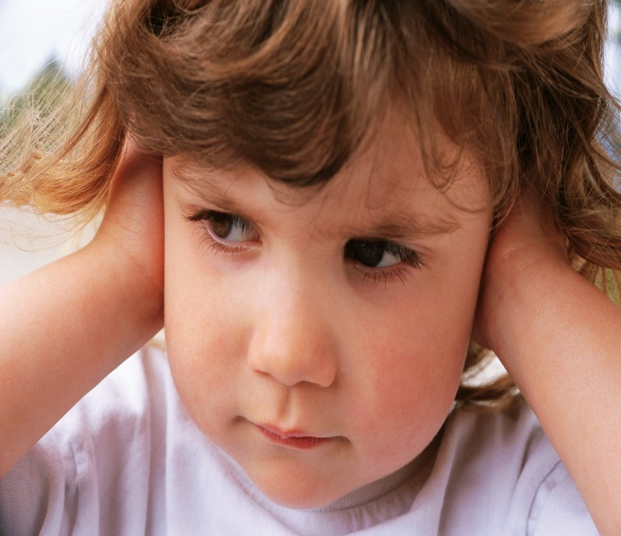
Classical or Operant?
=

Slide 5
Classical or Operant?
=

Slide 6
Early Behaviorism
Mental concepts are useless
Introspection
Consciousness
Thoughts/feelings
Psychology = observable behavior
All animals learn in the same way

Slide 7
Classical Conditioning
Ivan Pavlov
Physiology of salivation
OBSERVED interesting pattern
Would dogs salivate upon presentation of a neutral stimulus, if the stimulus is paired w/food?
YES!!!

Slide 8
Classical Conditioning
Before conditioning
Food = salivation
Tone ≠ produce salivation
During conditioning
Pairing of tone & food = salivation
After conditioning
Tone = salivation

Slide 9
Classical Conditioning Terms
Unconditioned stimulus (US)
Naturally triggers a response
Unconditioned response (UR)
Naturally occurring response to US
Conditioned stimulus (CS)
Neutral stimulus that comes to trigger CR
Conditioned response (CR)
Learned response to previously neutral CS

Slide 10
Classical Conditioning Diagram
US (food) |  | UR (salivation)
Neutral (tone)
CS (tone) |  | CR (salivation)

Slide 11
Major Conditioning Processes
Acquisition
Initial learning of S/R relationship
Consider timing
May be biologically important
CS signals the US is coming
Tone signals food
Lightning signals thunder

Slide 12
Major Conditioning Processes
Extinction
Decrease of a CR, when…
A US does not follow a CS
Repeated tone w/out food
Spontaneous recovery
Reappearance of a weakened CR…
Following a pause

Slide 13
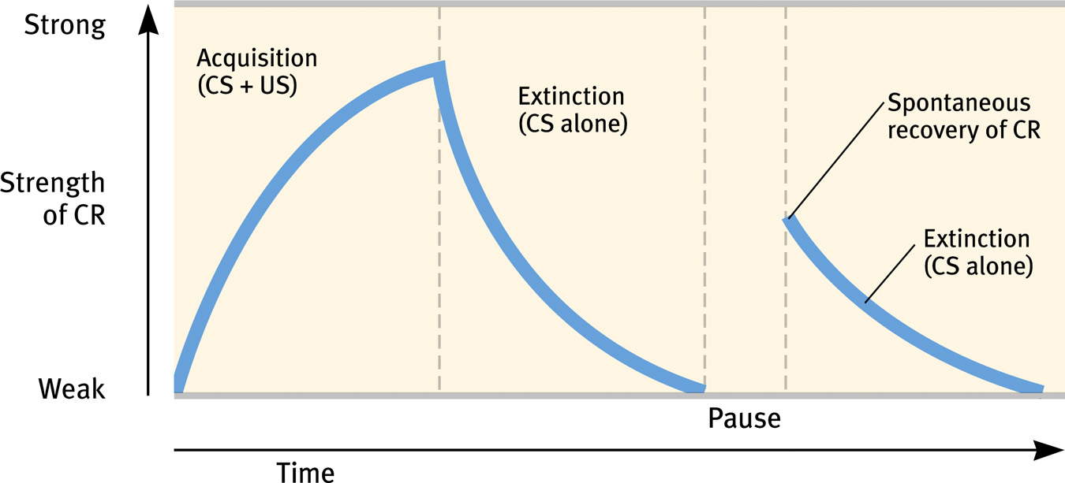
Extinction & Spontaneous Recovery

Slide 14
Major Conditioning Processes
Generalization
Respond to stimuli similar to CS
Lion & tiger = increased heart rate
(Pavlov) = Similar sounding tones
Discrimination
Distinguish between a CS & other stimuli
Lion & house cat ≠ increased heart rate
(Pavlov) = Tone & voice

Slide 15
Classical Conditioning Examples
Taste aversion
Food w/characteristic of food = sickness
One-trial learning
Consider timing
Does not have to occur quickly

Slide 16
Classical Conditioning Examples
Watson & Little Albert
Conditioned fear of a white rat
Loud noise w/playing with rat
Crying & FEAR of the rat
Fear generalized to other furry things
Rabbit, beard, Santa Claus
Unethical experiment!

Slide 17
Little Albert, what goes where?
US (?) |  | UR (?)
Neutral (?)
CS (?) |  | CR (?)

