Slide 1
Learning #2

Slide 2
A quick review..
Remember associative learning…
Classical conditioning
Associations between events the organism DOES NOT control
Respondent behavior
THIS IS DIFFERENT FROM…

Slide 3
Operant conditioning
Operant conditioning
Behavior then reinforcer = strengthened
Behavior then punisher = weakened
Operant behavior
Behavior operates on the environment & PRODUCES responses

Slide 4
Skinner & behaviorism
Thorndike’s law of effect
Rewarded behavior is likely to recur
Shaping
Build on existing behaviors
Reinforce successive approximations of desired behavior
1st step cannot be too BIG

Slide 5
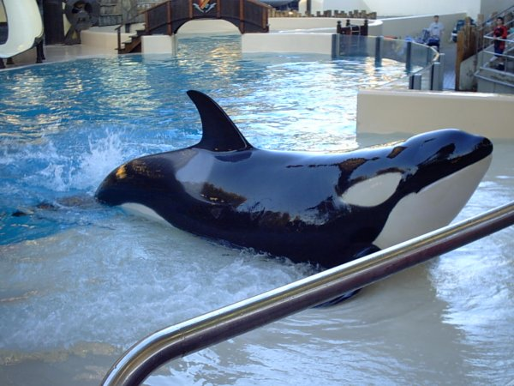
Examples of shaping
Overcoming fears
Learning to write
Learning to swim
AND…
Animal training

Slide 6
Reinforcement
What is it?
Event that strengthens the behavior it follows
2 types
Positive reinforcement
Negative reinforcement

Slide 7
Positive vs. negative reinforcement
Positive reinforcement
Addition of desirable consequence increases behavior
Negative reinforcement
Removal of an aversive consequence increases behavior
IS NOT PUNISHMENT

Slide 8
Positive or negative?

Slide 9
Punishment
What is it?
Event that decreases the behavior it follows
Opposite effect of reinforcement
2 types
Positive punishment
WHAT, POSITIVE PUNISHMENT?
Negative punishment

Slide 10
Positive vs. negative punishment
Positive punishment
Addition of an aversive consequence decreases behavior
Negative punishment
Removal of a desirable consequence decreases behavior

Slide 11
Remember…
For both reinforcement and punishment, the words positive & negative refer only to the addition or removal of a consequence, not the effects on behavior.

Slide 12

Positive or negative?

Slide 13
Potential side effects of punishment
Spanking for example:
May lead to unwanted fears
Gives no information about what to do
Unwanted behaviors reappear in its absence
May lead to aggression against the agent
One unwanted behavior replaces another

Slide 14
Schedules of reinforcement
Continuous
Reinforcing every instance of behavior
Best for teaching new skills
EX: housebreaking a pet
Partial (intermittent)
Reinforcing some instances of behavior
Best for maintaining established behaviors
Ex: occasionally giving in to tantrums

Slide 15
Partial reinforcement (ratio schedules)
Fixed-ratio
Reinforce after a specific number of responses
EX: sticker after every 4 assignments turned in
Variable-ratio
Reinforce after unpredictable number of responses
EX: slot machines

Slide 16
Partial reinforcement (interval schedules)
Fixed-interval
Reinforce after specific period of time
EX: praise after 5 min of on-task behavior
Variable-interval
Reinforce after unpredictable period of time
EX: fishing

Slide 17
Operant conditioning is everywhere!
At school…
Classroom behavioral management
At work…
Bonuses for good work, fired for bad
At home…
Parent-training programs
In sports…
Relationship between performance & playing time

