Slide 1
Memory #1

Slide 2
Memory
Encoding
Getting information into memory
Encoding - How?
Automatic processing
Effortful processing
Encoding - What?
Meaning
Image
Organization

Slide 3
Encoding - How?
Automatic processing
Unconscious encoding of incidental information
Examples
Space
Time
Frequency
Encoded information may become automatic after…

Slide 4
Encoding - How?
Effortful processing
Requires attention and conscious effort
Leads to durable & accessible memories
Enhanced though rehearsal
Repetition of info to maintain in consciousness or encode for storage
Consider
Herman Ebbinghaus

Slide 5
Encoding – An Example
Without talking to anyone…

Slide 6
Answers

Slide 7
Memory Effects
Spacing effect
Distributed practice is better than massed study for long-term retention
Longer space between practice = better retention
EX: studying over time vs. cramming
Serial position effect
Tendency to recall first & last items in a list
Recency effect
Primacy effect
EX: name recall

Slide 8
Remember…
The amount remembered depends on the time spent learning.

Slide 9

Encoding – What?
Encoding the meaning
Semantic encoding
Meaningful context aids in encoding
Rephrasing what we hear into meaningful terms
EX: self-reference effect

Slide 10
Encoding – What?
Visual encoding
Encode visual images more easily
Remember concrete words better than abstract
Mnemonic devices
Memory aids that use vivid imagery & organization
Method of loci
A few more…

Slide 11
Mnemonic Devices What do these mean?

Slide 12
Memory is enhanced through:
Meaning
Imagery
Organization

Slide 13
Encoding – What?
Organization & encoding
Chunking
Organizing items into familiar, manageable units
Chunking numbers for recall
Acronyms
Hierarchies
Complex info broken down into broad concepts and further subdivided

Slide 14
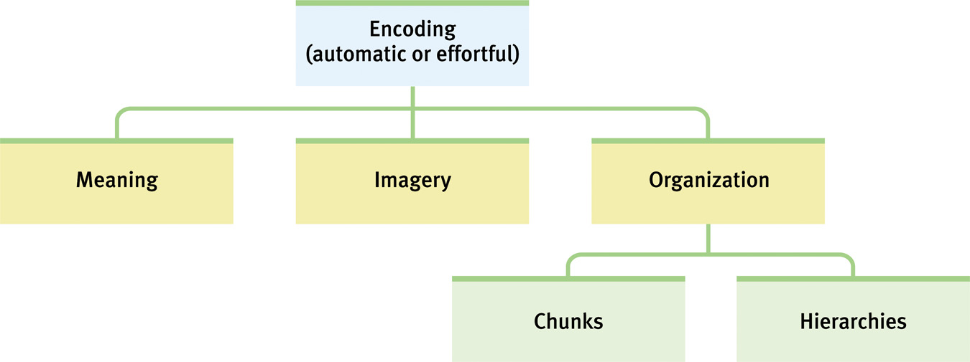
Hierarchy – Example

