Slide 1
Personality #1

Slide 2
The Psychoanalytic Perspective
Finally, FREUD!!
Psychoanalysis THEN
Unconscious mind
Personality development
Personality structure
Defense mechanisms
Psychoanalysis TODAY

Slide 3
Personality & Psychoanalysis
Personality
Characteristic pattern of thinking, feeling, & acting
Psychoanalysis
Freud’s personality theory
Thoughts & actions result from unconscious motives/conflicts

Slide 4
Freud & Structure of the Mind
Three levels of awareness
Conscious mind
Current awareness
Preconscious mind
Outside awareness, but accessible
and, the
UNCONSCIOUS MIND

Slide 5
Unconscious Mind
UNCONSCIOUS (2 views)
Freud = storehouse for repressed thoughts and feelings
Today = information processing of which we are unaware
Analyzed through
Free association
Dreams

Slide 6
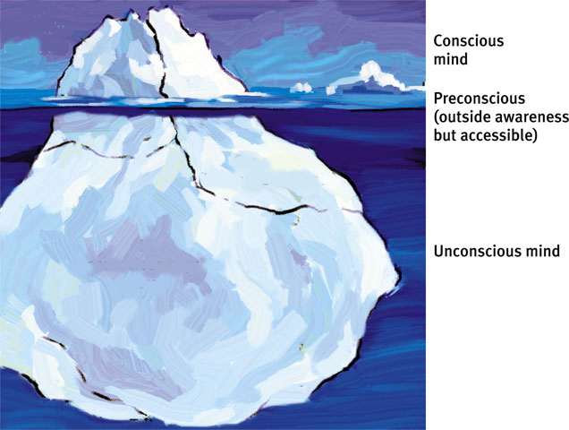
Freud’s Model of Mind*
*Adapted from Freud, 1933, pg. 11

Slide 7
Personality Development
A brief story…

Slide 8
Personality Structure
Evolves from conflict between:
Biological impulses
Social restraints
3 Personality Systems
ID
EGO
SUPEREGO

Slide 9
Personality Structure
ID (unconscious)
Strives to satisfy sexual & aggressive drives
Pleasure principle
EGO (partly conscious)
Mediates demands of Id & Superego
Reality principle
Personality executive
SUPEREGO (conscious)
Standards for judgment & internalized ideals
How one ought to behave.

Slide 10

Defense Mechanisms
Ego’s protective methods of reducing anxiety by unconsciously distorting reality
Repression (review)
Regression
Reaction Formation
Projection
Rationalization
Displacement

Slide 11
Types of Defense Mechanisms
Repression
Banish anxiety-arousing thoughts from consciousness
Regression
Retreat to a more infantile stage of development
Reaction Formation
Ego unconsciously switches unacceptable impulses to their opposites

Slide 12
Types of Defense Mechanisms
Projection
Disguise threatening impulses by attributing them to others
Rationalization
Generate self-justifying explanations to hide real reasons for our actions
Displacement
Shift sexual/aggressive impulses to a more acceptable object or person

Slide 13
Which is which?
A baseball player who throws the bat after striking out.
Displacement
Inability to recall events during time spent in war.
Repression
Someone who gossips is critical of others doing the same.
Projection
An adult who looks for dad to fix their financial difficulty.
Regression
Campaigning against pornography despite personal interest in such material.
Reaction formation
A habitual drinker who says he does not like alcohol, but has to drink with friends to be sociable.
Rationalization

Slide 14
Psychoanalysis Today
Some criticisms of Freud may be unfair
Different methodology, technology
But, some are valid because…
Personality develops throughout life
Peer influence greatly impacts our life
Gender identity may develop before 5 or 6
Dreams do not represent unfulfilled wishes
Verbal slips represent cognitive choices

Slide 15
Most Valid Criticism…
Psychoanalysis is based on after-the-fact explanations, rather than scientifically-based predictions. Thus, the theory cannot be disproved.

Slide 16
Freud’s Enduring Contributions
Much of mental life is unconscious.
Personality patterns start to form in early childhood.
Mental representations guide social interactions.
Personality development involves more than learning to regulate sexual/aggressive impulses.

