Slide 1
Psychological Disorders #3

Slide 2
Mood Disorders & Schizophrenia
Mood Disorders
Major depression
Explanations
Bipolar disorder
Schizophrenia
Symptoms

Slide 3
Mood Disorders
Mood disorders
Psychological disorders characterized by emotional extremes.
2 principal forms
Major depressive disorder
Bipolar disorder

Slide 4
Major Depression
Major depressive disorder
Signs last 2 or more weeks and
Not due to drugs or medical condition
Lethargy & tiredness
Feelings of worthlessness
Loss of interest in most activities
Common cold of psychological disorders

Slide 5

Depression: Related Facts
Depression is:
Accompanied w/ behavioral & cognitive changes
Widespread
Nearly twice as likely to affect women
Often self-limiting
Often preceded by stressful life events
Striking earlier in life

Slide 6
Depression: Explanations
Biological Perspective
Importance of:
Norepinephrine
Serotonin
Less brain activity
Frontal lobes
Social-Cognitive Perspective
Self-defeating beliefs
Negative explanatory style
Pessimistic

Slide 7
Bipolar Disorder
Bipolar disorder
Moods alternate between
Hopelessness/ lethargy of depression
Overexcited state of mania
Formerly called manic-depression
Link to creativity?
Walt Whitman
Virginia Woolf
Samuel Clemens
Ernest Hemingway

Slide 8
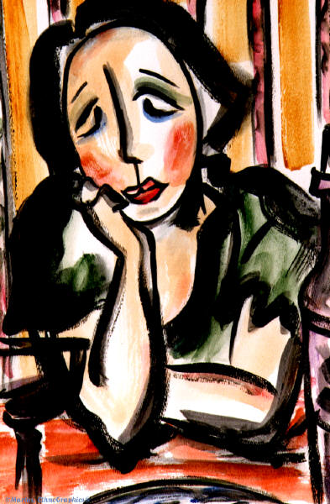
Bipolar Disorder (Symptoms Contrast)
Depressive symptoms
Gloomy
Withdrawn
Tired
Inability to make decisions
Slowness of thought
Manic symptoms
Elation
Euphoria
Desire for action
Hyperactive
Multiple ideas
Little need for sleep

Slide 9
Schizophrenia
Schizophrenia
Characterized by disorganized and delusional thinking, disturbed perceptions, and inappropriate emotions and actions.
Means “split mind”
Split from reality
NOT Multiple Personality

Slide 10
Schizophrenia (Symptoms #1)
Disorganized thinking
Thinking that is:
Fragmented
Bizarre
Distorted
Delusions
False beliefs
May involve persecution or grandeur
Breakdown in selective attention
Overreaction to irrelevant stimuli

Slide 11
Schizophrenia (Symptoms #2)
Disturbed perceptions
Perceive things that are not there, usually as…
Hallucinations
Most often auditory
Voices that insult or give orders

Slide 12
Schizophrenia (Symptoms #3)
Inappropriate emotions & actions
Inappropriate affect
(e.g., laughing at death)
Flat affect
Shows no response at all
Catatonic behavior
≠

