Slide 1
The Story of Psychology & Thinking Critically with Psychological Science

Slide 2
What is Psychology?
Definition
Scientific study of behavior and mental processes
Roots of Psychology
Prescientific psychology
Birth/development of psychological science
Contemporary psychology
3 levels of analysis
Subfields

Slide 3
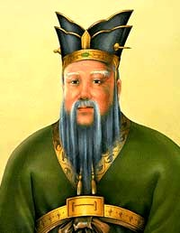
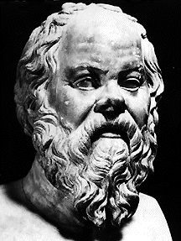
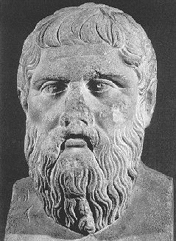
Prescientific Psychology
Confucius:
power of ideas/educated mind
Socrates & Plato
mind/body separate
mind exists after death
knowledge is innate

Slide 4
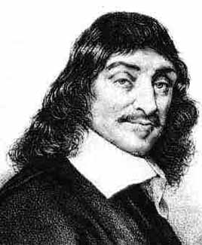
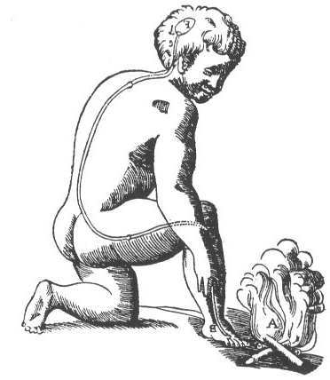
Prescientific Psychology (France)
Rene Descartes
mind/body separate
“animal spirits”

Slide 5
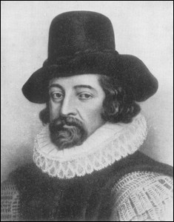
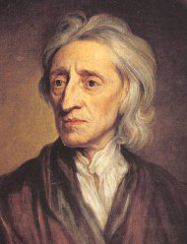
Prescientific Empiricism (Britain)
+
Francis Bacon
experimental method
John Locke
“tabula rasa”

Slide 6
= Empiricism: knowledge originates in experience and science should rely on observation and experimentation.

Slide 7
Structuralism vs. Functionalism
Structuralism
Elements of the mind
Introspection
Inside information
Wilhelm Wundt (1879)
Edward Tichner
Functionalism
Evolved functions of thoughts/feelings
Adaptive skills
William James
Father of American Psychology
Principles of Psychology

Slide 8
Contemporary Psychology
3 Main Levels of Analysis
Biological influences
genetic predispositions
genetic mutations
natural selection of adaptive physiology and behaviors
genes responding to environment
Psychological Influences
learned fears and other learnt expectations
emotional responses
cognitive processing and perceptual interpretations
Behavior or mental process
Social-cultural Influences
presence of others
cultural, societal, and family expectations
peer and other group influences
compelling models (such as media)

Slide 9
Contemporary Psychology
Subfields – Basic Research (to build knowledge)
Psychologist | What s/he does
Biological | Explores the links between brain and mind.
Developmental | Studies changing abilities from birth to death.
Cognitive | Studies how we perceive, think, and solve problems.
Personality | Investigates our persistent traits.
Social | Explores how we view and affect one another.

Slide 10
Contemporary Psychology
Applied Research (investigates practical problems)
Psychologist | What s/he does
Industrial/ Organizational | Studies and advise on behavior in the workplace.
Counseling | Helps people cope with academic, vocational, and marital challenges.
School | Assess and treat academic/behavioral difficulties that affect student learning
Clinical | Study, assess, and treat people with psychological disorders

Slide 11
Psychology and Critical Thinking
Limits of intuition & common sense
Hindsight bias
Overconfidence
Scientific Attitude
Scientific Method

Slide 12
Intuition and Common Sense
Intuition & common sense = error & inaccuracy!
Hindsight bias: “I knew it all along phenomenon.”
Stock market decline after the fact
Tragedy of 9/11 after the fact
Common sense predictions proven INCORRECT
Repression of traumatic experiences
Dreams predict the future
Absence makes the heart grow fonder

Slide 13
Overconfidence
Overconfidence
tendency to think we know more than we do.
often persists after proven wrong
“I was almost right.”

Slide 14
Remember…
hindsight bias & overconfidence often = overestimates of intuition.

Slide 15
Scientific Attitude
Components of scientific attitude
Curiosity
Skepticism
Humility
Critical thinking
Does not blindly accept arguments and conclusions
But, examines assumptions, discerns values, evaluates evidence, and assesses conclusions.


Slide 16
Scientific Method
Theory
Principles that organize and predict behaviors/events
EX: ADHD & observable behavior
Hypothesis
Testable prediction that allows acceptance, rejection, or revision of theory.
Experimentation
Operational definitions
Replication

