Slide 1
Thinking Critically with Psychological Science

Slide 2
Brief Overview…
Types of Psychological Studies
Descriptive studies
Case study, survey, naturalistic observation
Correlational studies
Correlation coefficient, scatterplot
Experimental studies
IV’s and DV’s
Statistics…(only a few!!)
Central tendency & variation

Slide 3
Descriptive Studies (case study)
Attempt to identify universal principles by studying one person in depth
Suggest hypotheses, but can be misleading
Clinical study
Columbine school shooting

Slide 4
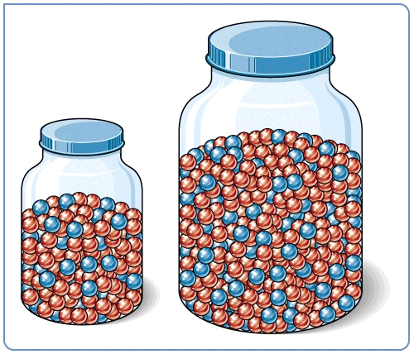
Descriptive Studies (survey)
Assess self-reported data by questioning a representative, random sample
Population vs. sample
The fastest way to know about the marble color ratio is to blindly transfer a few into a smaller jar and count them.

Slide 5
Descriptive Studies (naturalistic observation)
Observing & recording behavior in the natural environment.
Animals in the wild
Educational/parenting practices

Slide 6
Correlational Studies
Extent to which 2 factors vary together and how well either factor predicts the other.
Correlation coefficient
Scatterplots
Correlation and causation

Slide 7
Correlation Coefficient
Indicates strength
of relationship
(0.00 to 1.00)
Correlation
coefficient
r =
+
0.37
Correlation Coefficient is a statistical measure of relationship between two variables.
Indicates direction
of relationship
(positive or negative)

Slide 8
Scatterplots
Perfect positive
correlation (+1.00)
Perfect negative
correlation (-1.00)
No relationship (0.00)

Slide 9
Scatterplots
Slope = direction of relationship
Either + or –
Amount of scatter = strength of relationship
Less scatter means higher correlation
Positive or negative?
As height increases, weight increases
As television watching increases, reading decreases

Slide 10
Correlation and Causation
could cause
Positive thinking
Disease cure
or
could cause
Disease cure
Positive thinking
or
Disease cure
could cause
Environmental or biological events
and
Positive thinking

Slide 11
Remember…
Correlation DOES NOT imply causation!!!

Slide 12
Experimental Studies
Manipulating factors of interest while keeping other factors under control.
Attempts to limit alternative explanations
Experimental condition = gets the treatment
Control condition = does not get the treatment

Slide 13
Experimental Studies
Independent variable
The factor manipulated by the experimenter
Dependent variable
The factor that may change in response to the independent variable (i.e., the outcome)
Most often a behavior or mental process
Random assignment

Slide 14
Statistics (measures of central tendency)
A single score that represents a set of scores
Mean: average = total sum divided by number of scores
Mode: most frequently occurring score
Median: the midpoint score = 50th percentile

Slide 15
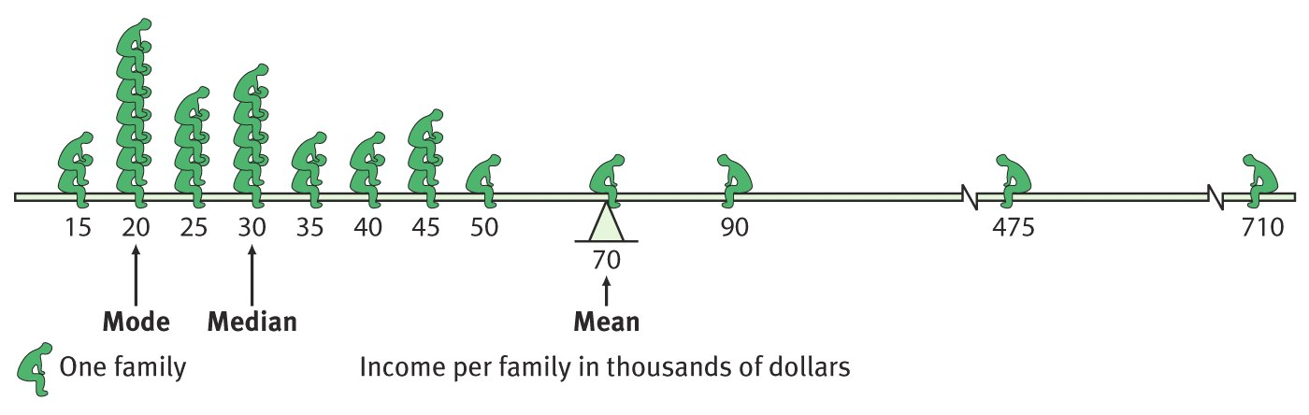
Example

Slide 16
Statistics (measures of variation)
Measures of similarity or diversity in a distribution
Range: difference between lowest & highest score
Standard deviation: measure of how much scores vary around the mean

