Slide 1
The Biology of Mind

Slide 2
Introduction
Biopsychosocial system
Neurons
Makeup
How they communicate
Nervous system
Central nervous system
Peripheral nervous system
Endocrine system
Hormones
Glands

Slide 3
Neurons (makeup)
Cell body
Dendrites (listen)
Axon (speak)
Myelin sheath
Multiple sclerosis
Terminal branches

Slide 4
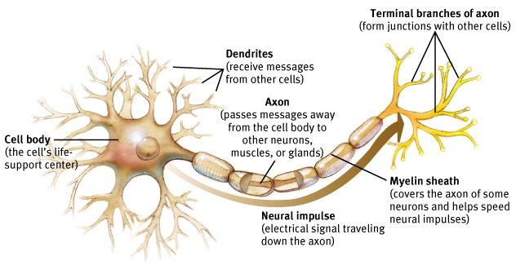
Neurons (makeup)
Building blocks of nervous system

Slide 5
Neurons (action potential)
Action potential (AP)
Neural impulse, brief electrical charge
Travels down the axon
Caused by:
Signals from sense receptors
Chemical messages from neighboring neurons

Slide 6
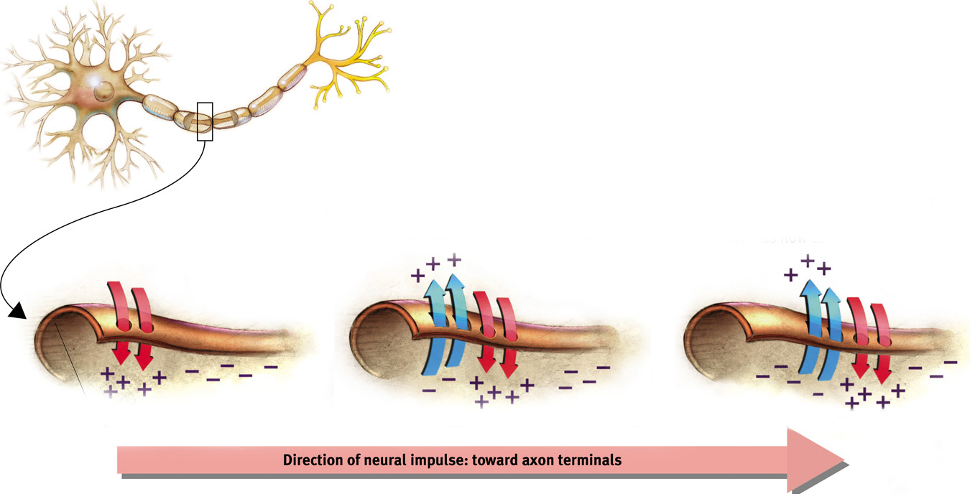

Slide 7
Action Potential
Depolarization
Entry of positive ions make an AP more likely
Threshold
Minimum intensity needed to fire an AP
all or none response
EX: gun, thermostat

Slide 8
Neuronal Communication
Synapse
junction between sending & receiving neurons
Nuerotransmitters
chemicals released from the sending neuron
travel across the synapse
bind to receptors of receiving neuron
either exciting or inhibiting
Reuptake
Reabsorbtion of excess neurons by the sending neuron

Slide 9
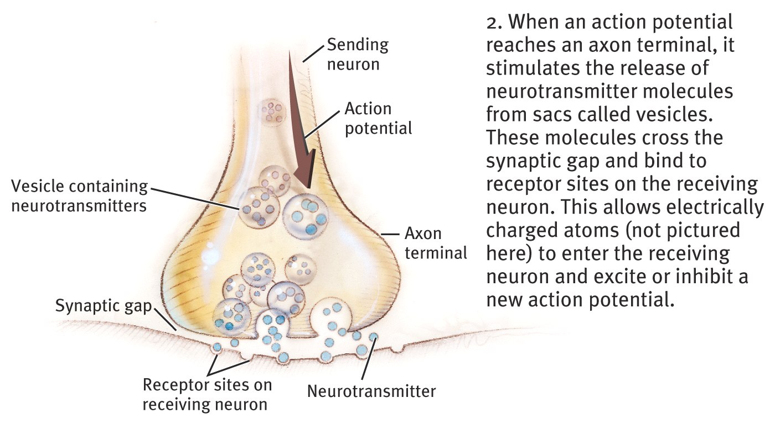
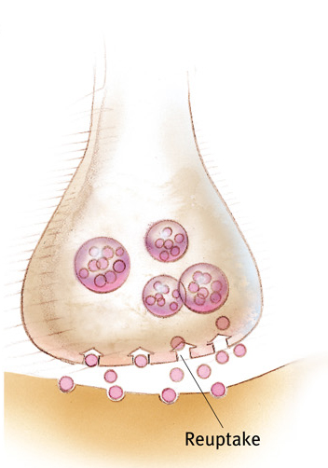

Slide 10
Nervous System
Electrochemical communication system
2 parts
Central nervous system (CNS)
Peripheral nervous system (PNS)

Slide 11
Types of Neurons
Sensory
Carry incoming info to the CNS (input)
Motor
Carry outgoing info from the CNS to bodily tissues (output)
Interneurons
Part of the CNS
Communicate/intervene between sensory & motor
EX: catching a ball

Slide 12
Central Nervous System
Spinal cord
Connects PNS to the brain
Controls reflexes
Knee-jerk response
Pain reflex
Brain
Neural networks: clustered neurons that work together
Change w/growth and experience

Slide 13
Peripheral Nervous System
Connects the CNS to rest of body
2 components
Somatic
Voluntary control of skeletal muscles
Autonomic
Control of internal glands/muscles
Usually operates on its own, but may be consciously overridden

Slide 14
Autonomic Nervous System
Dual system
Differing effects on same structures
Sympathetic nervous system
Arousal
Mobilizes energy in stressful situations
lie detector test
Fight or flight
Parasympathetic nervous system
Calming
Conserves energy

Slide 15
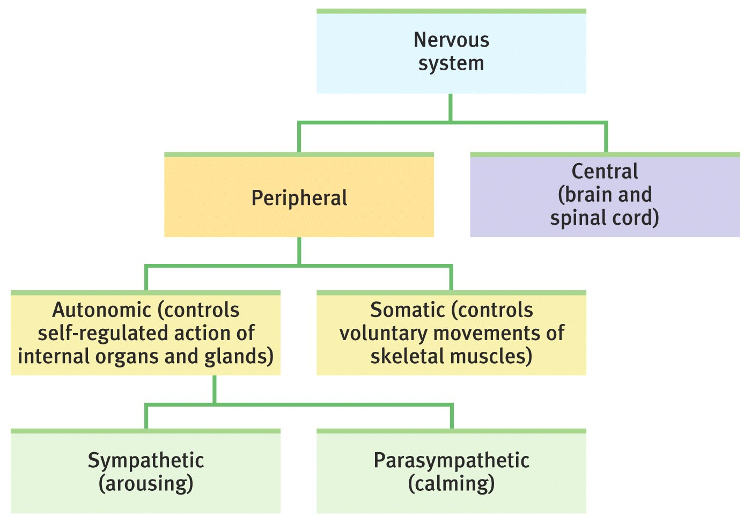
Remember…

Slide 16
Endocrine System
Slow communication system
Hormones
Chemical messengers
Affect brain and bodily tissues
Glands
Synthesize hormones
Pituitary gland (“MASTER GLAND”)
Hypothalamus
Influences growth
Affects other glands

