Slide 1

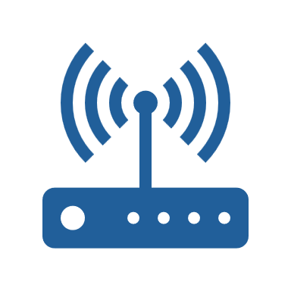
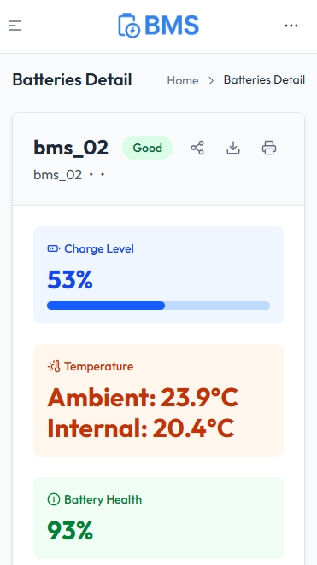
‘HUB’
ESP32
ANTENNA
LoRa
WEB SERVER
BMS
DATABASE
MESH
‘ROOT’
NODE
NODE
Wi-Fi connection
SMARTPHONE
Internet connection
Radio transmission

