Slide 1


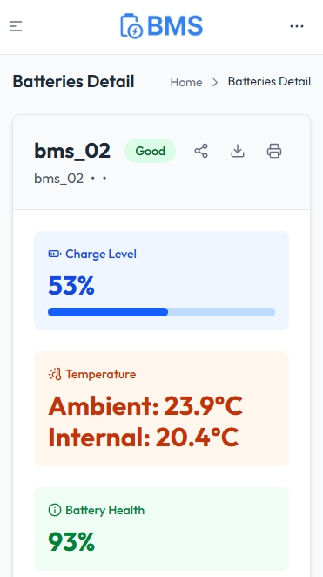
‘HUB’
ESP32
WEB SERVER
DATABASE
BMS
MESH
Wi-Fi connection
SMARTPHONE
Internet connection
Radio transmission

