Slide 1
Most Popular Family Film Category
Family films are films with one of the following categories: Animation, Children, Classics, Comedy, Family, and Music. Of these categories which is the most popular to date?
‘Animation’ is the most popular category in the Family genre followed by ‘Family’. The third most popular category is ‘Children’.

Slide 2
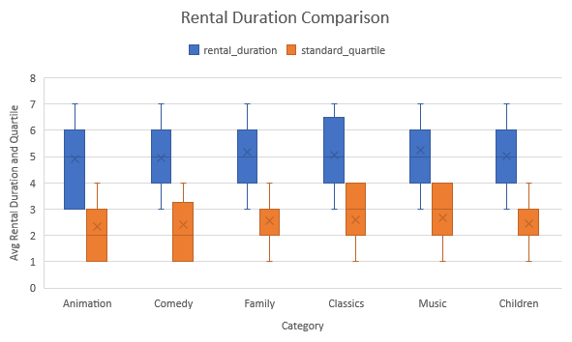
Rental Duration Comparison
Can you provide a table with the movie titles and divide them into 4 levels (first_quarter, second_quarter, third_quarter, and final_quarter) based on the quartiles (25%, 50%, 75%) of the average rental duration(in the number of days) for movies across all categories?
On average films in the ‘Animation’ category are rented out for the shortest duration. No category is rented out longer than one calendar week, and none have a median in the 3rd quartile or better.

Slide 3
Number of Rentals in Each Quartile
Provide a table with the family-friendly film category, each of the quartiles, and the corresponding count of movies within each combination of film category for each corresponding rental duration category.
‘Animation’ has an IQR of -4 while ‘Children’s’ is 0. ‘Classics’ has an interquartile range of 2, and ‘Comedy’ has an IQR of -4. The IQR for ‘Family’ films is the same as ‘Classics’, and for ‘Music’ the value is 6.

Slide 4
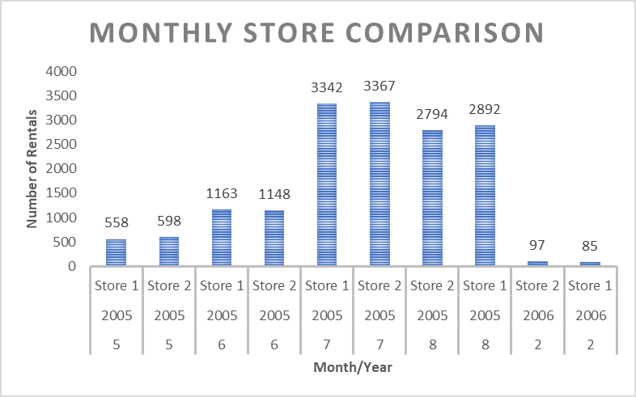
Monthly Store Comparison
Write a query that returns the store ID for the store, the year and month and the number of rental orders each store has fulfilled for that month. Your table should include a column for each of the following: year, month, store ID and count of rental orders fulfilled during that month.
July 2005 was the best month for the franchise, and of all the months data was collected store 2 outperformed store 1 3 months to 2 months.

