Slide 1
Dynamic Reports Generator
Yaser aburrub

Slide 2
Agenda
What is Dynamic Report
Building Database Graph
Building Database Graph Example
Building Dynamic Query
Building Dynamic Query Example
Additional Features
Future Works
Other Projects

Slide 3
What is Dynamic Report
A report is any document of structured data generated by user from database.
Dynamic report is a report that is automatically generated by user based on his needs and preferences.
This include the process of tying and connecting database tables to each other

Slide 4
Building Database Graph
Database Graph
it is a data structure generated from database schema.
each node in this graph represent a database table.
connections between these nodes represents foreign keys.
Build Graph
Open connection to database schema
For each table in database schema, we build a node including all information about it. i.e. Table Name, Foreign Keys and Primary Keys.
For each foreign key in table, we build a link between this table and foreign key table.

Slide 5
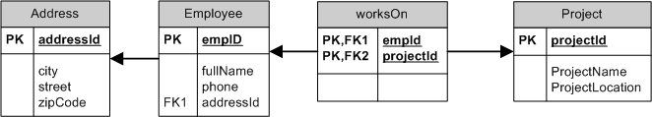
Building Database Graph Example
Assume we have the following table
Employee(empId, fullName, phone, AddressId)
Address(addressId, city, ctreet, zipcode)
Project(projectId, projectName, projectLocation)
WorksOn(empId, ProjectId)
Generated Graph

Slide 6
Building Dynamic Query
We have two types of query
If all fields from the same table we called it Simple Query (SQ).
If query expand more than one table we called it Complicated Query(CQ).
When the user check/choose fields from the same table(SQ), we didn’t parse the graph just prepared the query.
When the user check/choose fields from different tables (CQ), we parse the graph [recursive call]until we found a path between two tables or nodes.

Slide 7
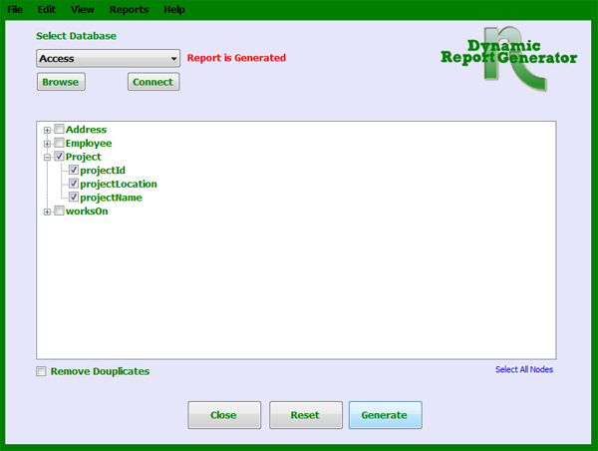
Building Dynamic Query Example Simple Query
Assume that the use choose all information about the project

Slide 8
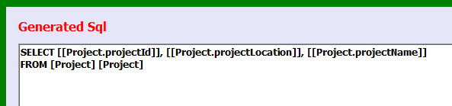
Building Dynamic Query Example Simple Query Cont.
In this simple case we just generate simple form of sql.
SELECT [selected fields] FROM [table name]

Slide 9
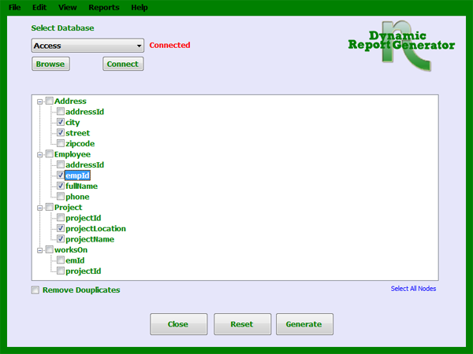
Building Dynamic Query Example Complicated Query
Assume we choose a report of employee names with their projects and addresses.

Slide 10
Building Dynamic Query Example Complicated Query cont.
In this case we should connect [Employee, Address, Project] with each other. Hence, we take all possible combinations with no duplications:
[Employee, Address] : we have direct foreign key so we take them. Sql: emplyee.addressid = Address.addressid
[Employee, Project] : we have a link but through worksOn Table. Sql: employee.empId = workOn.empId AND project.projectId = worksOn.projectID

Slide 11
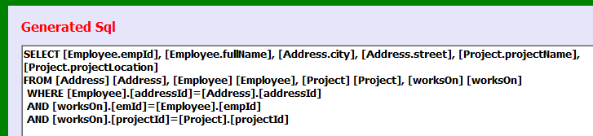
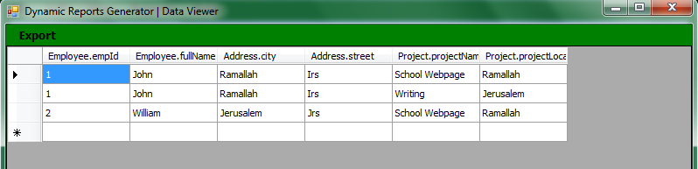
Building Dynamic Query Example Complicated Query cont.
Result of applying query

Slide 12
Additional Features
In addition to what we present, the application do the following tasks
Change columns Headers
Add filter to Sql Where condition
Support Aggregation Functions
COUNT for ACCESS DBMS
COUNT, SUM, AVG, MAX and MIN for Postgresql DBMS
Sort data based specific column
Save Generated Reports
Export Result into Excel, Xml and HTML documents

Slide 13
Future Works
There are some feature support specific DBMS, So I need to make sure that all features works fine for all DBMS
Support more Database Management Systems.
This is the most important point, try to embed this application with DBMS.
make this application as a feature installed with oracle.
For sure this point can not be done except I contact DBMS company

Slide 14
Other Projects
I have developed some projects close to this area
Mdb2Xml : this project convert access database file into XML file with XSD.
R2Rdf : Mapping Relational Database Into Oracle Semantic RDF.
Arabic2Arabic Dictionary : Build Arabic to Arabic dictionary from English to Arabic Dictionary based on graph of word meanings.
SPAM Filtering Tool

Slide 15
Questions
?

