Slide 1
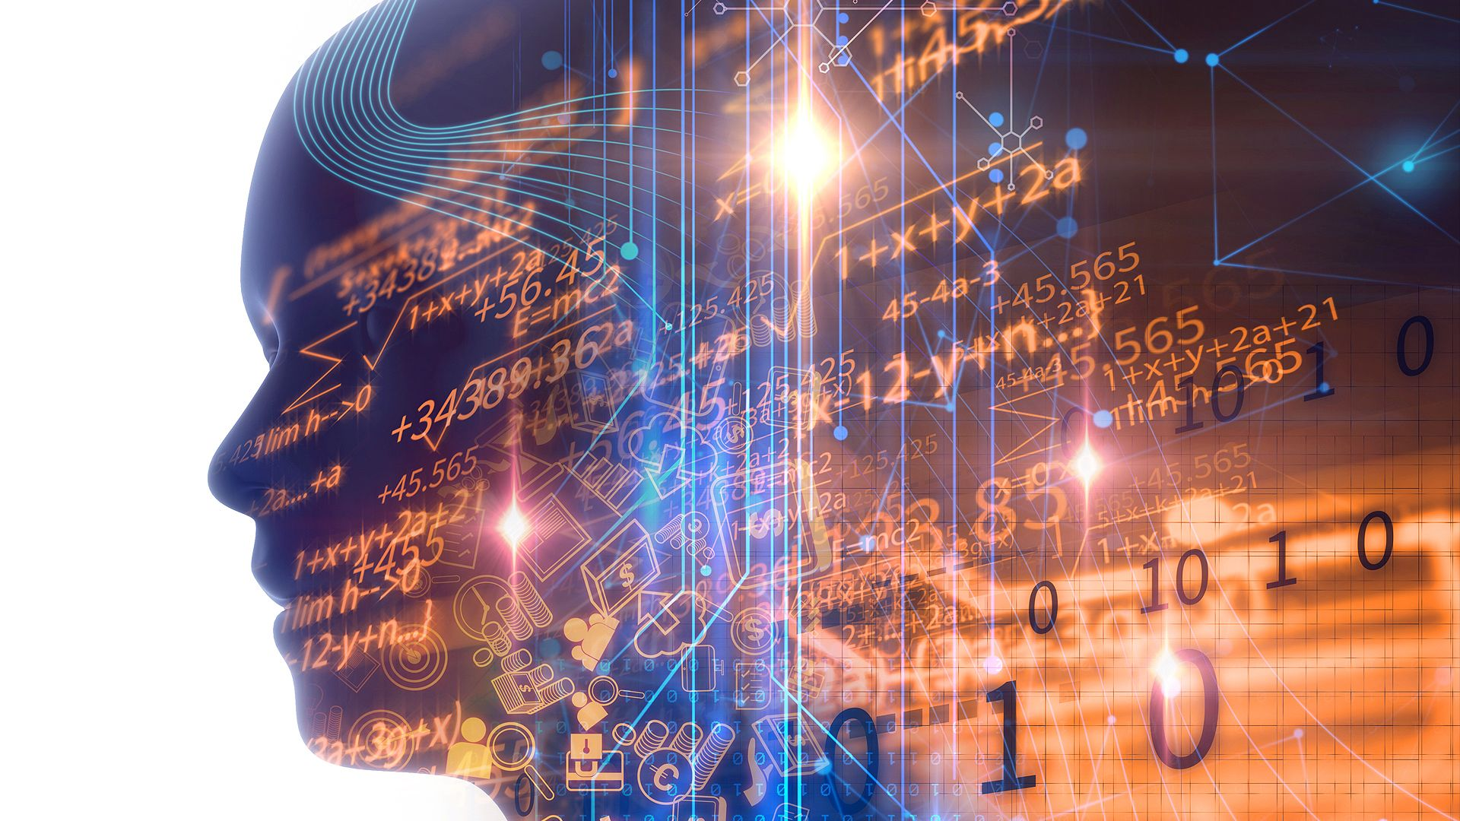
Overview of Data Science
Abusad Ahmad
Data Science Enthusiast
APJ Abdul Kalam Technical Univercity
Github :- https://github.com/abusadahmad
Linkedin :- https://www.linkedin.com/in/abusad-ahmad/

Slide 2
Data Science is the process of getting insight from data.
Artificial intelligence
Machine Learning
Deep Learning
Data Science
Domain

Slide 3
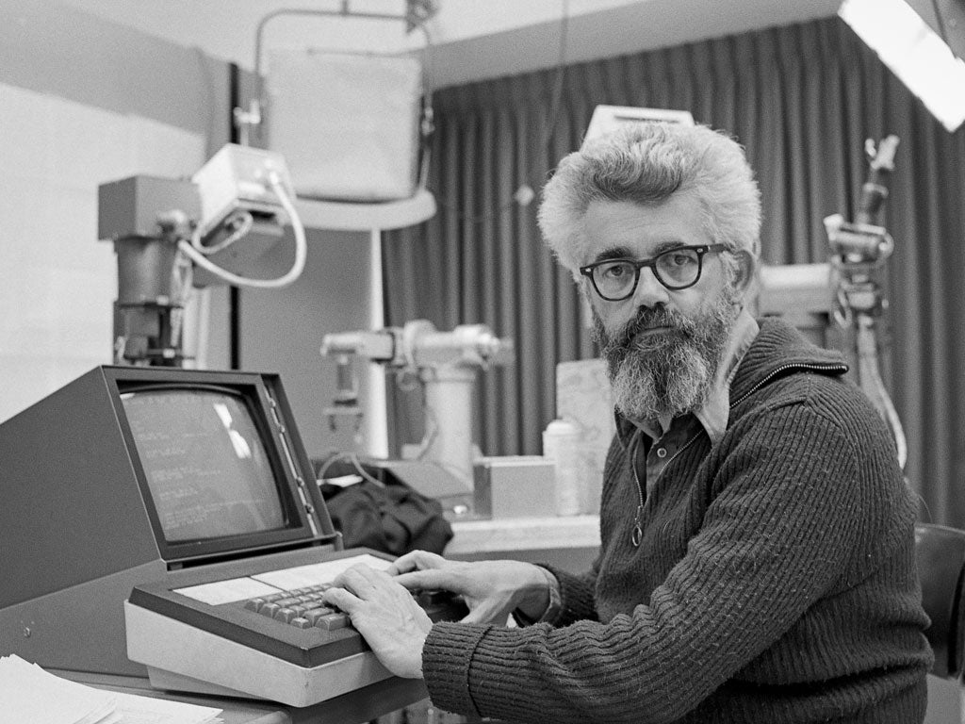
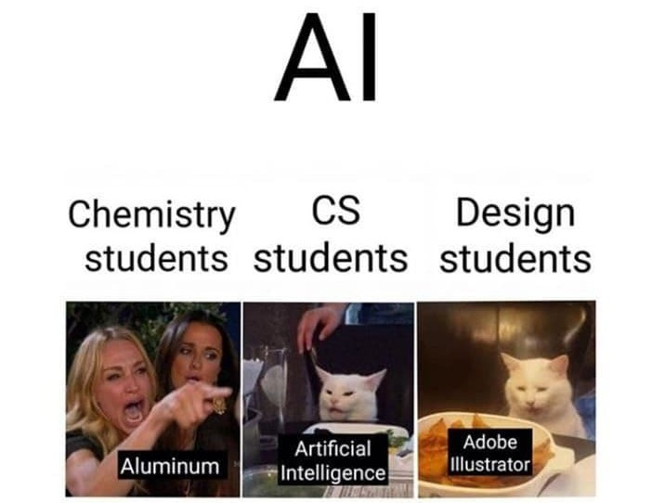
Artificial intelligence
AI is a technique of getting machine to work and behave like human.
Artificial Intelligence first coined ago in 1956 by John McCarty at the Dartmouth Conference.
The wide are of use Artificial Intelligence
John McCarty
Heath care
Marketing
AI
Robotics
Business
Machine Learning
Mechatronics
We think AI as robot doing our daily work but the truth is AI has found in our daily life. We use it all the time

Slide 4
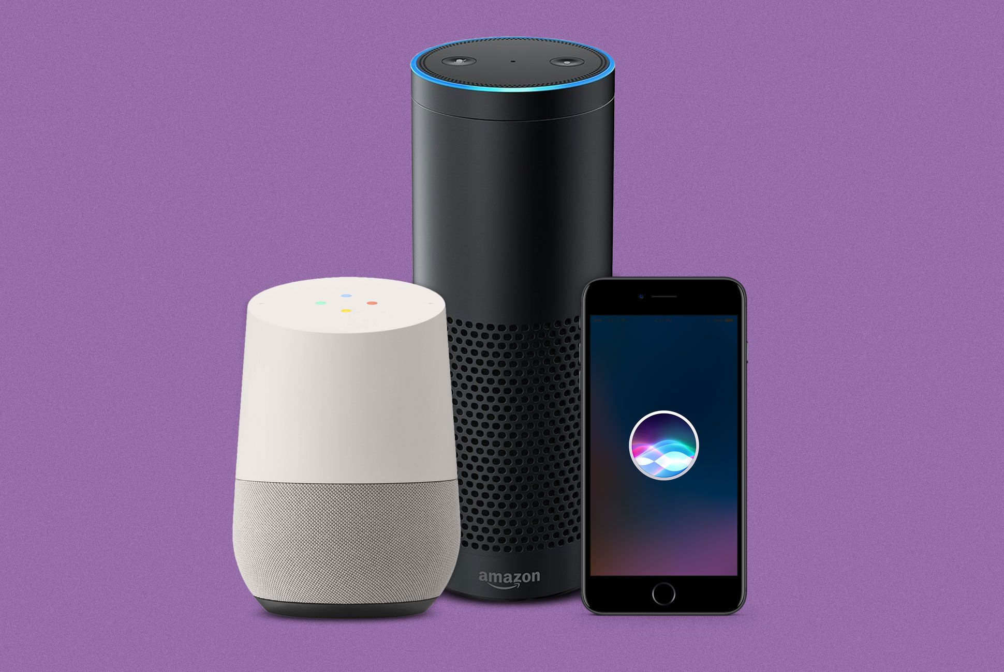
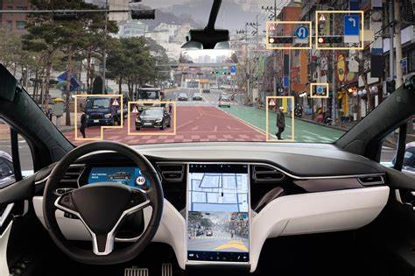
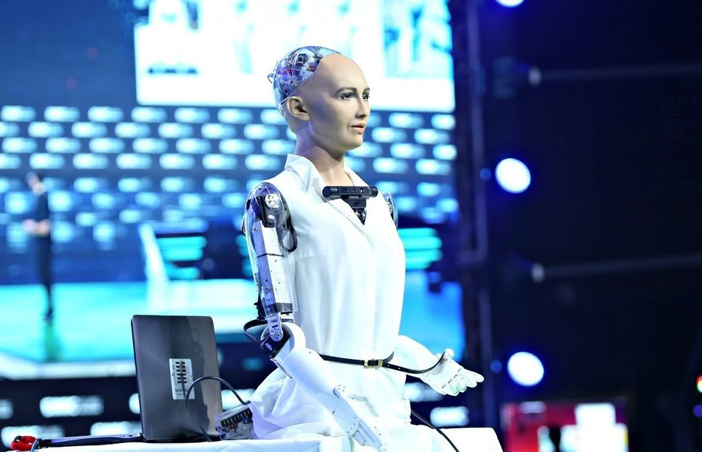
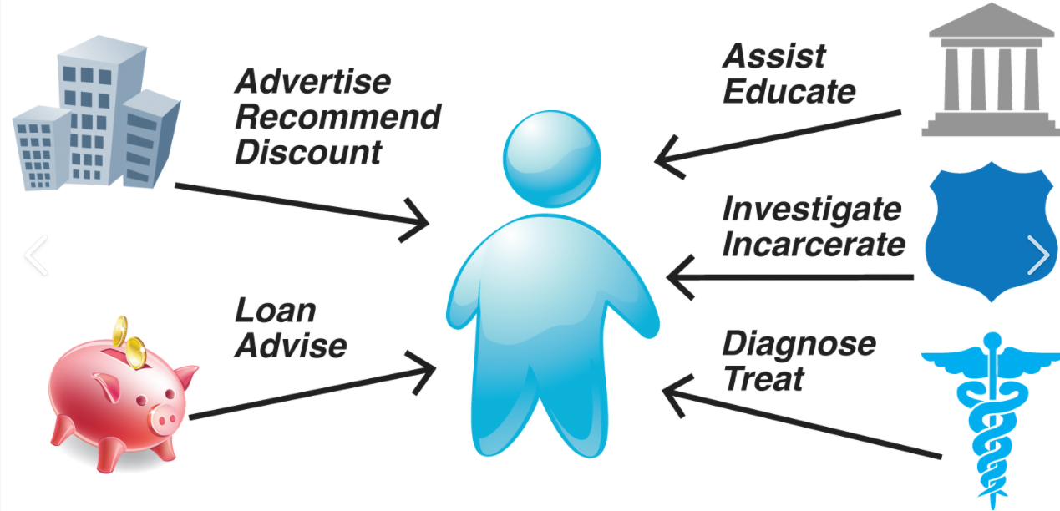
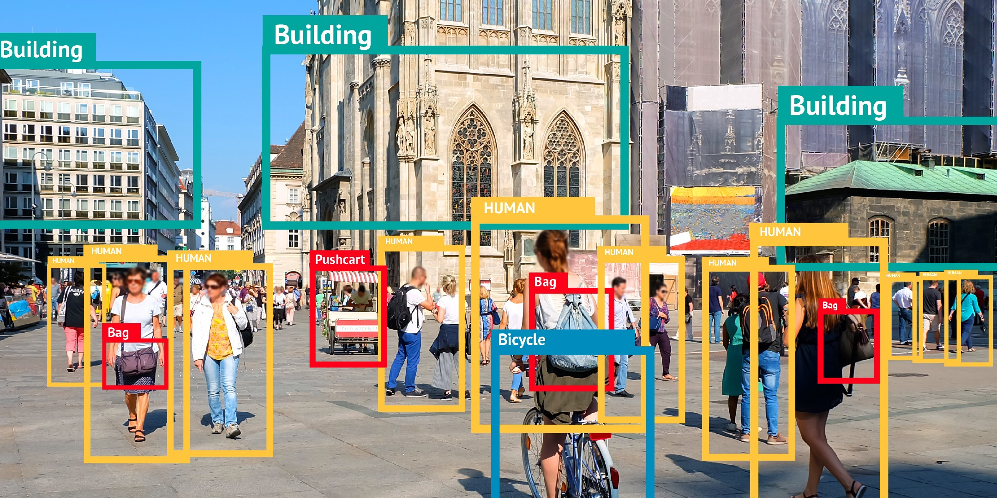
Most frequently used AI Technology today
Robotics
Virtual Assistance
Self driving car
Predictive Analysis
Image Analysis

Slide 5
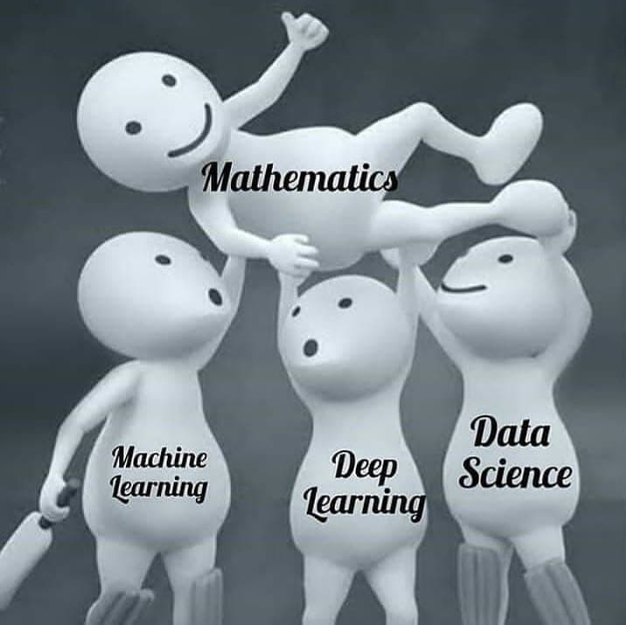
Machine Learning
Machine Learning an subset of AI that include mathematical algorithm that are able to learn from previous data and then apply what they have learned to make informed decision.
Machine Learning
Mathematic
Structured
Unstructured
Deep Learning
Regression
Classification
Clustering

Slide 6

Machine Learning
Me trying to understand Algorithm
Supervised Learning
Unsupervised Learning
Regression
Classification
Clustering
Lasso Regression
Logistic Regression
K-mean Clustering
Linear Regression
Decision Tree
Hierarchical Clustering
Naive Bayes
Random Forest
Support V M
Nearest Neighbor

Slide 7
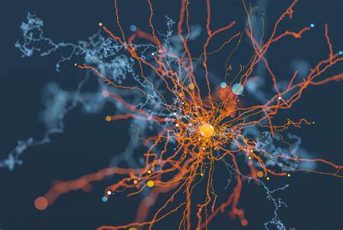
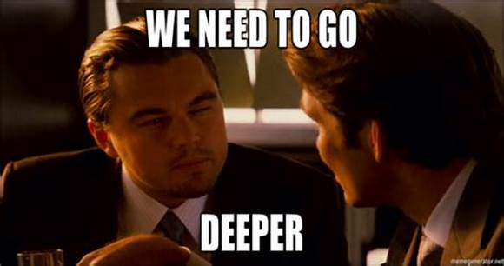
Deep Learning
Deep Learning is a subset of Machine Learning based on artificial neural network in which multiple layers of processing are used to make intelligence decision its own.
Human Brain
Deep Learning
Billions of neurons in our human brain and whenever we think or make decision a chemical signal is generated and pass one neuron to other neuron. And all neuron connected with synapsis. Then synapsis size rise and fall on the basis of this functionality we learn things.
Convolutional Neural Network
Recurrent Neural Network
Images
NLP (Text, Voice)

Slide 8
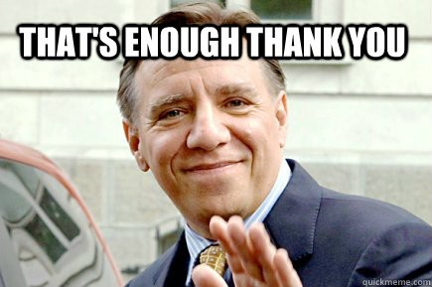
Domain Knowledge
Domain knowledge is the specifics, specialized and depth understanding in particular industry to which the methods of data science are being applied .
Example of different Domain
Finance
Retail
Telecom
Medical
Sports
Education

Slide 9
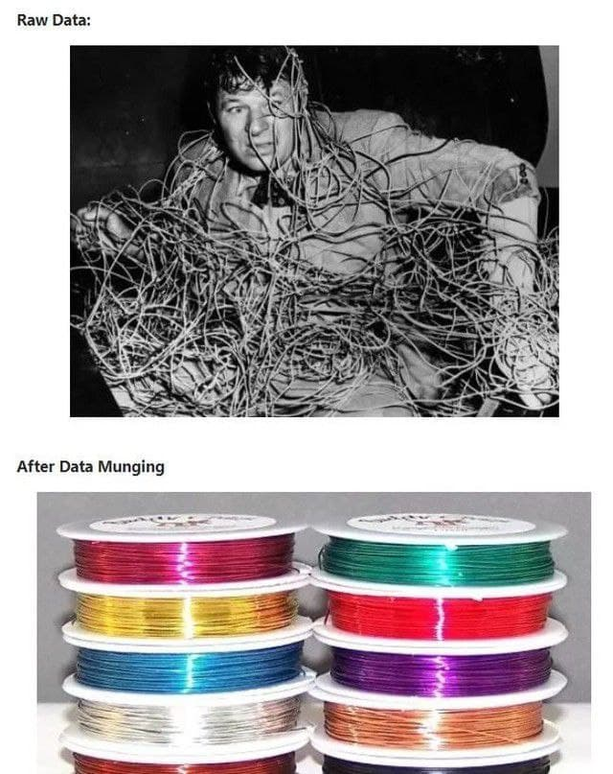
Business Intelligence
The set of processes that convert raw data into actionable answer to business question and provide insight for Business Decision.
Understanding the Domain problem
Domain
Information is the oil of 21st century.
And analytics is the combustion engine.
Finding the gathering data to answer
Data Collection
Understanding the quality of data
ETL
Feature Engineering
Data Cleaning
Use valid algorithm for each use case
Model Building
Presenting data on Dashboard
Insight
Take action for improve business
Business Decision

Slide 10
Different Carrier and Required skills for Data Enthusiast
Data Engineer
Data Analyst
Data Scientist
Data modeling & warehousing
Big data, Hadoop, Kafka, Spark
SQL(MySQL) & No SQL db (mongodb)
Python, Java, Scala
ELT tools: Talend, Apache NIFI, Apache Airflow, SAS
Expert in Excel (vlookup, pivot table)
SQL
Statistics*
Python*
ETL tools: Talend,Apache NIFI, Apache Airflow, SAS*
Enterprise BI tools: Tableau, Power BI
Domain Knowledge
Statistics
Python or R
Jupyter notebook, spark, tableau
Data cleaning and Exploration (pandas, numpy,matplotlib)
Machine Learning, Deep Learning, NLP (sklearn, tensorflow)

Slide 11
Data Engineer
A data engineer is a software engineer who specialized in database technology and is well extracting data from structured and unstructured sources.
Data Analytics
Data analysis is a process of inspecting, cleansing, transforming, and modelling data with the goal of discovering useful information, informing conclusions, and supporting decision-making.
Data Scientist
A data scientist is all has the skillset like an analyst, but is also a good at statistics and knows deep learning, machine learning and natural language processing .

Slide 12
Sources of Data
Data are just summaries of thousand of stories – tell a few of those stories to help make the data meaningful.
Data warehouse
DB
Web scraping
Open source
Extract
Transform
Load
ETL
DB
Data warehouse
Third Party
DB
Collective data
Data Warehouse
Data warehouse is like a relational database designed from analytical need. It is a central location where consolidated data from multiple location (database) Normal database help to run the business and Data warehouse help for analysis.

Slide 13
Some resources for Data Enthusiastic
Basic Excel- https://www.youtube.com/playlist?list=PLmQAMKHKeLZ_ADx6nJcoTM5t2S1bmsMdm
Advanced Excel- https://www.youtube.com/playlist?list=PLmQAMKHKeLZ_e9xmZNPACsLdgie3Tkaxf
SQL-
https://www.youtube.com/watch?v=5JCyiutyu_o&list=PLmQAMKHKeLZkD9VN0prfKCByr9pa4jw6
SQL- (Khan Academy)-
https://www.khanacademy.org/computing/computer-programming/sql
Python Programming Language- https://www.youtube.com/watch?v=bPrmA1SEN2k&list=PLZoTAELRMXVNUL99R4bDlVYsncUNvwUBB
Stats Lectures- https://www.youtube.com/watch?v=zRUliXuwJCQ&list=PLZoTAELRMXVMhVyr3Ri9IQ-t5QPBtxzJO
Stats Lectures(Khans Academy)- https://www.khanacademy.org/math/statistics-probability
Python EDA- https://www.youtube.com/playlist?list=PLZoTAELRMXVPQyArDHyQVjQxjj_YmEuO9
Power BI- https://ineuron.ai/home/coursedetail/powerbi--100
Tableau- https://ineuron.ai/home/coursedetail/tableau-101

Slide 14
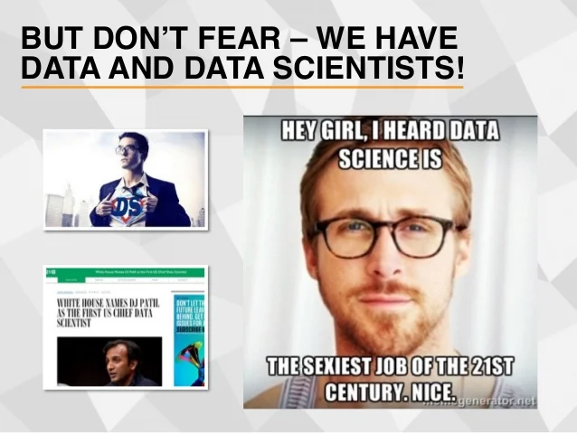
Top Data Science Community
Kaggle
Analytic Vidya
Toward Datascience
IBM Data Community
Open Data science
Data science central
Data Community DC
Data avest
Data Science Society
Driven Data
Focus on Activity
Conference :- Jupyter room, pydata, nvidia gtc
Blog :- Analytic vidya, Toward data science.
Podcast :- Super data science, Data formed

Slide 15
Thank You
I sincerely appreciate your interest and attention .
Please connect with on:-
Facebook – https://www.facebook.com/datascienv/
Instagram – https://www.instagram.com/datascienv/
Twitter – https://twitter.com/datascienv
Telegram – https://t.me/datascienv

