Slide 1
Encoding hidden text into image using steganography
Presented By:
Md Mahir Abrar Khan
Roll: 1907008
4th year
1st semester
Gratitude To Hon’ble Teachers:
Dr. SK. Masudul Ahsan Dipannita Biswas
Professor Lecturer
Dept of CSE Dept of CSE
KUET , Khulna KUET , Khulna
Khulna University of Engineering & Technology, Khulna-9203
Bangladesh

Slide 2
Contents of Presentation
Introduction
Working Procedure
User Interface
Encoding
Decoding
Encryption
Decryption

Slide 3
Introduction
Steganography is the practice of concealing information within other non-secret text or data.
It is used in digital watermarking, protecting intellectual property, covert communication, and securing digital content.
Applications include embedding hidden messages in images, audio, and video files, and enhancing cybersecurity by disguising sensitive information.

Slide 4
Working Procedure
Sender
Receiver
Input Image
Encode the text into the image
Encrypt the encoded image
Decrypt the encrypted image
Decode the hidden text from the encoded image
Sender
Input text
Fig 1 : Flow chart of working procedure

Slide 5
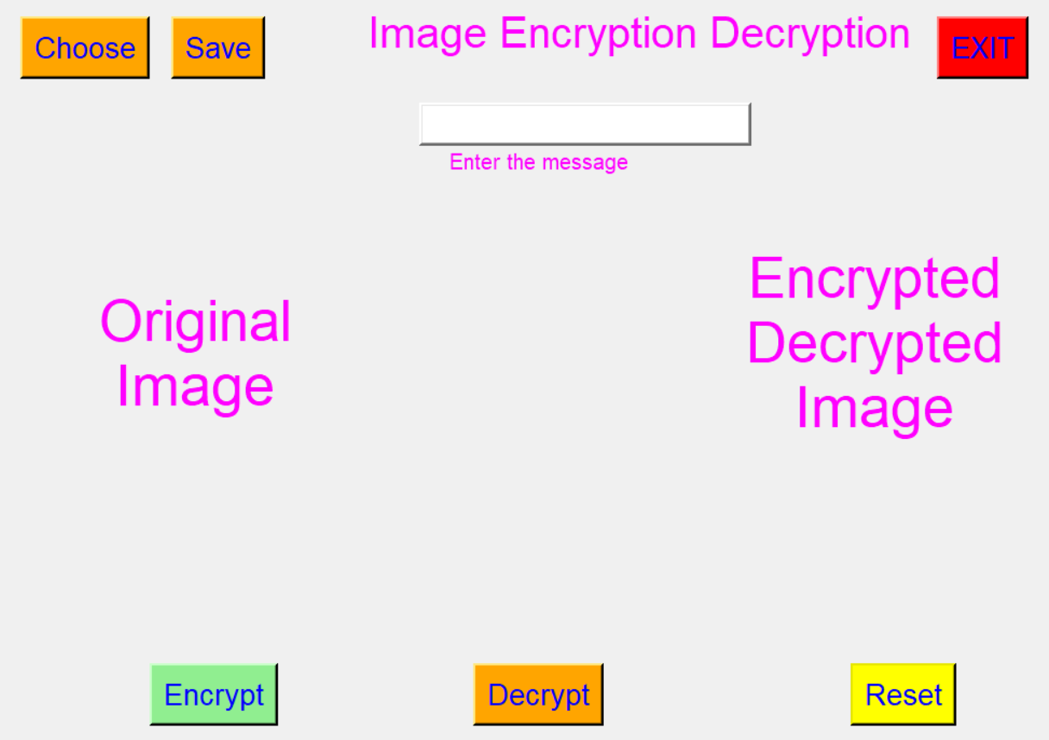
User Interface
Fig 2 : Simple user interface for the project

Slide 6
Encoding
Splitting the input image into blue, green , red channel
Dividing blue channel int 8x8 block and forming image blocks
Applying Discrete cosine transform to each of the image blocks to find the DC coefficient
Quantize the DC coefficient of each block
By looping through the quantized block embedding the bits of each character of the hidden text at the top left position of the blocks .
And then reconstructing the green channel form the blocks.
Reconstructing the image from the channel by merging operation .

Slide 7
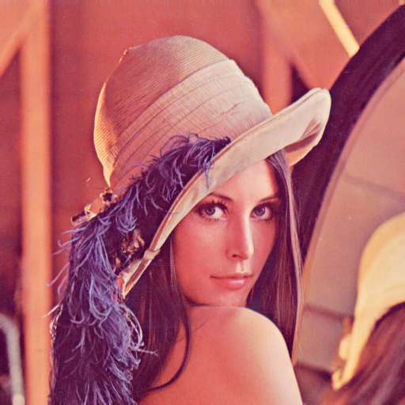

Encoding(Cnt’d)
Fig 3 : Before Embedding the text
Fig 4 : After embedding the text

Slide 8


Encoding(Cnt’d)
Fig 5 : Blue channel Before Embedding the text
Fig 6 : Blue Channel After embedding the text

Slide 9
Encrypting
Generating a matrix using normal distribution to use as decryption key
Split image into RGB channels
Dividing the image with the key channel wise
Merging all the channels back

Slide 10

Encrypting(Cnt’d)
Fig 7 : Image Before Embedding the text
Fig 8 : Image After embedding the text
Fig 9 : Image After encryption

Slide 11

Encrypting(Cnt’d)
Fig 10 : Blue channel Before Embedding the text
Fig 11 : Blue Channel After embedding the text
Fig 12 : Blue Channel After encryption

Slide 12
Decrypting
Splitting the encrypted image into RGB channels
Multiplying each channel with the encryption key
Merging the channels back to form the encoded image

Slide 13

Decrypting(Cnt’d)
Fig 13 : Blue channel Before Embedding the text
Fig 14 : Blue Channel After embedding the text and encryption
Fig 15 : Blue Channel After decrypting

Slide 14

Decrypting(Cnt’d)
Fig 16 : Image Before Embedding the text
Fig 17 : Image After embedding the text and encryption
Fig 18 : Image After decryption

Slide 15
Decoding
Splitting the image into RGB channels
Dividing blue channel into 8x8 blocks
Quantizing dct blocks
Iterating through quantized DCT blocks and extracting LSB from DC coefficients
Building message bits and build the secret message
Merging the channels

Slide 16
Thank You

