Slide 1
Digit recognition from image CSE-4128: Image Processing and Computer Vision Laboratory
Submitted to
Dr. Sk. Mohammad Masudul Ahsan
Professor
Department of CSE, KUET
Dipannita Biswas
Lecturer
Department of CSE, KUET
Submitted by Md. Abu Saeed
Roll : 1907057
Department of CSE, KUET
Notes:
Add figure in methodology and update recommendations and findings

Slide 2
Outline
Introduction
Tools used
Methodology
User Interface
Limitation
Conclusion
2

Slide 3
Introduction
A digit recognition system that can identify English digits (0-9) in an input image.
The input image will have multiple digits.
The digits can be in different orientation with different sizes.
The final result will show all the recognized digit with annotation.
3

Slide 4
Tools used
Programming language:
Python
Libraries
cv2
numpy
colorsys
Math
collections
Interface
Tkinter
PIL
4

Slide 5
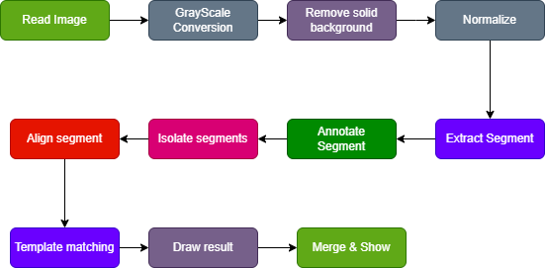
Methodology
5

Slide 6
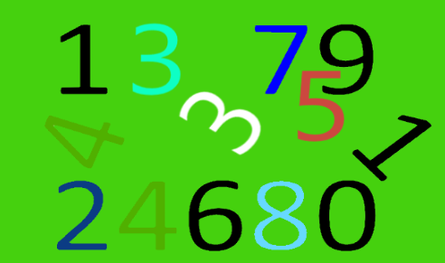
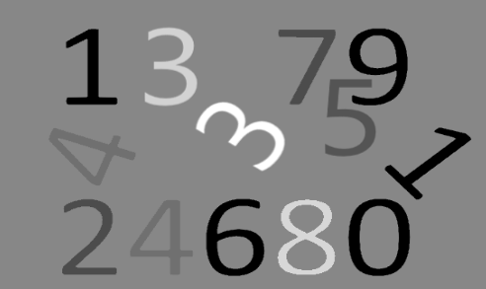
Read image & gray-scale conversion
Read image using cv2 library.
Convert the image into grayscale.
Input image
Gray-scale converted
6

Slide 7
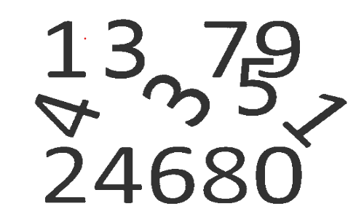
Remove solid background
Assumes the background’s intensity is constant and appears the most in the image.
Count the intensity appears maximum in image.
Then change the intensity to white(255).
Background removed
7

Slide 8
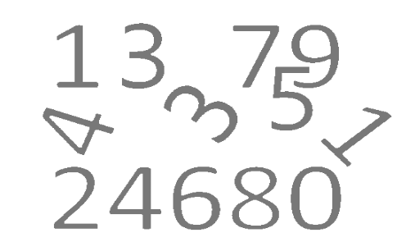
Extract segment
Iterate the whole image and find black pixel.
Apply DFS on that black pixel and extract four corner points for that digit.
Continue until all black pixels are visited.
Extracted segments
8

Slide 9
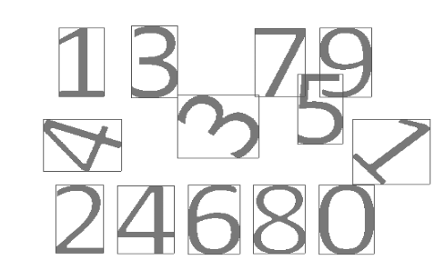
Annotate segment
Iterate all the segments in previous steps and draw a rectangle around it.
Extracted segments
9

Slide 10


Isolate segment
Iterate all the segments and extract them one by one.
Ignore part of other digit by DFS.
Example of two isolated segments
10

Slide 11
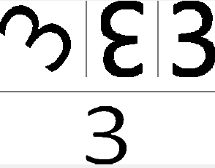
Align segment
Rotate the segment from (0-360) at interval 2.
Compute the area for each rotation and takes the first two segments with minimum width then area.
Original(left) and two segment with minimum area
11

Slide 12
Template matching
Some predefined images are used template.
Compares the actual and minimum segments with template and calculate best match.
Segments(top) and matched template(bottom)
12

Slide 13
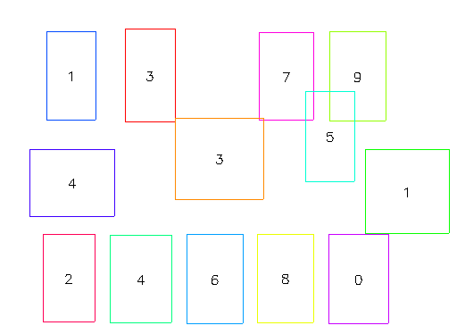
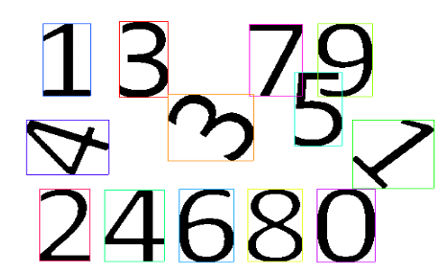
Result
An empty rectangle is drawn at corresponding position and matched annotation.
Annotated input
Final result
13

Slide 14
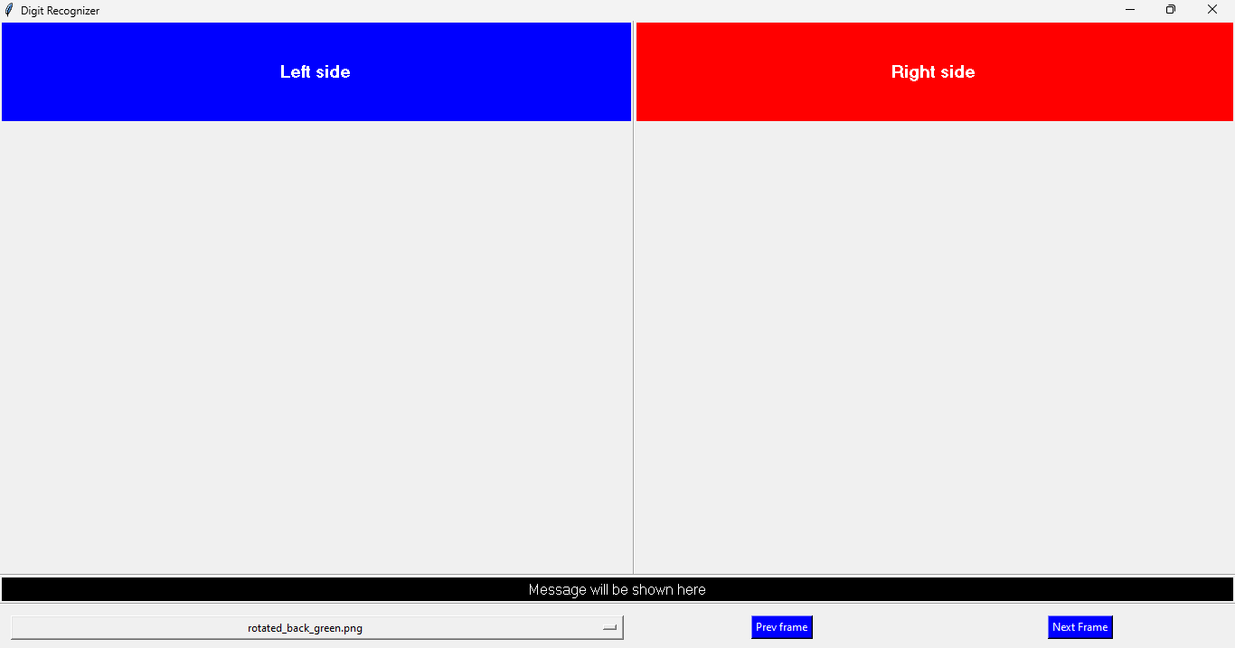
GUI
Select from predefined image.
Stepwise preview and output
Next and Prev to see next and previous step results.
14

Slide 15
Limitation
Background should be solid.
Multiple fonts are not allowed.
Can’t detect if digits touch each other.
May produce incorrect results.

Slide 16
Conclusion
This project can detect digits (0-9).
It aligns digit by using the minimum area bounding box to handle different orientation.
It can handle solid or no background images.
It produces correct result, but may have wrong outcome.

Slide 17
Thank you

