Slide 1
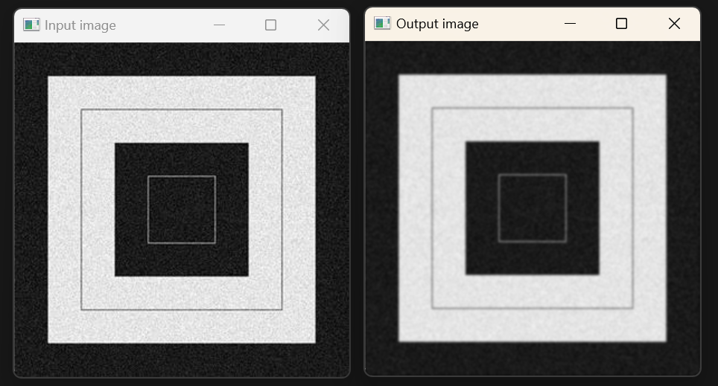
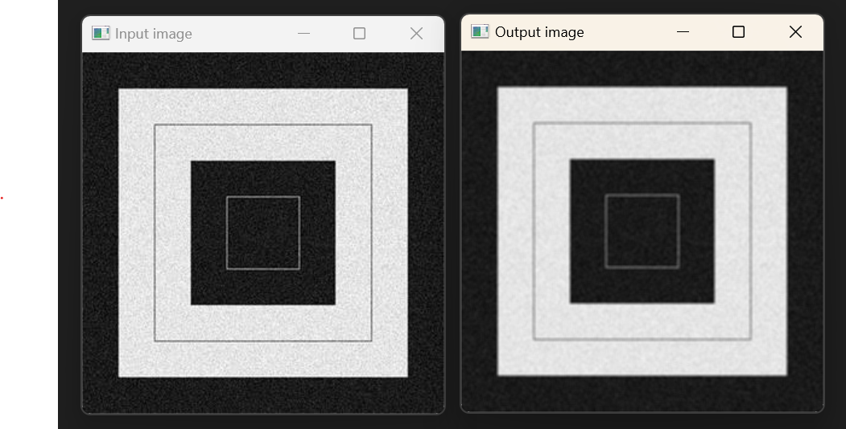
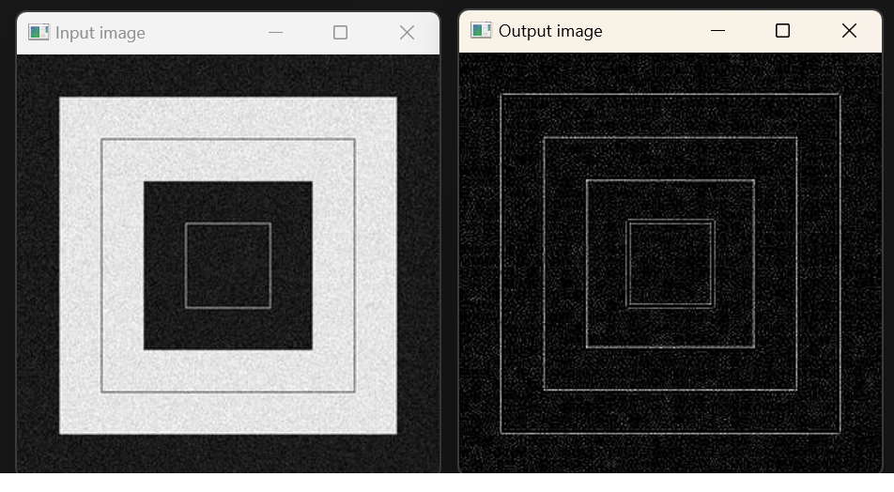
GRAY-SCALE Convolution
Gaussian Kernel
- Performs smoothing operation on image
Fig-1: Gaussian with sigmaX=1 sigmaY=1, center = (3,3)
Mean Kernel
- Performs smoothing operation on image
Fig-2: Mean of size (3x3) with center = (1,1)
Laplacian Kernel
- Performs smoothing operation on image
Fig-3: Laplacian of size 3x3 with center = (1,1)

Slide 2
GRAY-SCALE Convolution
Gaussian Kernel
- Performs smoothing operation on image
Fig-1: Gaussian with sigmaX=1 sigmaY=1, center = (3,3)
Mean Kernel
- Performs smoothing operation on image
Fig-2: Mean of size (3x3) with center = (1,1)
Laplacian Kernel
- Performs smoothing operation on image
Fig-3: Laplacian of size 3x3 with center = (1,1)

