Slide 1
Test Automation Framework
Design And Implementation Goals And Standards

Slide 2
Ten Commandments For Robust,Readable,Maintainable,Reusable Framework
Object Oriented Design And Implementation
Code Abstraction And Encapsulation
Three Tier Framework Infrastructure (Inner, Middle, Outer)
Centralized Object Repository For Object Recognition
Global Parameters Shared By All Methods During Runtime
Parameterization Of Various Input Data (No Hard Coding)
Built-in Error/Failure Handling And Reporting
Built-in Exception/Popups Handling And Reporting
Common External File Input/Output Routines
Fully Data Driven Approach For Automated Test Development (No Cryptic Scripting/Coding)

Slide 3
Object Oriented Design And Implementation
Object Oriented Programming Methodologies Used For Framework Coding
Object Oriented Data Modeling Principals Used For Data Management And Accessing In The Framework
Common Parameterized Subroutines Shared By Various Methods For Same Kind Of Tasks, Thus Avoiding Significant Amount Of Repeated Code Segments
Object Centric Set Of General Purpose Core Methods For All Kinds Of Data/Web-Table Field Interactions During Runtime, i.e. Value Setting, Retrieval, Verification And So On

Slide 4
Code Abstraction And Encapsulation
All Complex And Cryptic Coding Resides Hidden In The Inner Layer
Algorithmic Data Structure And Object Models Follow Encapsulation Techniques With Data Getter, Setter Methods
All Test Specific Data Arrays Defined, Initialized, Updated And Cleared Dynamically During Run Time
All Input Parameter Data Vs. Data Type Integrity Checks Are Done In Each Individual Method Entry Level

Slide 5
Three Tier Framework Infrastructure (Inner, Middle, Outer)
The Inner Tier Contains Complex Coding Of All Functional Methods Of Various Categories, i.e. Generic, Application Feature Specific, Utilities, Common Framework Subroutines And So On
The Middle Tier Consists Of The Object Repository, Global Parameters And The Test Driver Script Called “The Test Engine” (This Is The Interceptor, Interpreter, Executor Of The Test Steps Of The Test In Order, Evaluator Of The Test Pass/Fail Status And Reporter Of The Test Result)
The Middle Tier Is Equipped To Run Multiple Tests In Batch Mode Or A Single Test In Individual Mode Seamlessly
The Outer Tier Is The Actual Automated Test Saved In Excel File With Multiple Data Sheets Containing A Series Of Method Calls And Various Test Data Used In The Test Actions, Data Retrievals And Verifications

Slide 6
Centralized Object Repository For Object Recognition
One Central Location For All Object Recognition Properties Of An Application Module
One Object Repository Property File Per Application Module
All Updates Are Confined In One Location Only For Any Object Property Changes In The Application
Object Recognition Properties Are Easily And Readily Accessible During Test Automation Runtime From The Property Object Model

Slide 7
Global Parameters Shared By All Methods During Runtime
Global Parameters Contain Predefined Default Values Used By Various Methods
Global Parameters Can Be Redefined During Runtime Based On The Need Of The Test
This Approach Saves Considerable Hard Coding Of Actual Values
Allows Default Or Dynamically Updated Value Exchange/Share Among Methods And The Three Tiers Of The Framework Easily

Slide 8
Parameterization Of Various Input Data (No Hard Coding)
Any Number Of Local Parameters Can Be Defined Based On The Need Of The Test
All Methods Are Duly Parameterized To Receive Input Data
All Method Calls Can Be Parameterized Using Local Parameters
This Approach Makes Updates Simple In One Place When Running The Test With New Set Of Data

Slide 9
Built-in Error/Failure Handling And Reporting
Any Kind Of System Level Error Is Trapped And Reported To The Test Report And Log Files Automatically
All Action And Verification Level Failures Are Trapped And Reported To the Test Report And Log Files Automatically
Sets The Test Run Stopper Indicator Due To Error
The Test Engine Controls Whether To Continue Or Interrupt The Test Run Due To Error As Per Instruction From The Automated Test (The Outer Tier)

Slide 10
Built-in Exception/Popups Handling And Reporting
Any Kind Of Unhandled Error Pop Up Box Is Detected And Reported To The Test Report And Log Files Automatically
Any Kind Of Unknown Error Pop Up Box Is Detected And Reported To the Test Report And Log Files Automatically
Sets The Test Run Stopper Indicator Due To Error
The Test Engine Controls Whether To Continue Or Interrupt The Test Run Due To Exception As Per Instruction From The Automated Test (The Outer Tier)

Slide 11
Common External File Input/Output Routines
One Common Routine For Handling All Kinds Of Test Data Input
One Common Routine For Handling All Kinds Of Test Result Output
One Common Routine For Printing Pre Formatted Header And Footer Information To The Test Report And Log Files
One Common Routine For Handling All Kinds Of Test Input Files As Attachments
Test Data Input Supported In Excel Data Sheet Format Only
Test Result Output Supported In Unicode Text File Format Only

Slide 12
Fully Data Driven Approach For Automated Test Development (No Cryptic Scripting/Coding)
The Automated Test And All Related Input Data Are Bundled In One Excel File
Each Of Such Excel File Represents One Complete Automated Test Based On The Corresponding Test Case
The “Test Main” Datasheet Contains The Sequential Test Steps Mapped Into Corresponding Method Calls Only, No Cryptic Scripting/Coding Required
The “Test Params” Datasheet Contains All The Local And Redefined Global Parameters Used By The Automated Test
The “Test Data Sheet(s)”, One Or More, Contain(s) The Raw Test Data For Data Driving The Automated Test For All Actions And Verifications
Any Tester With Proper Training On The Framework Usage, Can Develop Automated Tests Without Having Any Prior Knowledge Or Skill In Scripting Or Coding

Slide 13
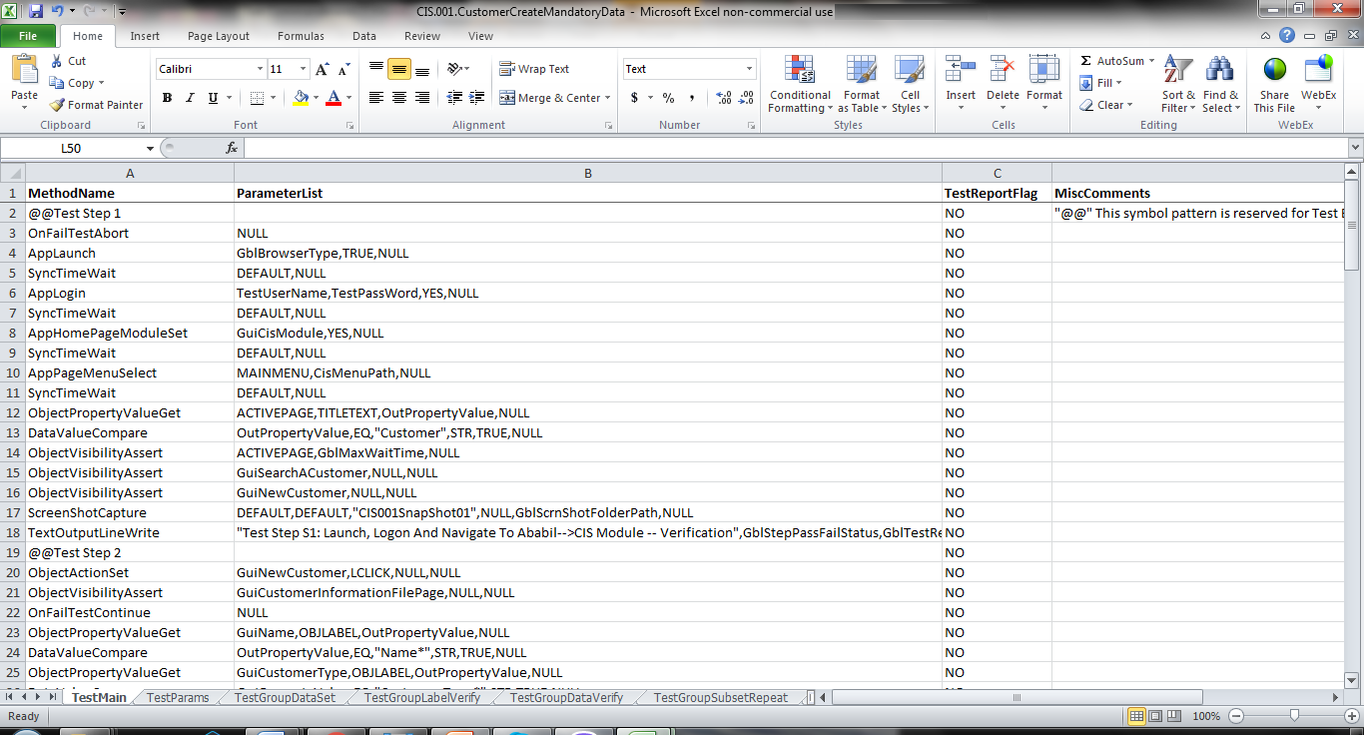
The Automated Test Data File Layout: Excel Datasheet “Test Main”

Slide 14
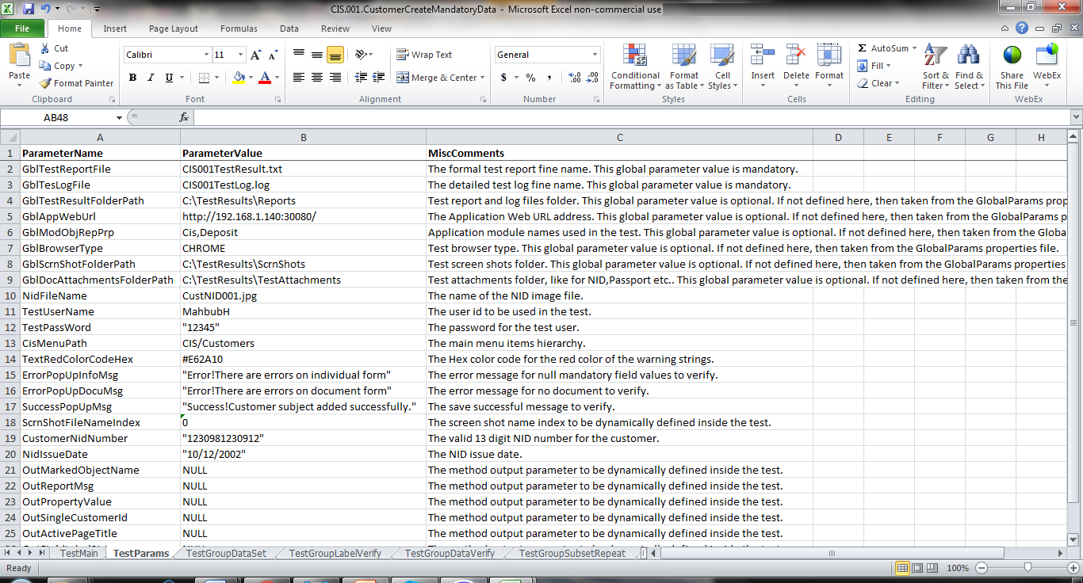
The Automated Test Data File Layout: Excel Datasheet “Test Params”

Slide 15
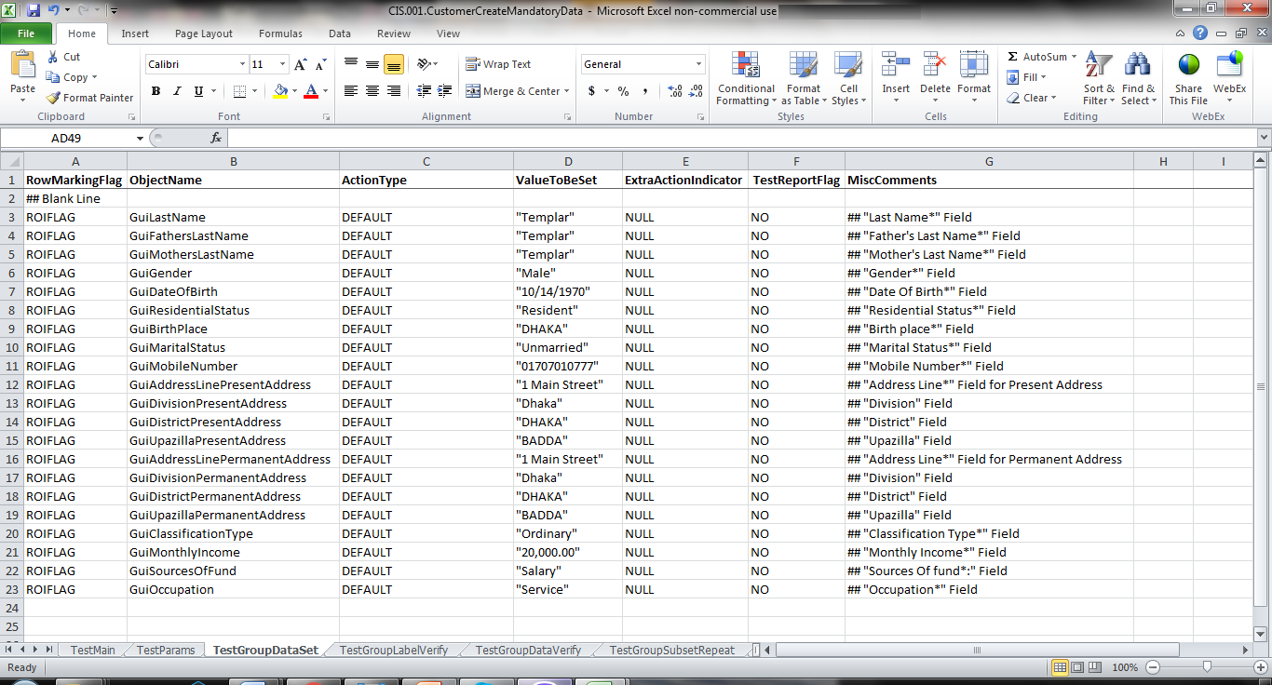
The Automated Test Data File Layout: Excel Datasheet “Field Data Setting”

Slide 16
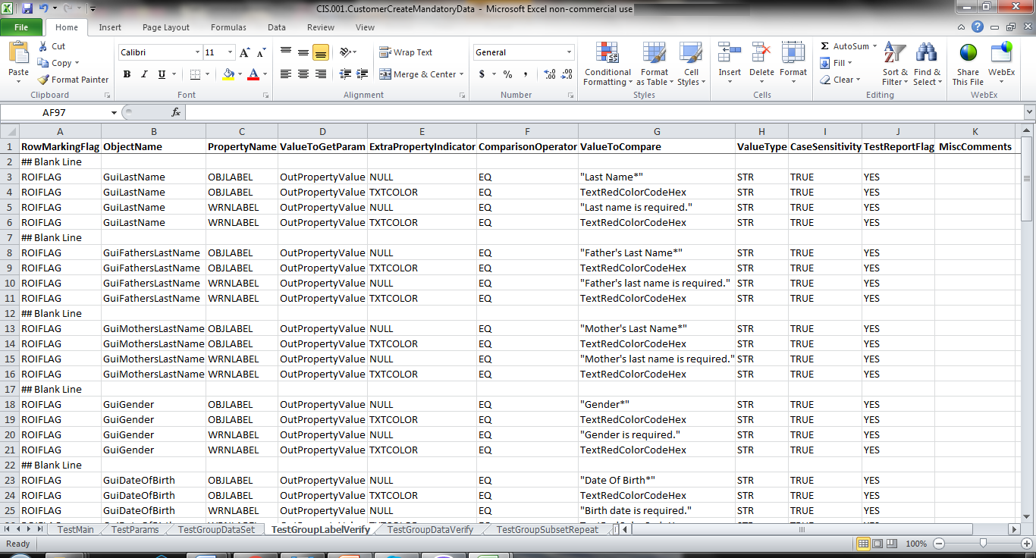
The Automated Test Data File Layout: Excel Datasheet “Field Label Verification”

Slide 17
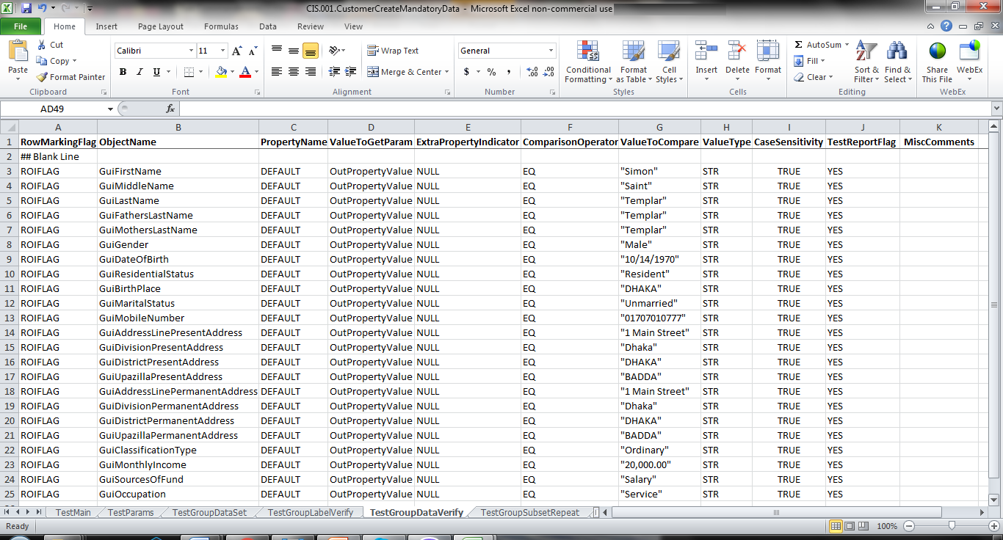
The Automated Test Data File Layout: Excel Datasheet “Field Data Verification”

Slide 18
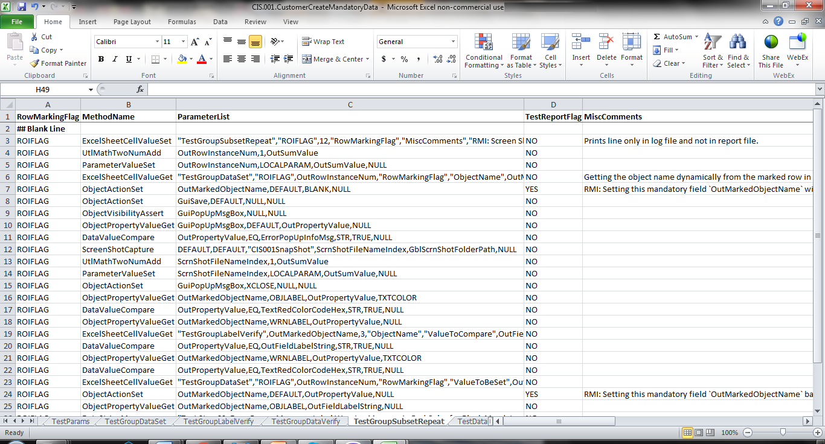
The Automated Test Data File Layout: Excel Datasheet “Test Action Repeat”

Slide 19
Test Automation Prerequisites
The Test Cases That Are Suitable And Worthwhile For Automation Must Be Selected Wisely With Due Diligence
Test Automation Is Most Effective For GUI Based Regression Tests Only
Test Automation Should Be Used For Application Features That Are Stable
The Regression Test Cases Must Be Written In Automation Friendly Manner With Specific, Clear And Sufficient Details, No Vague Statements, No Guess Work, No Repetitious Verification
Each Test Case For Automation Should Be Targeted For Thorough Testing Of One Specific Feature Of The Application Instead Of Cramming In Too Many Of Them In One Test Case
There Should Be Predefined And Well Maintained Data Sets For The Test Cases For Test Automation
Manual Review Of The Test Result Report File And The Captured Screen Shots During Runtime Is Mandatory
There Should Be A Separate Application Server With Strict Version Control In Place For Test Automation Run
There Should Be A Dedicated Team Of At Least Two Engineers For Test Automation Framework Updates And Maintenance
Reasonable R&D Time Should Be Allocated Without Undue Pressure For Finding Solutions Of Unexpected Or Intriguing Challenges In Test Automation

Slide 20
Test Automation Framework To-Do List
Making A Command Line Executable Version Of The Automated Test Run And The Test Tool Validation Via Manual Interactive Sessions
Implementing An Alternative Method For Selenium Tool Limitation Of Interacting With Windows Objects Beyond The Web Page, i.e. Windows Document Attachment Interface
Enabling Framework Support For Condition Based Decision Making And Bifurcation Of Actions And Verifications Accordingly During Runtime
User Manual Documentation For Test Automation Framework And A Representative Set Of Fully Automated Test Samples For Training Purposes
Enabling Framework Support For Image Bitmap Capture And Compare For Baseline Testing Of GUI Elements’ Appearance As deemed Appropriate
Facilitation Of Automated Test Development Via Excel Datasheet Template With Dropdown Selection List Of Key Elements (Next Step Is To Come Up With A User Friendly GUI Interface For Automated Test Data File Generation)
Enabling Framework Support For Back End Testing Using Database Connectivity, Query By SQL, Data Retrieval And Verification Which Is Otherwise Not Possible Via UI
Enabling Framework Support For Accessing And Utilizing Windows API Library And Windows Registry For Various Testing Purposes As Deemed Necessary
Enabling Framework Support For Test Automation Of Various Statistical Graphs Like Line And Bar Graphs, Pie Charts, Histograms, Cartesian Graphs And So On
Continually Adding More And More New Web Elements As GUI Objects In The Object Repository, Various Test Methods In The Framework Inner Tier For Different Application Modules As Deemed Necessary

