Slide 1
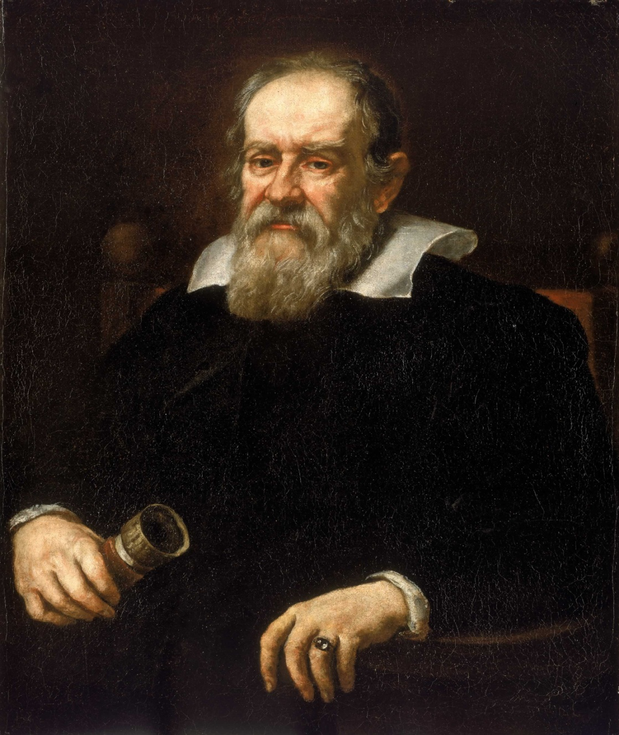
Galileo Galilei
Italian, 1564-1642

Slide 2
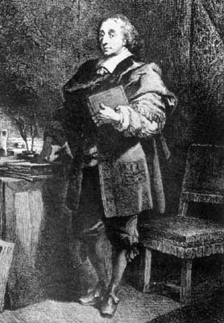
Blaise Pascal
French , 1623- 1662

Slide 3
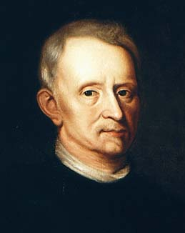
Robert Hook
English, 1635-1703

Slide 4
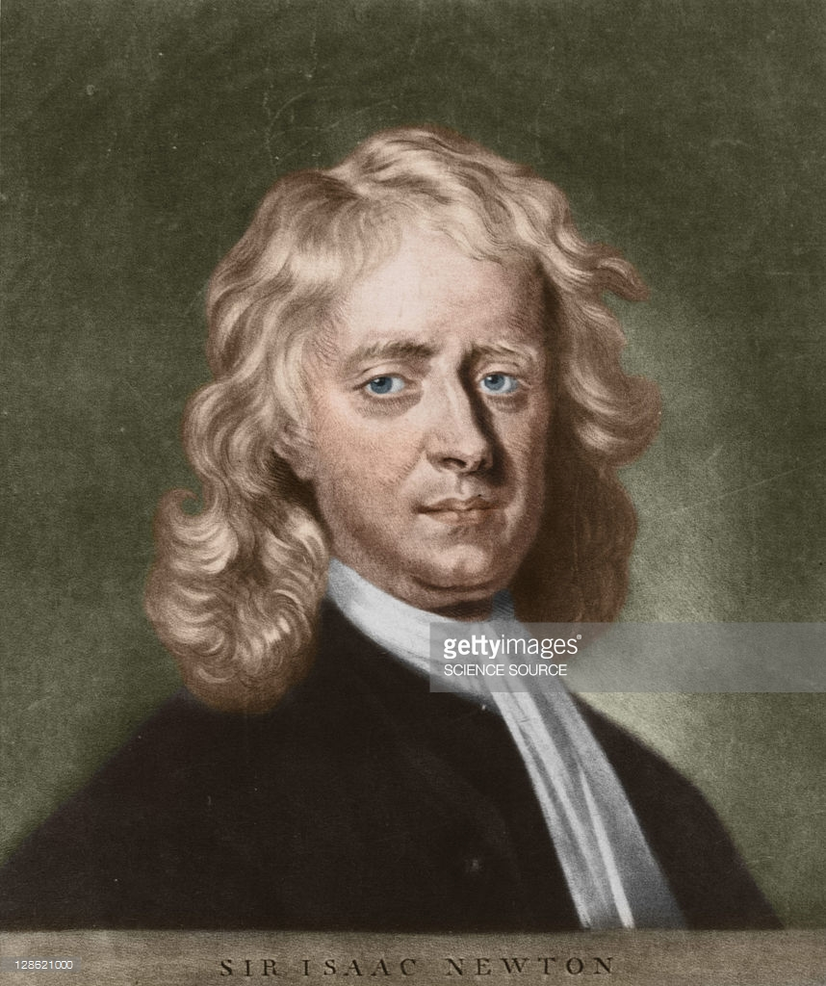
Sir Isaac Newton
English, 1643-1727

Slide 5
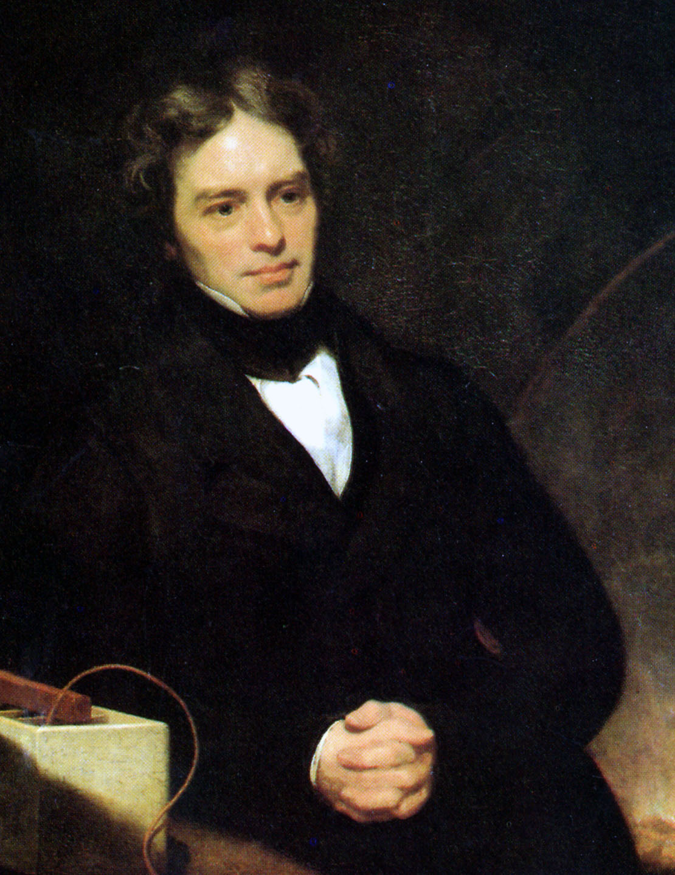
Michael Faraday
English, 1791-1841

Slide 6
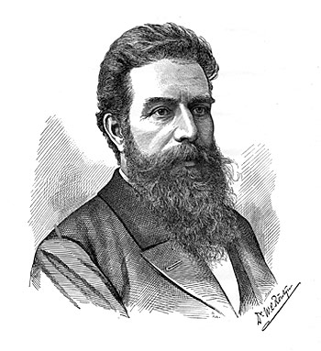
Wilhelm Rontgen
German, 1845-1923

Slide 7
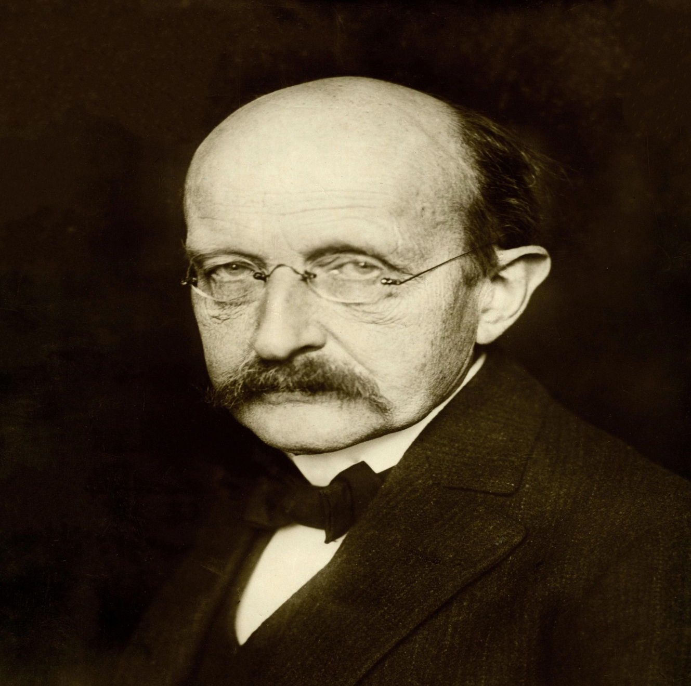
Max Planck
German, 1858-1947

Slide 8
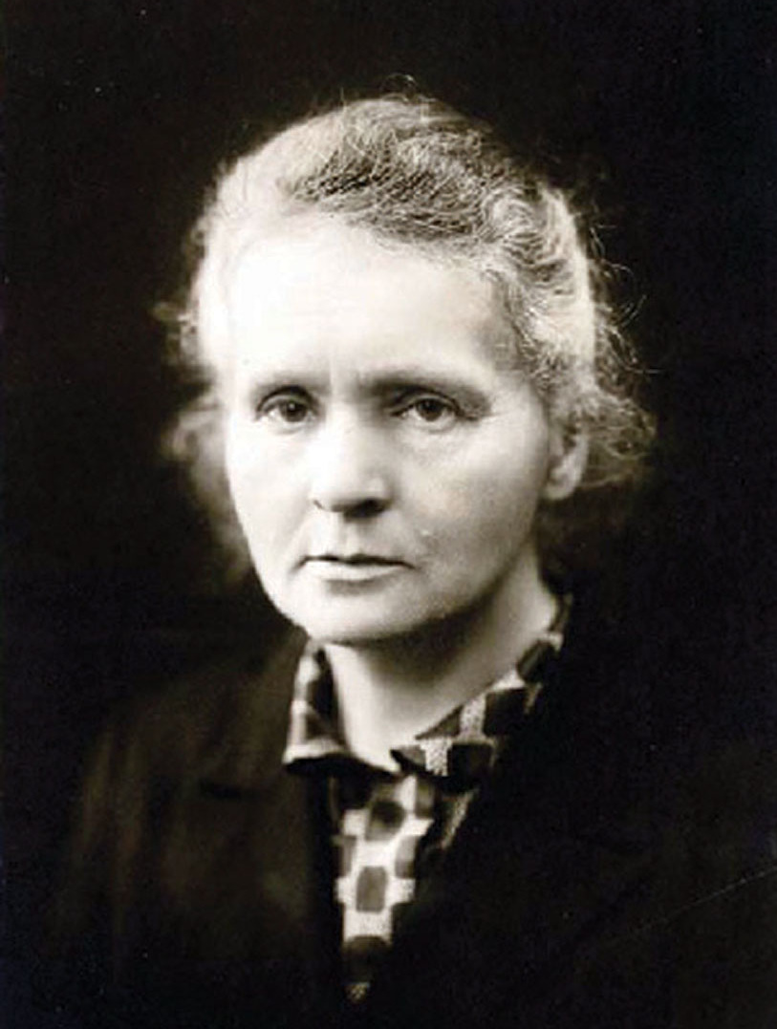
Marie Curie
Polish, 1867-1934

Slide 9
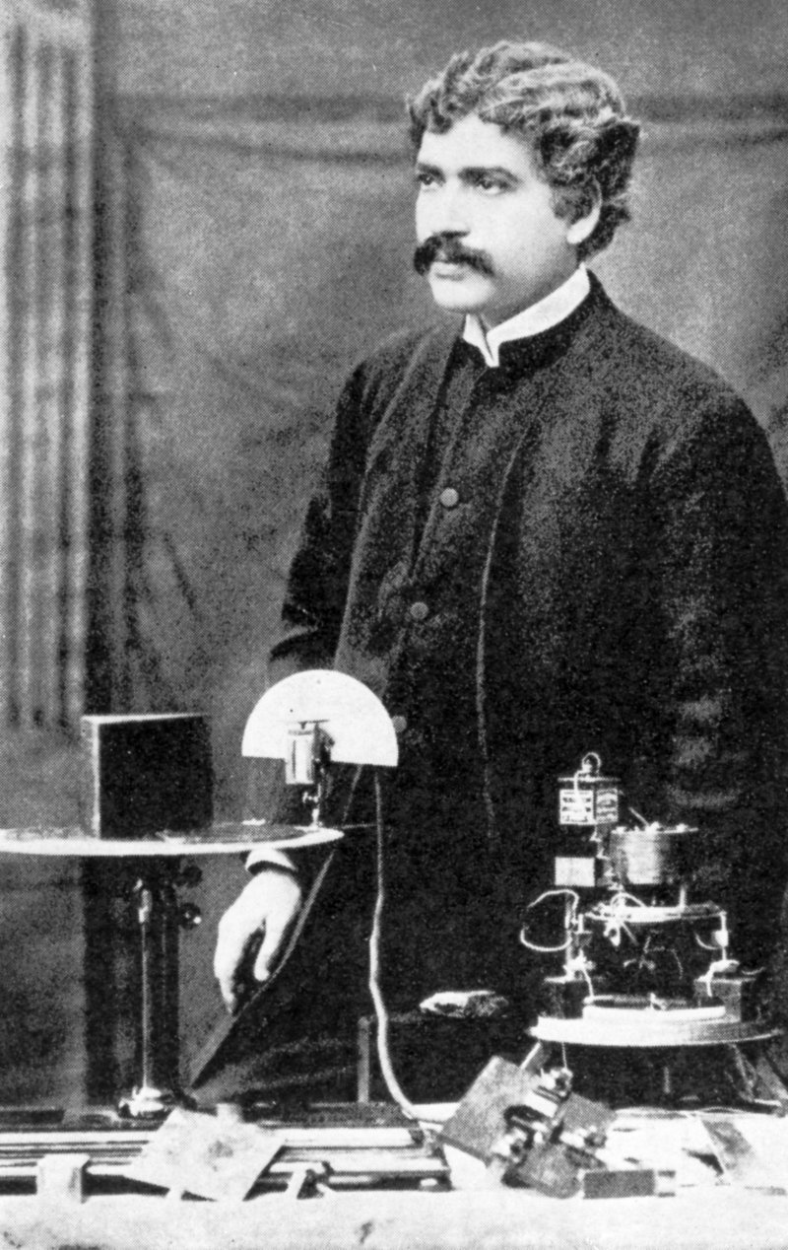
Jagadish Chandra Bose
Born in Munshiganj, Bangladesh
30 Nov 1858- 23 Nov 1937

Slide 10
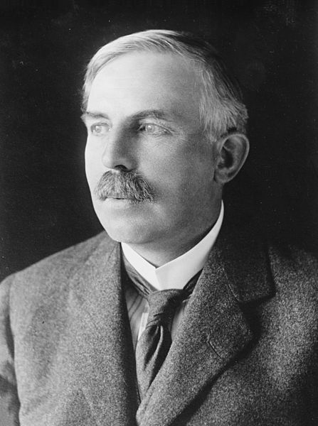
Lord Ernest Rutherford
New Zealander, 1871-1937

Slide 11
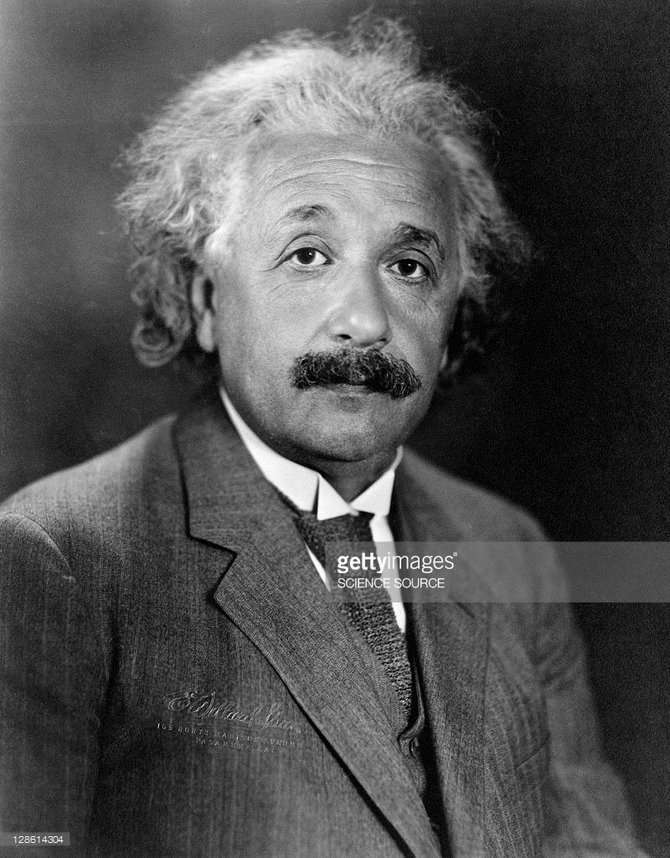
Albert Einstein
German, 1879-1955

Slide 12
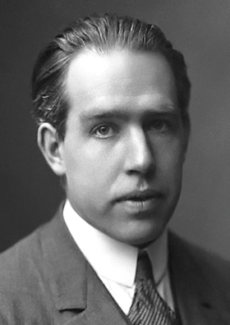
Niels Bohr
Danish,1885-1962

Slide 13
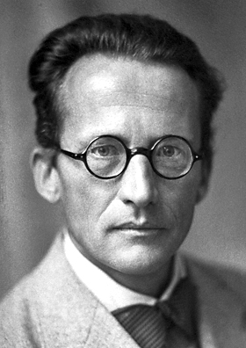
Erwin Schrodinger
Austrian,1887-1961

Slide 14
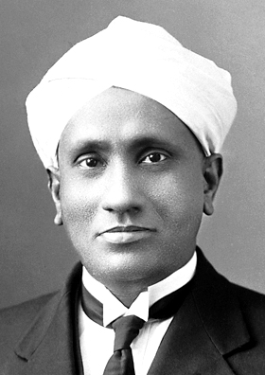
Chandrasekhara Venkata Raman
Indian, 1888-1970

Slide 15
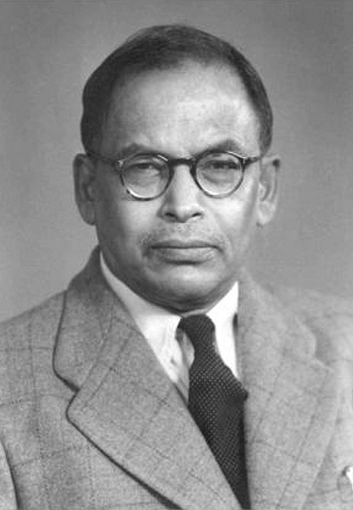
Meghnad Saha
Indian , 1893-1956

Slide 16
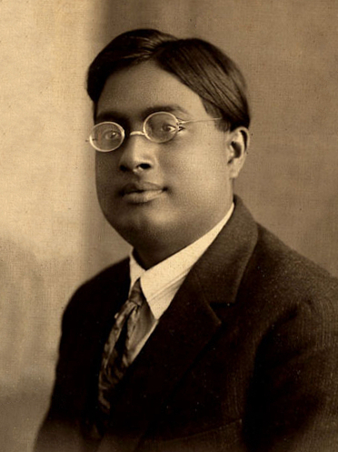
Satyendra Nath Bose,
Indian, 1894-1974

Slide 17
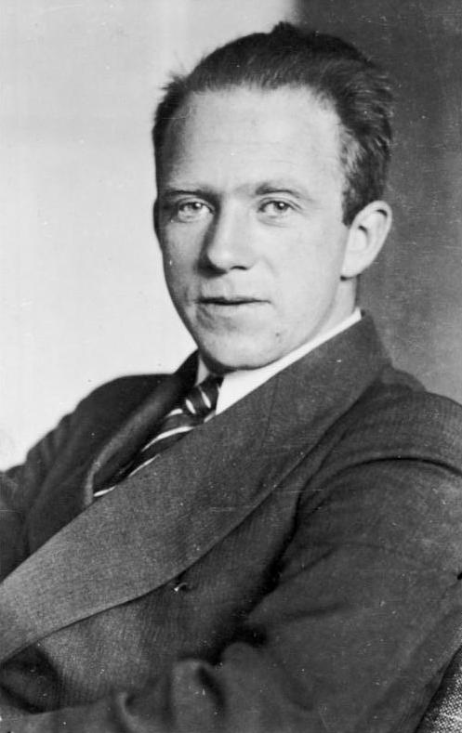
Werner Heisenberg
German,1901-1976

Slide 18
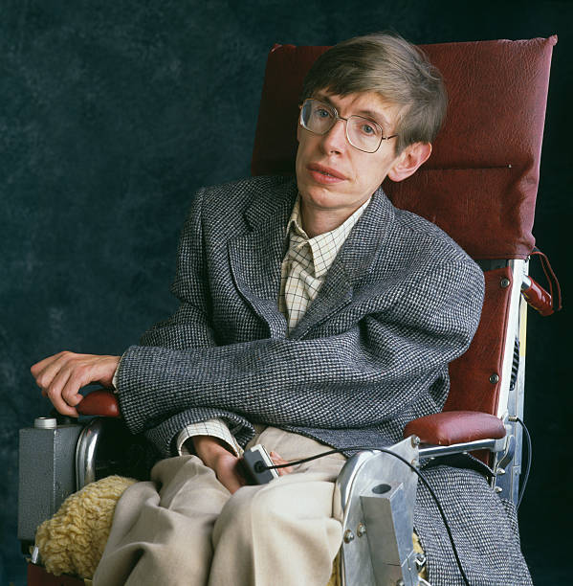
Stephen William Hawking
Born in Oxford, England, 1942

