Slide 1


BookMyDoc
Hi! I will be your guide here!
Spartan Health Team
CmpE131 – Software Engineering
Guided by Prof. Frank Lin

Slide 2
Introduction - BookMyDoc
Did you know: For every 10-percent increase in problem complexity, there is a 100-percent increase in the software complexity
Hassle free appointments
Ease to find convenient timings
Paperless medical reports
Online solution to patient queries
Compatibility with Google Health
Key Points in a Development Cycle
SDLC - Waterfall Model
Systematic, Disciplined & Quantifiable Approach
Requirement Analysis and Design
Implementation
Review and Testing

Slide 3
Requirement
Mediate between Doctor and Patient
Manage appointments
Maintain medical history
How did we go about it?
Elicitation – brainstorming, requirement gathering
Requirement analysis – feasibility study
Inputs from SJSU Health Center
Create SRS - Break into functional and non functional, Use cases, diagrams, validation criteria
Did you know: One of the common causes of runaway projects is unstable requirements.

Slide 4
Design and Implementation
Architecture – Object Model
Design – UML Concepts
Stability Pattern
Static Design – Class Diagram
Behavior Design – Sequence Diagram
Implementation – Java
Database – MySQL
Platform – Apache Tomcat
Did you know: Designer 'primitives' rarely match programmer 'primitives'

Slide 5
System Framework
UI Component
Control Servlet
Business Objects
Backend
Patient.java
pat_login.jsp
login()
doc_register.jsp
Servlet.java
Database
Doctor.java
register()
Appointment.java
book()
all .jsp
Request
Object
Query
Render
Data

Slide 6
Stability Pattern – BookMyDoc
Patient
Admin
dbase
Appointment
Prescription
Doctor

Slide 7
Stability Pattern – E.g. BookMyShow
Patron
Admin
dbase
Appointment
Notification
Multiplex

Slide 8
Highlights of the Project
Enable Software Reuse
  MVC Architecture
  Stability Pattern
  Stress on intuitive UI
  Use of collaboration software
  DropBox
  Automated Testing
  Test Code
  Test Cases
Did you know: Reusable components are three times as hard to build.

Slide 9
Improvement Areas
Depends on Google Health!
Lack of normalized database
Stability pattern can be improved
Security features
Improved testing techniques
Did you know: Efficiency is more often a matter of good design than of good coding

Slide 10
What We Learnt – Best Practices
Be clear with the requirement
K.I.S.S.
Software Design
  No “dangling” class
  “Snake” in a sequence diagram
  Document Everything!
Quality Assurance
  Much more than software defects
  P2P review
Did you know: Money wasted in US for cancelled software projects is $63 billion.

Slide 11
1 Minute Screen-cast

Slide 12
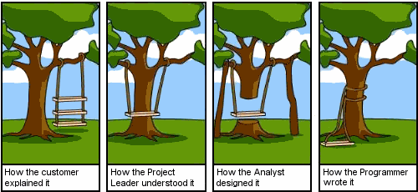
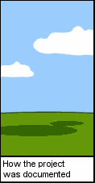
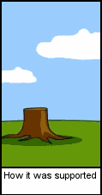
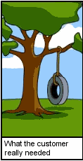
Moral of the Story
Pre Development
Post Development

Slide 13
Any Questions??!!!
“nobody is perfect! Anybody who is perfect has nothing more to achieve!!”

Slide 14
Thank You!

