Slide 1
Acute nephritic syndrome in children
Gemechu Edae ( MD, Assistant professor of pediatrics
Dept of Peds, CHS, AU )
April 04, 2022
Notes:
Nephrotic syndrome slide 43
UTI Slide 72

Slide 2
Objectives
Understand the pathogenesis and clinical manifestations of A-PSGN and IgA nephropathy
Understand the approach to a child with nephritic syndrome
Know the DDX of Nephritic syndrome
Know the principles of management of APSGN

Slide 3
Acute nephritic syndrome
Sudden onset of:
  Hematuria
  Oliguria:- < 500 ml/day, or < 0.5 ml/kg/hr)
  Edema:- Extracellular Vol. expansion
  Hypertension
  Proteinuria might reach nephrotic range
Proliferative GN:-the classical pathological correlate of AGN
APGN - a prototype of acute nephritic syndrome:

Slide 4
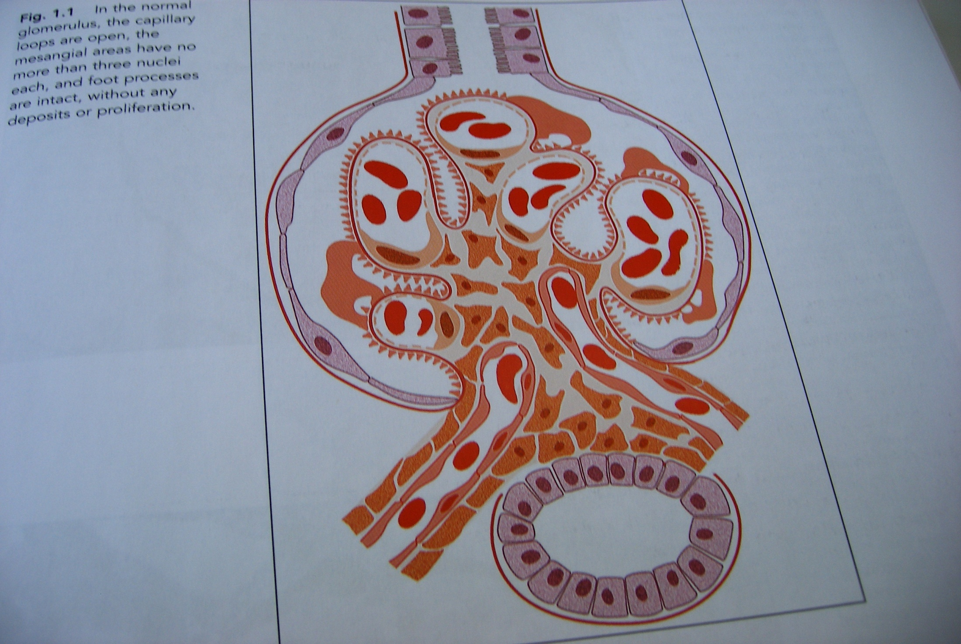

Slide 5
Glomerulonephritis
Is a term reserved for a variety of renal diseases
The whole mark is inflammation of the glomerulus:-
  Proliferation of cellular elements secondary to an immunologic mechanism

Slide 6
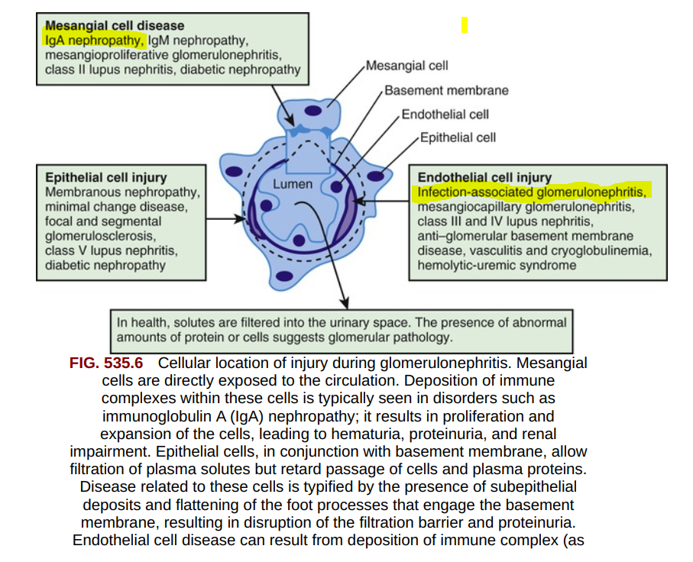


Slide 7
APSGN
Pathogenesis
The immunologic system may be activated by:
  Streptococcal Ag that adhere to glomerular structures and act as planted antigens or by alterations of endogenous Ag.
Ab against streptococci → immune complexes → activation of the complement system → glomerular injury.

Slide 8
Pathogenesis…
Non-group A streptococci, particularly group C and G have also demonstrated to produce GN.
Erythrogenic toxin type B produced by:
  Streptococci may be a key part of the immune complexes
Pharyngitis related AGN
Pyoderma related AGN

Slide 9
Pathogenesis…
The tufts:
  Enlarged, swollen,
  and a moderate-to-marked increase proliferation of mesangial and epithelial cells is present
PMNL:- often observed as part of the inflammatory process.

Slide 10
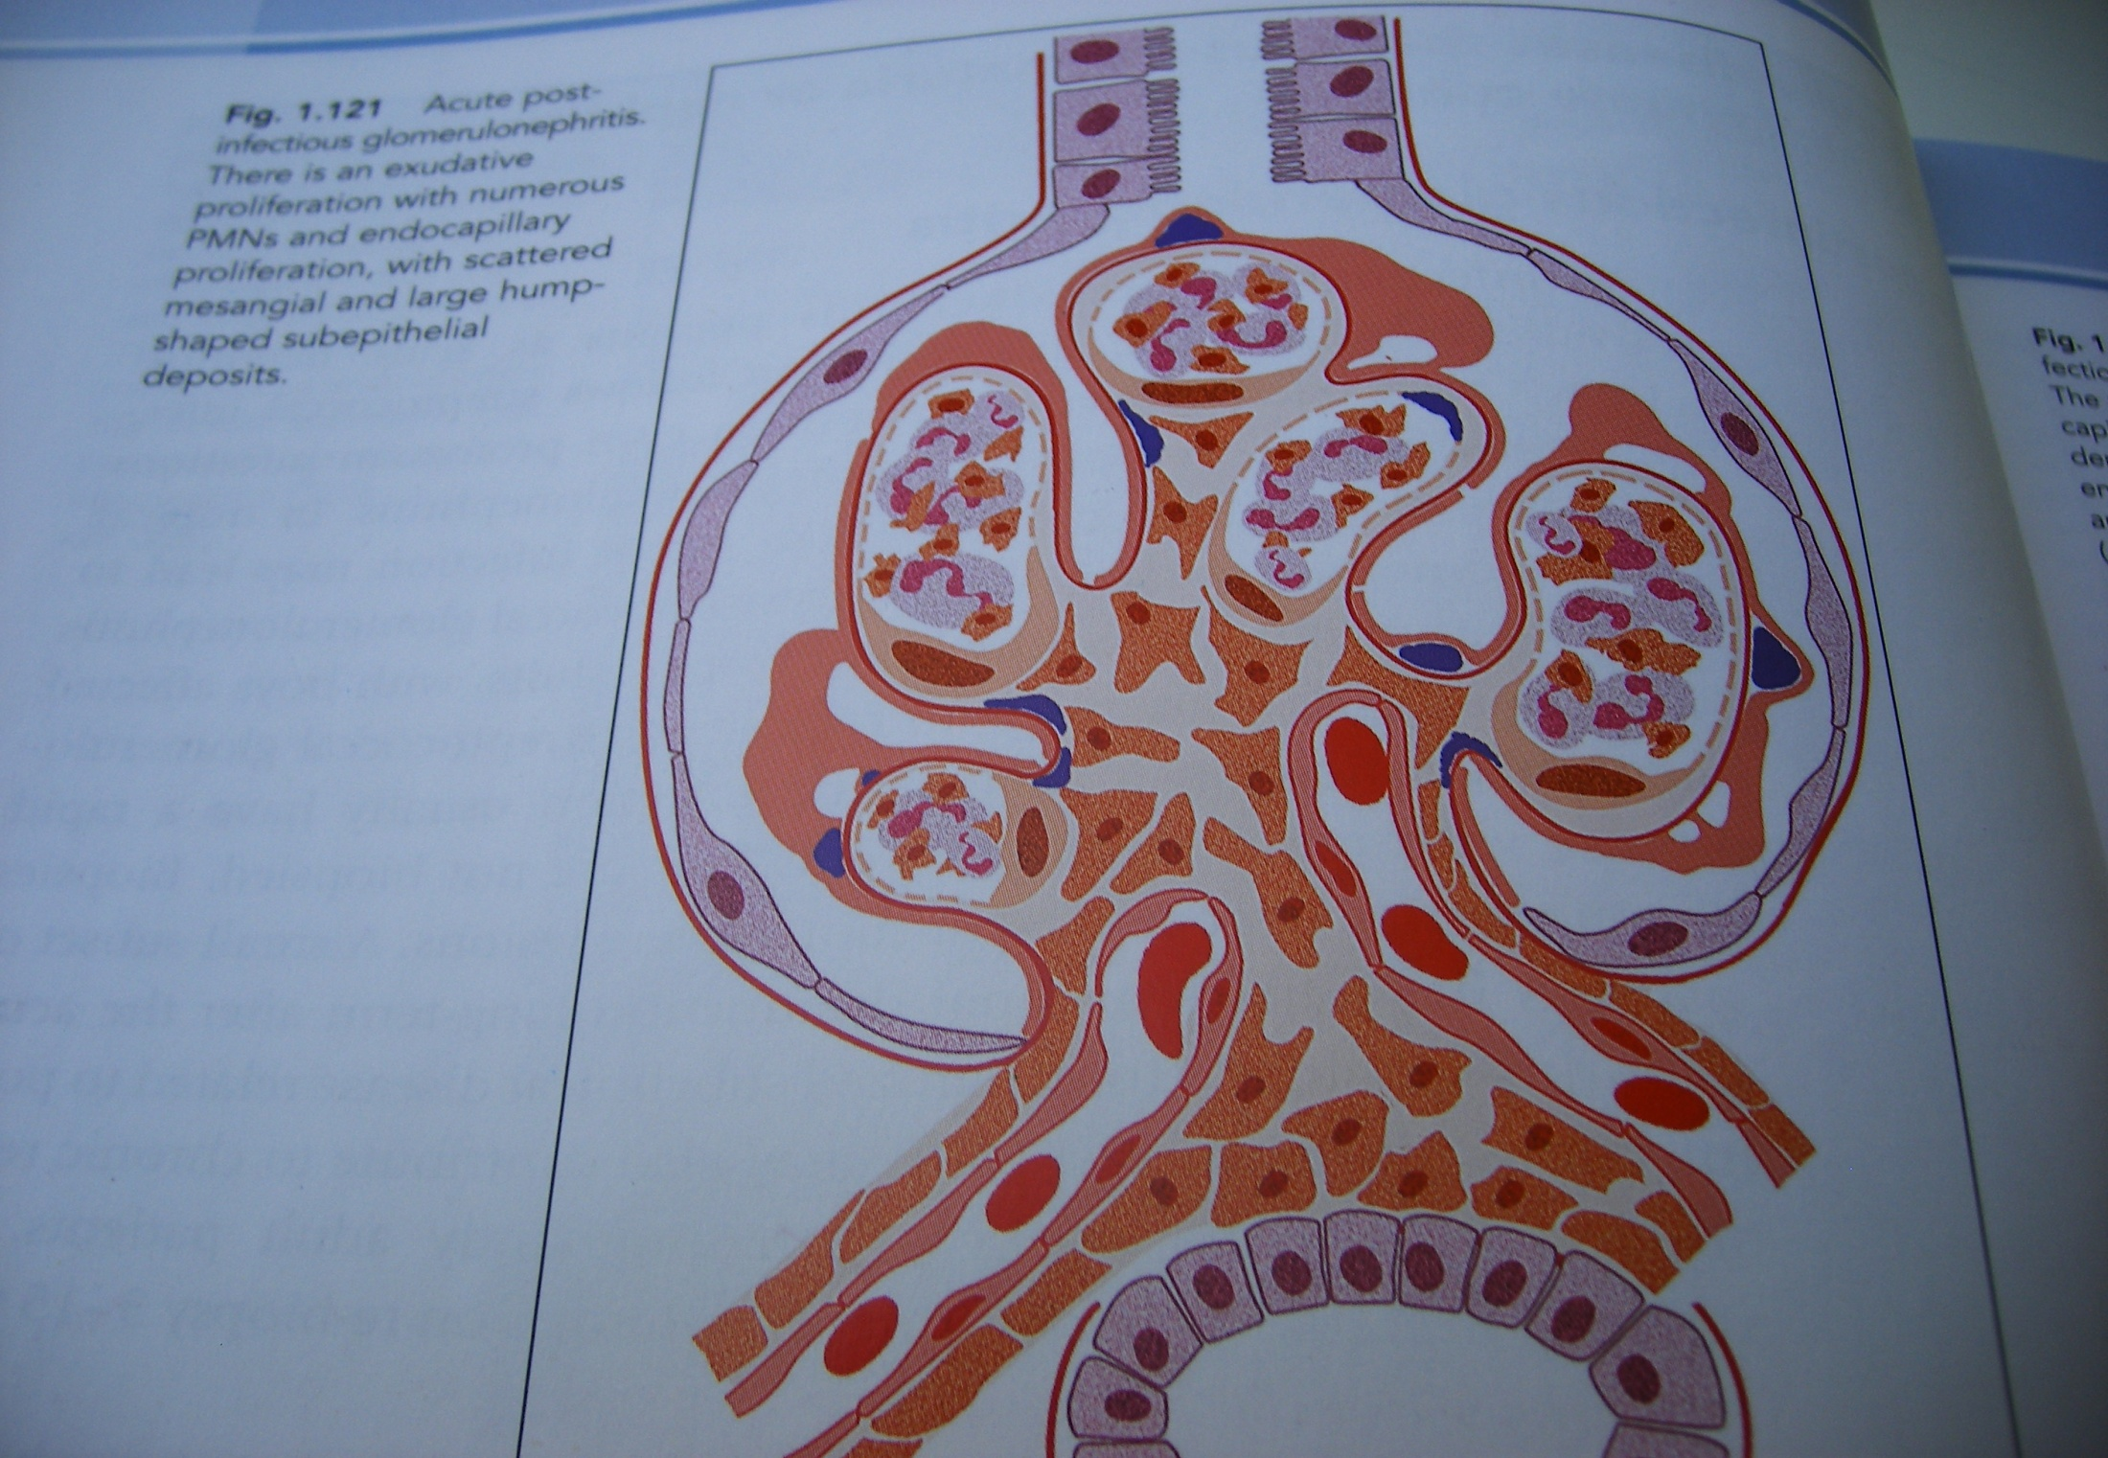

Slide 11
Pathogenesis…
Reduction in GF leading to:-
  Edema formation, HTN, circulatory congestion and encephalopathy
Various cytokines might be the causes of hypertension
Hypertensive encephalopathy
Plasma renin level is low, normal or slightly increased

Slide 12
Pathogenesis …
Three immunofluorescence patterns
  Starry sky – due to coarse irregular deposits along the GBM
  Garland pattern – due to more elongated deposits along the capillary wall- worst prognosis
  Mesangial patterns

Slide 13
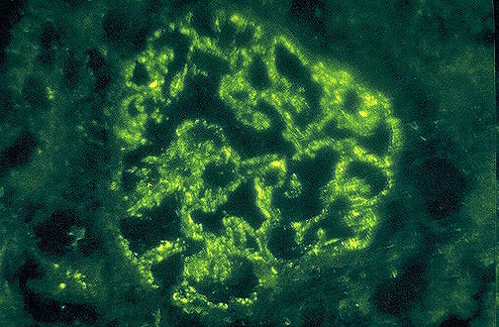
GRANULAR BUMPY DEPOSITS ON I.F

Slide 14
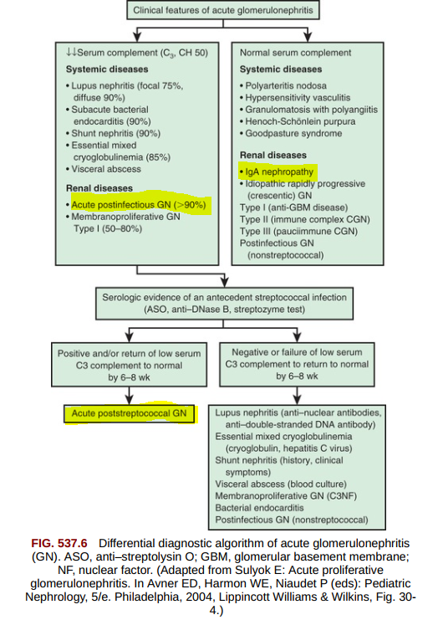

Slide 15
Epidemiology and clinical manifestations
Epidemiology
  Reported as young as 8 months of age,
  Greatest frequency occurs in children 5-12 years
  Uncommon before 3yr.
Clinical
  May be asymptomatic/have sever symptoms
  Gross hematuria and/or edema: ...

Slide 16
Clinical manifestations…
  Insidious onset indicates other forms of renal disease
  Urine usually described as smoky, cola colored,
  Observant parents may note oliguria
  Hypertension is the third cardinal feature, reported

Slide 17
Laboratory studies
Urine
  Glucosuria occasionally,
  Proteinuria is commonly present, rarely exceeds 3+
  Massive proteinuria and a nephrotic picture
  PMNL and renal epithelial cells are common
  Hyaline and/or cellular casts are almost always present
  RBC casts in 60-85% of cases

Slide 18
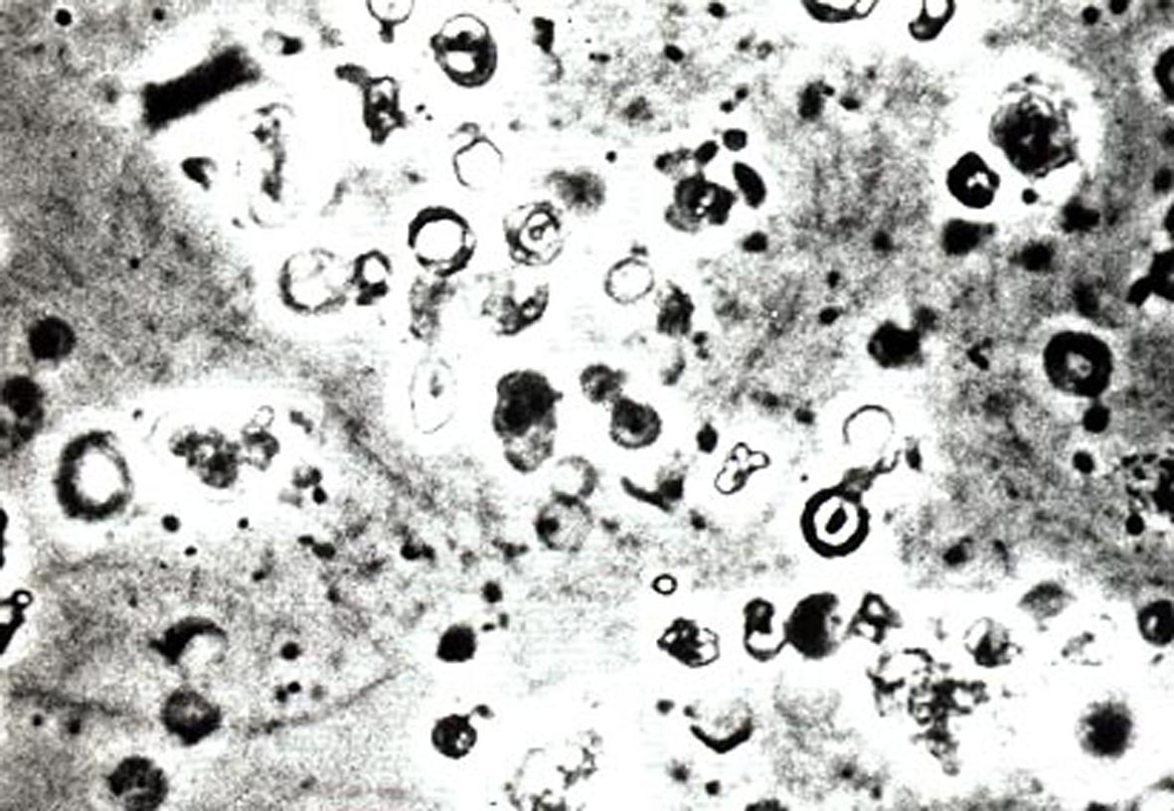
Laboratory – urine sediment

Slide 19
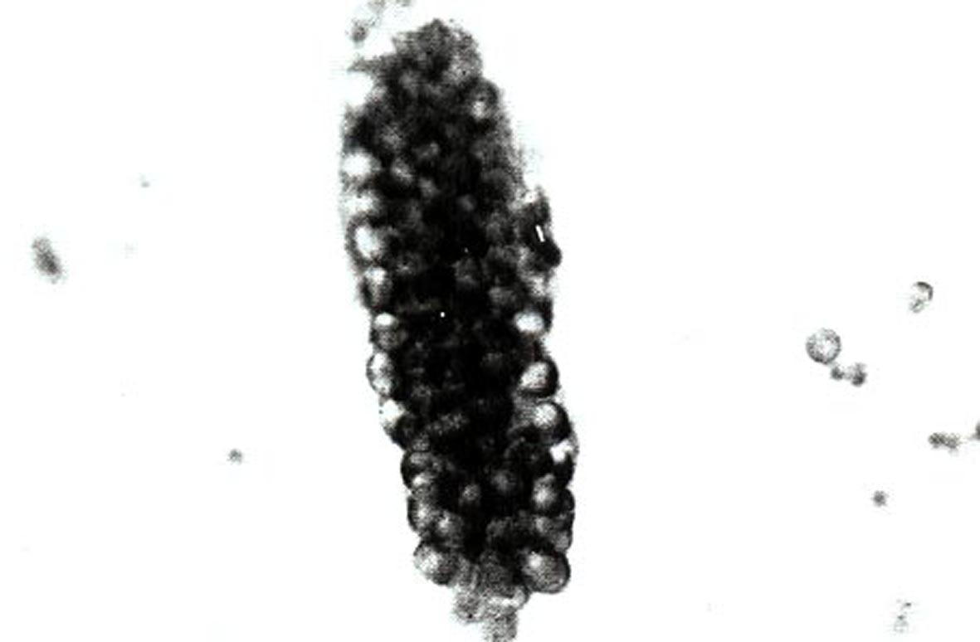
Lab…RBC cast

Slide 20
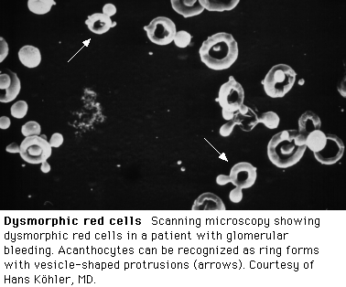
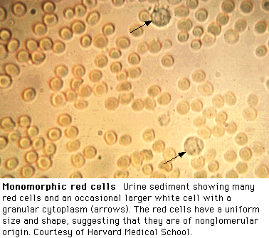

Slide 21
Lab…
Streptococcal infection
  Culture from pharynx or throat may be positive
  Anti-DNase B / ASO titers may be positive
Hemolytic complement
  Total hemolytic complements are low
  C3 decreased

Slide 22
Lab …
C4 levels are most often normal
C5 and properdin are usually decreased
Renal
RF impairment correlates directly to the severity of glomerular injury
  Elevated creatinine and BUN in severe azotemia

Slide 23
Lab …
Electrolyte profile is usually normal,
  ↑K⁺ and metabolic acidosis in severe functional impairment
Total serum calcium may be low in patients who have NS
Blood
A mild anemia (normocytic, normochromic)
  Erythropoiesis may decline in the after month of AGN
Hypoproteinemia and hyperlipidemia

Slide 24
Lab...
Imaging studies
Renal U/S :
  Demonstrates normal to slightly enlarged kidneys with echogenicity

Slide 25
Lab ...
Renal biopsy should be considered:
  Nephrotic syndrome,
  Absence of evidence of streptococcal infection
  Normal complement levels
  When hematuria and proteinuria, diminished renal function, and/or a low C3 level persist more than 2 mo after onset.

Slide 26
Treatment …
Directed at treating the acute effects of
  Renal insufficiency and hypertension.
Decision to admit the child
Control of hypertension
  Mild-to-moderate HTN: Rx with bed rest, fluid restriction
  Lasix, nifedipine
  ACEIs are effective if no renal impairment
  Osmotic diuretics such as mannitol are contraindicated.

Slide 27
Treatment ...
A course of penicillin administered
Steroid therapy: severe crescentic GN or in those with RPGN
Diet
  A low Na⁺, low-protein diet during the acute phase
Activity
  Limited activity during the early phase
Follow up

Slide 28
Prognosis
Prognosis depends on the severity of the initial insult
  C/F rarely recur after the first 3 months,
  Second episodes of AGN are uncommon.
  Edema usually resolves within 5-10 days,
  HTN & proteinuria usually resolves within 4-6 weeks.

Slide 29
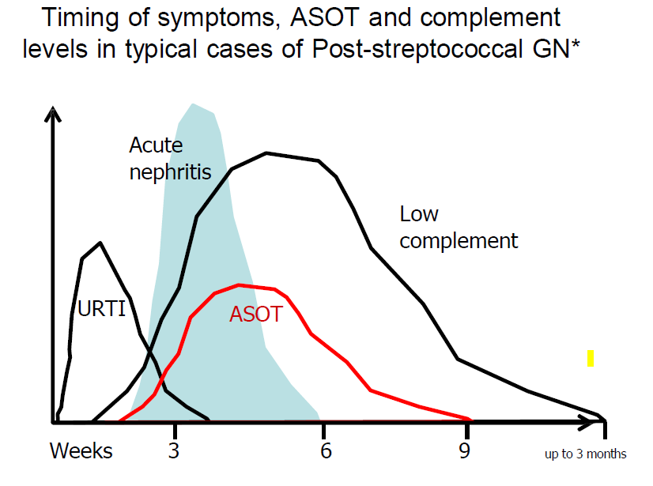

Slide 30
Prognosis…
Gross hematuria disappears within 1-3 weeks,
Microscopic hematuria may persist:
C3 returns to normal within 6-8 weeks after onset in 95%.
Complete recovery occurs in > 95% of children with APSGN.
CKD in < 2% of affected children

Slide 31
IgA or Berger nephropathy
Characterized by:
  Predominance of IgA deposits within mesangial glomerular in the absence of systemic disease.
Most common chronic glomerular disease
More common in male

Slide 32
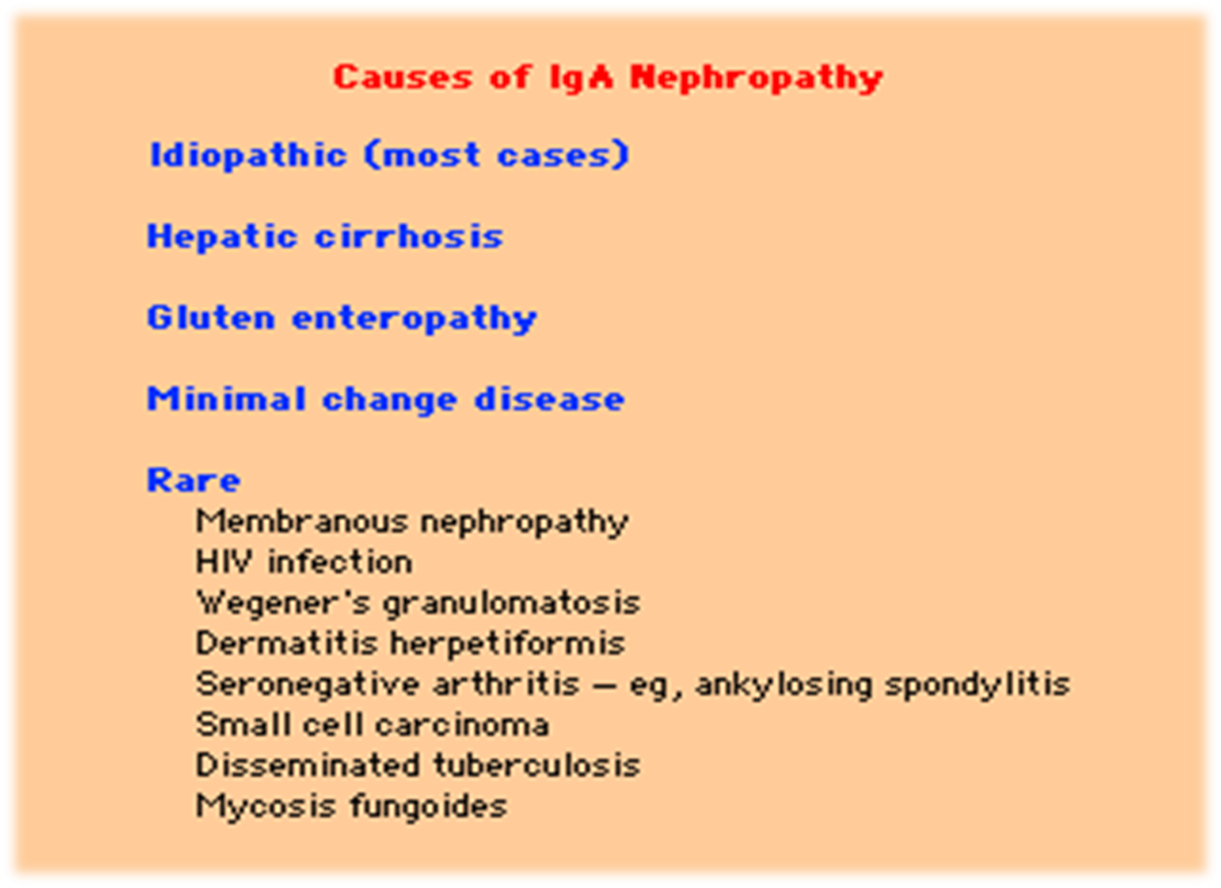

Slide 33
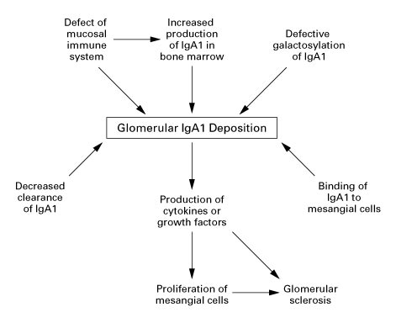
Pathogenesis

Slide 34
Pathology
Variable
  Minimal mesangial expansion
  Diffuse proliferative lesion with crescents or widespread sclerosis
  Often mesangial area increase due to increase in both mesangial cells, matrix and deposits.

Slide 35
IgA nephropathy…
Clinical and Lab findings
Five main presentations
  Macroscopic hematuria
  Asymptomatic microscopic hematuria with or without proteinuria
  Acute nephritis – hematuria, proteinuria, hypertension, renal failure
  Nephrotic syndrome ( < 10%)
  Mixed nephrotic/nephritic state

Slide 36
IgA nephropathy...
Macroscopic hematuria-
  Commonest mode of presentation following URTI
  Latent period 1-2 days
Elevated serum IgA in 15% of cases
Serum complement is typically normal
Diagnosis: Renal biopsy

Slide 37
WHO classification of IgA Nephropathy
Minimal lesion
Minor changes with small segmental proliferation
Focal and segmental GN ( <50% involved)
Diffuse mesangial lesion with proliferation and sclerosis
Diffuse sclerosing GN affecting >80% of glomeruli

Slide 38
Treatment
Primary treatment is appropriate Bp control
  ACEIs/ARBs
Controversial
  Fish oil??
  Steroid??
  Tonsillectomy??

Slide 39
Prognosis
Worse prognosis:
  In older male patients with:
    Hypertension,
    Marked proteinuria,
    ↑Cr at presentation and persistent microscopic hematuria
Progressive disease: 20-30% of patients after15-20 yrs..

Slide 40
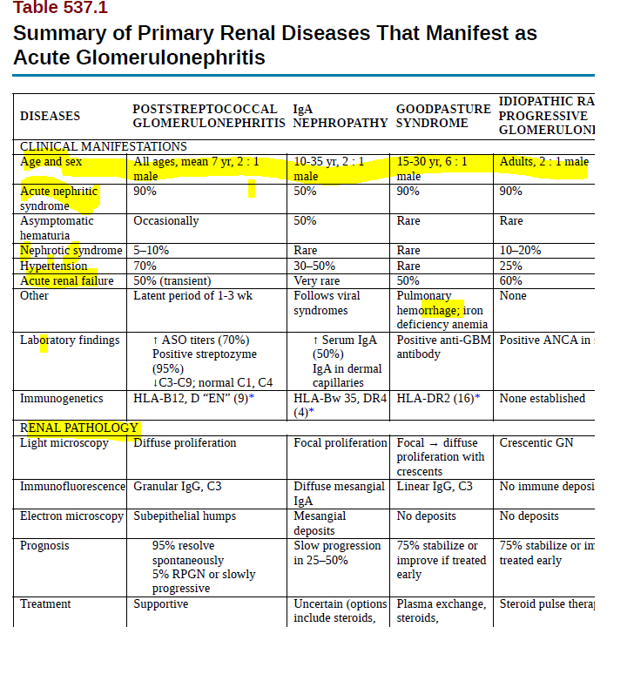

Slide 41

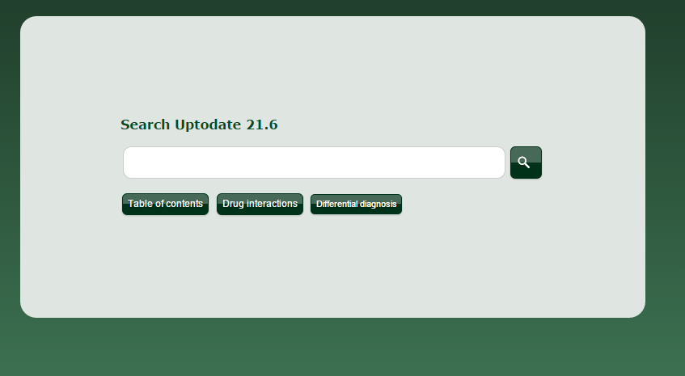

References

Slide 42

Thank You

Slide 43
NEPHROTIC SYNDROME
Gemechu Edae ( MD, Assistant professor of pediatrics
Dept of Peds, CHS, AU )

Slide 44
Outline
Definitions
Classification
Epidemiology
Pathogenesis
Clinical features
Treatment
Prognosis

Slide 45
Nephrotic Syndrome (NS)
Definitions
NS
  A syndrome characterized by:
    Proteinuria
    Hypoalbuminemia ( <2.5g/dl)
    Edema and
    Hyperlipidemia
  Nephrotic proteinuria – urinary excretion > 1 g/m² /day (40 mg/m²/hr) or a first morning protein : creatinine ratio of >2-3:1

Slide 46
Classification
Etiologic
  Primary/Idiopathic
    associated with primary glomerular disease
  Secondary: Occurs as part of recognized systemic disease
    Post infectious (GAS., Syphilis, malaria, TB and viruses
    Collagen vascular disease (SLE, RA, polyarteritis nodosa)
    Drugs (mercury, gold, porbencid, captopril…)
    HSP, SCD, DM, malignancy (leukemia, lymphoma, wilm’s tumor)

Slide 47
Classification…
    Congenital NS
Histologic
  Minimal lesion NS
  Diffuse mesangial hypercellularity
  Focal glomerulosclerosis
  Membranous glomerulonephritis
  Membranoproliferative glomerulonephritis

Slide 48
Epidemiology
Incidence 2-7/100,000 children per year
Primary NS accounts for approximately 90% of all cases
Age of onset and sex incidence varies with the type of NS
The most common type of NS in children is Minimal lesion NS

Slide 49
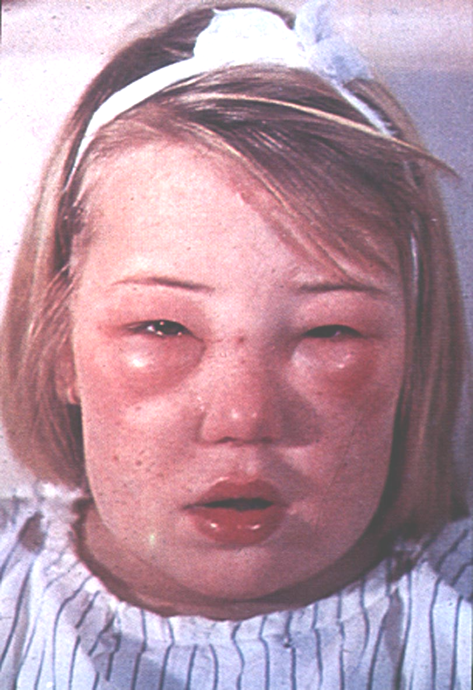
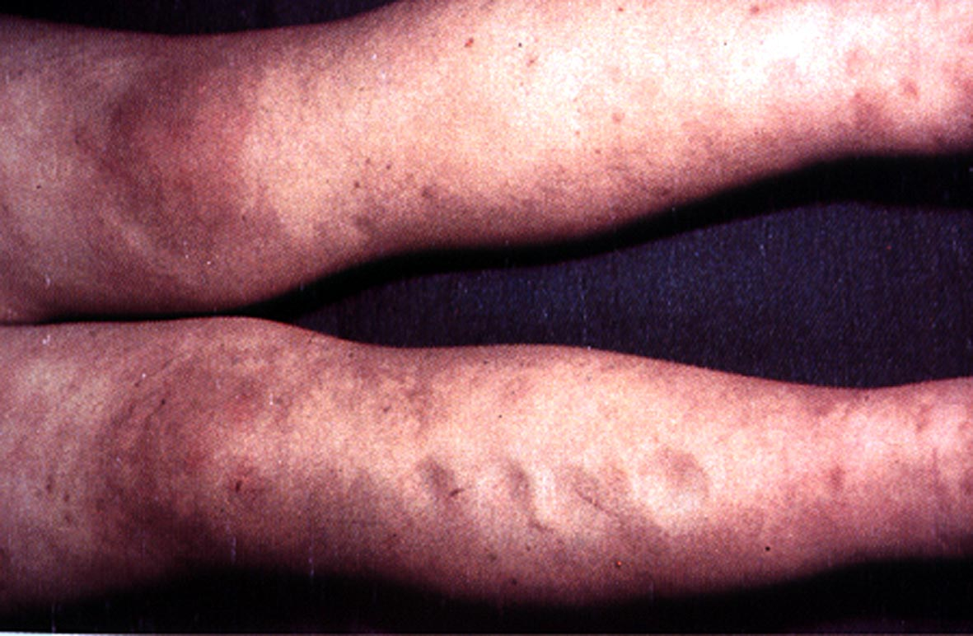
Nephrotic syndrome
Primarily a pediatric disorder
15 times more common in children than adults.

Slide 50
Glomerular handling of proteins
Glomerular capillary wall has three components:
The fenestrated endothelial cell
The glomerular basement membrane (GBM)
The epithelial cell foot processes - the pores between the epithelial foot processes are closed by a thin membrane called the slit diaphragm

Slide 51
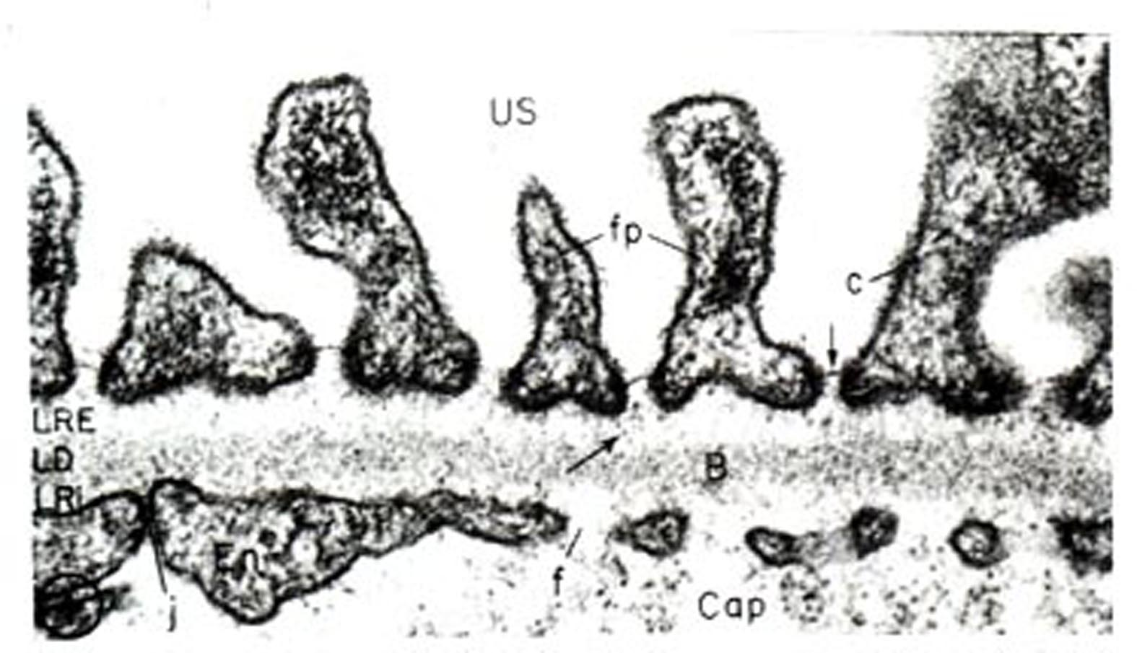
Glomerular capillary wall

Slide 52
Glomerular handling…/2
Filtration barrier by:
  Size (albumin “not allowed”) : the endothelial cell is not part of the size barrier
  Charge (heparan sulphate glycosaminoglycan), the endothelial cell and GBM are negatively charged
  Slit diaphragm proteins (nephrin, podocin, etc.) Essential for prevention of protein filtration

Slide 53
Mechanisms of increased protein excretion:
Glomerular proteinuria
Commonest cause in children
Due to increased filtration of macromolecules like albumin
May be due to anatomic or functional lesions
The cause might be fever, exercise, or orthostatic

Slide 54
Tubular proteinuria:
Due to reduced reabsorption of low molecular weight proteins in the proximal tubule
Beta-2 and alpha-1 microglobulins and retinol binding protein are excreted
usually associated with the Fanconi syndrome, glycosuria, phosphaturia, PRTA, cystinuria…or tubulointerstial nephritis

Slide 55
Overflow proteinuria
Due to increased production of a particular LMWP to a level beyond the absorptive capacity of the proximal tubule.
Increased production of Ig light chains in multiple myeloma, usually in adults is an example

Slide 56
Idiopathic (Minimal Lesion) NS
Accounts for approximately 90% of nephrosis in childhood
It occurs in three morphologic patterns:
    Minimal change disease (85%)
    Focal segmental glomerulosclerosis (10%)
    Mesangial proliferative (5%)
Occurs between 2-6 yrs commonly
    But is reported as early as 6 months and throughout adulthood
Male to female ratio is ~ 2:1

Slide 57
Idiopathic…
Pathphysiology
  Results from alteration in the permeability selective characteristics of the GBM
  Protein loss is generally > 2g/24 hr (normal <150 mg/24 hr)
  Protein lost is primarily albumin resulting in hypoalbuminemia
  Edema appears when serum albumin falls below 2.5 g/dl
  Normal protein excretion in children < 100 mg/m2/day or <4 mg/m2/hr. or a total of 150 mg/d, in the neonates up to 300 mg/d

Slide 58
Pathophysiology......
The normal low rate of protein excretion is due to:
Restriction of filtration of proteins across the GBM
Reabsorption of the filtered proteins by the proximal tubule

Slide 59
Idiopathic…
  Serum level of almost all lipids is increased as a result of increases in lipoprotein synthesis and low levels of lipoprotein lipase
Clinical Manifestations
  Attacks may follow URTI
  Usually presents
    With edema, initially noted in periorbital area and lower extremities
    Edema becomes generalized with time
    Some may present with hypotension

Slide 60
Atypical features
Infants and children >10yrs
Positive family history of NS
Presence of extra renal symptoms like rash, arthritis, anemia
Hypertension
Renal insufficiency
Gross hematuria

Slide 61
Idiopathic…
    Rarely may develop renal failure as a result of the hypotension
    With massive pleural effusion and ascites, patients may develop dyspnea
    Unlike nephritic syndrome, gross hematuria and hypertension are uncommon

Slide 62
Idiopathic…
Lab findings
  Urinalysis reveals proteinuria of +3 or +4 on dipstick
  Serum albumin - <2.5 g/dl
  High serum cholesterol and triglyceride level
  Normal C3 level
  Renal biopsy - is indicated in children with:
    Gross hematuria, HTN, renal insufficiency, hypocomplementemia and whose age is <1 yr or >8yr

Slide 63
Complications
  Infection
  Commonest infection is spontaneous peritonitis
    Commonest cause – strep. Pneumoniae
  Other infections include
    Pneumonia, cellulitis, sepsis and UTI
Hypercoagulability
ARF
Malnutrition

Slide 64
DDx for edematous child
Protein losing enteropathy
Hepatic failure
Heart failure
SAM
Acute or chronic GN

Slide 65
Idiopathic…
Treatment
General
  Children with mild to moderate edema can be managed as outpatient
  Salt restriction
  High protein diet
  Diuretics can be used cautiously to reduce severe form of edema:
    Frusemide
    Albumin
    Careful monitoring of RF and electrolytes

Slide 66
Idiopathic…
2. Steroids
Consideration:..
  Prednisolone – given in a dose of 60 mg/m² /24 hr or 1-2 mg/kg/24 hr (Max. 80 mg/24 hr) in 3 or 4 divided dose for at least 4 wks
    80-90% of patients respond in a median time of 10 days to remission
  After the initial 4-6 wk course, Prednisolone should be tapered to 40 mg/m²/24 hr every other day every morning

Slide 67
Idiopathic…
  The alternate day dose is slowly tapered over the next 2-3 months
Response to steroids
    >95% with minimal change NS
    ~50% with mesangial proliferation NS
    ~20% with focal glomerulosclerosis NS
Cytotoxic drugs
  Cyclophosphamide – used in frequently relapsing NS or in severe steroid toxicity or in steroid resistant NS

Slide 68
Definitions…
Steroid responsive NS
  Disappearance of the proteinuria within 8 wks of starting treatment with a corticosteroid
Steroid resistance NS
  When there is no remission after 8 wks of treatment with steroid
Steroid dependent NS
  When a patient is unable to discontinue corticosteroid use without experiencing a relapse

Slide 69
Definitions…
Remission of NS
  When urine is negative or trace for protein for a period of at least 3 days
Relapse of NS
  The occurrence of proteinuria measuring 2+ or more on 3 consecutive days in a patient who is in remission
Frequently relapsing course
  Greater than 2 relapse of NS with in 6 months

Slide 70
Idiopathic…
Prognosis
  Most children with steroid responsive NS have repeated relapses till the end of 2nd decade

Slide 71
THANK YOU
ANY QUESTIONS ?

Slide 72
UTI
Gemechu Edae ( MD, Assistant professor of pediatrics
Dep't of Peds, CHS, AU )
April 05, 2022

Slide 73
Learning objective
List etiology and prevalence of UTI
Classify UTI
Explain pathogenesis of UTI
List risk factor of UTI
Outline diagnosis and treatment of child with UTI

Slide 74
UTI
Infection in any part of urinary system
Prevalence and Etiology
  Occur in 4-7% of infants & 3-5% of school age children with FEVER
  3-5% of girls and 1% of boys affected
  In girls average age at first diagnosis – 3 yrs.
  In boys – first yr of life
  First year – M:F ratio is 2.8:5.4
  Beyond 2 yr – M:F ratio is 1:10
  Mainly caused by colonic bacteria

Slide 75
UTI…
  In females 75-90% caused by E. coli followed by Klebsiella and proteus
  In males > 1 yr proteus is as common as E. coli
  Other causes are viral (adenovirus) – especially in cystitis
Classification
  Complicated vs. uncomplicated;
  Three basic forms:

Slide 76
UTI…
Pyelonephritis
  Manifests with any or all of the following:
    Abdominal or flank pain, fever, malaise, vomiting, jaundice in neonates
    Some newborns may show non specific symptoms such as poor feeding, irritability and weight loss
  Acute form may result in renal scarring
Cystitis
  Indicate bladder involvement, and manifest:
    With dysuria, urgency, frequency, supra-pubic pain, incontinence and malodorous urine

Slide 77
UTI…
Asymptomatic Bacteriuria
    A positive urine culture with out any manifestation of infection
    Occurs exclusively in girls
    Benign and does not cause renal injury
    Rx:..
Pathogenesis
  Ascending infection from fecal flora
  Rarely hematogenous
  Infected urine gets to intra-renal area ➞ inflammatory response ➞ renal injury and scarring

Slide 78
UTI…
Risk Factors
Female Uncircumcised male Vesico-urethral reflux Toilet training Voiding dysfunction Obstructive uropathy Urethral instrumentation Wiping from back to front Pregnancy | Tight underwear Pinworm infestation Constipation Anatomic abnormalities Neurogenic bladder Sexual activities

Slide 79
UTI…
Diagnosis : ....
Urine culture; depends on having proper urine sample:
  In toilet trained children
    Mid-stream urine
    If > 100,000 colonies of a single pathogen or
    If 10,000 colonies and child is symptomatic ~ UTI
    In uncircumcised children prepuce must be retracted

Slide 80
UTI…
  In infants
    Sterile collection bag after skin disinfection may help to avoid contamination
    Symptoms + > 100,000 colonies ~ Presumed UTI
    If above is not possible, catheterization needed for urine collection
Urinalysis
    Pyuria (leucocytes in urine) suggests infection, but infection can occur with out pyuria or pyuria can occur with out infection

Slide 81
Interpretation of culture results in children:
single organism >10⁶ cfu/L (10³ cfu/mL) may indicate UTI in voided urine
any growth from a supra-pubic aspirate is significant
pyuria >107 WBC/L (104 WBC/mL) usually indicate UTI, especially with clinical symptoms but may be absent

Slide 82
UTI…
    Positive Nitrites and leukocyte esterase
    Microscopic hematuria ( especially in cystitis)
    WBC casts
Hematology
    Leukocytosis, neutrophilia, elevated ESR and CRP are common
Treatment
  Acute cystitis
    Trimethoprim – Sulfamethoxazole or
    Nitrofurantoin or
    Amoxicillin for 5 days

Slide 83
UTI…
AFI suggestive of Pyelonephritis
    Ceftriaxone or
    Ampicillin + Aminoglycoside for 10-14 days

Slide 84
Thank You

