Slide 1
NEPHROTIC SYNDROME
Gemechu Edae ( MD, Assistant professor of pediatrics
Dept of Peds, CHS, AU )
August 20, 2024

Slide 2
Outline
Definitions
Classification
Epidemiology
Pathogenesis
Clinical features
Treatment
Prognosis

Slide 3
Nephrotic Syndrome (NS)
Definitions
NS
  A syndrome characterized by:
    Proteinuria
    Hypoalbuminemia ( <3g/dl)
    Edema and
    Hyperlipidemia(cholesterol > 200 mg/dL).
  Nephrotic range proteinuria – urinary excretion > 1 g/m² /day (40 mg/m²/hr) or a first morning protein : creatinine ratio of >2:1

Slide 4
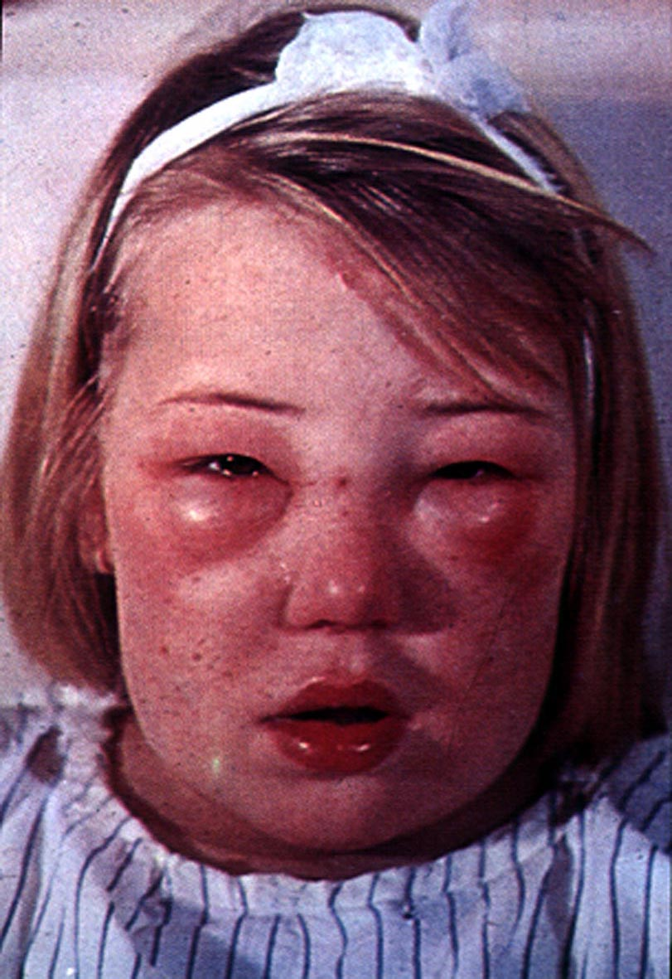
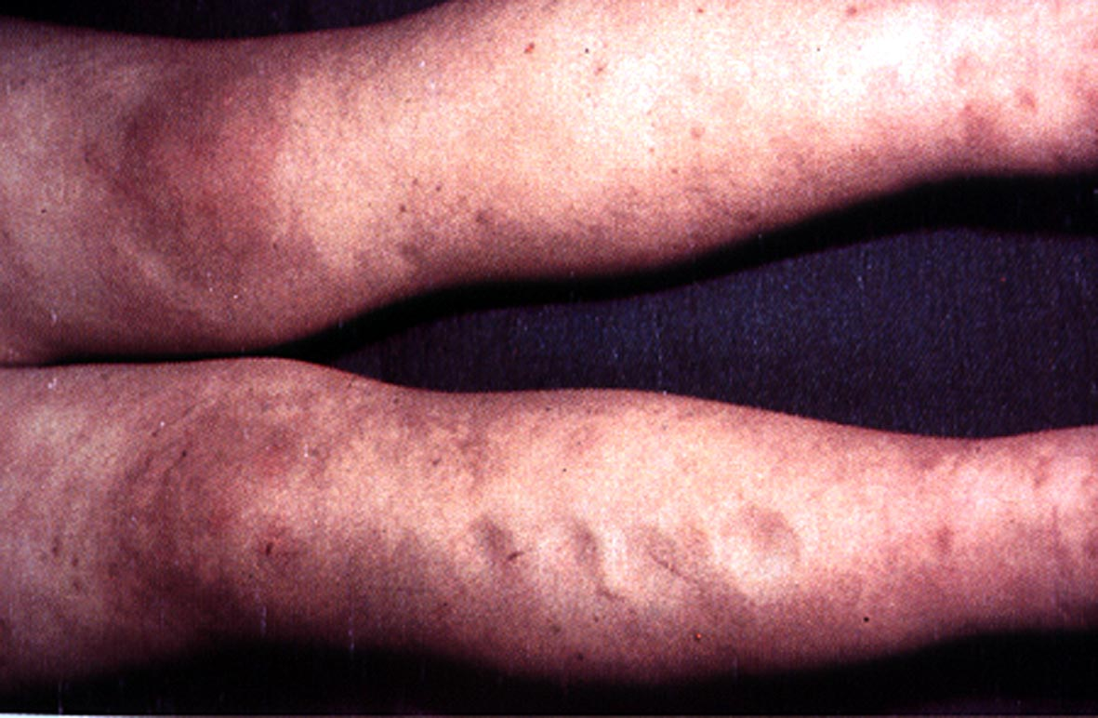
Nephrotic syndrome
Primarily a pediatric disorder
15 times more common in children than adults.

Slide 5
Classification
Etiologic
  Primary
    associated with primary glomerular disease
  Secondary
    Occurs as part of recognized systemic disease or results from some evident cause; possible causes are as follows:
    Post infectious (G-A β-hemolytic strep., Syphilis, malaria, TB and viruses
    Collagen vascular disease (SLE, RA, polyarteritis nodosa)
    Drugs (mercury, gold, porbencid, captopril…)

Slide 6
Classification…
    HSP, sickle cell disease, DM, malignancy (leukemia, lymphoma, wilm’s tumor)
Histologic
  Minimal lesion NS
  Diffuse mesangial hypercellularity
  Focal glomerulosclerosis
  Membranous glomerulonephritis
  Membranoproliferative glomerulonephritis

Slide 7
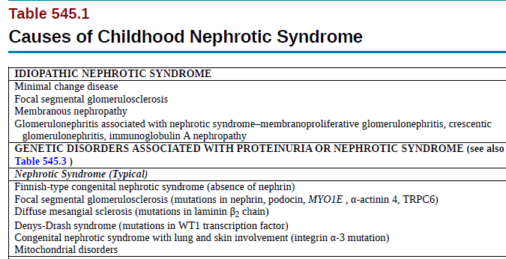

Slide 8
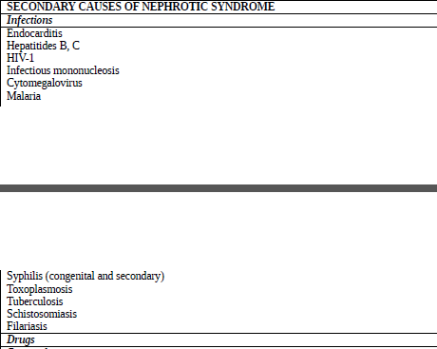

Slide 9
Epidemiology
Incidence 1-3 per 100,000 children/year , < 16 yr of age.
Primary NS accounts for approximately 90% of all cases
Age of onset and sex incidence varies with the type of NS
The most common type of NS in children is Minimal lesion NS

Slide 10
Glomerular handling of proteins
Glomerular capillary wall has three components:
The fenestrated endothelial cell
The glomerular basement membrane (GBM)
The epithelial cell foot processes - the pores between the epithelial foot processes are closed by a thin membrane called the slit diaphragm

Slide 11
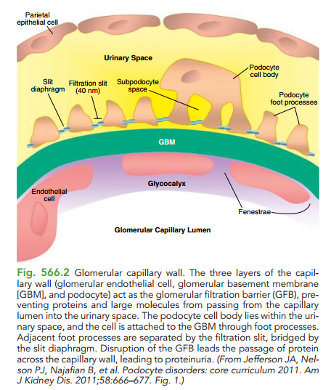

Slide 12
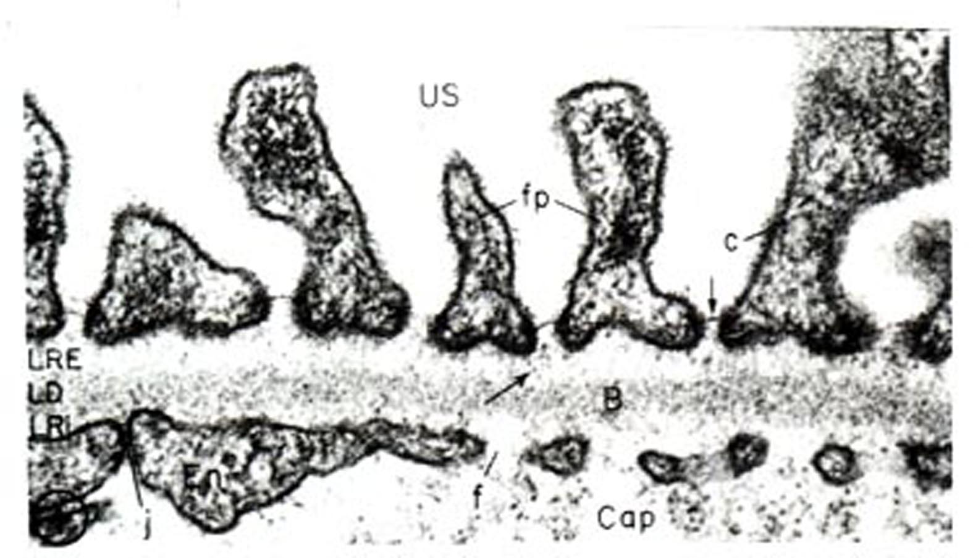
Glomerular capillary wall

Slide 13
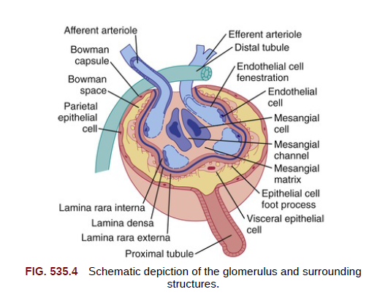

Slide 14
Glomerular handling…/2
Filtration barrier by:
  Size (albumin “not allowed”) : the endothelial cell is not part of the size barrier
  Charge (heparan sulphate glycosaminoglycan), the endothelial cell and GBM are negatively charged
  Slit diaphragm proteins (nephrin, podocin, etc.) Essential for prevention of protein filtration

Slide 15
Mechanisms of increased protein excretion:
Glomerular proteinuria
Commonest cause in children
Due to increased filtration of macromolecules like albumin
May be due to anatomic or functional lesions
The cause might be fever, exercise, or orthostatic

Slide 16
Mechanisms of increased protein excretion:
Tubular proteinuria:
Due to reduced reabsorption of low molecular weight proteins in the proximal tubule
Beta-2 and alpha-1 microglobulins and retinol binding protein are excreted
usually associated with the Fanconi syndrome, glycosuria, phosphaturia, PRTA, cystinuria…or tubulointerstial nephritis

Slide 17
Mechanisms of increased protein excretion:
Overflow proteinuria
Due to increased production of a particular LMWP to a level beyond the absorptive capacity of the proximal tubule.
Increased production of Ig light chains in multiple myeloma, usually in adults is an example

Slide 18
Idiopathic NS
Accounts for approximately 90% of NS cases in b/n 1-10 years & 50% after 10 years
It occurs in three morphologic patterns:
    Minimal change disease (85%)
    Focal segmental glomerulosclerosis (10%)
    Mesangial proliferative (5%)
Occurs between 2-6 yrs commonly
    But is reported as early as 6 months and throughout adulthood
Male to female ratio is ~ 2:1

Slide 19
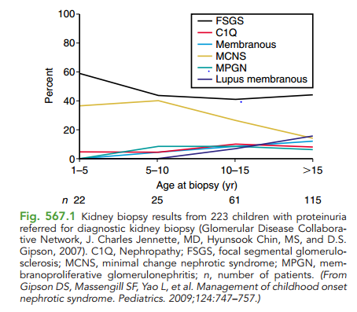

Slide 20
Idiopathic…
Pathphysiology
  Results from alteration in the permeability selective characteristics of the GBM
  Protein loss is generally > 2g/24 hr (normal <150 mg/24 hr)
  Protein lost is primarily albumin resulting in hypoalbuminemia
  Edema appears when serum albumin falls below 2.5 g/dl
  Normal protein excretion in children < 100 mg/m2/day or <4 mg/m2/hr. or a total of 150 mg/d, in the neonates up to 300 mg/d

Slide 21
Pathophysiology......
The normal low rate of protein excretion is due to:
Restriction of filtration of proteins across the GBM
Reabsorption of the filtered proteins by the proximal tubule

Slide 22
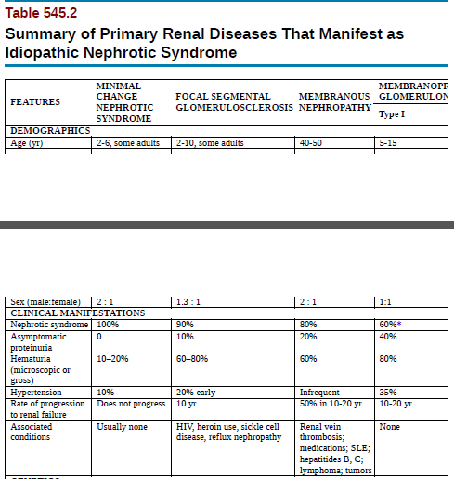

Slide 23
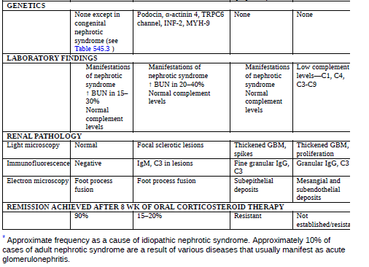

Slide 24
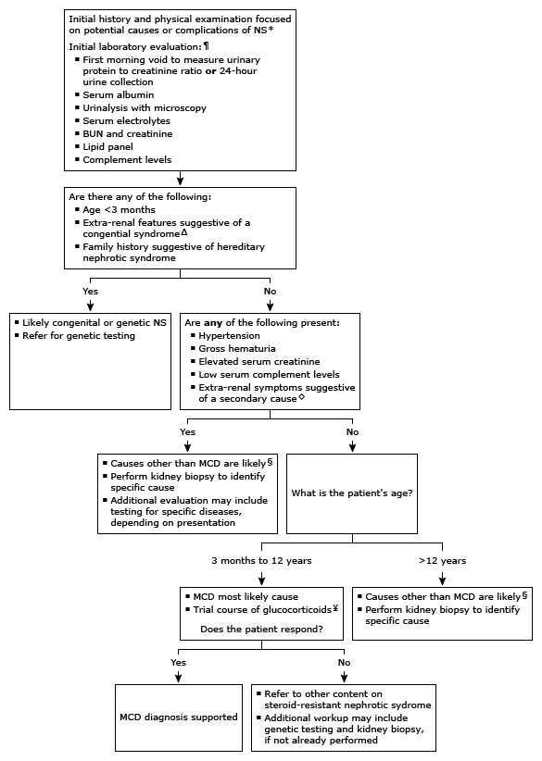
Approach to the infant or child with nephrotic syndrome

Slide 25
Idiopathic…
  Serum level of almost all lipids is increased as a result of increases in lipoprotein synthesis and low levels of lipoprotein lipase
Clinical Manifestations
  Attacks may follow URTI
  Usually presents
    With edema, initially noted in periorbital area and lower extremities
    Edema becomes generalized with time
    Some may present with hypotension

Slide 26
Atypical features
Infants and children >10yrs
Positive family history of NS
Presence of extra renal symptoms like rash, arthritis, anemia
Hypertension
Renal insufficiency
Gross hematuria

Slide 27
Idiopathic…
    Rarely may develop renal failure as a result of the hypotension
    With massive pleural effusion and ascites, patients may develop dyspnea
    Unlike nephritic syndrome, gross hematuria and hypertension are uncommon
Lab findings
  Urinalysis reveals proteinuria of +3 or +4 on dipstick
  Serum albumin - <3 g/dl
  High serum cholesterol and triglyceride level

Slide 28
Idiopathic…
  Normal C3 level , electrolytes, RFT, CBC
  Renal biopsy - is indicated in children with:
    Macroscopic hematuria, hypertension, renal insufficiency, hypocomplementemia, whose age is <1 yr or >12yr, extra-renal symptoms (ie, malar rash, purpura, adenopathy), steroid resistant

Slide 29
    Complications
  Infection is the major complication
  Commonest infection is spontaneous peritonitis
    Commonest cause – strep. Pneumoniae
  Other infections include
    Pneumonia, cellulitis, sepsis and UTI
Thromboembolism
Renal insufficiency
Anasarca
Hypovolemia….

Slide 30
DDx for edematous child
Protein losing enteropathy
Hepatic failure
Heart failure
SAM
Acute or chronic GN

Slide 31
Idiopathic…
Treatment
The goal of therapy should be a gradual reduction of edema with judicious use of diuretics, sodium restriction, and cautious use of intravenous albumin infusions, if indicated.
General measures: focused on preventing or minimizing complications
  Children with mild to moderate edema can be managed as outpatient
  Salt restriction
  Diuretics can be used cautiously to reduce severe form of edema:
    Frusemide – respiratory distress due to massive pleural effusion and ascites or severe scrotal edema
    Careful monitoring of RF and electrolytes

Slide 32
Treatment…
Infection control
Prevention of infection with vaccination with 23-valent polysaccharide (PPSV23) pneumococcal and varicella vaccines if not previously immunized,
live vaccinations should be avoided during relapse and while on daily immunosuppressive medications.
Identification and treatment of suspected infections

Slide 33
Treatment…
2. Steroids
Consideration:..
  Prednisolone – given in a dose of 60 mg/m² /24 hr or 2 mg/kg/24 hr (Max. 60 mg/24 hr) in 2 divided dose for at least 4 wks
    80-90% of patients respond in a median time of 10 days to remission
  After the initial 4-6 wk course, Prednisolone should be tapered to 40 mg/m²/24 hr every other day every morning

Slide 34
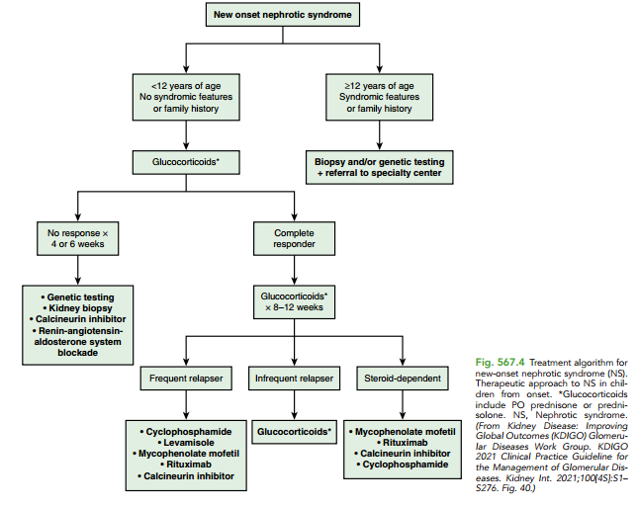

Slide 35
Treatment…
  The alternate day dose is slowly tapered over the next 2-3 months
Response to steroids
    >95% with minimal change NS
    ~50% with mesangial proliferation NS
    ~20% with focal glomerulosclerosis NS
Cytotoxic drugs
  Cyclophosphamide – used in frequently relapsing NS or in severe steroid toxicity or in steroid resistant NS

Slide 36
Treatment response
SRNS is NS resistant to steroid therapy, defined by the absence of complete remission after an initial course of daily prednisone therapy at a dose of 60 mg/m² per day.
Complete remission is resolution of proteinuria defined as a UPCR based on a first morning void or 24-hour collection of ≤0.2 mg prt/mg cr or urine dipstick readings of negative or trace protein on three consecutive days.
Partial remission is a decrease in proteinuria with a UPCR based on first morning void or 24-hour urine sample of >20 but <200 mg/mmol and, if available, serum albumin ≥30 g/L.
Relapse is the recurrence of nephrotic-range proteinuria following either complete or partial remission.

Slide 37
Definitions…
Steroid responsive NS
  Disappearance of the proteinuria within 8 wks of starting treatment with a corticosteroid
Steroid resistance NS
  When there is no remission after 8 wks of treatment with steroid
Steroid dependent NS
  relapsing during taper or within two weeks of discontinuation of steroid therapy

Slide 38
Definitions…
Remission of NS
  When urine is negative or trace for protein for a period of at least 3 days
Relapse of NS
  The occurrence of proteinuria measuring 2+ or more on 3 consecutive days in a patient who is in remission
Frequently relapsing course
  Greater than 2 relapse of NS with in 6 months

Slide 39
Idiopathic…
Prognosis
  Most children with steroid responsive NS have repeated relapses till the end of 2nd decade

Slide 40
References
Nelsons 22 edition
Up To Date

Slide 41
THANK YOU

