Slide 1

Arsi University
College of Health science
Department of pediatrics and child health
PERINATAL ASPHYXIA
By Tejitu U. (Pediatrician)

Slide 2
INTRODUCTION
PNA results from compromised placental or pulmonary gas exchange.
This disorder can lead to hypoxia and hypercarbia in the blood.
Severe hypoxia results in anaerobic glycolysis and lactic acid production first in the peripheral tissues (muscle and heart) and then in the brain.
Notes:
Ischemia (lack of sufficient blood flow to all or part of an organ) is both a cause and a result of hypoxia.
Hypoxia and acidosis can depress myocardial function, leading to hypotension and ischemia.
Ischemia can impair oxygen delivery, causing further compromise, as well as disrupt delivery of substrate and removal of metabolic and respiratory by-products (eg, lactic acid, carbon dioxide).

Slide 3
Terminology
Hypoxemia:- decreased arterial concentration of oxygen.
Hypoxia:- decreased oxygenation to cells or organs.
Ischemia:- refers to blood flow to cells or organs that is insufficient to maintain their normal function.
Asphyxia :- refers to progressive hypoxia, hypercarbia and acidosis.

Slide 4
Conti…
Neonatal encephalopathy- a clinical term describing an abnormal neurobehavioral state (altered level of consciousness)
Hypoxic-ischemic encephalopathy (HIE)- describes clinical evidence of encephalopathy a hypoxic-ischemic (HI) mechanism.

Slide 5
Neonatal encephalopathy
A heterogeneous, clinically defined syndrome characterized by disturbed neurologic function in the earliest days of life.
Manifested by a reduced level of consciousness or seizures .
often accompanied by difficulty with initiating and maintaining respiration.
Depression of tone and reflexes
Causes 23% of all neonatal deaths worldwide

Slide 6
ACOG definition/criteria for PNA
Apgar score of <5 at 5 minutes and 10 minutes.
Fetal umbilical artery pH <7.0, or base deficit ≥12 mmol/L, or both
Acute brain injury seen on brain MRI or magnetic resonance spectroscopy consistent with hypoxia–ischemia
Presence of multisystem organ failure consistent with hypoxic–ischemic encephalopathy

Slide 7
Risk factors
Antepartum conditions
Abnormal maternal oxygenation (eg, severe anemia, cardiopulmonary disease)
Inadequate placental perfusion and/or gas exchange (eg, maternal hypertension or severe hypotension, placental insufficiency caused by vascular disease)
Congenital infection or anomalies

Slide 8
Conti…
Intrapartum events
Interruption of umbilical circulation
(eg, true knot, cord prolapse, cord avulsion)
Inadequate placental perfusion and/or gas exchange
(eg, placental abruption, uterine rupture, severe maternal hypotension, abnormal uterine contractions)
Traumatic delivery (eg, shoulder dystocia, difficult breech extraction)
Abnormal maternal oxygenation (eg, pulmonary edema)

Slide 9
Conti…
Postnatal disorders (10%)
  Persistent pulmonary hypertension of the newborn (PPHN)
  Severe circulatory insufficiency (eg, acute blood loss, septic shock)
  Congenital heart disease

Slide 10
ETIOLOGY
MATERNAL FACTORS | hypertension (acute or chronic), hypotension, infection (including chorioamnionitis), hypoxiafrom pulmonary or cardiac disorders, diabetes, maternal vascular disease, and in utero exposure to cocaine
PLACENTAL FACTORS | abnormal placentation, abruption, infarction, fibrosis, or hydrops
UTERINE RUPTURE
UMBLICAL CORD ACCIDENTS | prolapse, entanglement, true knot, compression
ABNORMALITIES OF UMBLICAL VESSELS
FETAL FACTORS | anemia (e.g., from fetal-maternal hemorrhage), infection, cardiomyopathy, hydrops, severe cardiac/circulatory insufficiency
NEONATAL FACTORS | cyanotic congenital heart disease, persistent pulmonary hypertension of the newborn (PPHN), cardiomyopathy, other forms of neonatal cardiogenic and/or septic shock, respiratory failure due tomeconium aspiration syndrome, neonatal pneumonia, pneumothorax,

Slide 11
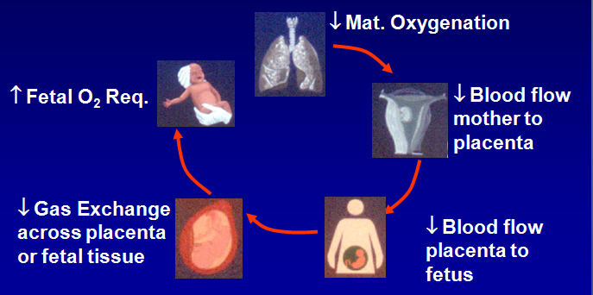
Pathophysiology

Slide 12
  After an episode of hypoxia and ischemia
  Decreased ATP
  Increased lactate and inorganic phosphates
  Accumulation of toxic aminoacid like glutamate
  Overactivation of NMDA,AMPA, and kainite receptors
  .
  Increased cellular permeability to sodium and calcium ions
  cytotoxic edema and neuronal death

Slide 13
Mechanism of hypocalcemia in PNA
Hyperphosphatemia:- Increased endogenous phosphate load due to tissue catabolism
Delayed introduction of feeds
Increased calcitonin production
Renal failure
Metabolic acidosis
Its treatment with alkali therapy

Slide 14
Acute asphyxia
Diving seal reflex
Shunting of blood to brain, adrenals & heart
Asphyxia continues
Anterior Circulation Suffers
Away from lungs, kidney, skin gut & skin
Posterior Circulation Maintained
NONE BRAIN ORGAN DAMAGE
Shunting within the brain
CEREBRAL CORTICAL LESIONS

Slide 15
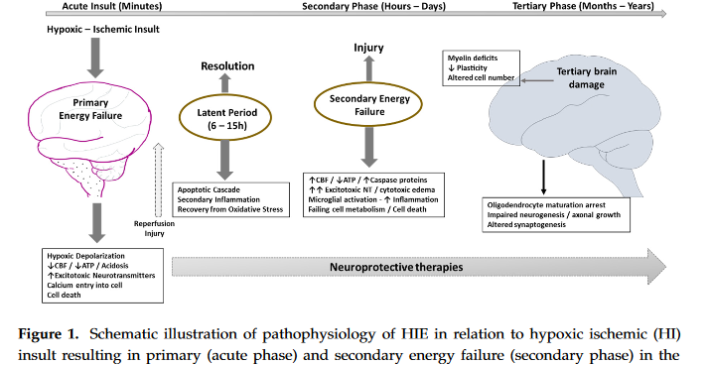

Slide 16
Conti...
The magnitude of the final neuronal damage depends
➔ Initial insult
➔ Damage due to energy failure
➔ Reperfusion injury
➔ Apoptosis

Slide 17
Pathology
Target organs damage of perinatal asphyxia
  Kidneys 50%
  Brain 28%
  Heart 25%
  Lung 23%
  Liver, Bowel, Bone marrow < 5%
Notes:
kidneys are the most common organs tobe affected by HIE especially the proximal tubules dueto the decreased perfusion

Slide 18
Clinical Manifestations
Asphyxia may be suspected and HIE
  Prolonged (>1 hour) antenatal acidosis
  Fetal HR <60 beats per minute
  Apgar score ≤3 at ≥10 minutes
  Need for PPV for >1 minute or first cry delayed >5minutes
  Seizures within 12 to 24 hours of birth
  Burst suppression or suppressed background pattern on EEG.

Slide 19
Conti…
At birth, affected infants may have neurologic impairment and may fail to breathe spontaneously.
The presence of MSAF is evident that fetal distress has occurred.
Pallor, cyanosis, apnea, a slow heart rate, and unresponsiveness to stimulation are initial signs of potential HIE.

Slide 20
Conti…
Infants may be hypotonic, may change from a hypotonic to a hypertonic state.
Cerebral edema may develop during the next 24 hr and result in profound brainstem depression.
Seizure activity may occur which may be severe and refractory to typical doses of anticonvulsants.

Slide 21
Conti…
Possible causes of seizure in PNA are:-
  Hypoxic ischemic encephalopathy
  Cerebral edema
  Vascular events(hemorrhage, acute ischemic stroke, sinus venous thrombosis)
  Metabolic derangement (hypocalcemia, hypoglycemia)
  CNS infection

Slide 22
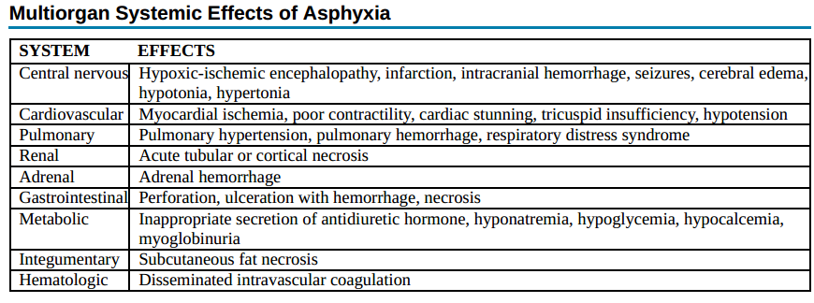

Slide 23
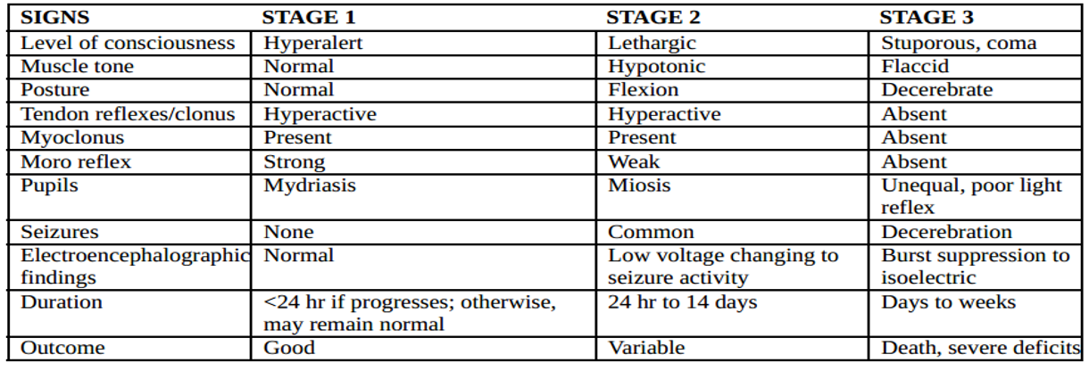
Sarnat Stages of Hypoxic-Ischemic Encephalopathy

Slide 24
Laboratory Investigations
Complete Blood Count
Renal function tests
Serum electrolytes
Coagulation profiles
Arterial Blood Gas analysis

Slide 25
Neuroimaging
MRI:-
  The most sensitive imaging modality for detecting hypoxic brain injury in the neonate.
  Establish the presence and pattern of injury.
  Predict neurologic outcome/prognosis of the insult.

Slide 26
Cotni…
MRI findings
After severe acute total asphyxia
  Deep gray matter injury (putamen, thalamus)
  Brainstem injury
After mild asphyxia
  Parasagittal injury of the cerebral cortex and
  subcortical white matter in the arterial watershed distribution

Slide 27
Management
Supportive care
Adequate resuscitation in delivery room
Keep NPO
Maintenance of adequate ventilation (avoidance of hypoxemia or hyperoxia)
Maintenance of sufficient brain and organ perfusion (avoidance of systemic hypotension or hypertension)
Control of seizures
Avoid hyperthermia, Hypogycemia, hypergycemia

Slide 28
Feeding
Keep NPO
Put on calculated MF
Start TF and escalate accordingly
Add Ca in MF

Slide 29
Therapeutic hypothermia
The only proven neuroprotective therapy for treatment of neonatal encephalopathy.
Started within the first 6hrs after delivery.
Maintained for 72 hrs at 33 to 35°C with target temperature set at 33.5°C.
2 Types
  Selective head cooling.
  Whole body cooling.

Slide 30
Mechanism of action
Decreased cerebral metabolism and blood flow:
  Decrease in energy requirement and
  cerebral edema
Decreased brain lactic acid, glutamate, and nitric oxide concentrations:
  Less excitotoxic and oxidative injury
3. Inhibits protease activation, mitochondrial failure, free radical damage, lipid peroxidation:
  Less apoptosis and necrosis
4. Reduced vascular permeability & disruptions of blood - brain barrier functions

Slide 31
Criteria
GA ≥36 wks and ≤6 hrs of age.
A pH of ≤7.0 or a base deficit of ≥16 mmol/L
One of the following:
  A 10-minute Apgar score of <5
  Ongoing resuscitation initiated at birth and continued for at least 10 minutes
Moderate to severe HIE on clinical examination

Slide 32
Contraindications
Major congenital malformations
Suspected/known chromosomal disorder
Clinical and echocardiographic evidence of PPHN
Active bleeding
Major intracranial hemorrhage

Slide 33
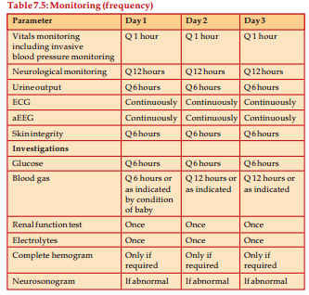

Slide 34
Rewarming
Increase the infant’s core temperature by 0.5 C every hour until 36.5 C has been reached
When the infant’s core temperature is 36.5 C, remove the patient from the cooling blanket/device
Re-activate the radiant warmer, monitor and document the infant’s temperature with the skin probe
Problems while rewarming:
  Seizures and
  Hypotension

Slide 35
Complications of induced hypothermia
Thrombocytopenia
Coagulopathy
      PPHN
      Hypotension
Reduced heart rate
Subcutaneous fat necrosis
The potential for overcooling and the cold injury syndrome which is usually avoided with a servo-controlled cooling system

Slide 36
Management of seizure
Ensure ABC
Check RBS & manage hypoglycemia
Second consider hypocalcemia
Load calcium gluconate 200mg/kg iv with strict cardiac monitoring
If seizure responds continue maintenance of calcium
If no response with calcium gluconate loading consider anti-epileptics

Slide 37
Phenobarbital
  The historical first line drug for neonatal seizures
  Loading dose (20 mg/kg).
  Additional doses of 5-10 mg/kg (up to 40 mg/kg total) may be needed
Phenytoin
  Socond line drug (20 mg/kg loading dose)

Slide 38
Duration of therapy
There has been an increasing trend toward early discontinuation of antiseizure drugs
Discontinue before or shortly after discharge from the hospital.

Slide 39
Prognosis
The outcome correlates with the timing and severity of the insult.
The prognosis varies depending on the severity of the insult and the treatment.
  Infants with initial cord or initial blood pH <6.7 have a 90% risk for death or severe neurodevelopmental impairment at 18 mo of age.

Slide 40
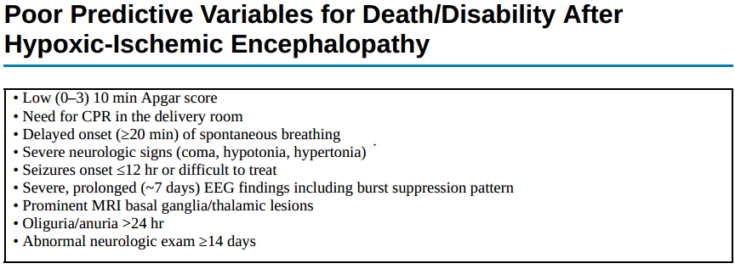

Slide 41
Follow up
All survivors of HIE require comprehensive high-risk medical and developmental follow-up.
The recommendations for follow-up and intervention are based on:-
  The clinical condition of the infant at the time of discharge
  An assessment of feeding, vision, hearing
  Whether seizures continue to be present or not
  Head growth
  General health and motor neurodevelopment
  Assessments of cognitive skills and language development

Slide 42
References
Up-to-date 2018
Nelson text book of pediatrics 21st edition
Faranaof & marten’s neonatal-perinatal medicine.

