Slide 1




PASSWORD MANAGER & GENERATOR
CYBERSECURITY
PROTECT YOUR DIGITAL LIFE
Secure • Smart • Simple
A Python-based password management system for generating and securely managing credentials.
PRESENTED BY
GENERATE • ENCRYPT • STORE
Abubakar Siddiq 1924260012
Kavin Raj 1965260048
Immanuel 1972260002
Jomin 1924260080
Mohamed Haneef 1925260004
Built with Python
Password Manager & Generator using Python
PYTHON • CYBERSECURITY • PROJECT

Slide 2
02 · LITERATURE REVIEW
What Existing Approaches Tell Us
Key security principles that guide our Password Manager & Generator.
01
Password Security
02
Password Managers
Strong, unique passwords are important for reducing risks associated with weak or reused credentials.
Centralized credential storage helps users manage multiple website and application passwords.
03
Secure Generation
04
Secure Storage
The project uses Python's secrets module to generate unpredictable passwords from selectable character sets.
The proposed design protects the local vault with encryption and uses a salted hash for master-password verification.
PROJECT TAKEAWAY
Our project combines password generation, authentication, encrypted storage and credential management in one Python application.

Slide 3

Module : 1
PRESENTED BY
Abubakar Siddiq
Introduction & Project Overview
01 · GETTING STARTED
What is a Password Manager?
An average person juggles dozens of online accounts — email, banking, social media, college portals. Reusing simple passwords across them is one of the biggest security risks a person can take. A Password Manager securely stores and retrieves logins; a Password Generator creates strong, random passwords on demand. This project combines both into one lightweight Python app.
1
Problem Statement
Weak, reused or written-down passwords lead to account takeovers and data breaches.
2
Our Goal
Build a simple, offline Python tool that generates strong passwords and stores them safely.
3
Why Python?
Modules like secrets, string, hashlib and cryptography make secure password handling quick to build.
Password Manager & Generator using Python | Project Overview
Abubakar Siddiq · Slide 1 of 10

Slide 4
PRESENTED BY
Abubakar Siddiq
Introduction & Project Overview
02 · OBJECTIVES
Project Objectives & Scope
Scoped as a lightweight command-line utility that demonstrates core security principles in a beginner-friendly way — ideal as an academic mini-project.
1
Generate
Create random passwords of customizable length, mixing letters, digits and symbols.
2
Store
Save each password against a website/app name in an encrypted local vault.
3
Retrieve & Manage
Search, update, copy or delete credentials — never exposed in plain text.
“A chain is only as strong as its weakest link — in cybersecurity, that link is often a weak password.”
Password Manager & Generator using Python | Project Overview
Abubakar Siddiq · Slide 2 of 10

Slide 5
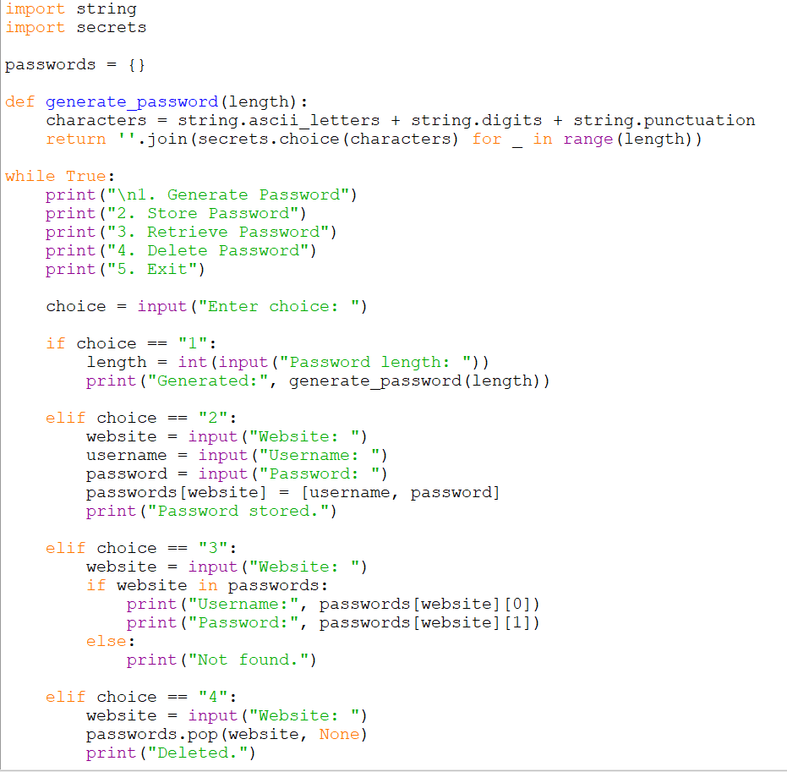
Module : 1

Slide 6
Module : 2
PRESENTED BY
Kavin Raj
System Architecture & Libraries Used
03 · ARCHITECTURE
How the System is Structured
The app follows a clean, modular architecture — generating, encrypting, storing and retrieving passwords each live in their own function, keeping the codebase readable and easy to extend.
1
Input Layer
Takes user commands: generate, save, search, or view saved entries.
2
Logic Layer
The generator engine builds random strings; the security engine hashes/encrypts data.
3
Storage & Access
An encrypted local file holds the vault, gate-kept by one master password.
Password Manager & Generator using Python | Project Overview
Kavin Raj · Slide 3 of 10

Slide 7
PRESENTED BY
Kavin Raj
System Architecture & Libraries Used
04 · TOOLKIT
Python Libraries Powering the Project
Python's rich standard library, supplemented by a few well-tested cryptography packages, does almost all the heavy lifting.
1
secrets
Cryptographically strong randomness — safer than the plain random module.
2
string / hashlib
Character sets for passwords, plus one-way hashing to verify the master password.
3
cryptography (Fernet)
Symmetric encryption that locks every stored password inside the vault file.
“Good architecture separates what changes often from what should never change — security logic stays constant, the interface can evolve.”
Password Manager & Generator using Python | Project Overview
Kavin Raj · Slide 4 of 10

Slide 8
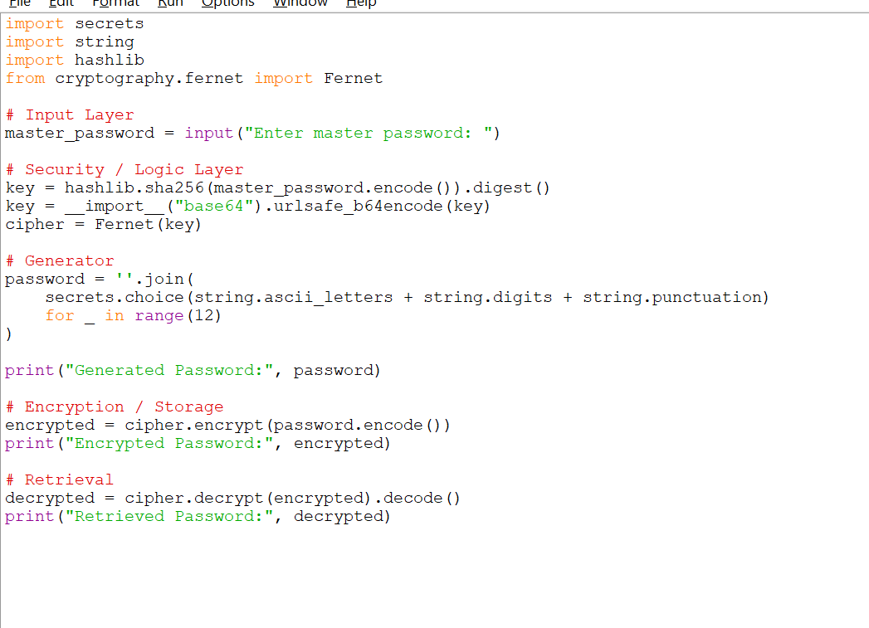
Module : 2

Slide 9
Module : 3
PRESENTED BY
Immanuel
The Password Generator Module
05 · CORE MODULE
Designing the Password Generator
The generator is the heart of the tool — produce a password that is long, unpredictable and resistant to brute-force or dictionary attacks.
1
Character Pools
Combines uppercase, lowercase, digits and symbols into one selectable pool.
2
Custom Length
User chooses length (typically 8–32 characters); longer = exponentially safer.
3
True Randomness
Uses secrets.choice() instead of random.choice() — output can't be predicted.
Password Manager & Generator using Python | Project Overview
Immanuel · Slide 5 of 10

Slide 10
PRESENTED BY
Immanuel
The Password Generator Module
06 · BEHIND THE CODE
Generator Workflow, Step by Step
1
2
3
4
5
Collect Preferences
Build the Pool
Randomize
Validate
Deliver
Length & character types
Merge chosen character sets
Sample chars until length is met
Check complexity rules are met
Show password, offer to save it
“Randomness is the currency of security — the harder a password is to predict, the more valuable it is.”
Password Manager & Generator using Python | Project Overview
Immanuel · Slide 6 of 10

Slide 11
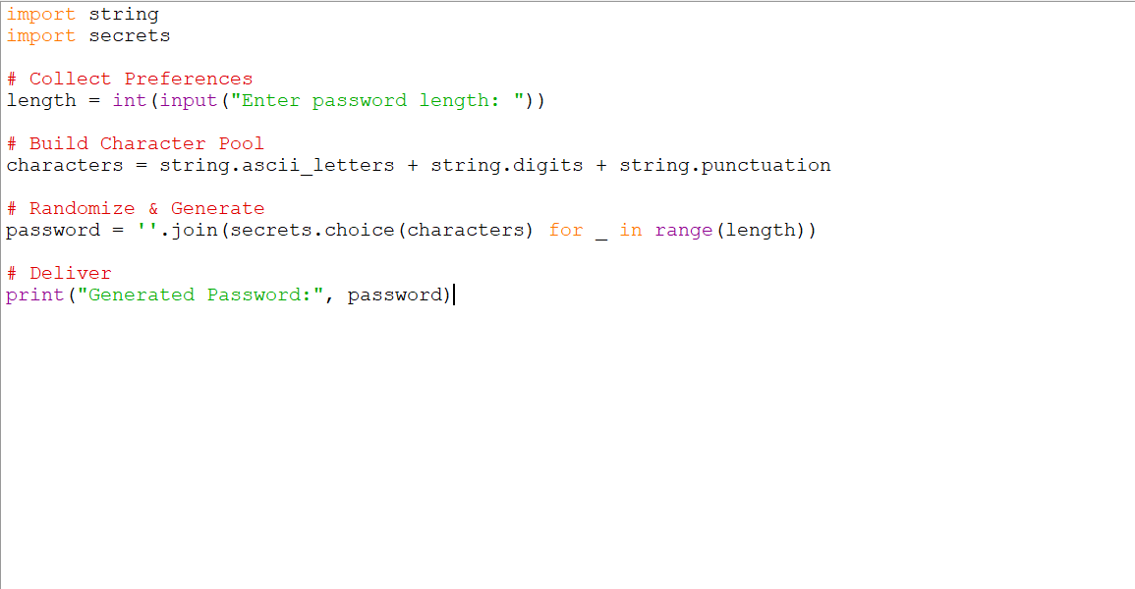
Module : 3

Slide 12
Module : 4
PRESENTED BY
Jomin
Secure Storage & Encryption
07 · DATA SECURITY
Keeping Stored Passwords Safe
Generating a strong password is only half the job — it must be stored so nobody, not even someone with file-system access, can read it directly.
1
Encryption at Rest
Every saved password is encrypted (Fernet/AES) before it touches the disk.
2
Master Key Derivation
The master password is never stored — only its salted hash, used to derive the key.
3
Zero Plain-Text Rule
No saved password is ever written to disk in readable form.
Password Manager & Generator using Python | Project Overview
Jomin · Slide 7 of 10

Slide 13
PRESENTED BY
Jomin
Secure Storage & Encryption
08 · ACCESS CONTROL
Authentication & Data Integrity
Beyond encryption, the system layers in checks so only the rightful user can unlock and use the vault.
1
Master Password Gate
The vault only decrypts after the master password is verified against its hash.
2
Salting
A unique random salt means identical passwords never produce identical hashes.
3
Backup Friendly
The encrypted vault file can be safely backed up — unreadable without the key.
“Encryption turns your data into a locked box; the master password is the only key that fits.”
Password Manager & Generator using Python | Project Overview
Jomin · Slide 8 of 10

Slide 14
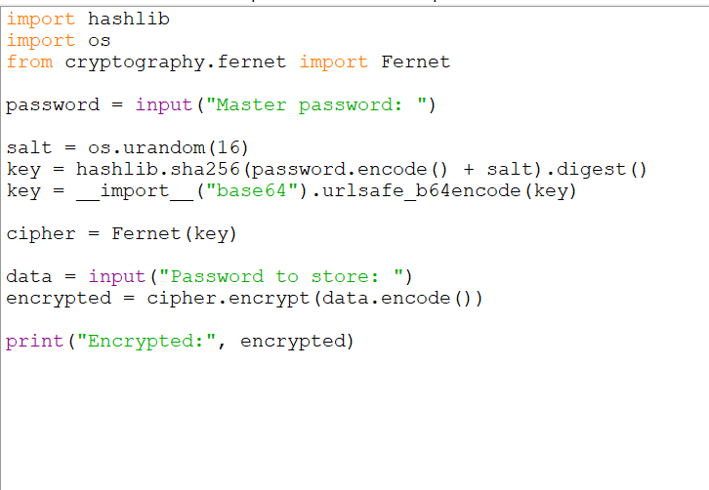
Module : 4

Slide 15
Module : 5
PRESENTED BY
Mohamed Haneef
Features, Applications & Conclusion
09 · HIGHLIGHTS
Key Features & Real-World Applications
Bringing everything together, the finished tool offers a compact but genuinely useful feature set with clear real-world value.
1
One-Click Generation
Instantly create strong, unique passwords for any new account.
2
Centralized Vault
Store and organize credentials for every website or app in one place.
3
Personal & Team Use
Suitable for individuals, small teams, or as a security-fundamentals project.
Password Manager & Generator using Python | Project Overview
Mohamed Haneef · Slide 9 of 10

Slide 16
PRESENTED BY
Mohamed Haneef
Features, Applications & Conclusion
10 · WRAP-UP
Advantages & Conclusion
This project shows how a handful of Python's standard and cryptography libraries can solve a genuine, everyday security problem.
1
Improved Security
Eliminates weak, reused passwords by making strong ones effortless to create.
2
Time Saving
No more manually inventing or recalling dozens of passwords.
3
Extensible Design
Ready for a GUI, browser integration, or cloud sync in future iterations.
“Security is not a product, it is a habit — this project is a small step toward building that habit in code.”
Password Manager & Generator using Python | Project Overview
Mohamed Haneef · Slide 10 of 10

Slide 17
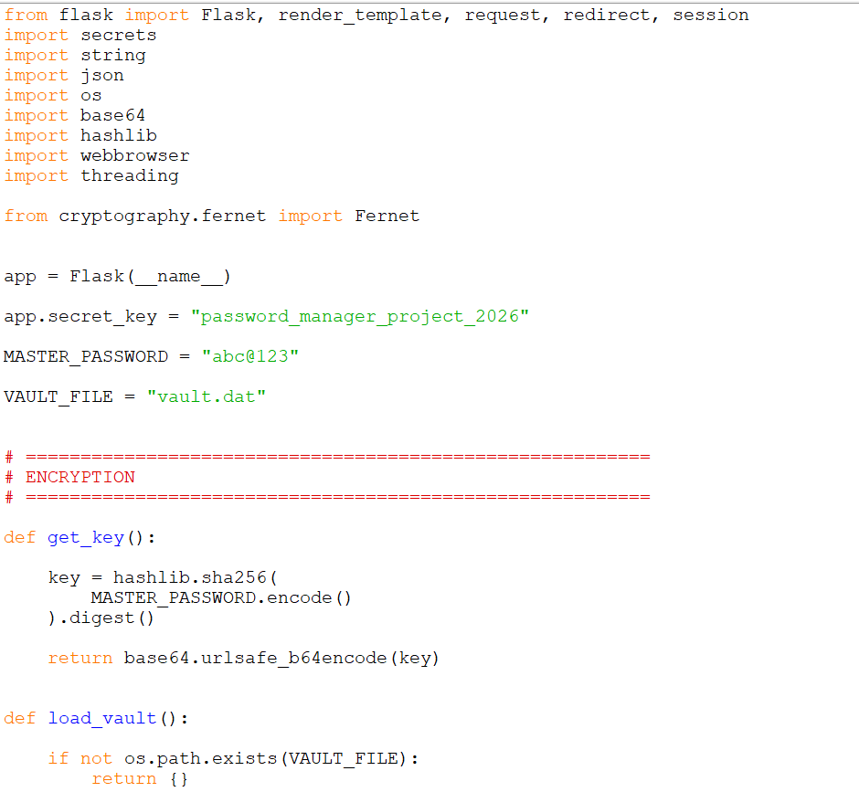
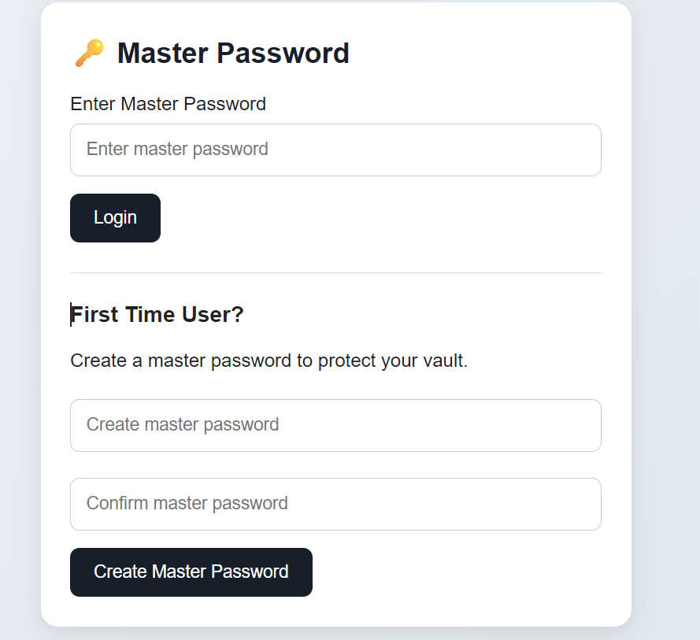
Module 5: Demonstration/ Implementation:

Slide 18




