Slide 1
DBMS GROUP PROJECT
TEAM · AGENDA
Clinic Appointment
Management System
01
Introduction
Sultan
02
Requirements
Elbek & Allisa
03
ER Diagram
A relational database that manages patients, doctors, appointments, medical records and payments — replacing paper records with one reliable, consistent system.
Aza
04
Database Demo
KX
05
SQL Queries
Abdushukur
06
Conclusion
Jeremy
LibreOffice Base (.odb) · Embedded HSQLDB · Normalized to 2NF
Database Management Systems — Group Assignment · June 2026

Slide 2
01
INTRODUCTION
PRESENTER — SULTAN
THE PROBLEM
THE SOLUTION
Paper records, forms & spreadsheets
One centralized relational database
Double bookings — no central booking record
Patient information — registration & personal details
Time wasted searching through physical files
Doctor information — specializations & departments
Records get lost or damaged
Appointments — date, time, attending doctor, status
Communication breakdowns when schedules change
Medical records — diagnosis, treatment, medicine
Reports become a paper-based nightmare
Payments — amount, method, status, date
✓ Improves efficiency
✓ Reduces data duplication
✓ Ensures data consistency
Built with LibreOffice Base (.odb) — staff find what they need in seconds, not minutes
Clinic Appointment Management System
02 / 08

Slide 3
02
REQUIREMENTS — SIX MAIN ENTITIES
PRESENTERS — ELBEK & ALLISA
1
Patient
2
Doctor
3
Department
PK PatientID
PK DoctorID
PK DepartmentID
FK DepartmentID
Personal details of every patient — name, gender, DOB, phone, address.
Doctor details & specialization, each linked to a department.
Clinic departments with their name and location in the building.
11 rows
6 rows
6 rows
4
Appointment
5
MedicalRecord
6
Payment
PK AppointmentID
PK RecordID
PK PaymentID
FK PatientID · DoctorID
FK AppointmentID
FK AppointmentID
Links patients & doctors — date, time, reason and status of each visit.
Diagnosis, treatment and medicine recorded after each completed visit.
Billing per appointment — amount, method, status and payment date.
10 rows
5 rows
5 rows
USER ROLES Receptionist / Admin · Doctor · Clinic Manager · Patient
Every table stores at least 5 sample records
Clinic Appointment Management System
03 / 08

Slide 4
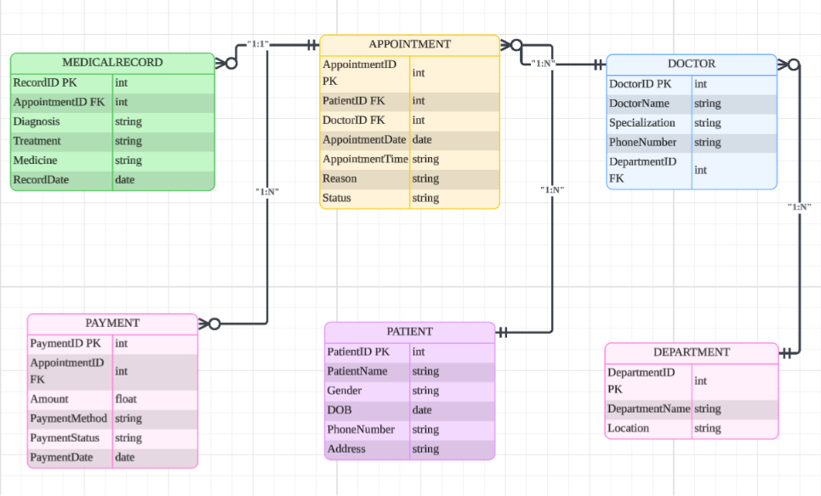
03
ER DIAGRAM & RELATIONSHIPS
PRESENTER — AZA
1 : N
Department → Doctor
1 : N
Patient → Appointment
1 : N
Doctor → Appointment
1 : 1
Appointment → MedicalRecord
1 : N
Appointment → Payment
APPOINTMENT IS THE CENTRAL ENTITY
Patients make appointments and doctors handle them — medical records and payments always link back to an appointment.
ER diagram in crow's foot notation — created with Lucidchart
Clinic Appointment Management System
04 / 08

Slide 5
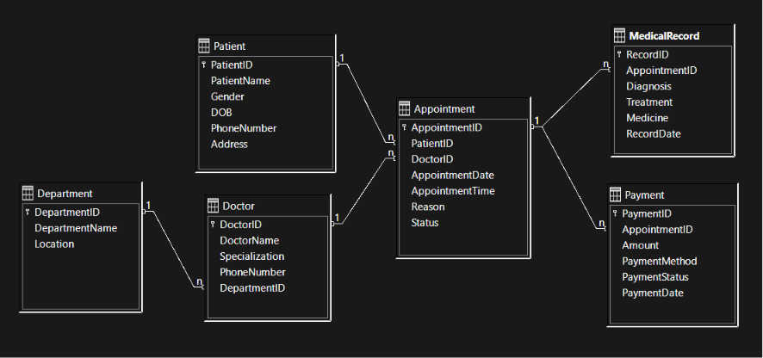
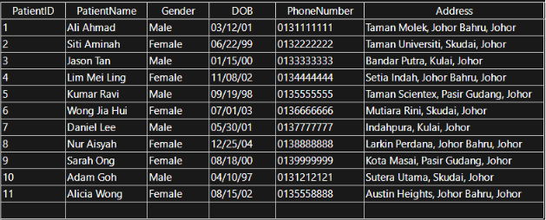
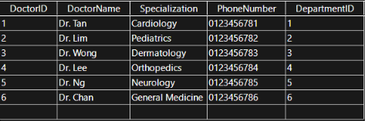
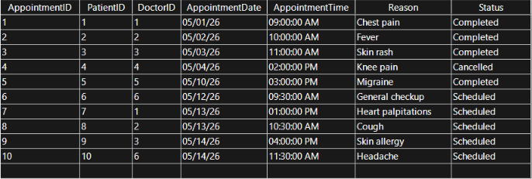
04
DATABASE DEMO — LIBREOFFICE BASE
PRESENTER — KX
Relationships view — foreign keys in action
Implementation
LibreOffice Base 24.2 — with the embedded HSQLDB 1.8 engine
.odb file format — no separate database server required
2NF design — all six tables built from the normalized model
Referential integrity — enforced through foreign keys
Realistic sample data — every table holds at least 5 records
Patient — 11 rows
Doctor — 6 rows
Appointment — 10 rows
Clinic Appointment Management System
05 / 08

Slide 6
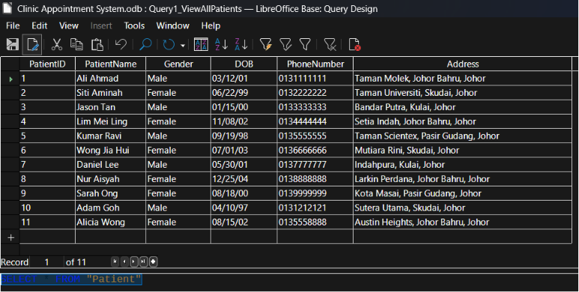
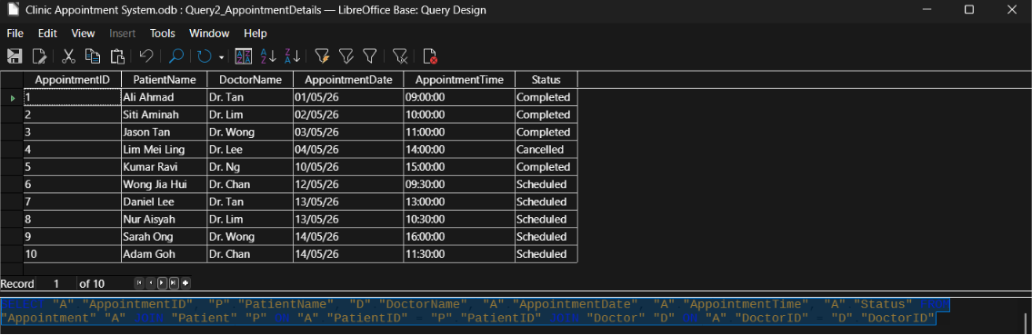
05
SQL QUERIES — SELECT & JOIN
PRESENTER — ABDUSHUKUR
Q1
View All Patients
Retrieves all 11 patient records — the full Patient table.
SELECT * FROM "Patient"
11 of 11 records returned
Q2
Appointment Details (JOIN)
Joins Appointment with Patient and Doctor — names instead of IDs.
SELECT "A"."AppointmentID", "P"."PatientName",
"D"."DoctorName", "A"."AppointmentDate",
"A"."AppointmentTime", "A"."Status"
FROM "Appointment" "A"
JOIN "Patient" "P" ON "A"."PatientID" = "P"."PatientID"
JOIN "Doctor" "D" ON "A"."DoctorID" = "D"."DoctorID"
Clinic Appointment Management System
06 / 08

Slide 7
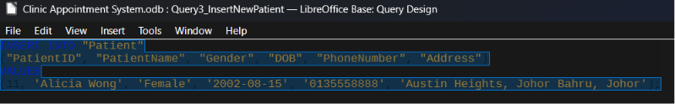
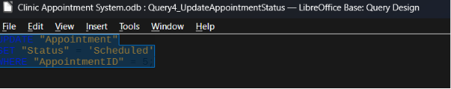
05
SQL QUERIES — INSERT & UPDATE
PRESENTER — ABDUSHUKUR
Q3
Insert New Patient
Query Design view — LibreOffice Base
Adds patient #11 — Alicia Wong — to the Patient table.
INSERT INTO "Patient" ("PatientID", "PatientName",
"Gender", "DOB", "PhoneNumber", "Address")
VALUES (11, 'Alicia Wong', 'Female', '2002-08-15',
'0135558888', 'Austin Heights, Johor Bahru, Johor');
After running: the Patient table grows from 10 to 11 rows.
Q4
Update Appointment Status
Query Design view — LibreOffice Base
Changes the status of appointment No. 5 via its AppointmentID.
UPDATE "Appointment"
SET "Status" = 'Scheduled'
WHERE "AppointmentID" = 5;
UPDATE + WHERE — only the matching row changes.
Clinic Appointment Management System
07 / 08

Slide 8
06
CONCLUSION
PRESENTER — JEREMY
The Clinic Appointment Management System successfully manages patients, doctors, appointments, medical records and payments.
The database is normalized to 2NF, keeps data consistent through foreign keys, and supports SQL operations efficiently.
6
6
6
11
10
TABLES
DEPARTMENTS
DOCTORS
PATIENTS
APPOINTMENTS
Thank you!
Questions are welcome.
Clinic Appointment Management System
08 / 08

