Slide 1

CSS Table
Styling

Slide 2
Using CSS to Style Tables
Up to this point, as we haven't applied any CSS styling to our tables, our example tables have not been too pleasing to the eye. CSS offers us several properties to customize how our tables appear on the page:
Style | Description
width | Width of element.
background-color | Background color of element.
color | Color of text in element.
text-align | Horizontal text alignment of element.
border | Border thickness and style of element.
padding | Padding (white space around content) of element.
We're already familiar with the color and text-align properties, but let's see examples of the other styles in action.
Though we're using these properties to style table elements, all of these properties may be used with many other XHTML elements, as we'll see in future lessons.

Slide 3
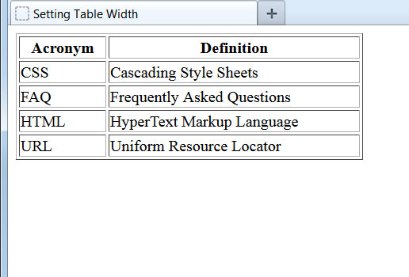
Setting Table Width
We can set the overall width of a table by applying a class to the <table> element:
<style type="text/css">
.glossary {
width: 350px;
}
</style>
...
<table class="glossary" border="1">
<tr>
<th>Acronym</td>
<th>Definition</td>
</tr>
<tr>
<td>CSS</td>
<td>Cascading Style Sheets</td>
</tr>
...
</table>
The table is now 350 pixels wide, creating some extra space in the data cells.
The width of the columns is automatically established by the browser to accommodate the cell contents, but we don't have to accept this format.

Slide 4
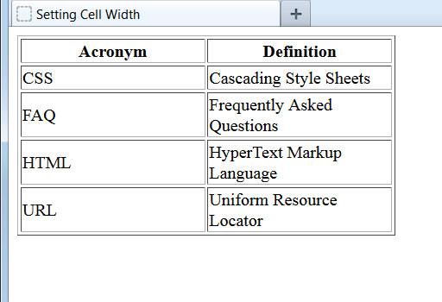
Setting Column Width in Pixels
We can set the width of columns by setting the widths of the first row of data cells:
<style type="text/css">
.glossary {
width: 350px;
}
.col {
width: 175px;
}
</style>
...
<table class="glossary" border="1">
<tr>
<th class="col">Acronym</td>
<th class="col">Definition</td>
</tr>
<tr>
<td>CSS</td>
<td>Cascading Style Sheets</td>
</tr>
...
</table>
We've now set each of the columns to be 175 pixels in width, or half of the total available table width.
Notice that due to the enforced width, some cell contents had to wrap to an additional line.

Slide 5
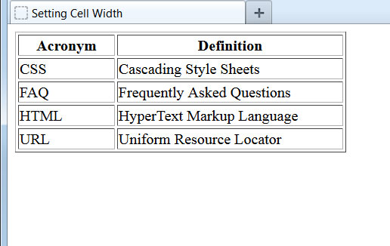
Setting Column Width in Percent
Rather than pixels, we can also set column widths to be a percent of the total available width:
<style type="text/css">
.glossary {
width: 350px;
}
.col1 {
width: 30%;
}
.col2 {
width: 70%;
}
</style>
...
<table class="glossary" border="1">
<tr>
<th class="col1">Acronym</td>
<th class="col2">Definition</td>
</tr>
...
</table>
Setting column widths by percent instead of pixels has the advantage of flexibility. Should we ever alter the width of the table itself, the columns will automatically adjust.

Slide 6
Borders
CSS provides us plenty of flexibility when generating borders around elements. There are multiple properties that affect the border that displays on the page:
Style | Description
border-style | Type of border: none, solid, dashed, dotted, double, groove, ridge, inset, outset.
border-color | Color of border.
border-width | Width of border, measured in pixels. Also available: thin, medium, and thick.
border-collapse | collapse: borders display as single border. separate: borders are detached (default).
We'll examine each of the first three, but first let's take a look at the border-collapse property.

Slide 7
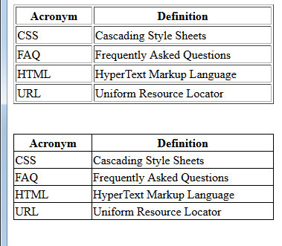
The border-collapse Property
By invoking the border-collapse property, we can force a table to collapse its borders into a single line between cells:
<style type="text/css">
.glossary {
width: 350px;
}
.collapse {
border-collapse: collapse;
}
...
</style>
...
<table class="glossary collapse" border="1">
<tr>
<th class="col1">Acronym</td>
<th class="col2">Definition</td>
</tr>
...
</table>
Here we created an identical table but added a class that included the border-collapse property.

Slide 8
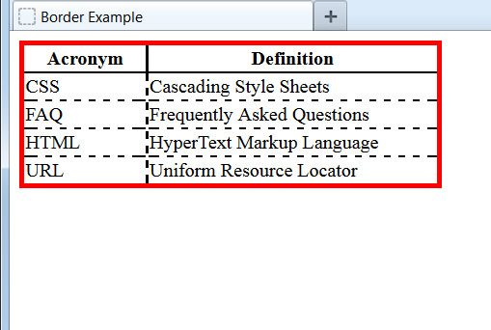
Customizing Borders
By using the other three properties, we can create custom borders for our table:
<style type="text/css">
.glossary {
width: 350px;
border-width: 4px;
border-style: solid;
border-color: red;
}
th {
border-width: 2px;
border-style: solid;
}
td {
border-width: 2px;
border-style: dashed;
}
...
Notice that we can apply different styles to the table, table headers, and table cell elements.
For demonstrative purposes, we applied CSS styles directly to the <th> and <td> elements, instead of using separate classes. In the real world, this would likely be a bad idea, as any other tables on our page would be affected too.

Slide 9
Using CSS Border Shorthand
When specifying multiple border properties, we can use the CSS border shorthand to reduce the statement to a single line:
<style type="text/css">
.glossary {
width: 350px;
border-width: 4px;
border-style: solid;
border-color: red;
}
th {
border-width: 2px;
border-style: solid;
}
td {
border-width: 2px;
border-style: dashed;
}
...
<style type="text/css">
.glossary {
width: 350px;
border: 4px solid red;
}
th {
border: 2px solid;
}
td {
border: 2px dashed;
}
...
By convention, the properties are ordered as border: border-width border-style border-color; (The color portion may be omitted.)

Slide 10
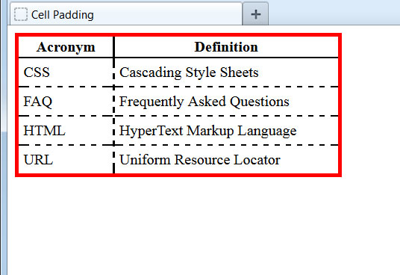
Adding Cell Padding
By setting the padding property, we can make sure there is at least that much white space around our cell contents. This keeps the actual cell contents from displaying too closely to the borders:
<style type="text/css">
.glossary {
width: 350px;
border: 4px solid red;
}
th {
border: 2px solid;
}
td {
border: 2px dashed;
padding: 5px;
}
...
Different border and padding settings can be set for the top, bottom, left, and right sides of elements. We will learn how to do this in an upcoming lesson.

Slide 11
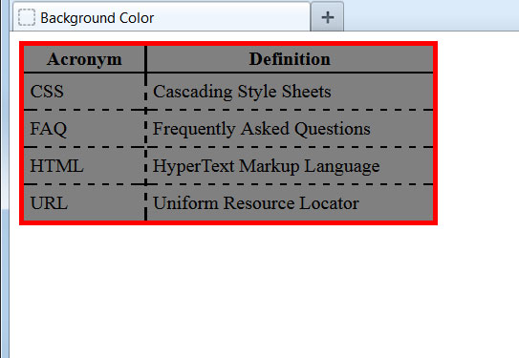
Setting a Background Color
By setting the background-color property, we can change our table's background away from the default:
<style type="text/css">
.glossary {
width: 350px;
border: 4px solid red;
background-color: gray;
}
th {
border: 2px solid;
}
td {
border: 2px dashed;
padding: 5px;
}
...
Let's use this property now on the data cells to make our table a bit more readable.

Slide 12
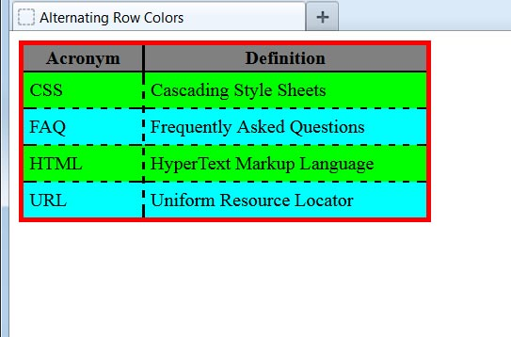
Using Background Color on Rows
<style type="text/css">
...
.odd {
background-color: lime;
}
.even {
background-color: aqua;
}
...
</style>
...
<tr class="odd">
<td>CSS</td>
<td>Cascading Style Sheets</td>
</tr>
<tr class="even">
<td>FAQ</td>
<td>Frequently Asked Questions</td>
</tr>
<tr class="odd">
...
This is a handy way to make our table rows show in alternating background colors. This technique makes reading wide tables far easier for viewers.

