Slide 1

Site Organization

Slide 2
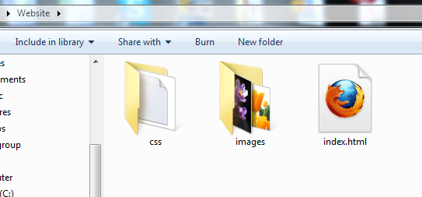
The Need to Organize Site Files
Thus far, we have placed all our site files into the main (root) website folder. As a website becomes larger and more sophisticated, a single folder becomes too cluttered to manage effectively.
To better organize our site, we can group similar files, such as images and CSS files, into their own dedicated subfolders.

Slide 3
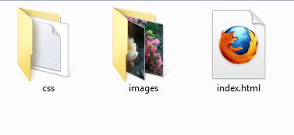
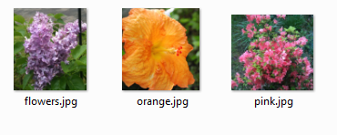
Relative Paths
Once we move site files to subfolders, we need a way to tell the browser where to find them. To do this, we use relative paths:
<div class="gallery">
<img src="images/flowers.jpg" />
<img src="images/orange.jpg" />
<img src="images/pink.jpg" />
</div>
The path is always relative to the file making the reference. In this case, the path is relative to the location of index.html.
Always use the forward slash (/) in file paths, never the backslash (\).

Slide 4
Absolute Paths
A common mistake committed by novice web designers is to copy and paste the full path to a local file in their markup:
<div class="gallery">
<img src="images/flowers.jpg" />
<img src="images/orange.jpg" />
<img src="file:///C:/Users/me/Desktop/Website/images/pink.jpg" />
</div>
This can be a frustrating error, as the browser on our own computer can locate and display the image. But when the site is uploaded to a live web server, the image won't appear, since the location is no longer valid.
These paths, since they are not relative to the current location, are known as absolute paths.

Slide 5

External CSS Style Sheets
Our earlier example of an external CSS style sheet assumed the actual CSS file was in the same directory as the XHTML file. Now that we are better organizing our site, we should move the CSS file to its own folder:
<head>
...
<link rel="stylesheet" type="text/css" href="css/mycss.css" />
</head>
Complex websites can have dozens of style sheet files in the CSS folder.

Slide 6

Relative Paths in Style Sheets
As we know, CSS style sheets can set background images for elements. Now that the style sheet is in its own folder, we need a way to point the CSS file to an image that is located up one folder level and then down into a different subfolder:
body {
background-image: url('../images/orange.jpg');
}
This is the mycss.css file.
Remember, the path is always relative to the file making the reference. In this case, that file is the CSS file in its own subfolder.
The two periods and forward slash instruct the browser to "go up one folder level".

