Slide 1
CPU Scheduling(cont’d)
Course Code: CSC 2209
Course Title: Operating Systems
Dept. of Computer Science
Faculty of Science and Technology
Lecturer No: | 07 | Week No: | 07 | Semester: | Fall 22-23
Lecturer: | NOBORANJAN DEY

Slide 2
Lecture Outline
Thread Scheduling
Multi-Processor Scheduling
Real-Time CPU Scheduling
Operating Systems Examples
Algorithm Evaluation

Slide 3
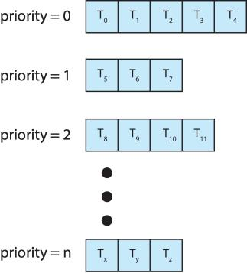
Multilevel Queue
With priority scheduling, have separate queues for each priority.
Schedule the process in the highest-priority queue!
Priority 0 ready queue = RR
Priority 1 ready queue = FCFS
CPU Scheduling algo queue & process

Slide 4
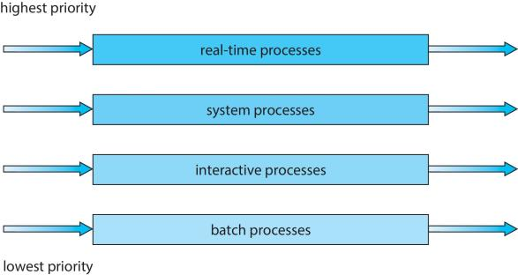
Multilevel Queue
Prioritization based upon process type

Slide 5
Multilevel Feedback Queue
A process can move between the various queues; aging can be implemented this way
Multilevel-feedback-queue scheduler defined by the following parameters:
number of queues
scheduling algorithms for each queue
method used to determine when to upgrade a process
method used to determine when to demote a process
method used to determine which queue a process will enter when that process needs service
Notes:
Parameters will be discussed after the next slide

Slide 6
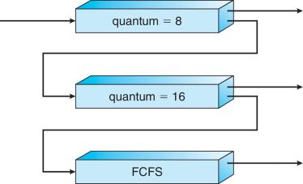
Example of Multilevel Feedback Queue
Three queues:
Q₀ – RR with time quantum 8 milliseconds
Q₁ – RR time quantum 16 milliseconds
Q₂ – FCFS
Scheduling
A new job enters queue Q₀ which is served RR
When it gains CPU, job receives 8 milliseconds
If it does not finish in 8 milliseconds, job is moved to queue Q₁
At Q₁ job is again served RR and receives 16 additional milliseconds
If it still does not complete, it is preempted and moved to queue Q₂ served FCFS.

Slide 7
Thread Scheduling
Distinction between user-level and kernel-level threads
When threads supported, threads scheduled, not processes
Many-to-one and many-to-many models, thread library schedules user-level threads to run on LWP
Known as process-contention scope (PCS) since scheduling competition is within the process
Typically done via priority set by programmer
Kernel thread scheduled onto available CPU is system-contention scope (SCS) – competition among all threads in system
Notes:
lightweight process(LWP)

Slide 8
Pthread Scheduling
API allows specifying either PCS or SCS during thread creation
PTHREAD_SCOPE_PROCESS schedules threads using PCS scheduling
PTHREAD_SCOPE_SYSTEM schedules threads using SCS scheduling
Can be limited by OS – Linux and macOS only allow PTHREAD_SCOPE_SYSTEM

Slide 9
Multiple-Processor Scheduling
CPU scheduling more complex when multiple CPUs are available
Multiprocess may be any one of the following architectures:
Multicore CPUs
Multithreaded cores
NUMA systems
Heterogeneous multiprocessing

Slide 10
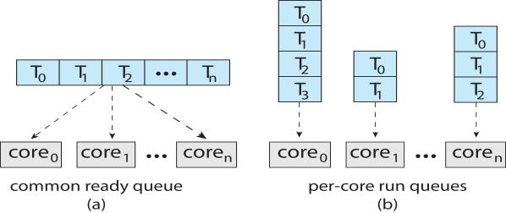
Multiple-Processor Scheduling
Symmetric multiprocessing (SMP) is where each processor is self scheduling.
All threads may be in a common ready queue (a)
Each processor may have its own private queue of threads (b)

Slide 11
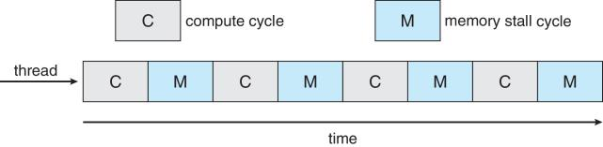
Multicore Processors
Recent trend to place multiple processor cores on same physical chip
Faster and consumes less power
Multiple threads per core also growing
Takes advantage of memory stall to make progress on another thread while memory retrieve happens
Notes:
When processor accesses memory then it spends a significant amount of time waiting for the data to become available. This situation is called MEMORY STALL. It occurs for various reasons such as cache miss, which is accessing the data that is not in the cache memory.

Slide 12
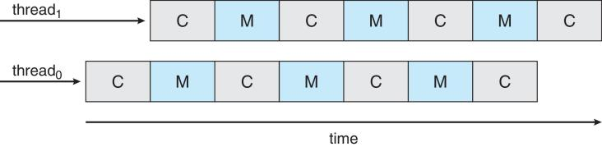
Multithreaded Multicore System
Each core has > 1 hardware threads.
If one thread has a memory stall, switch to another thread!

Slide 13
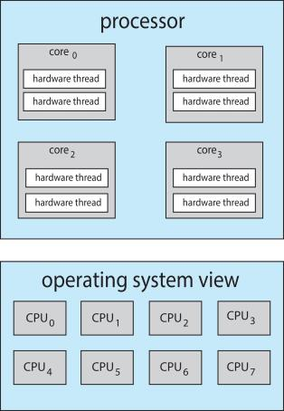
Multithreaded Multicore System
Chip-multithreading (CMT) assigns each core multiple hardware threads. (Intel refers to this as hyperthreading.)
On a quad-core system with 2 hardware threads per core, the operating system sees 8 logical processors.

Slide 14
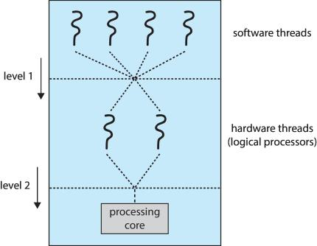
Multithreaded Multicore System
Two levels of scheduling:
The operating system deciding which software thread to run on a logical CPU
How each core decides which hardware thread to run on the physical core.

Slide 15
Multiple-Processor Scheduling – Load Balancing
If SMP, need to keep all CPUs loaded for efficiency
Load balancing attempts to keep workload evenly distributed
Push migration – periodic task checks load on each processor, and if found, pushes task from overloaded CPU to other CPUs
Pull migration – idle processors pulls waiting task from busy processor
Notes:
Symmetric multiprocessing (SMP), where each processor is self-scheduling.

Slide 16
Multiple-Processor Scheduling – Processor Affinity
When a thread has been running on one processor, the cache contents of that processor stores the memory accesses by that thread.
We refer to this as a thread having affinity for a processor (i.e. “processor affinity”)
Load balancing may affect processor affinity as a thread may be moved from one processor to another to balance loads, yet that thread loses the contents of what it had in the cache of the processor it was moved off of.
Soft affinity – the operating system attempts to keep a thread running on the same processor, but no guarantees.
Hard affinity – allows a process to specify a set of processors it may run on.

Slide 17
NUMA and CPU Scheduling
If the operating system is NUMA-aware, it will assign memory closes to the CPU the thread is running on.
Notes:
Non-uniform memory access, or NUMA, is a method of configuring a cluster of microprocessors in a multiprocessing system so they can share memory locally. The idea is to improve the system's performance and allow it to expand as processing needs evolve.
In a NUMA setup, the individual processors in a computing system share local memory and can work together. Data can flow smoothly and quickly since it goes through intermediate memory instead of a main bus

Slide 18
Real-Time CPU Scheduling
Can present obvious challenges
Soft real-time systems – Critical real-time tasks have the highest priority, but no guarantee as to when tasks will be scheduled
Hard real-time systems – task must be serviced by its deadline

Slide 19
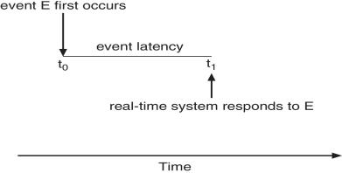
Real-Time CPU Scheduling
Event latency – the amount of time that elapses from when an event occurs to when it is serviced.
Two types of latencies affect performance
Interrupt latency – time from arrival of interrupt to start of routine that services interrupt
Dispatch latency – time for schedule to take current process off CPU and switch to another

Slide 20
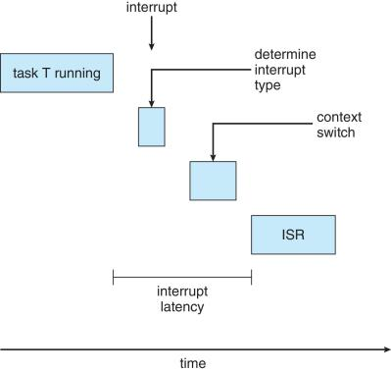
Interrupt Latency
Notes:
Interrupt Service Routine (ISR)

Slide 21
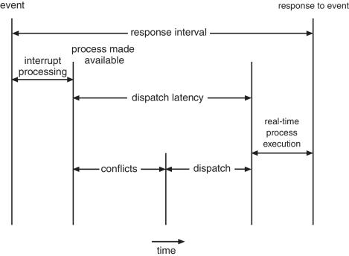
Dispatch Latency
Conflict phase of dispatch latency:
Preemption of any process running in kernel mode
Release by low-priority process of resources needed by high-priority processes

Slide 22
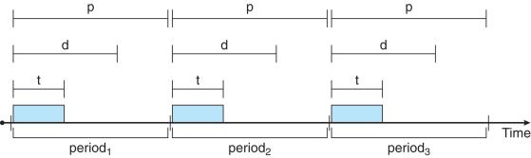
Priority-based Scheduling
For real-time scheduling, scheduler must support preemptive, priority-based scheduling
But only guarantees soft real-time
For hard real-time must also provide ability to meet deadlines
Processes have new characteristics: periodic ones require CPU at constant intervals
Has processing time t, deadline d, period p
0 ≤ t ≤ d ≤ p
Rate of periodic task is 1/p

Slide 23
Operating System Examples
Linux scheduling
Windows scheduling
Solaris scheduling

Slide 24
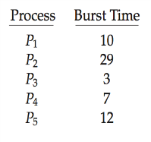
Algorithm Evaluation
How to select CPU-scheduling algorithm for an OS?
Determine criteria, then evaluate algorithms
Deterministic modeling
Type of analytic evaluation
Takes a particular predetermined workload and defines the performance of each algorithm for that workload
Consider 5 processes arriving at time 0:

Slide 25



Deterministic Evaluation
For each algorithm, calculate minimum average waiting time
Simple and fast, but requires exact numbers for input, applies only to those inputs
FCS is 28ms:
Non-preemptive SFJ is 13ms:
RR is 23ms:

Slide 26
Queueing Models
Describes the arrival of processes, and CPU and I/O bursts probabilistically
Commonly exponential, and described by mean
Computes average throughput, utilization, waiting time, etc
Computer system described as network of servers, each with queue of waiting processes
Knowing arrival rates and service rates
Computes utilization, average queue length, average wait time, etc

Slide 27
Little’s Formula
n = average queue length
W = average waiting time in queue
λ = average arrival rate into queue
Little’s law – in steady state, processes leaving queue must equal processes arriving, thus: n = λ x W
Valid for any scheduling algorithm and arrival distribution
For example, if on average 7 processes arrive per second, and normally 14 processes in queue, then average wait time per process = 2 seconds

Slide 28
Simulations
Queueing models limited
Simulations more accurate
Programmed model of computer system
Clock is a variable
Gather statistics indicating algorithm performance
Data to drive simulation gathered via
Random number generator according to probabilities
Distributions defined mathematically or empirically
Trace tapes record sequences of real events in real systems

Slide 29
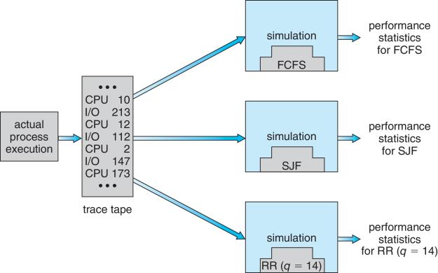
Evaluation of CPU Schedulers by Simulation

Slide 30
Implementation
Even simulations have limited accuracy
Just implement new scheduler and test in real systems
High cost, high risk
Environments vary
Most flexible schedulers can be modified per-site or per-system
Or APIs to modify priorities
But again environments vary

Slide 31
Books
Operating Systems Concept
Written by Galvin and Silberschatz
Edition: 9th

Slide 32
References
Operating Systems Concept
Written by Galvin and Silberschatz
Edition: 9th

