Slide 1
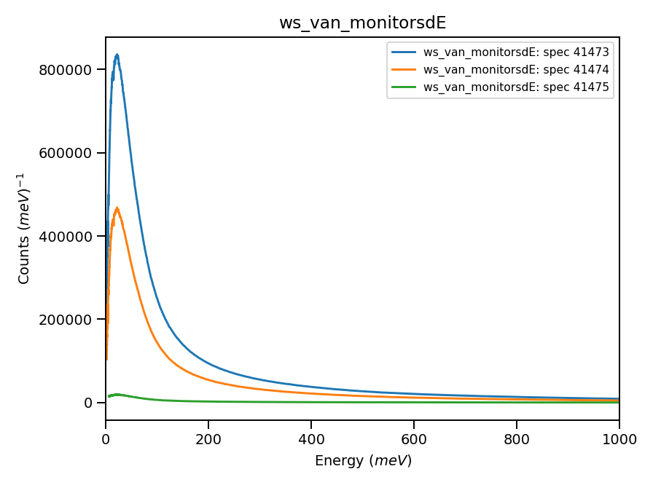
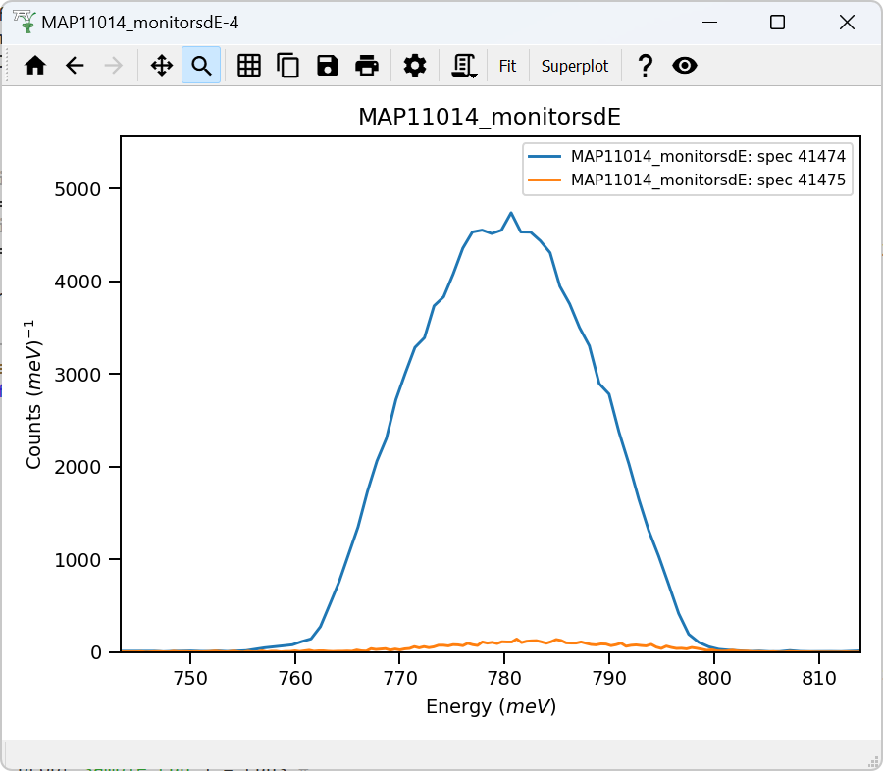
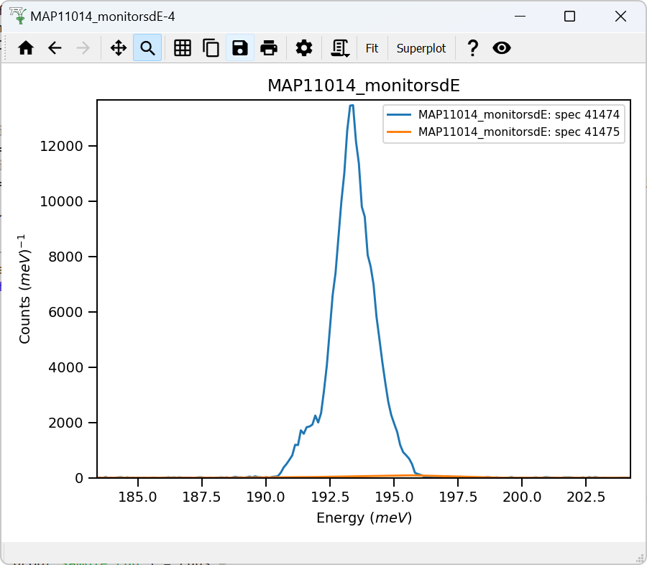
Detector’s vanadium
Monitors-1,2
dE = 800
Monitors-1,2
dE = 200
22mEv

Slide 2
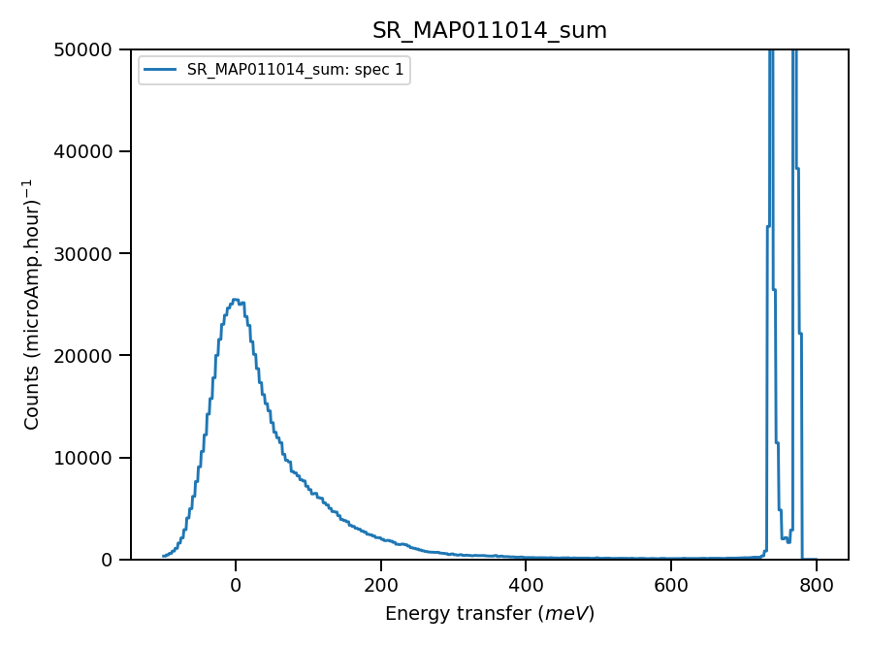
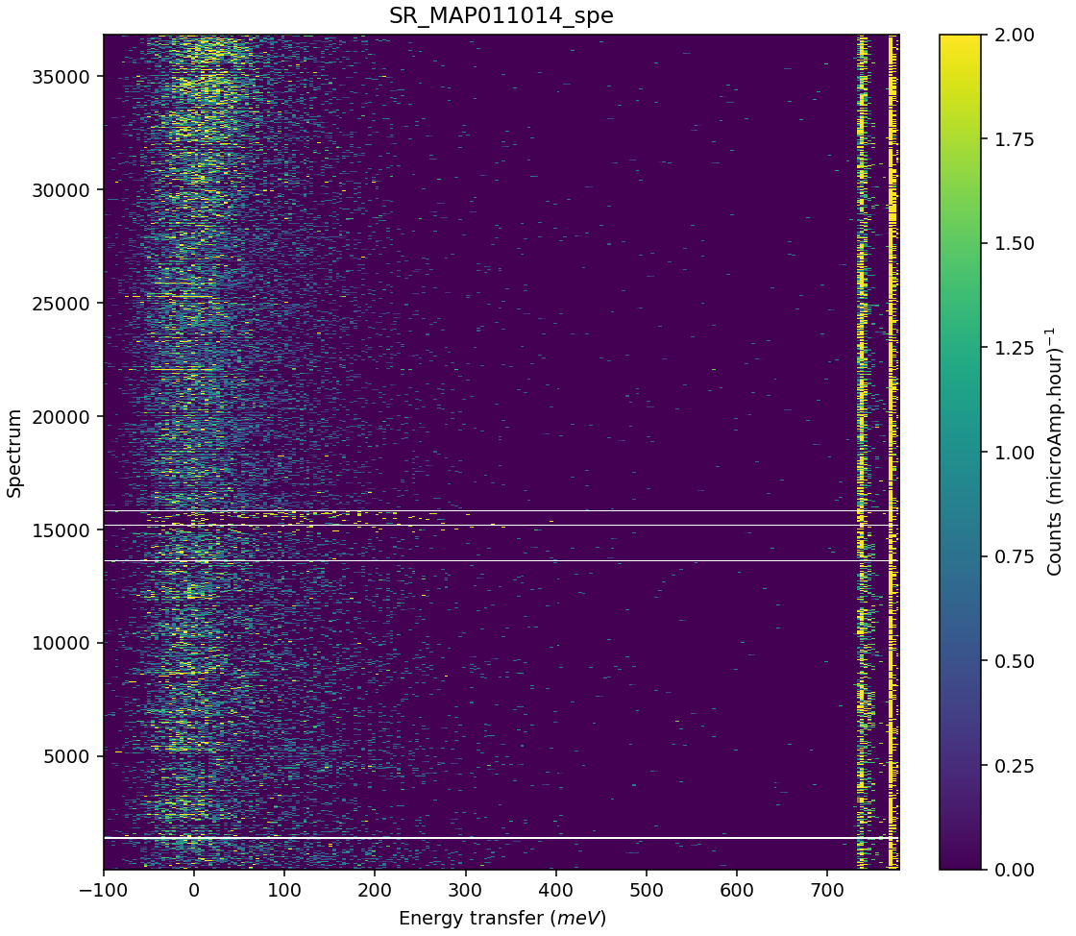
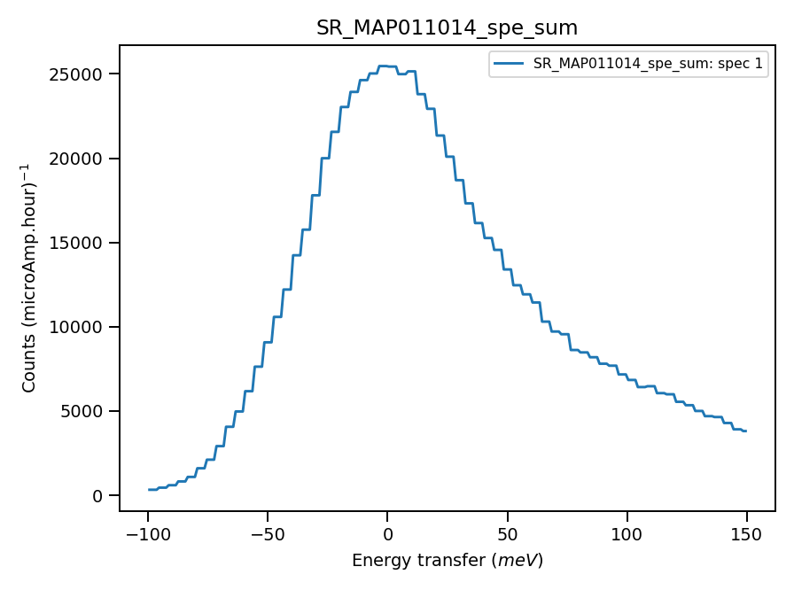
Validate correct incident energy for sample run N11014
Chopper peak around 800meV. Doing Ei on Vanadium elastic line.
Binning range 726meV
When Ei = 785, ΔEi =7.6 Phonons?

Slide 3
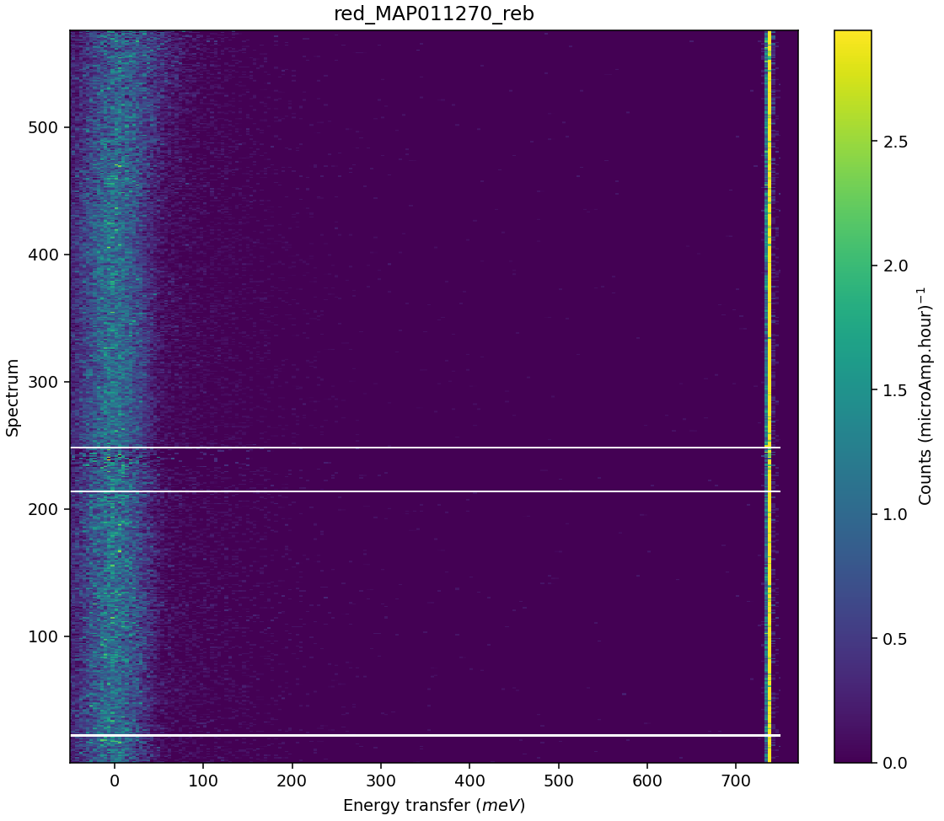
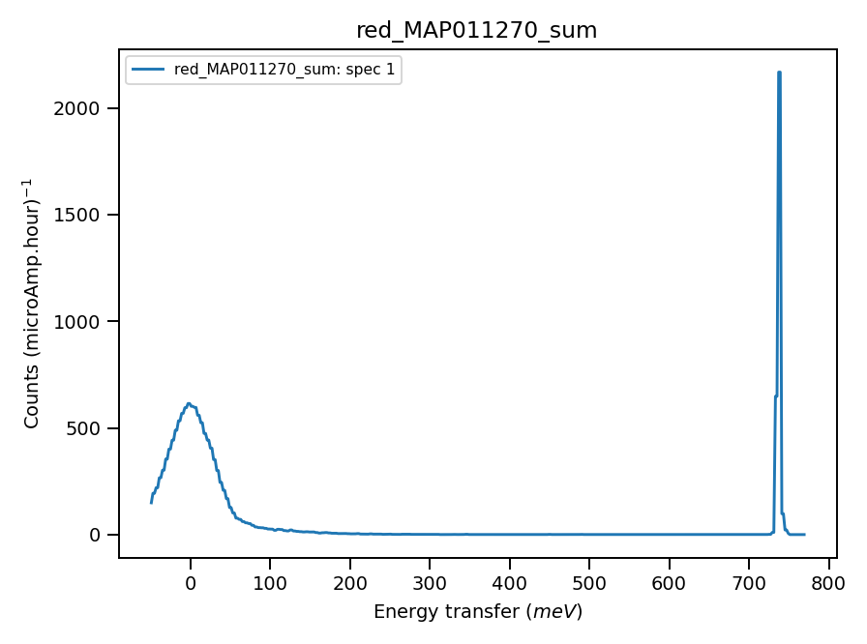
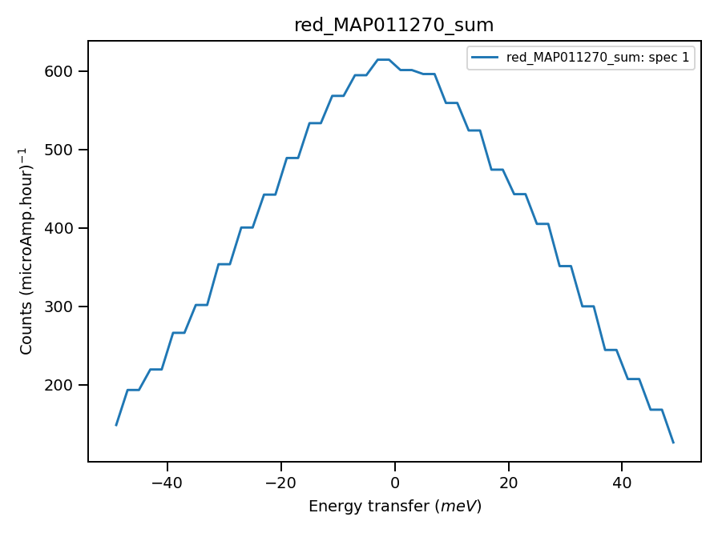
Validate correct incident energy using Vanadium run N120270
Chopper peak around 800meV..
Binning range 720meV from sample
As sample has strong phonons,
Vanadium may work up to 726
When Ei = 785, ΔEi =-0.3

Slide 4
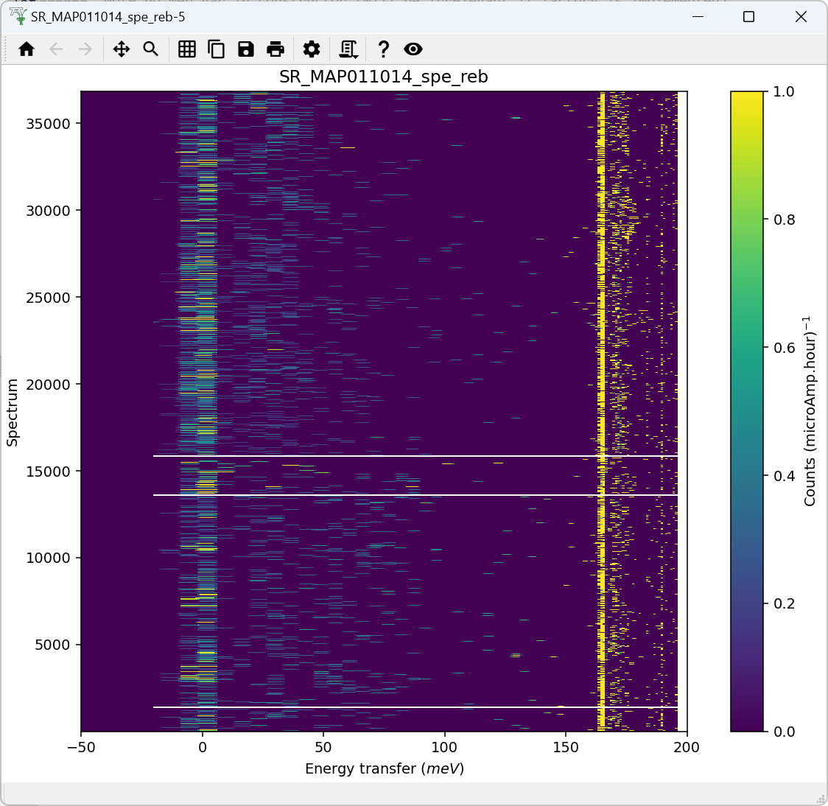
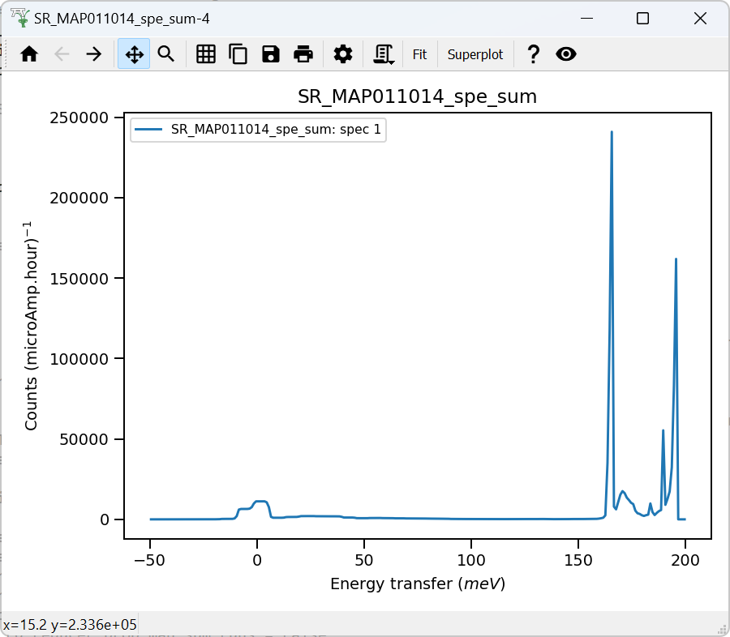
Chopper peak around 195meV. Calibration (Tube delays) necessary. Histogram mode, poor energy accuracy
Binning range 158 meV
When Ei = 195, ΔEi = -0.26

