Slide 1
Ei400

Slide 3
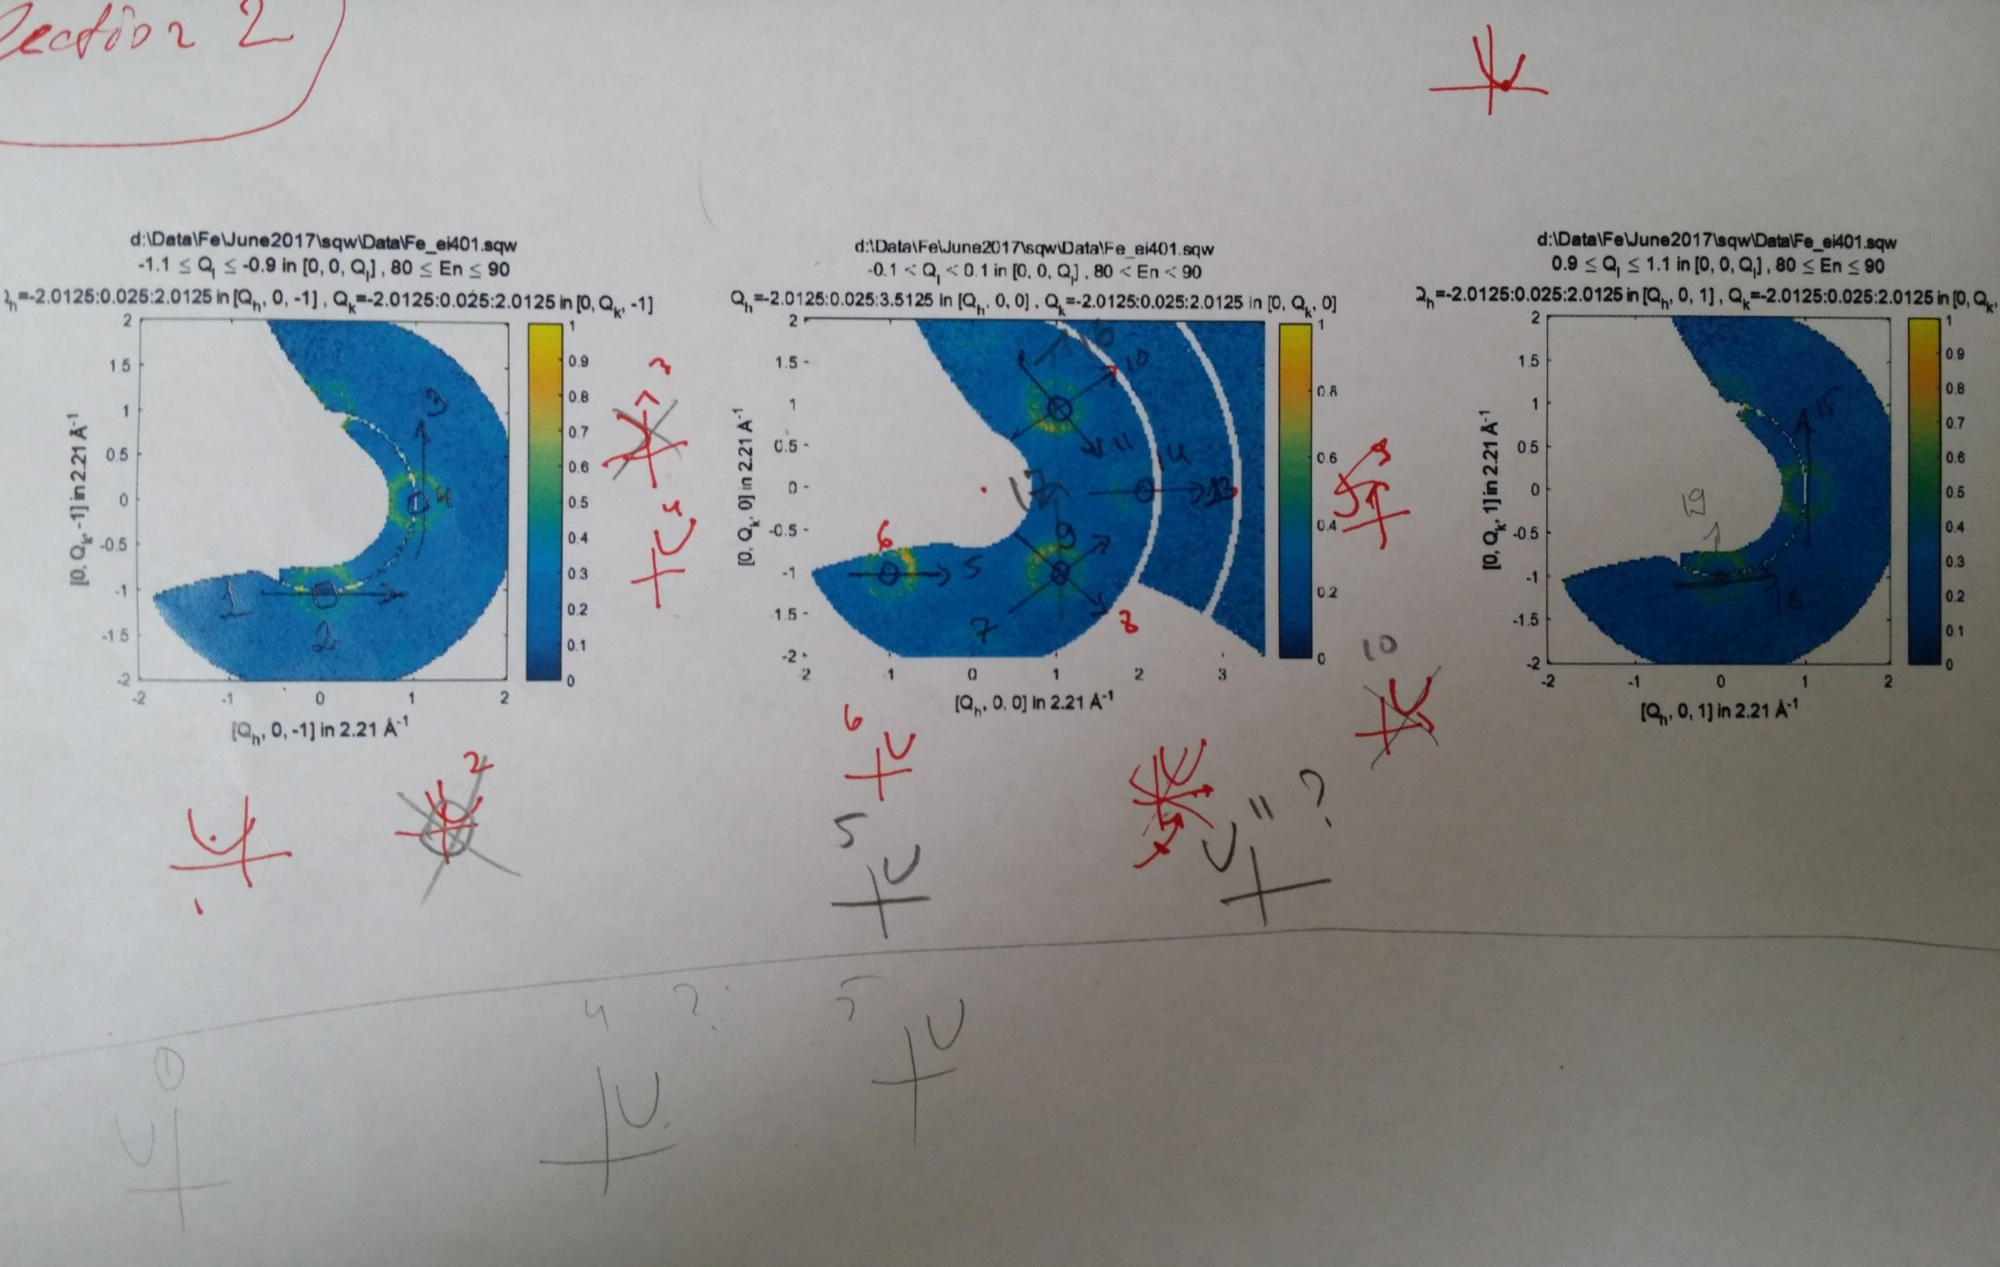
Alignment map

Slide 4
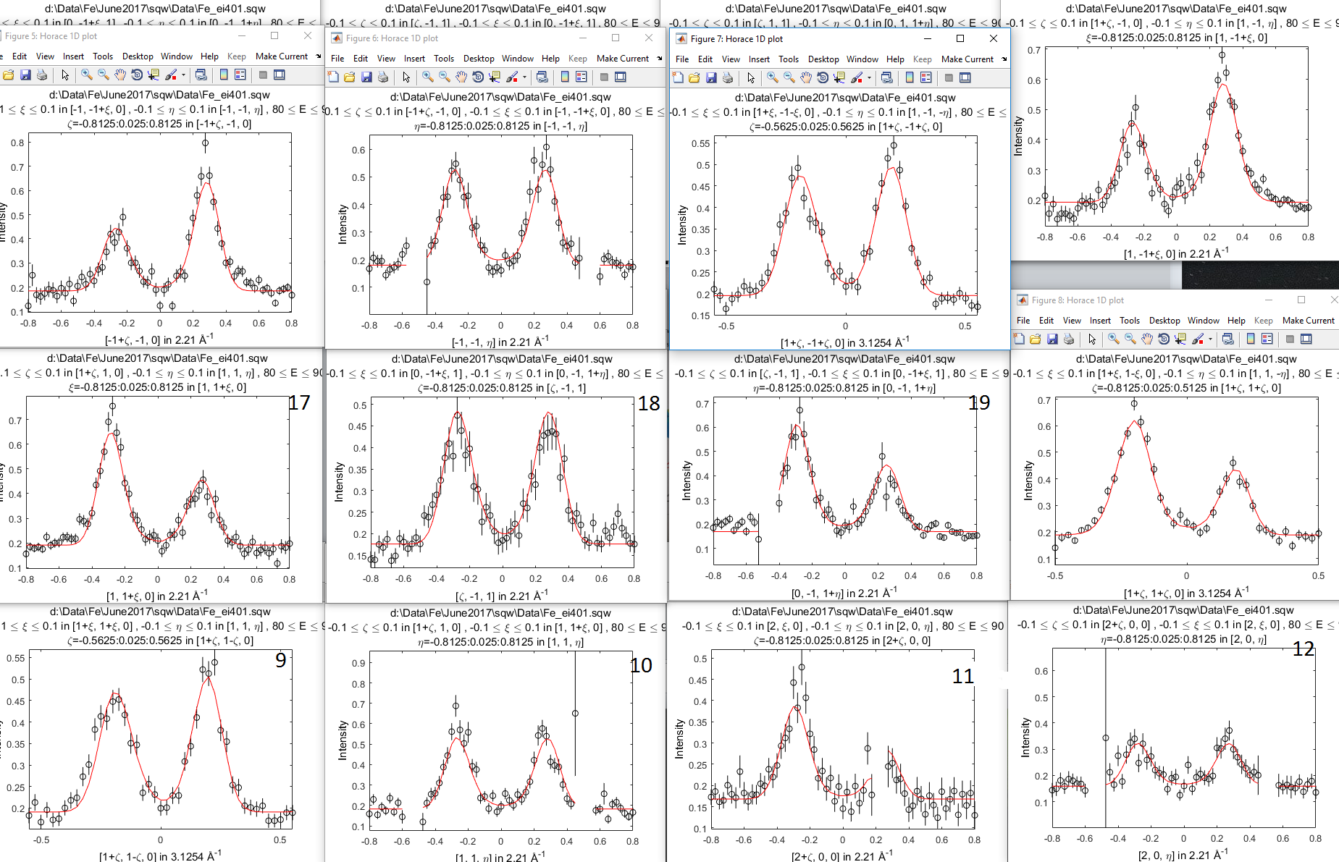
Alignment 19 cuts

