Slide 1
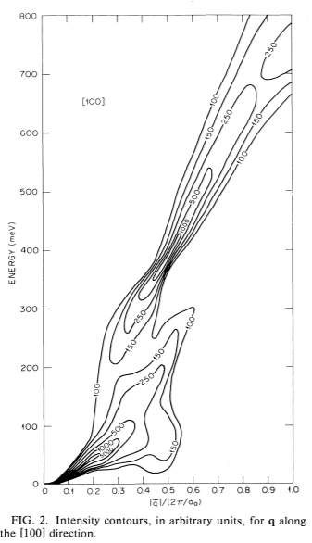
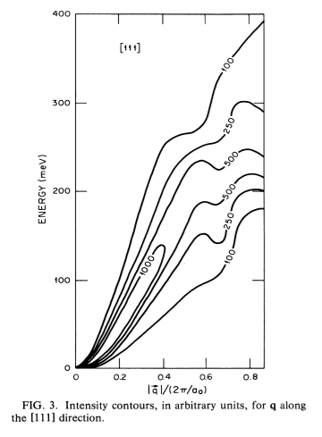
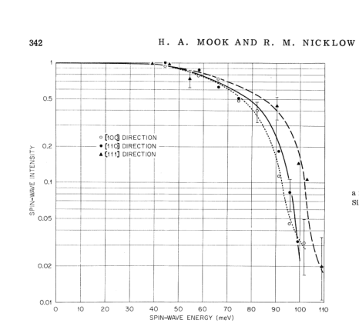
Spin wave excitations in Fe on the basis of band theory
Theory:
Experiment:
Blackman, J. A., Morgan, T. & Cooke, J. F. Prediction of High-Energy Spin-Wave Excitation in Iron. Phys. Rev. Lett. 55, 2814–2817 (1985).
Mook, H. A. & Nicklow, R. M. Neutron Scattering Investigation of the Magnetic Excitations in Iron. Phys. Rev. B 7, 336–342 (1973).

Slide 2
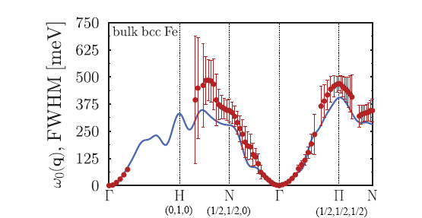
DFT and recent MFT calculations
Buczek, P., Ernst, A. & Sandratskii, L. M. Different dimensionality trends in the Landau damping of magnons in iron, cobalt, and nickel: Time-dependent density functional study. Phys. Rev. B 84, (2011).

Slide 3
Comprehensive neutron scatterings studies using MAPS spectrometer and data analysis using Horace
Full picture of spin waves dispersion
from combining energy scans at incident
energies of 0.2, 0.4, 0.8 and 1.4Ev.
Crystal realignment to Bragg peaks to adjust
lattice parameters and crystal orientation
Fixed magnetic form-factor
Cutting and fitting with background
to partially suppress instrument
resolution effects.
Simulation & resolution effects removal

Slide 4
DFT&MFT&BT-consistent SW cap in <1/2,1/2,0>
E=200-250
E=250-300
E=300-350

Slide 5
No evidence of gap at 100-200mEv (Stoner continuum damping) at least in <1,1,1> direction
Bragg 200, Directions <100> (ΓH), dE=5, dK=0.1
Fitted dispersion
|D|=230 [meV*Α⁻²]
Intensity along dispersion
curve
Bragg 200, Directions <110> (ΓΝ), dE=5, dK=0.1
Fitted dispersion
|D|=212 [meV*Α⁻²]
Intensity along dispersion
curve

Slide 6
Some evidence of narrow hole in <1,0,0> direction (DFT-predicted)?
Gap
Magnetic FF corrected

Slide 7
More evidence of narrow hole in <1,0,0> direction (DFT-predicted) from spherical cut.

