Slide 1
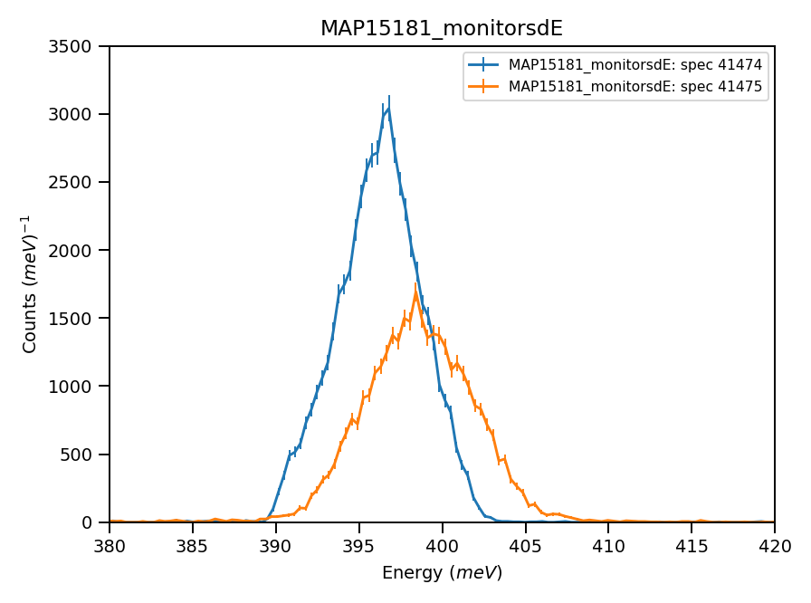
Monitors (15meV hfw):
Using calculated value : 31.65 of absolute units correction factor (TGP)

Slide 2
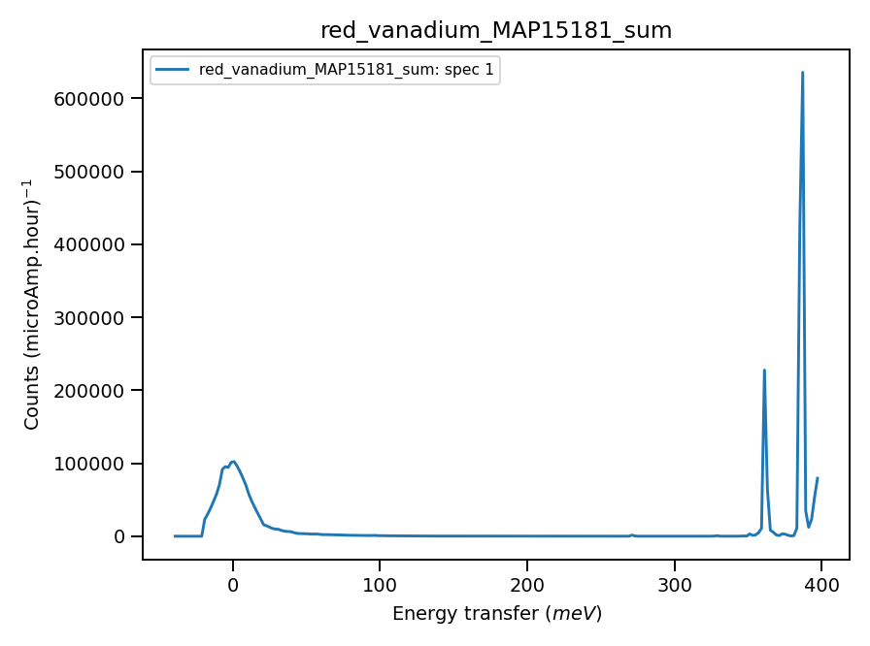
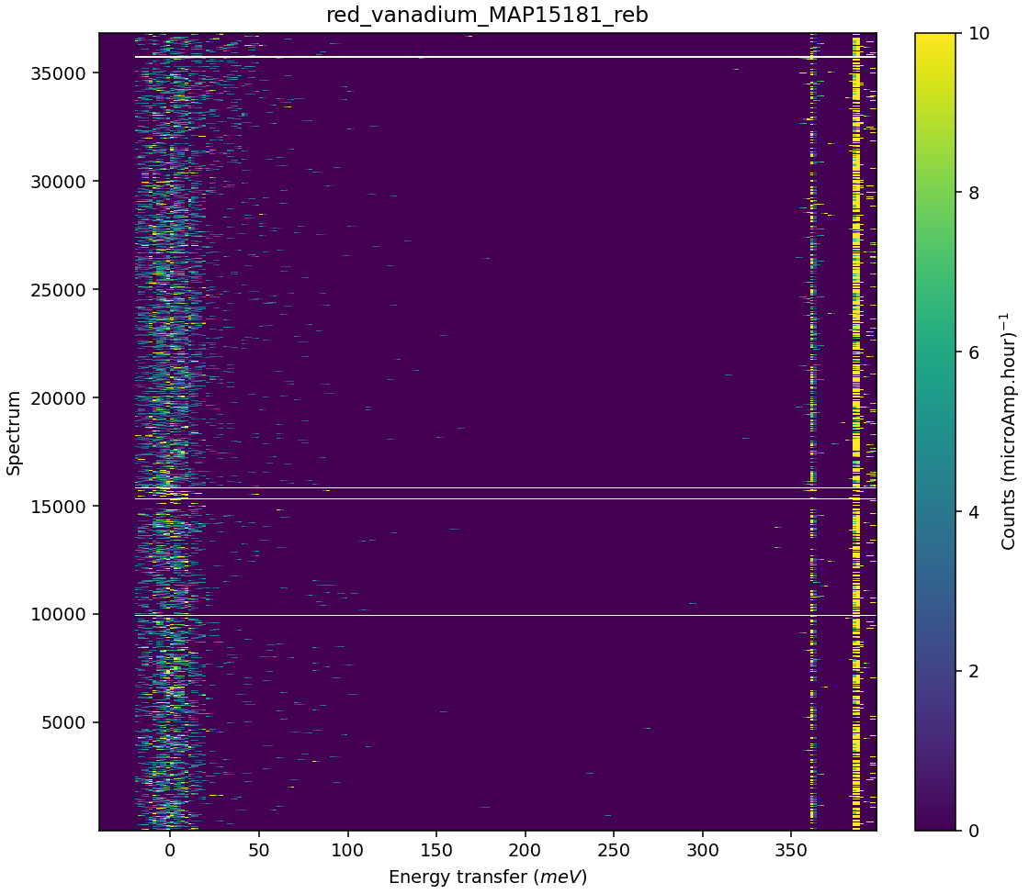
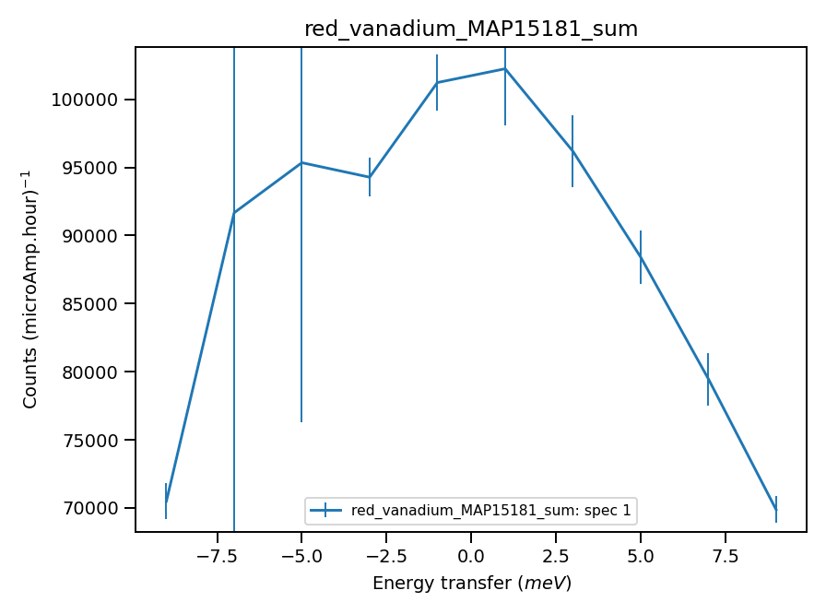
Validate correct incident energy for mono-vanadium run N15181
Chopper peak around 400meV
Binning range 350meV
Correct Ei = 401, so that Ei = -0.13 where

