Slide 1
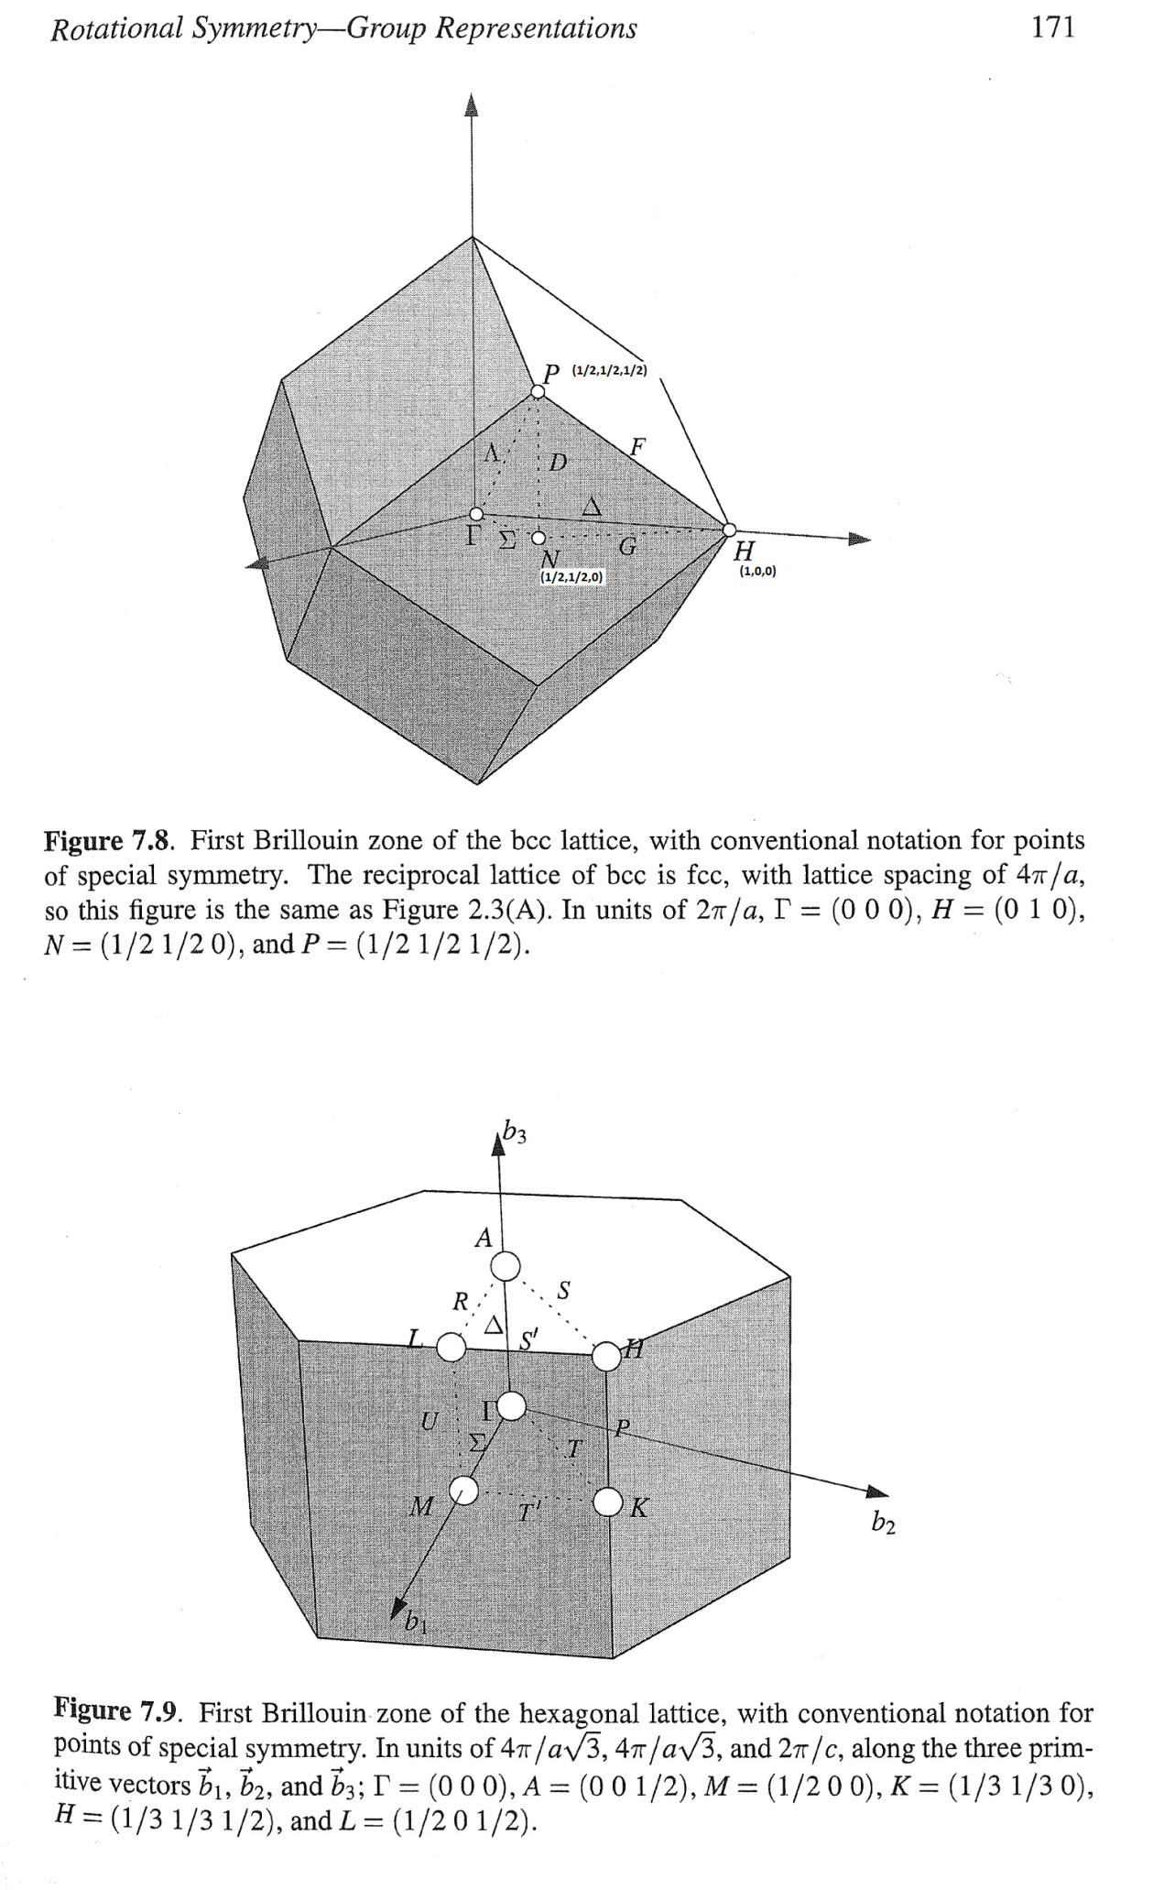
Identifying NP cut. Script at Fe\Article2020\fit_NP_Ei800_allCuts2.m

Slide 2
Background1: edges of np cut at [-0.5,2.5,-0.5]; [0.5,2.5,-0.5]

Slide 3
Partial cuts:

Slide 4
sym_cut with Background1:

