Slide 1
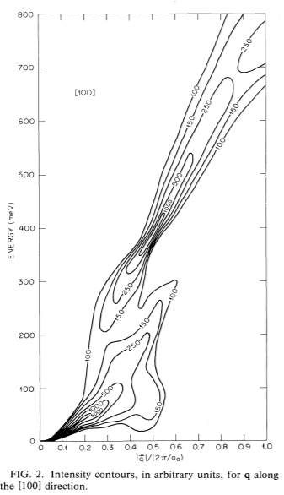
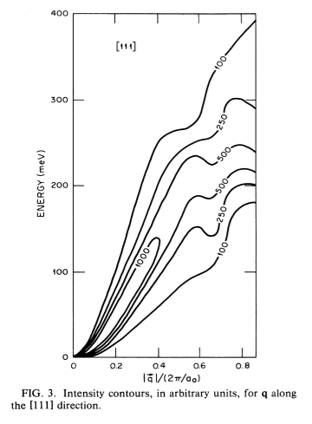
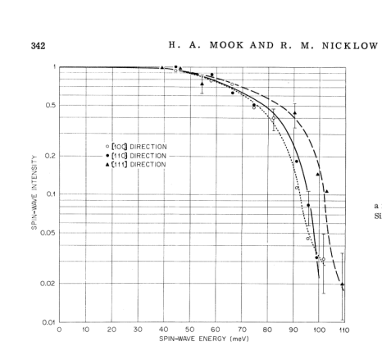
Spin wave excitations in Fe on the basis of band theory
Theory:
Experiment:
Blackman, J. A., Morgan, T. & Cooke, J. F. Prediction of High-Energy Spin-Wave Excitation in Iron. Phys. Rev. Lett. 55, 2814–2817 (1985).
Mook, H. A. & Nicklow, R. M. Neutron Scattering Investigation of the Magnetic Excitations in Iron. Phys. Rev. B 7, 336–342 (1973).

Slide 2
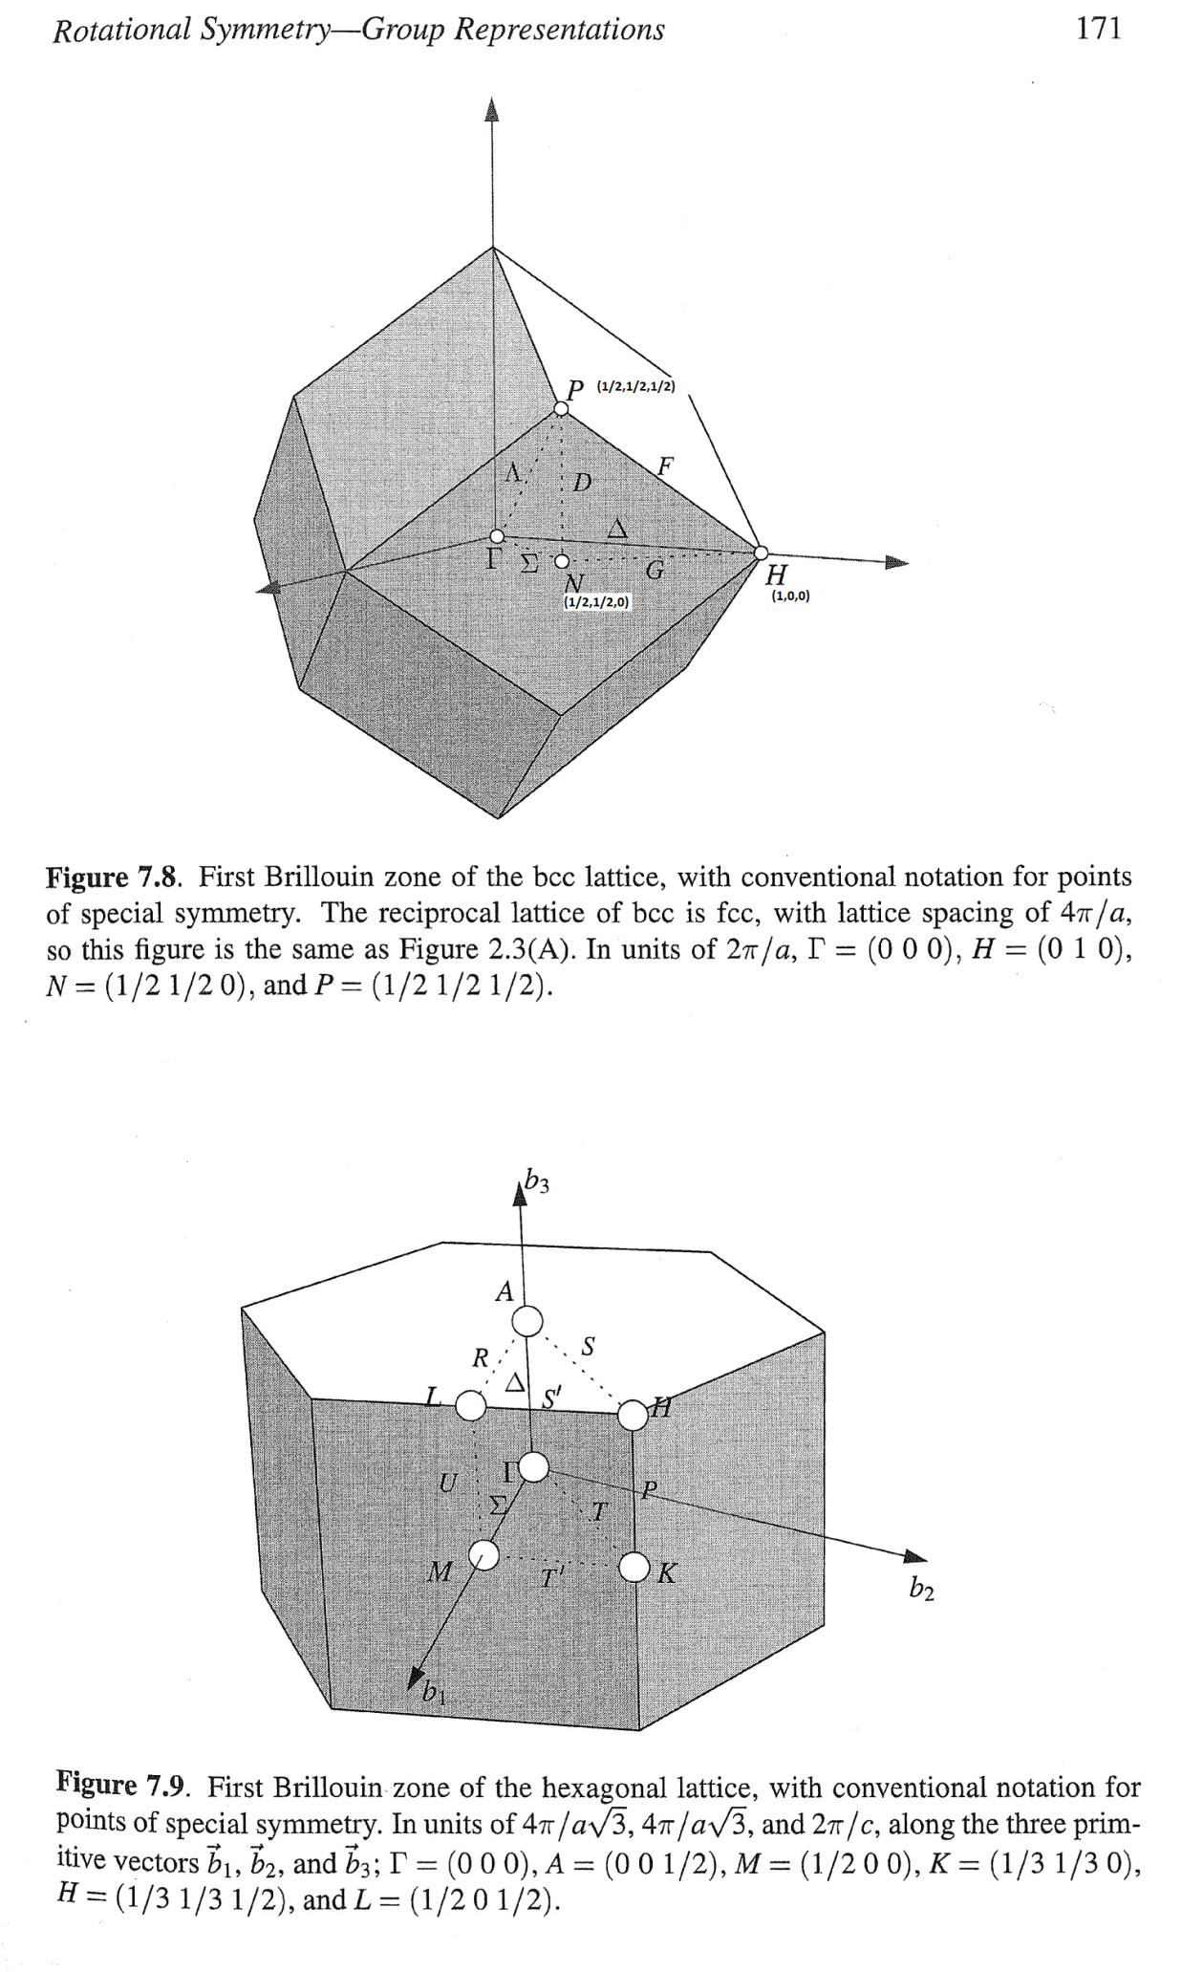
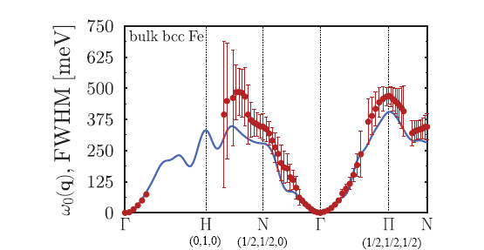
Time dependent DFT calculations
270
255
75
Paweł Buczek, Arthur Ernst, and Leonid M. Sandratskii. Different dimensionality trends in the Landau damping of magnons in iron, cobalt, and nickel: Time-dependent density functional study. PhysRevB.84 (174418) (2011).

Slide 3
Comprehensive measurements of SW excitations in Fe in Ei 200-1400meV using TOF spectrometer (MAPS)
E meV
[0,ζ,0]
[ξ,0,0]
[1+ξ,1+ξ,0]

Slide 4
No evidence of Stoner Continuum gap anywhere in whole 80-200 meV range
Fitted dispersion
|D|=230 [meV*Α⁻²]
Intensity along dispersion
curve
E meV
I (arb. units)
[ξ,0,0]
E meV
May be some evidence for gap in [1,0,0] direction.
(DFT predicted?)
Gap?
[0,ζ,0]
[0,ζ,0]
[ξ,0,0]
[ξ,0,-1]

