Slide 1
High Energy Magnetic Excitations in the Itinerant Electron Ferromagnet Iron Measured throughout the
Brillouin Zone
Alex Buts, H.A. Mook, and T.G. Perring
Iron is:
A classical example of itinerant electron ferromagnet
A textbook example of medium correlated electronic system
The benchmark example of various computational magnetism codes
The system we know all about and can model with high level of accuracy?

Slide 2
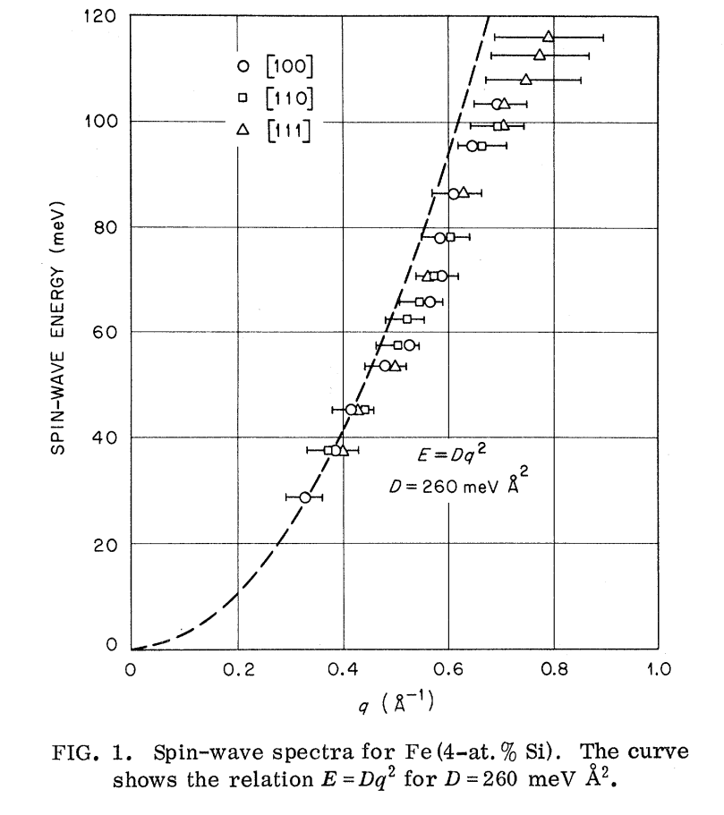
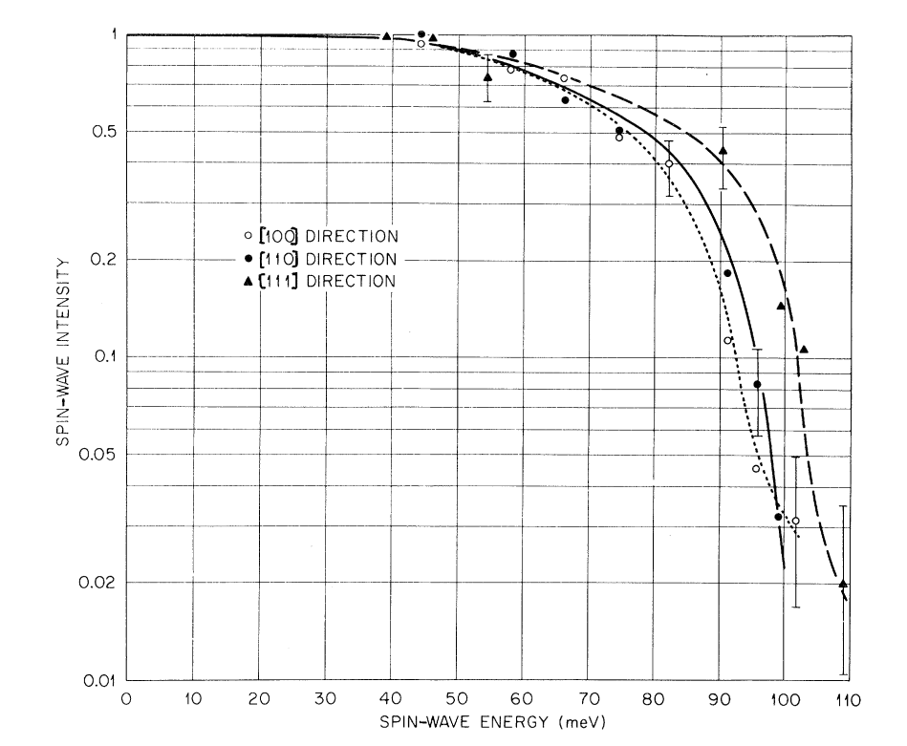
Experiments: Spin wave dispersion and interaction with Stoner continuum (1973)
Triple-Axis: H. A. Mook R;. M. Nicklow; PRB 7(1) 1973 (Fe54+4at%Si)
Spin wave intensity as function of energy for Fe (4at%Si)

Slide 3
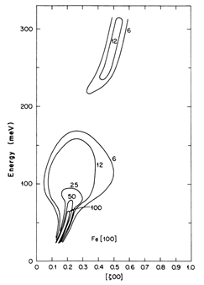
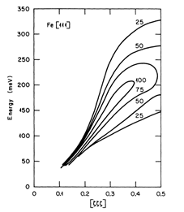
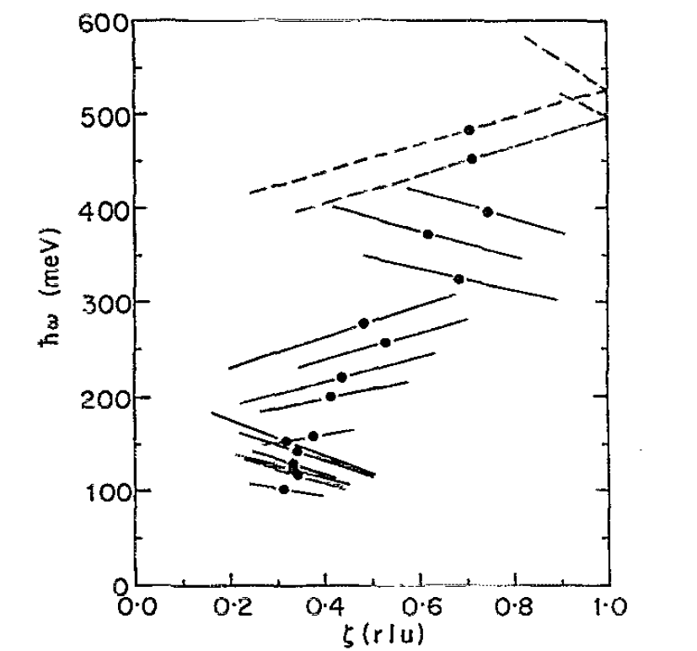
Experiments: Spin wave dispersion and interaction with Stoner continuum
(Triple axis : 1988, TOF: 1991)
Triple axis:
D. McKenzie Paul, P. W. Mitchell; H. A. Mook; U. Steigenberger PRB 38 (1 ) 1988 (Fe54+10at%Si)
TOF instrument:
T. G. Perring, A. T. Boothroyd, D. McK.
Paul A. D. TaylorR. OsbornR. J. Newport;
J. A. Blackman H. A. Mook; JAP 69 (8) 1991
[100]
[111]
[100]

Slide 4
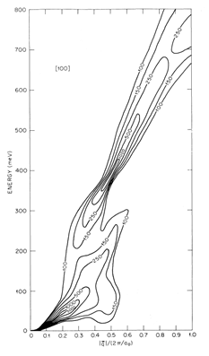
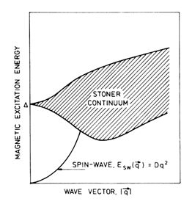
Theory: Classical zone theory wave functions random phase approximation (1985), 2007 – tight binding model.
J. A Blackman T. Morgan J. F Cooke PRL 55(25) 1985
Masayuki Naito; Dai S. Hirashima : J.Phys. Soc. Jpn 76(4) 2007
Predicted energy gap in [100] direction,
caused by interaction with Stoner continuum

Slide 5
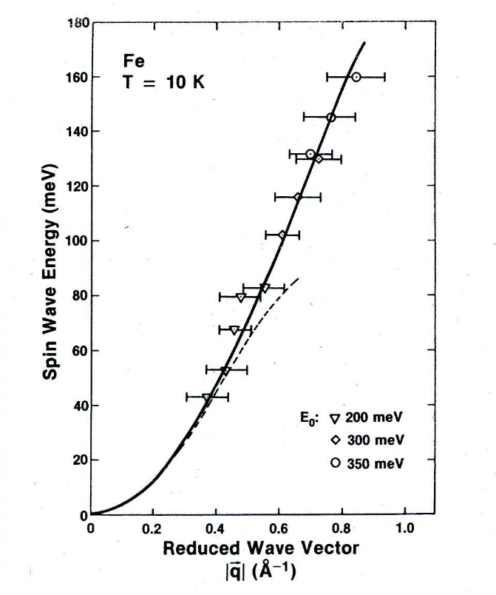
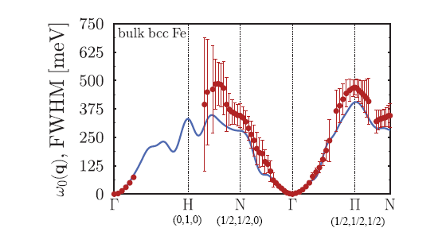
Preliminary evidence of different picture:
1) Inconclusive TOF measurements (1988)
2) linear response time dependent density functional theory (2011)
Experiment: C.-K. Loong; J. M. Carpenter; J. W. Lynn; R. A. Robinson; H. A. Mook; JAP 55(6) 1988
TD DFT sumulations: P.Buczek; A.Ernst; L. M.Sandratskii PRB 84(17) 2011
110

Slide 6
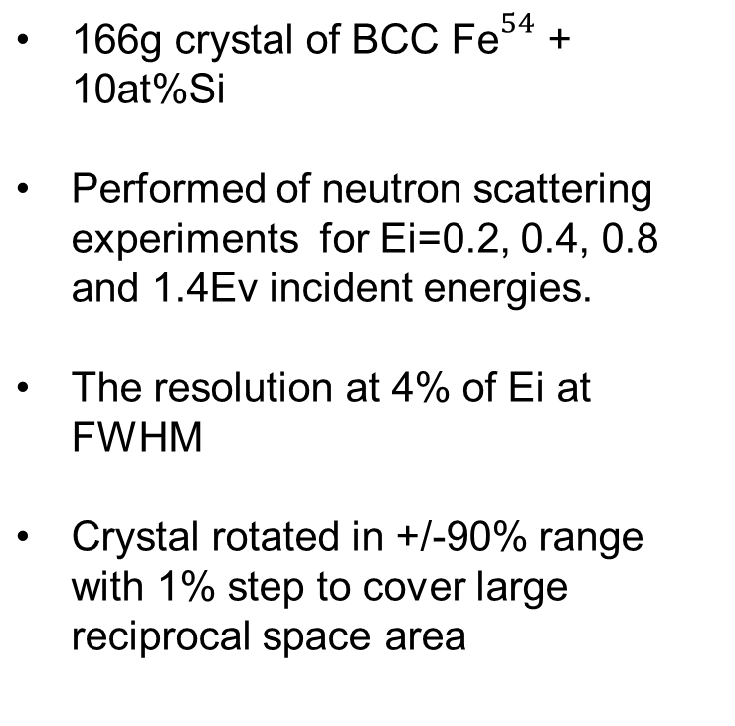
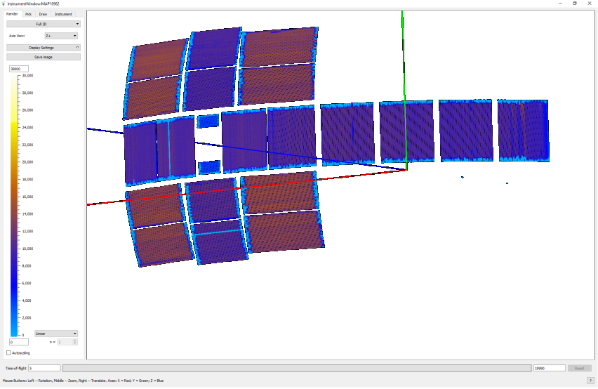
High energy magnons excitation measurements using MAPS spectrometer
http://www.isis.stfc.ac.uk/instruments/maps
First chopper spectrometer to employ a large array of position sensitive detectors, and the first to be designed solely for the purpose of measuring excitations in single crystals

Slide 7
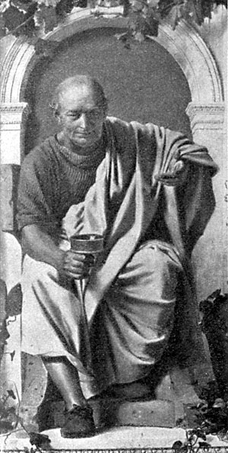
Horace software for data analysis and resolution convolution
http://horace.isis.rl.ac.uk
Horace: Software for the analysis of data from single crystal spectroscopy experiments at time-of-flight neutron instruments
R.A.Ewings; A.Buts; M.D.Le; J.van Duijn; I.Bustinduy; T.G.Perring NIM-A 834(21) 2016
Allows combining various experimental measurements into single
(sqw) file, containing the whole 4D space information
Conveniently select (cut) the regions of interest for detailed analysis.
Simulate various model functions in q-dE range of a cut and
fit the model’s parameters for best agreement with the cut.
Convolute selected model function with instrument resolution
function and fit the model parameters to provide best
agreement between model and experiment

Slide 8
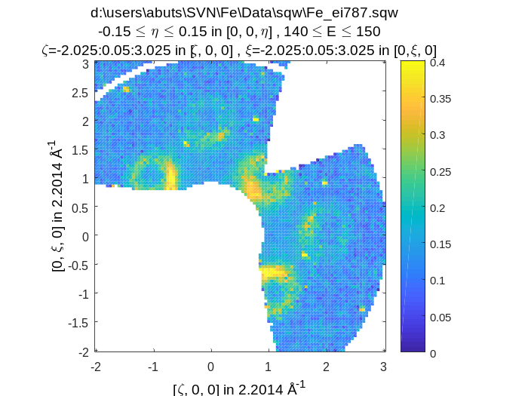
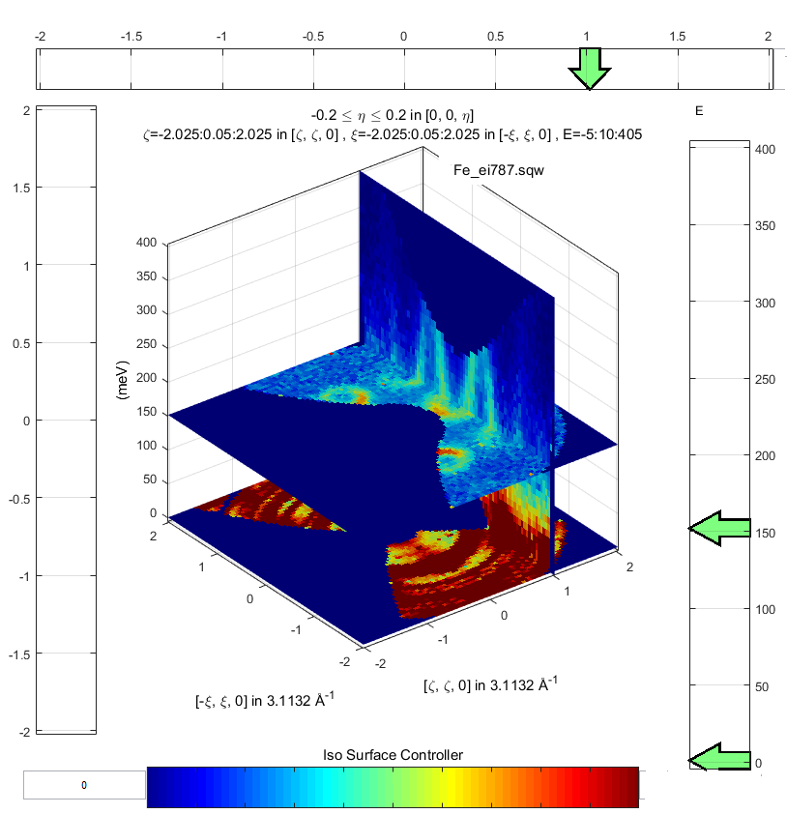
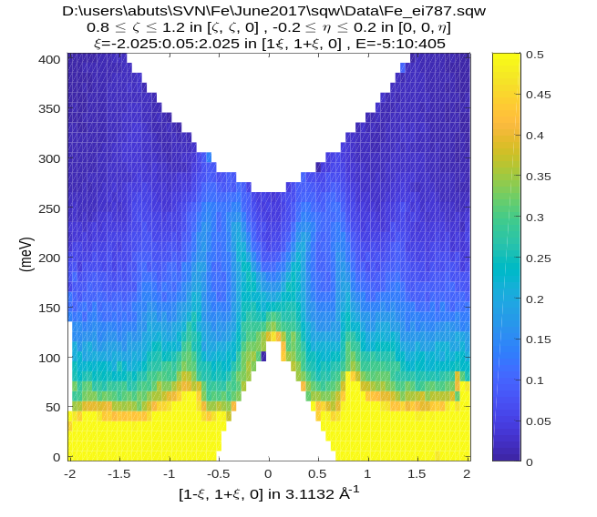
Example: Subsection of reciprocal space showing strong spin waves

Slide 9
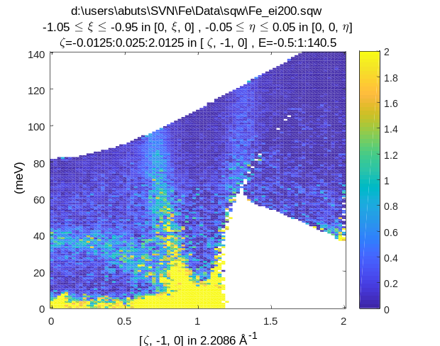
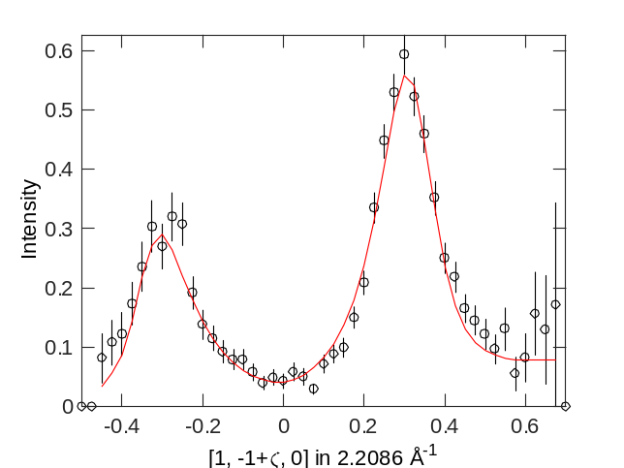
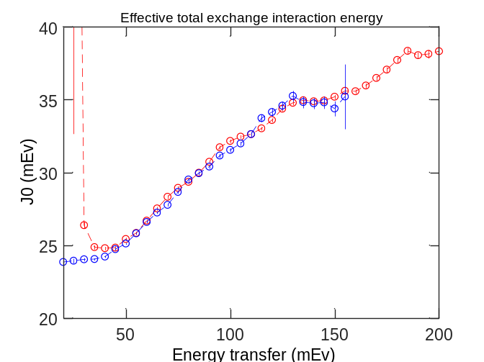
Analysing results: fitting using Heisenberg Ferromagnet dispersion, broaden by damped simple harmonic oscillator preserving static susceptibility convoluted with MAPS resolution function
-- Ei 400 mEv
-- Ei 200 mEv

Slide 10
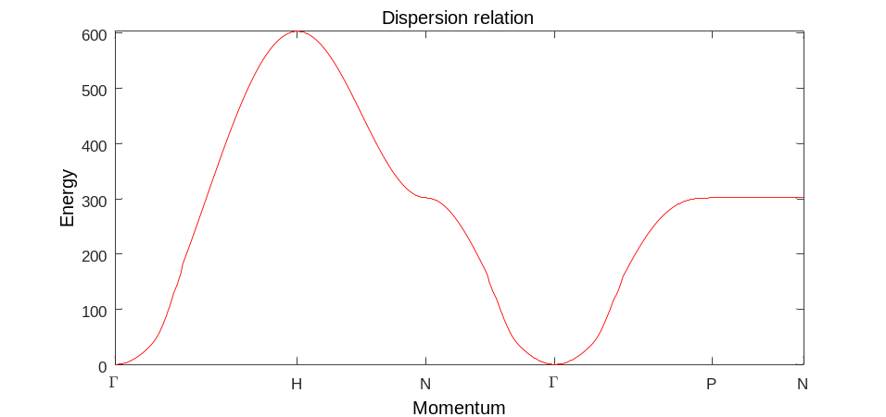
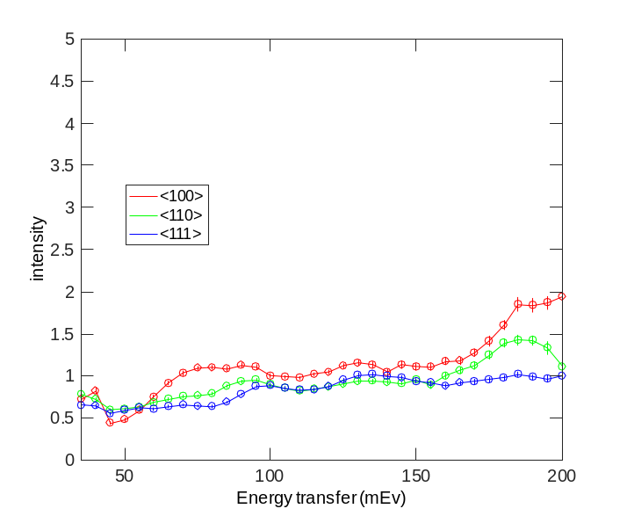



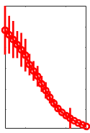
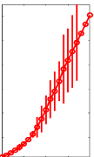
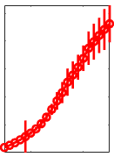
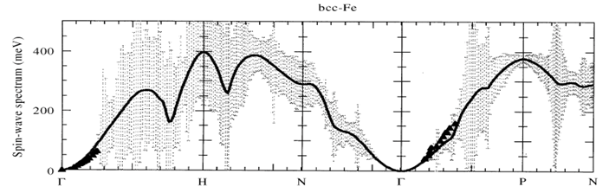
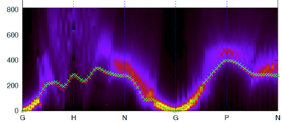
Results and comparison with modelling:
Intensity scale (I) for 3 high symmetry directions
TD DFT for BCC-Fe; Antropov at all, JM&MM 200(1999)
TD DFT Calculations courtesy of Dr Martin Luedes

Slide 11
Conclusions:
High accuracy measurements of magnetic excitations in iron over the whole
Brillion zone combined with advanced data processing reveal magnons
dispersion along the major part of Brilouin zone.
The results contradict the results of the previous measurements and calculations
namely:
We are not observing the spin wave intensity decay at ~90 mEv due
to interaction with Stoner continuum.
We observe well defined spin waves along 100 direction at all
accessible energies
The results are in better agreement with the results of modern TD-DFT calculations
though some details of the predicted dispersion are still different from the one,
observed experimentally.
Further improvement to TD-DFT codes is necessary.

