Slide 1
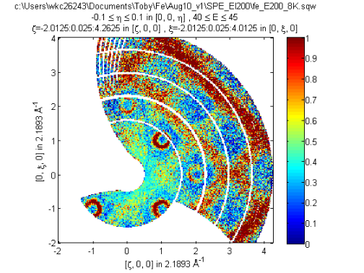
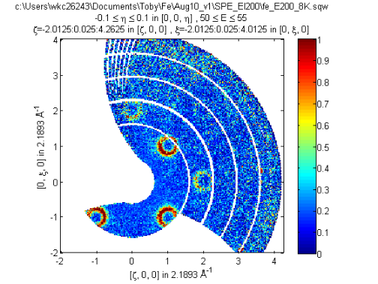
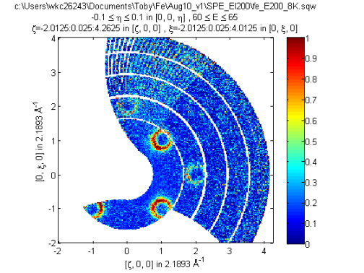
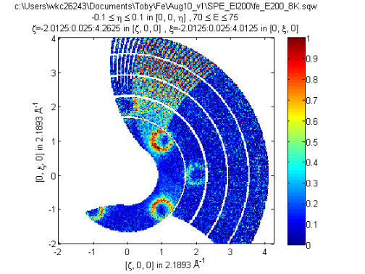
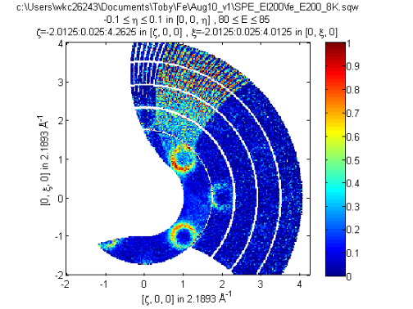
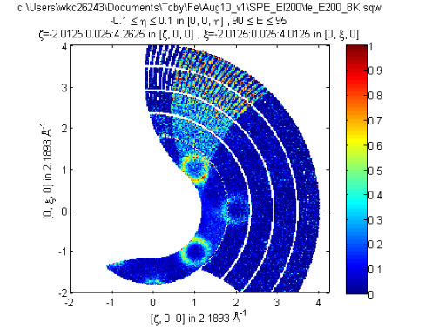
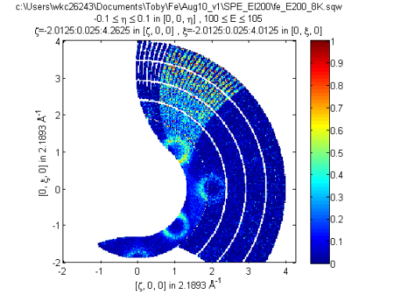
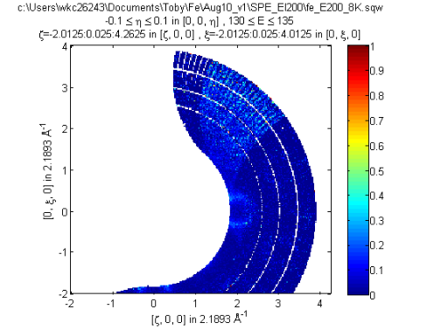

Slide 2
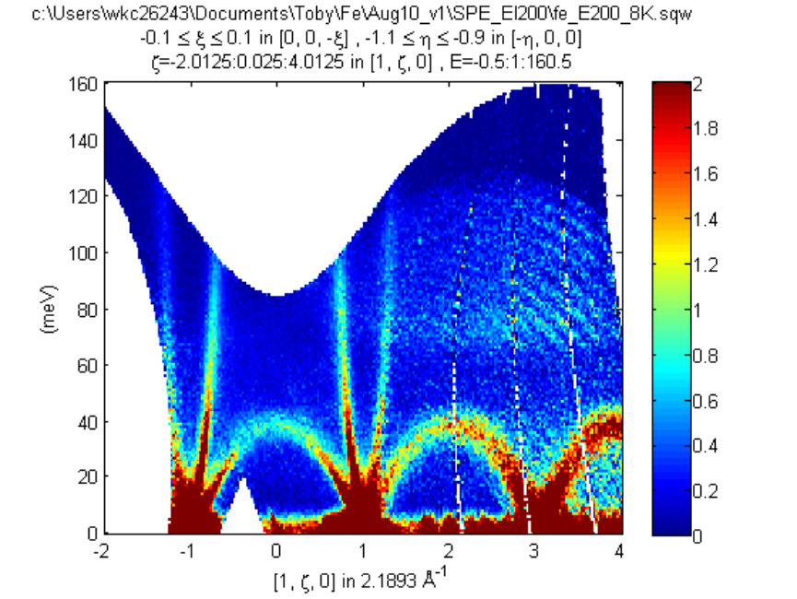
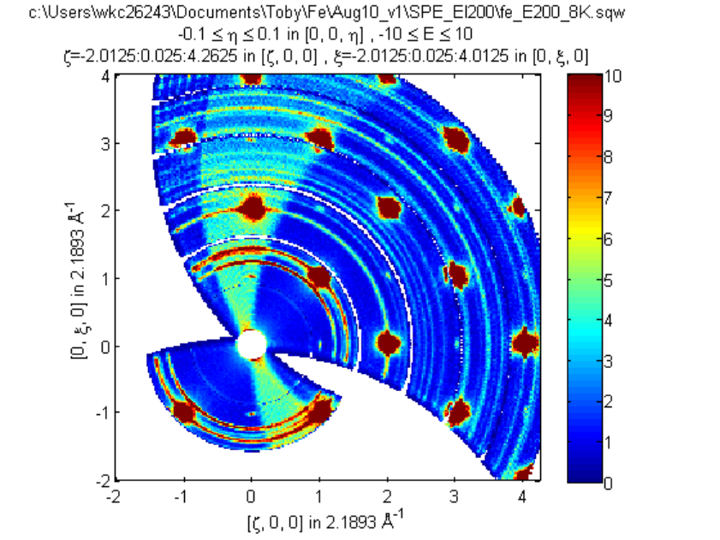
The banch of detectors for runs 15949:15962, fi =-1,-2,-33
calibrated differently but the script treats them equally;
Strange thing: The difference disappears at energy
range from 40>E>60mEv

Slide 3
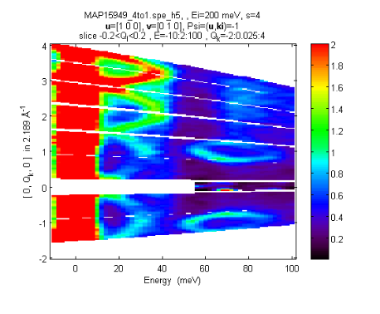
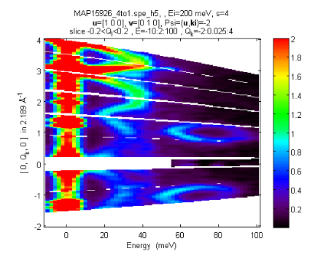
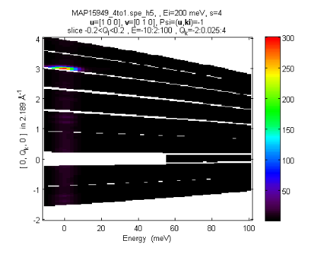
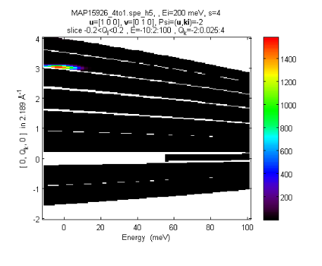
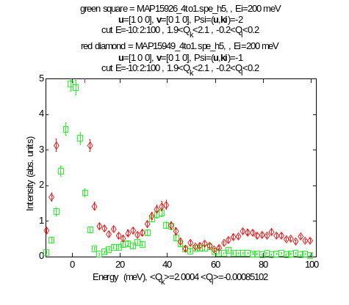
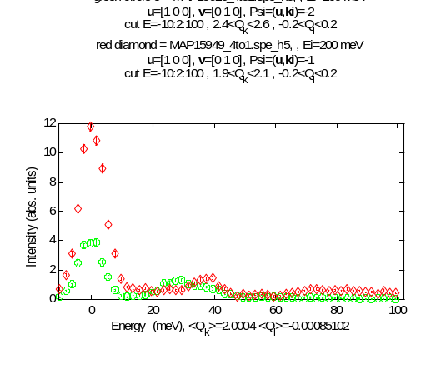
Strange thing: There are no obvious (homogeneous)
difference in intensity of two mslice images of correctly and
incorrectly calibrated sets of detectors:
“incorrectly” calibrated: (psi=-1)
“correctly” calibrated: (psi=-2)
There is clear energy dependence of the differences
between “correctly” and “incorrectly” calibrated runs
The dependence is better illustrated below.

Slide 4
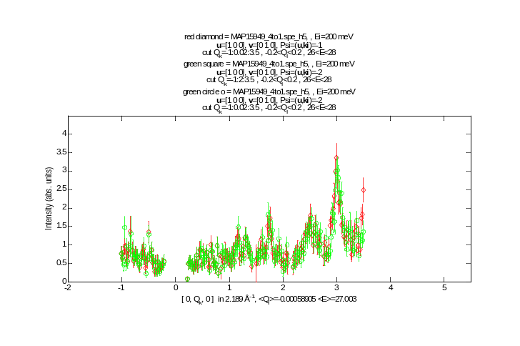
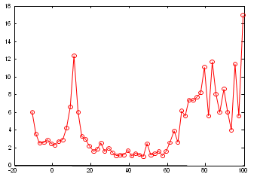
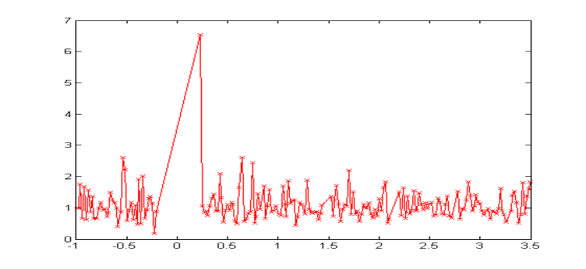
Ratio of intensities for “right” and “wrong” calibrated workspaces
green square = MAP15926_4to1.spe_h5, , Ei=200 meV
u
=[1 0 0],
v
=[0 1 0], Psi=(
u
,
ki
)=-1; -2
cut E=-10:2:100 , 1.9<Q
k
<2.1 , -0.2<Q
l
<0.2
ratuio
Energy (meV), <Q
k
>=2.0006 <Q
l
>=-0.00081495
ratio
Cut at ΔE=26-28meV + ratio of 2 cuts for
worksheets above;
Q_k
In approximately 20 to 60 meV energy transfer range both
runs are calibrated equally. In other ranges the ratio varies

