Slide 1
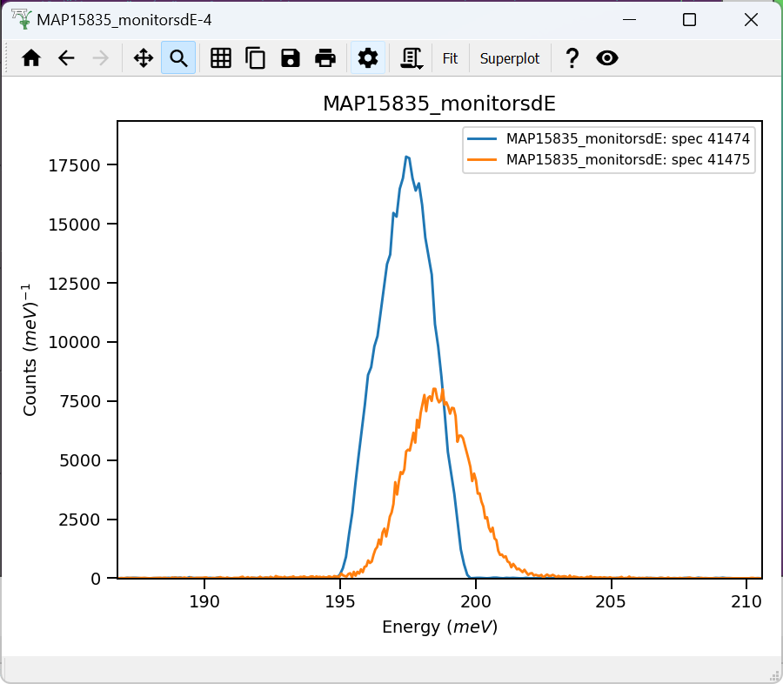
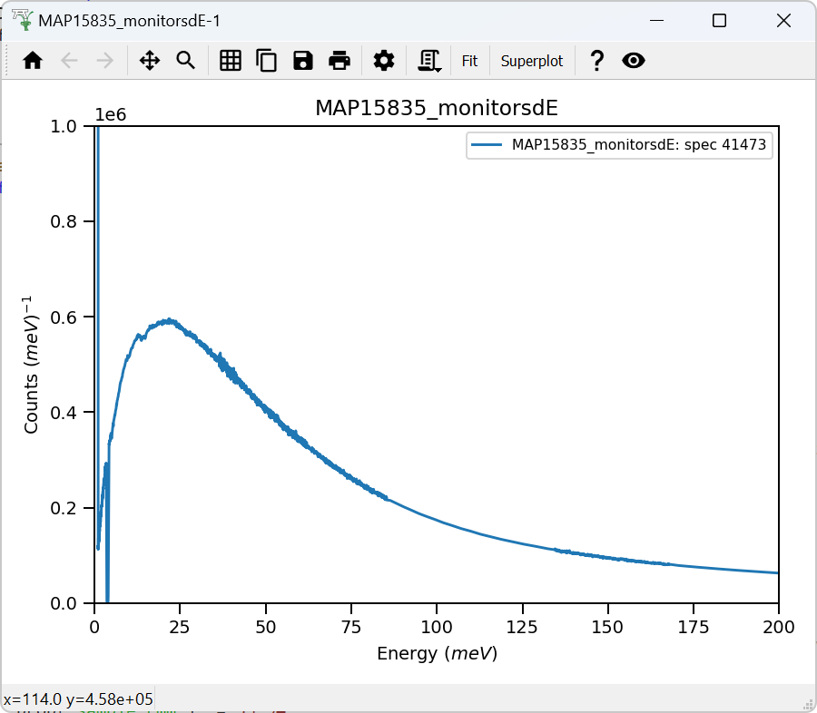
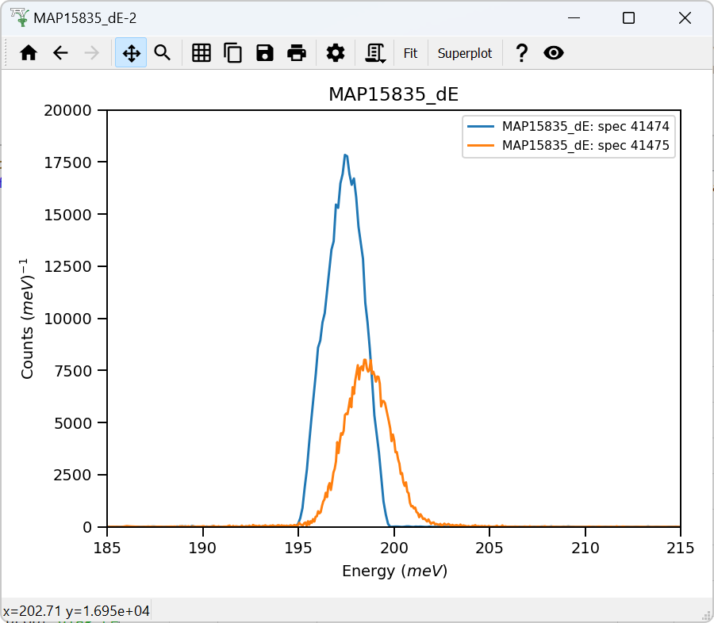
Monitors:
Wrong IDF ?
Calibration with "detector_102_libisis.nxs"
makes no difference to monitors signal position
or elastic line position. Data arrive calibrated by
control program.

Slide 2
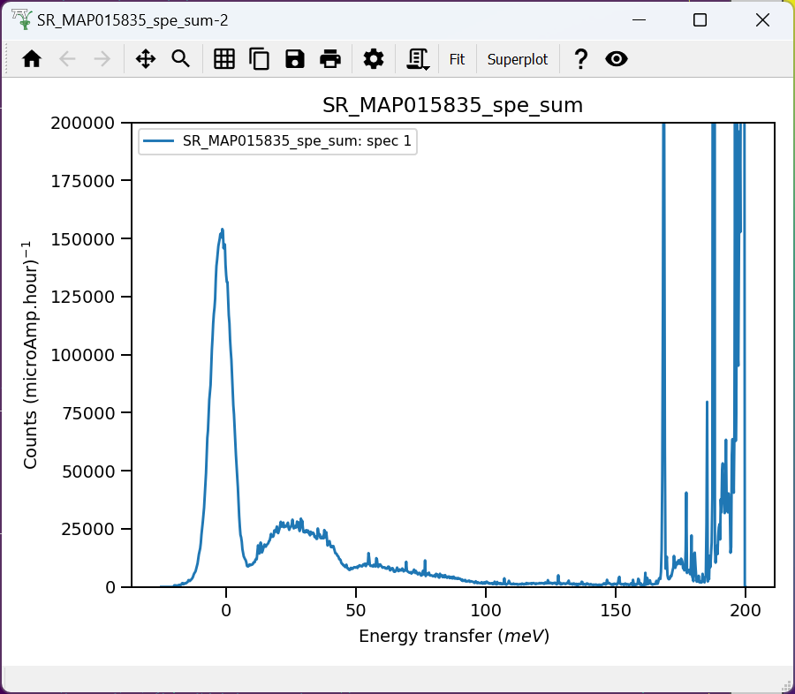
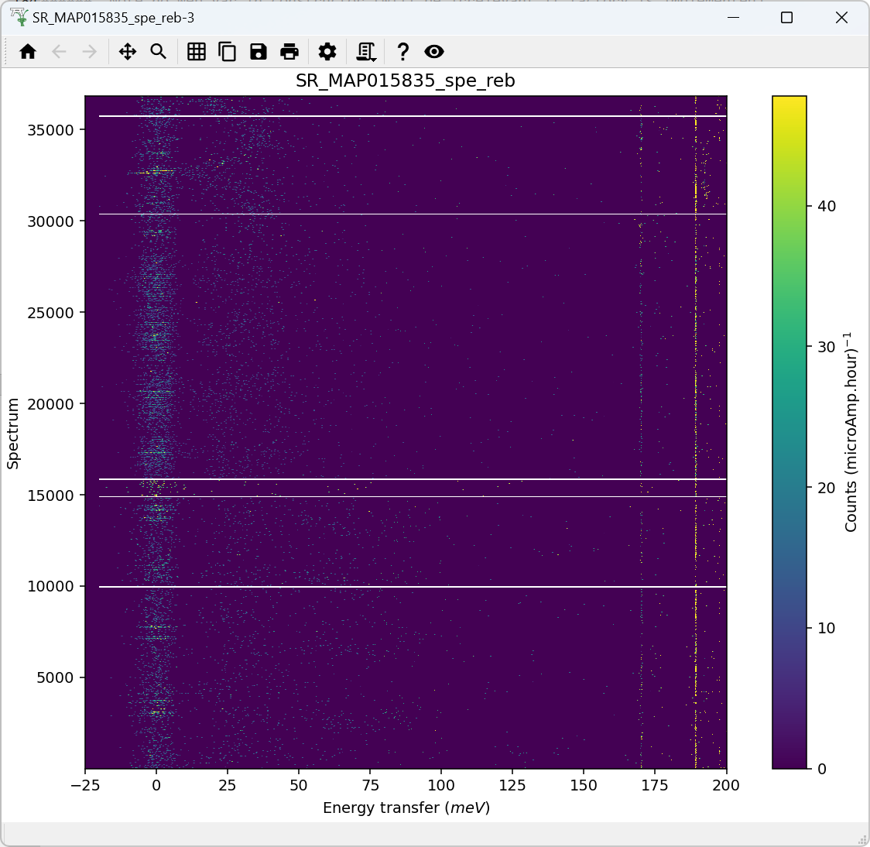
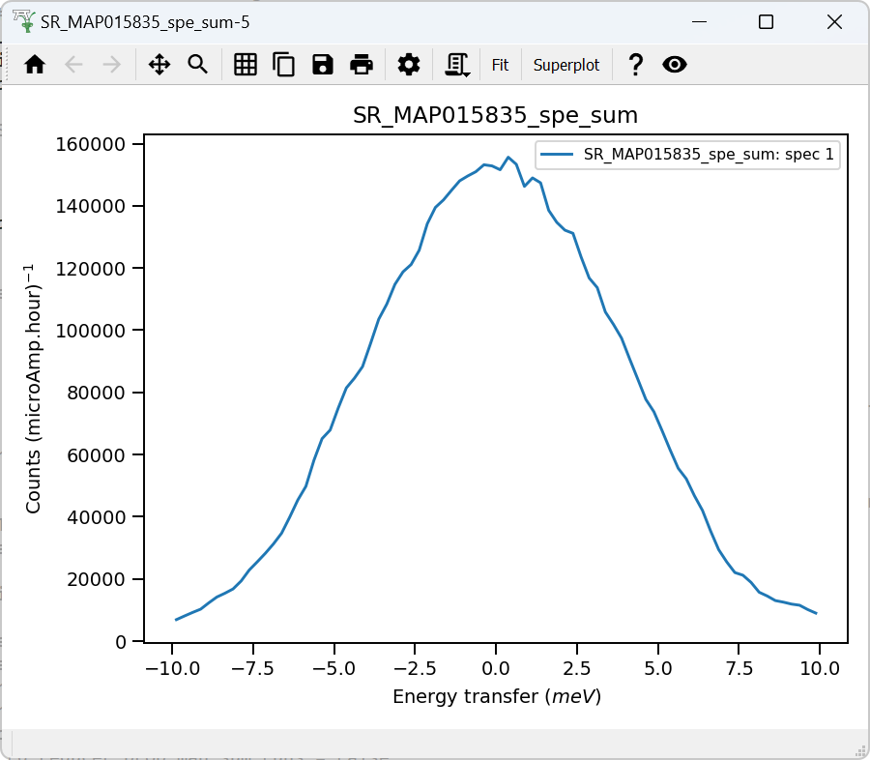

Validate correct incident energy for run N15532
Chopper peak around 201.2 meV
Binning range 166 meV
$$ΔE_{i}={\int_{−10}^{10}{f\left(e\right)⋅e⋅de}}/{\int_{−10}^{10}{f\left(e\right)⋅de}}$$
Correct Ei = 201.2meV, so that ΔEi = -0.007 where:

Slide 3
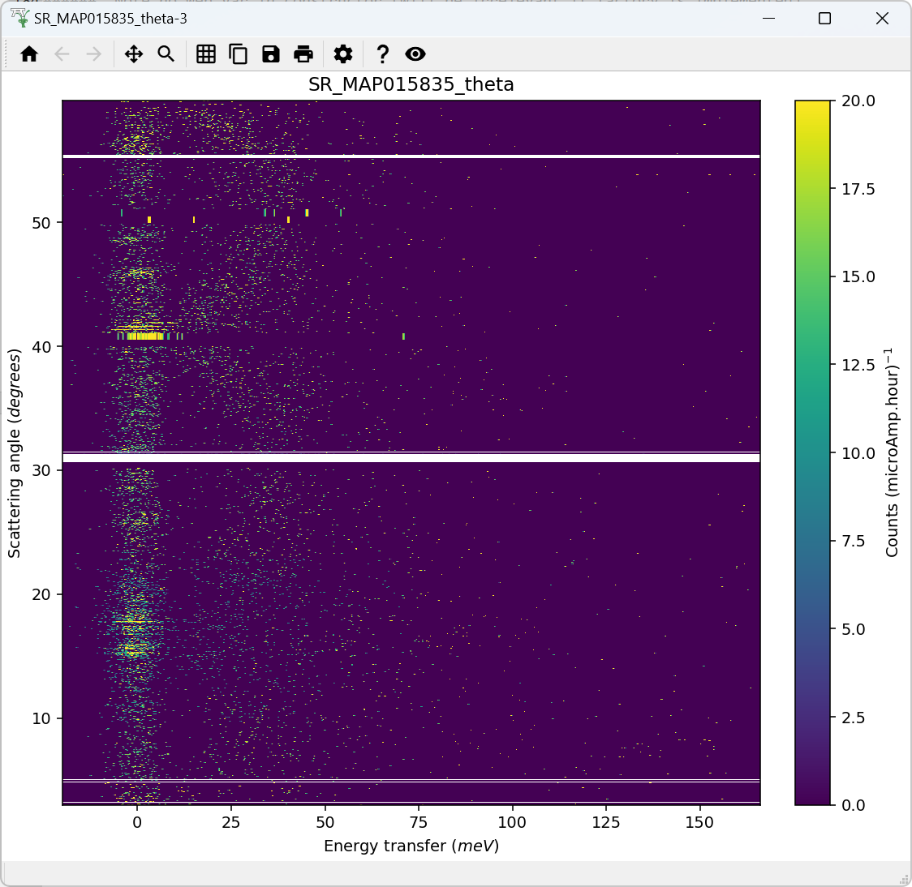
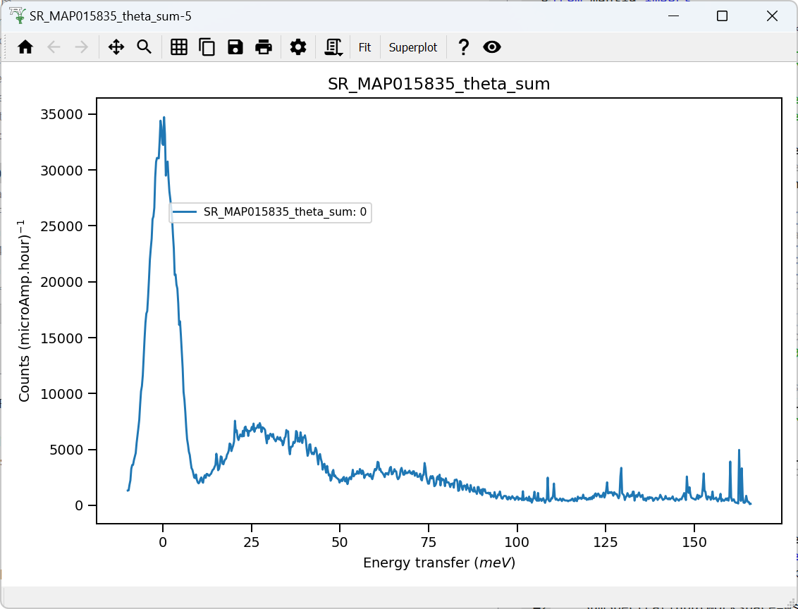
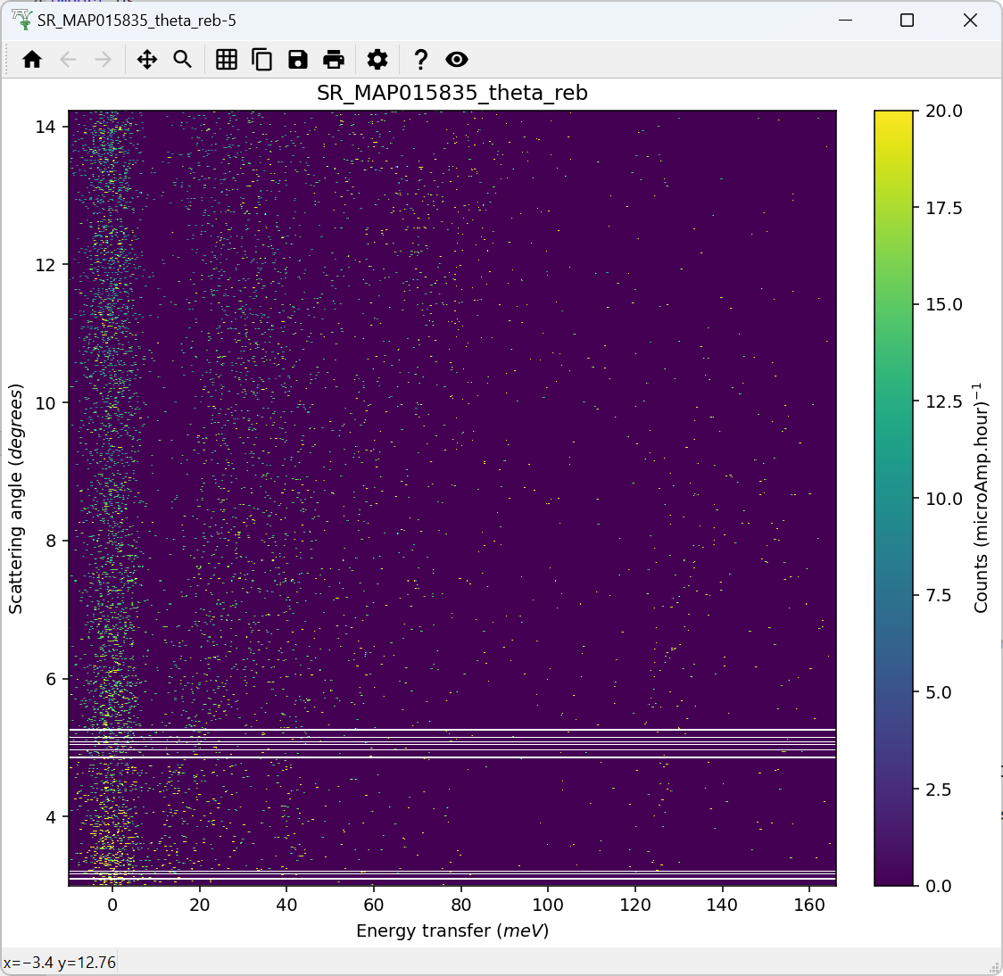
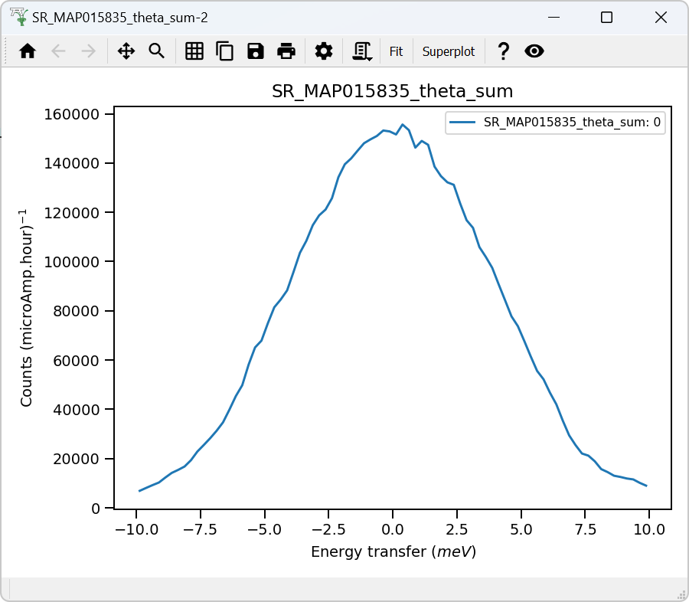
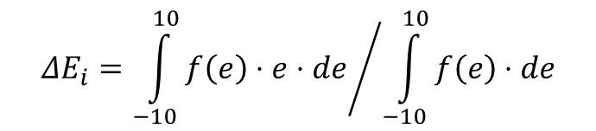
Validate correct incident energy for run N15532; convert to angle, small angle
$$ΔE_{i}={\int_{−10}^{10}{f\left(e\right)⋅e⋅de}}/{\int_{−10}^{10}{f\left(e\right)⋅de}}$$
Correct Ei = 201.2meV, so that ΔEi = -0.007 where:

