Slide 1
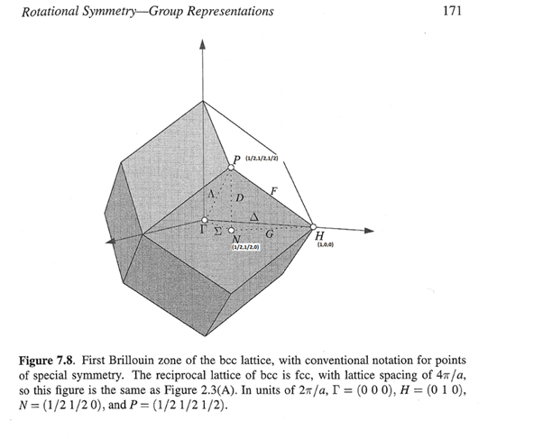

$$Scale=\frac{C}{1−e^{−a∗ε} }∗\frac{1}{π}$$
C=72.7mb/(4*pi*dW*RyTomEv),
a = 1.451meV⁻¹
meV

Slide 2
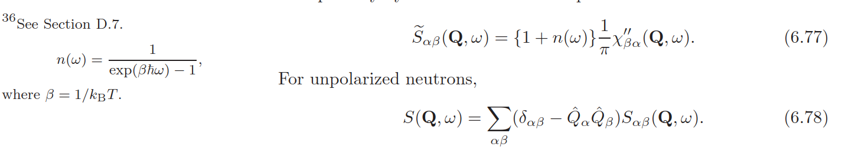
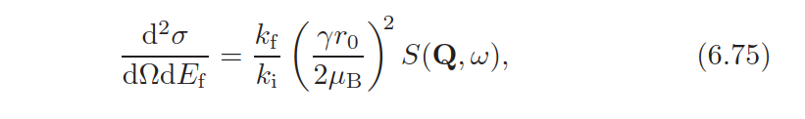

$Ry=\text{13605.693}$*meV
$\frac{d^{2}σ}{dΩ{dE}_{f}}\frac{k_{i}}{k_{f}}={\left(\frac{γr_{o}[m]}{2μ_{B}}\right)}^{2}\left(1+n(ω)\right)\frac{χ^{"}}{π}\left[\frac{{μ_{B}}^{2}}{Ry}\right]=$ $χ^{"}\left(1+n(ω)\right)\frac{γ^{2}{2.818}^{2}∗{10}^{−30}∗{10}^{31}[mBarn]}{4π∗1.36057∗{10}^{4}\left[meV\right]}$=1.6997*10⁻³ $χ^{"}\left(1+n(ω)\right)\left[\frac{mBarn}{meV}\right]$

Slide 3
LDA

Slide 4
GSGW

Slide 5
LDA spaghetti
Linear spin wave theory
fitting

Slide 6
GSGW spaghetti

Slide 7
Amplitude of symmetrised and non- symmetrised SW with and without Magnetic form-factor corrections
Black line – symmetrised with correction
Red line – non-symmetrised
Blue line – symmetrised without correction.

Slide 8
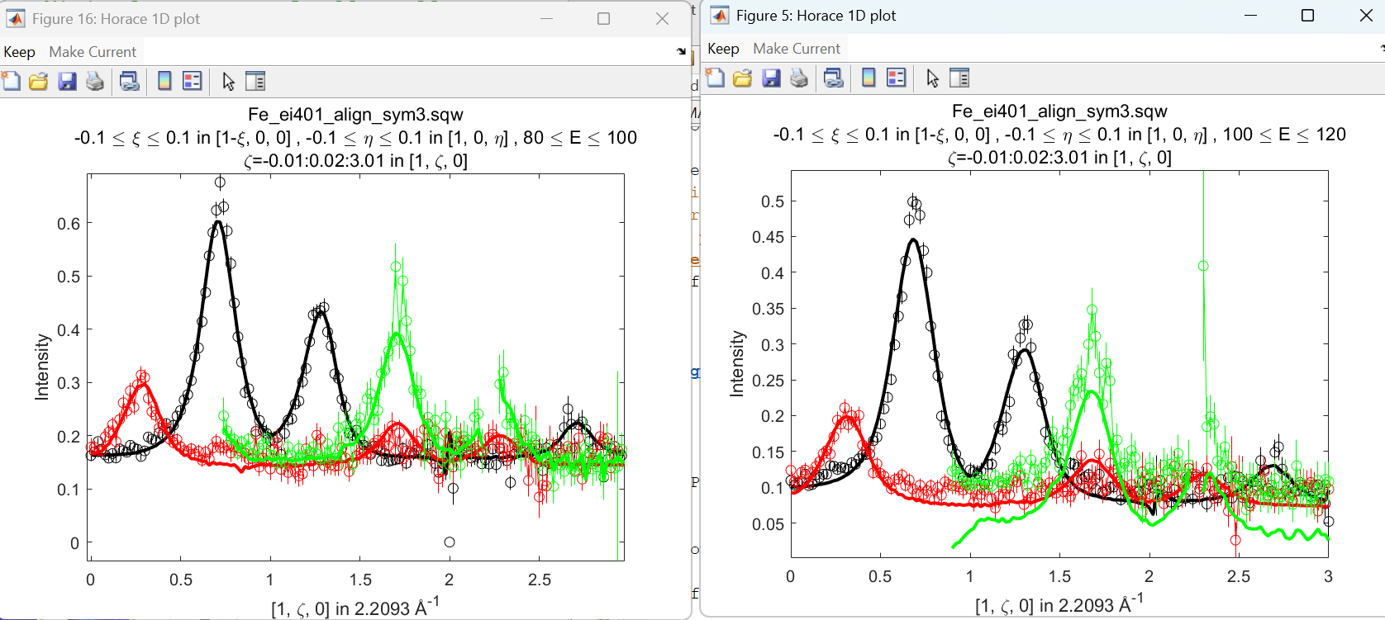
Problem with fitting. Figure 2(5) converges to different amplitude and J, which is not on smooth J line

Slide 10
Problem with magnetic form factors? Peak height for green peaks at ~±1.5 is almost twice of ~±0.5

Slide 11
Problem with magnetic form factors? Peak height for green peaks at ~±1.5 is almost twice of ~±0.5
Const background set at 0.02, peak amplitude selected manually.
Sqrt(2^2+0.3^2)=2.03
2.59
2.33
Sqrt(1+2.7^2)=2.88

Slide 12
Problem with magnetic form factors? Different issue. Peaks fitted with common background for each colour
1.68
2.03
1.64
2.61
2.33
2.88

Slide 13
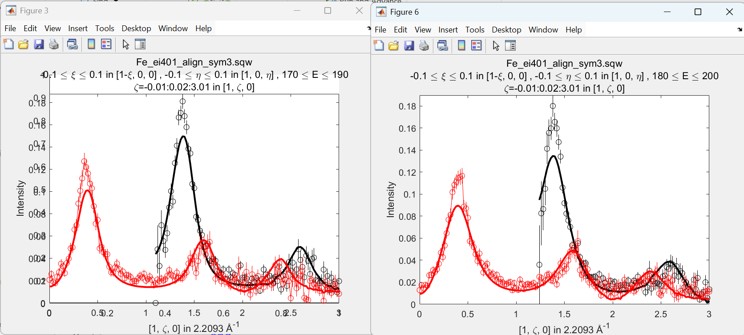
Problem with fitting. Figure 3(6) converges to different amplitude and J, which is not on smooth J line

Slide 14
Fitting 2D cut:
Fitting 1D cut:

Slide 15
Symmetrised:
For 200meV dataset is possible to fit double-exponential background separately and then fit data using this
background. The result is Ei200meV extern bg.
For 400meV ds, background looks too high even if taken from central part of SW? Strange
Ei400 2D cuts with 2-exp fit background, 1 st amplitude fit vs 1D cut with fit base bg

Slide 16
Fitting around <2,0,0> for 3 Ei. DSHO. High Ei data – first fit, Ei200 and 400 subsequently refitted to peaks only
Fitting around <1,1,0>, choosing minimal Q variation(~same magnetic FF); fit all (markers) and fit peak(connected)

Slide 17
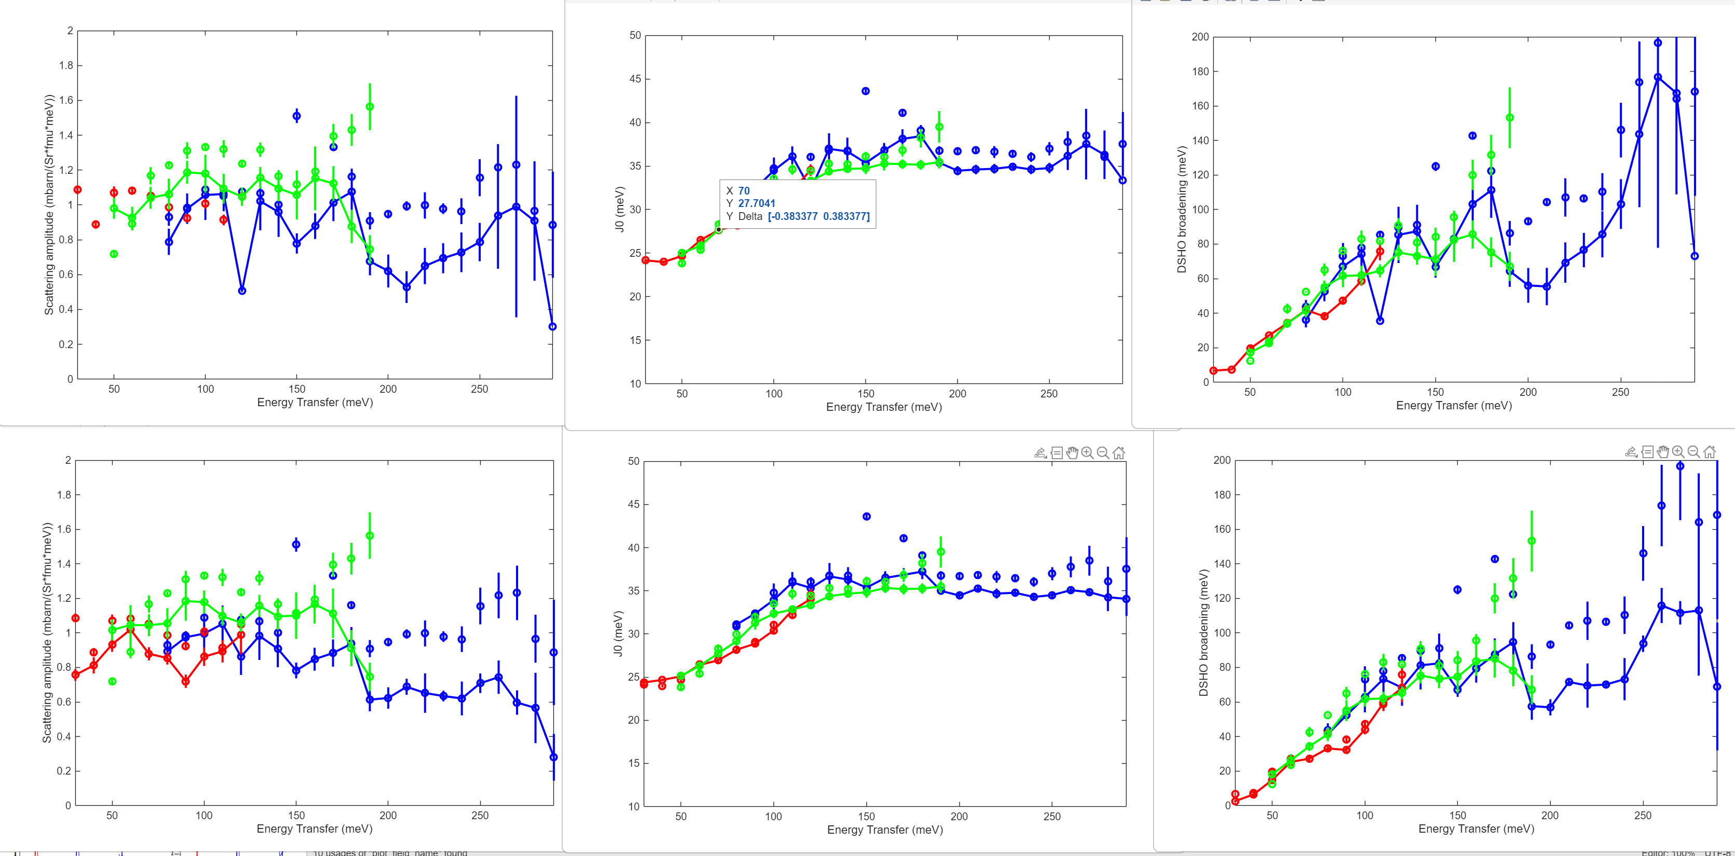
Peak fitting. Comparison between fitting background with fixed slope (bg intensity changes –lower fig)
and variable slope (intensity and slope change – upper figs).
3 incident energies. Dots – fitting whole 2D cut, lines – fitting peak cut up to 0.8 its intensity.

Slide 18
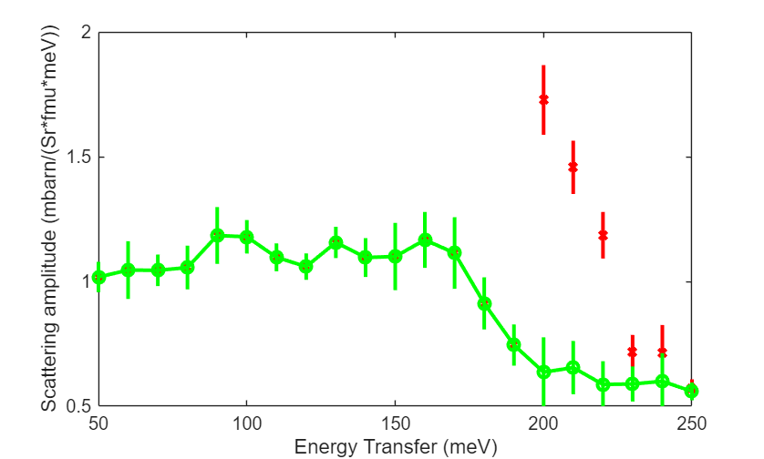
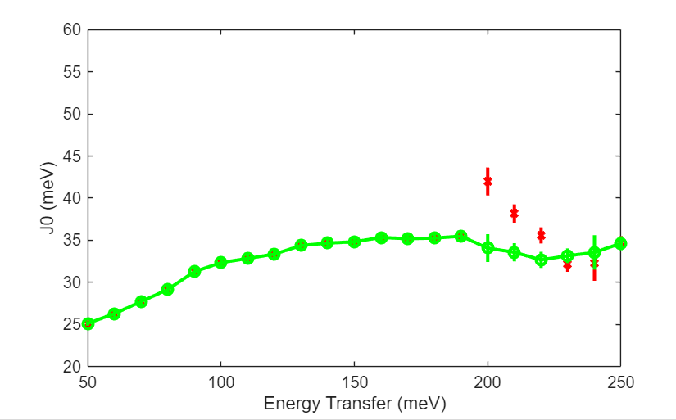
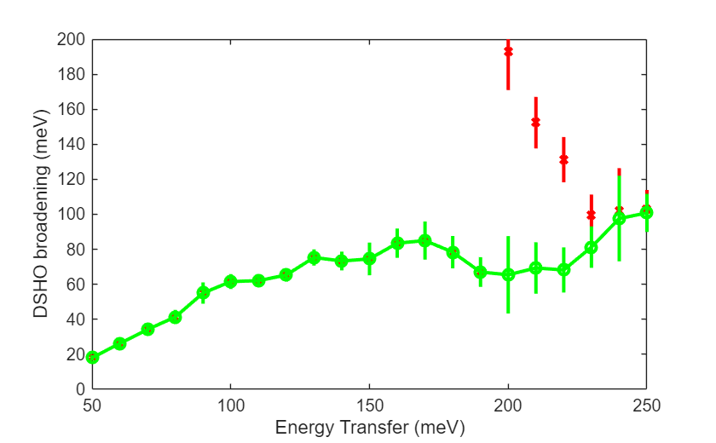
Fit peaks, for Ei400, <110> and <200> cuts combined. Cut <110> used up to 190meV; Cut 200 from 200.
Red marks – fit 400meV; <200> using whole dataset, fixed slope background
Fit peaks for Ei400, <110> and refit upper part of <200> cuts using fixed 2exp bg + delta.

Slide 19
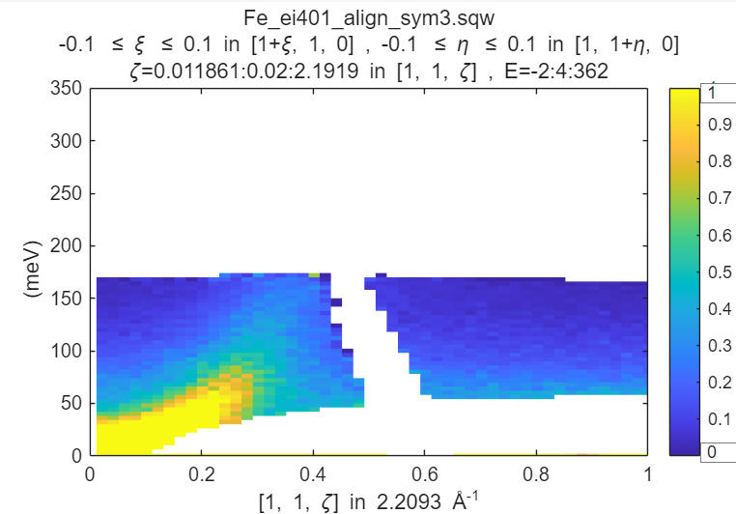
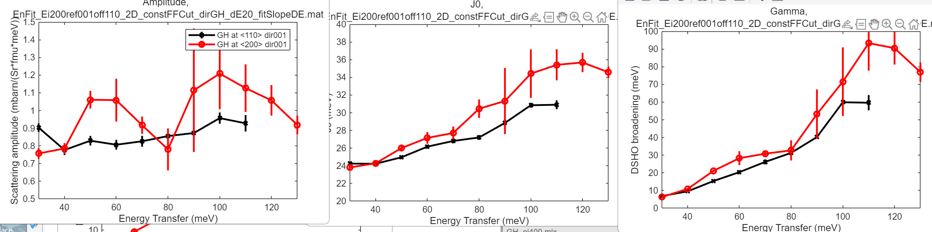
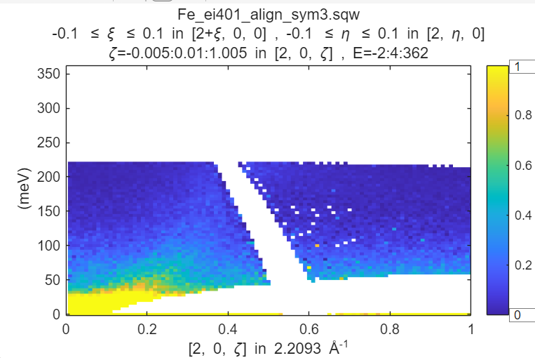
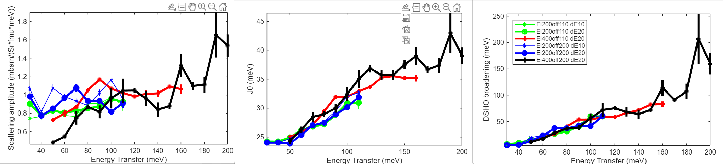
Peak fitting around <110> vs <200> for Ei=200meV + Ei400 meV;
DSHO fit in whole cut area, appropriate BZ; GH

Slide 20
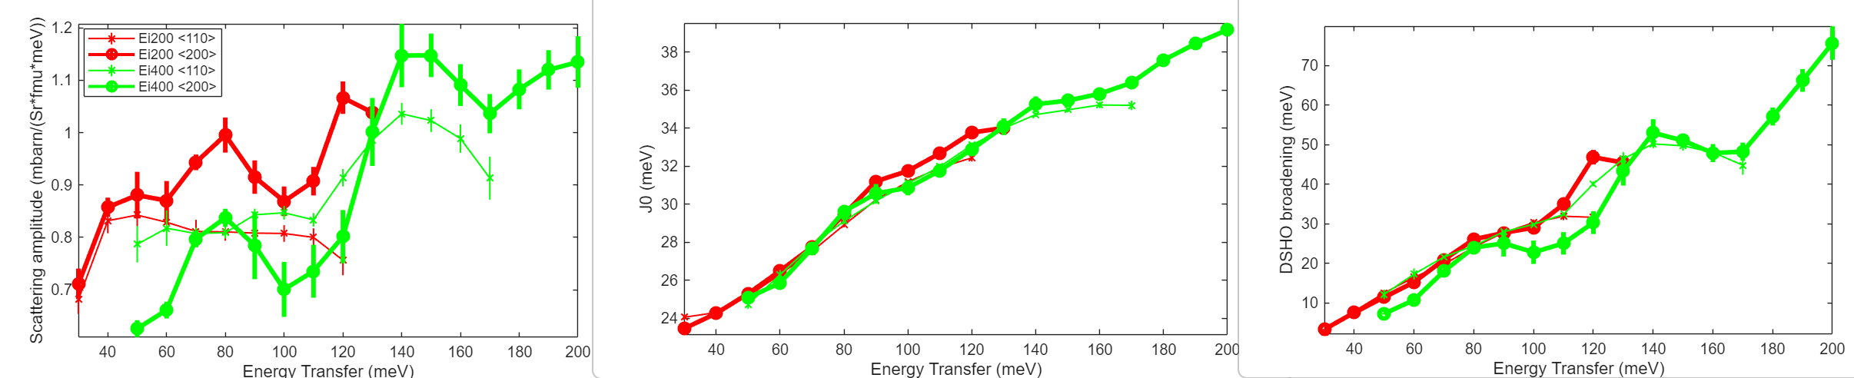
Dispersion Peak fitting with resolution around <110> vs <200> for Ei=200meV + Ei400 meV;
DSHO fit in whole cut area, appropriate BZ; GP (111 direction); min FF change

Slide 21
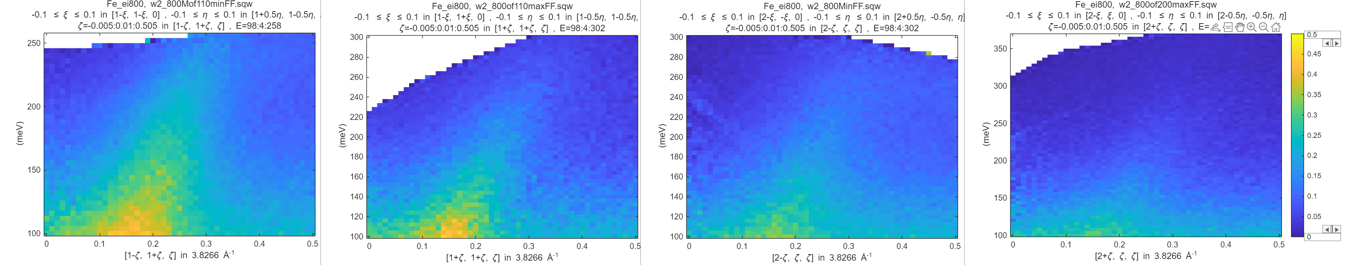
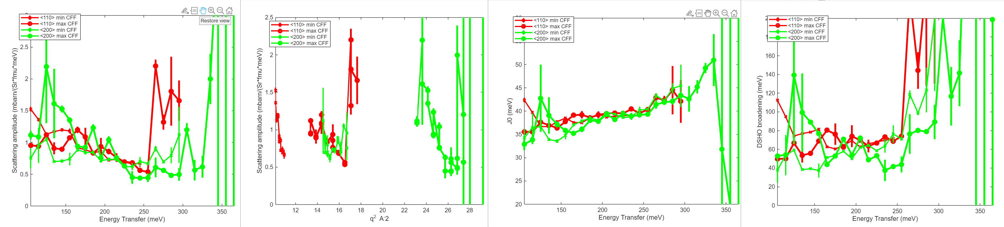
Dispersion Peak fitting with resolution around <110> vs <200> for Ei=800meV;
DSHO fit in whole cut area, appropriate BZ; GP (111 direction)
Affected by q-min reduction
Affected by q-min reduction

Slide 23
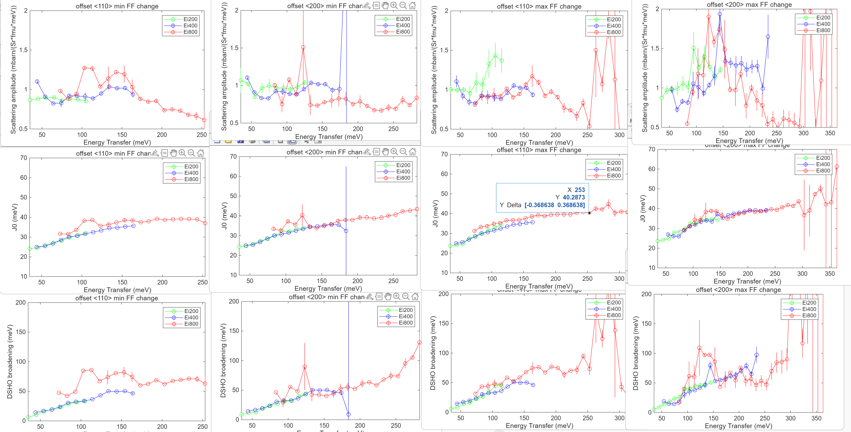
GP

Slide 24
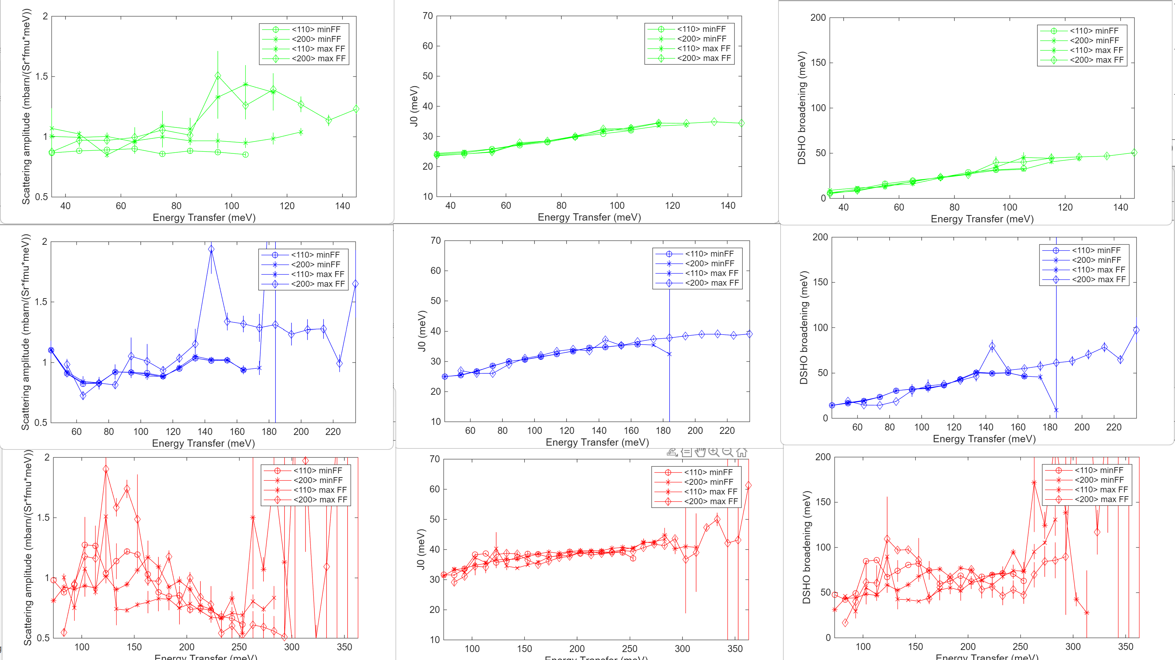
GP

Slide 25
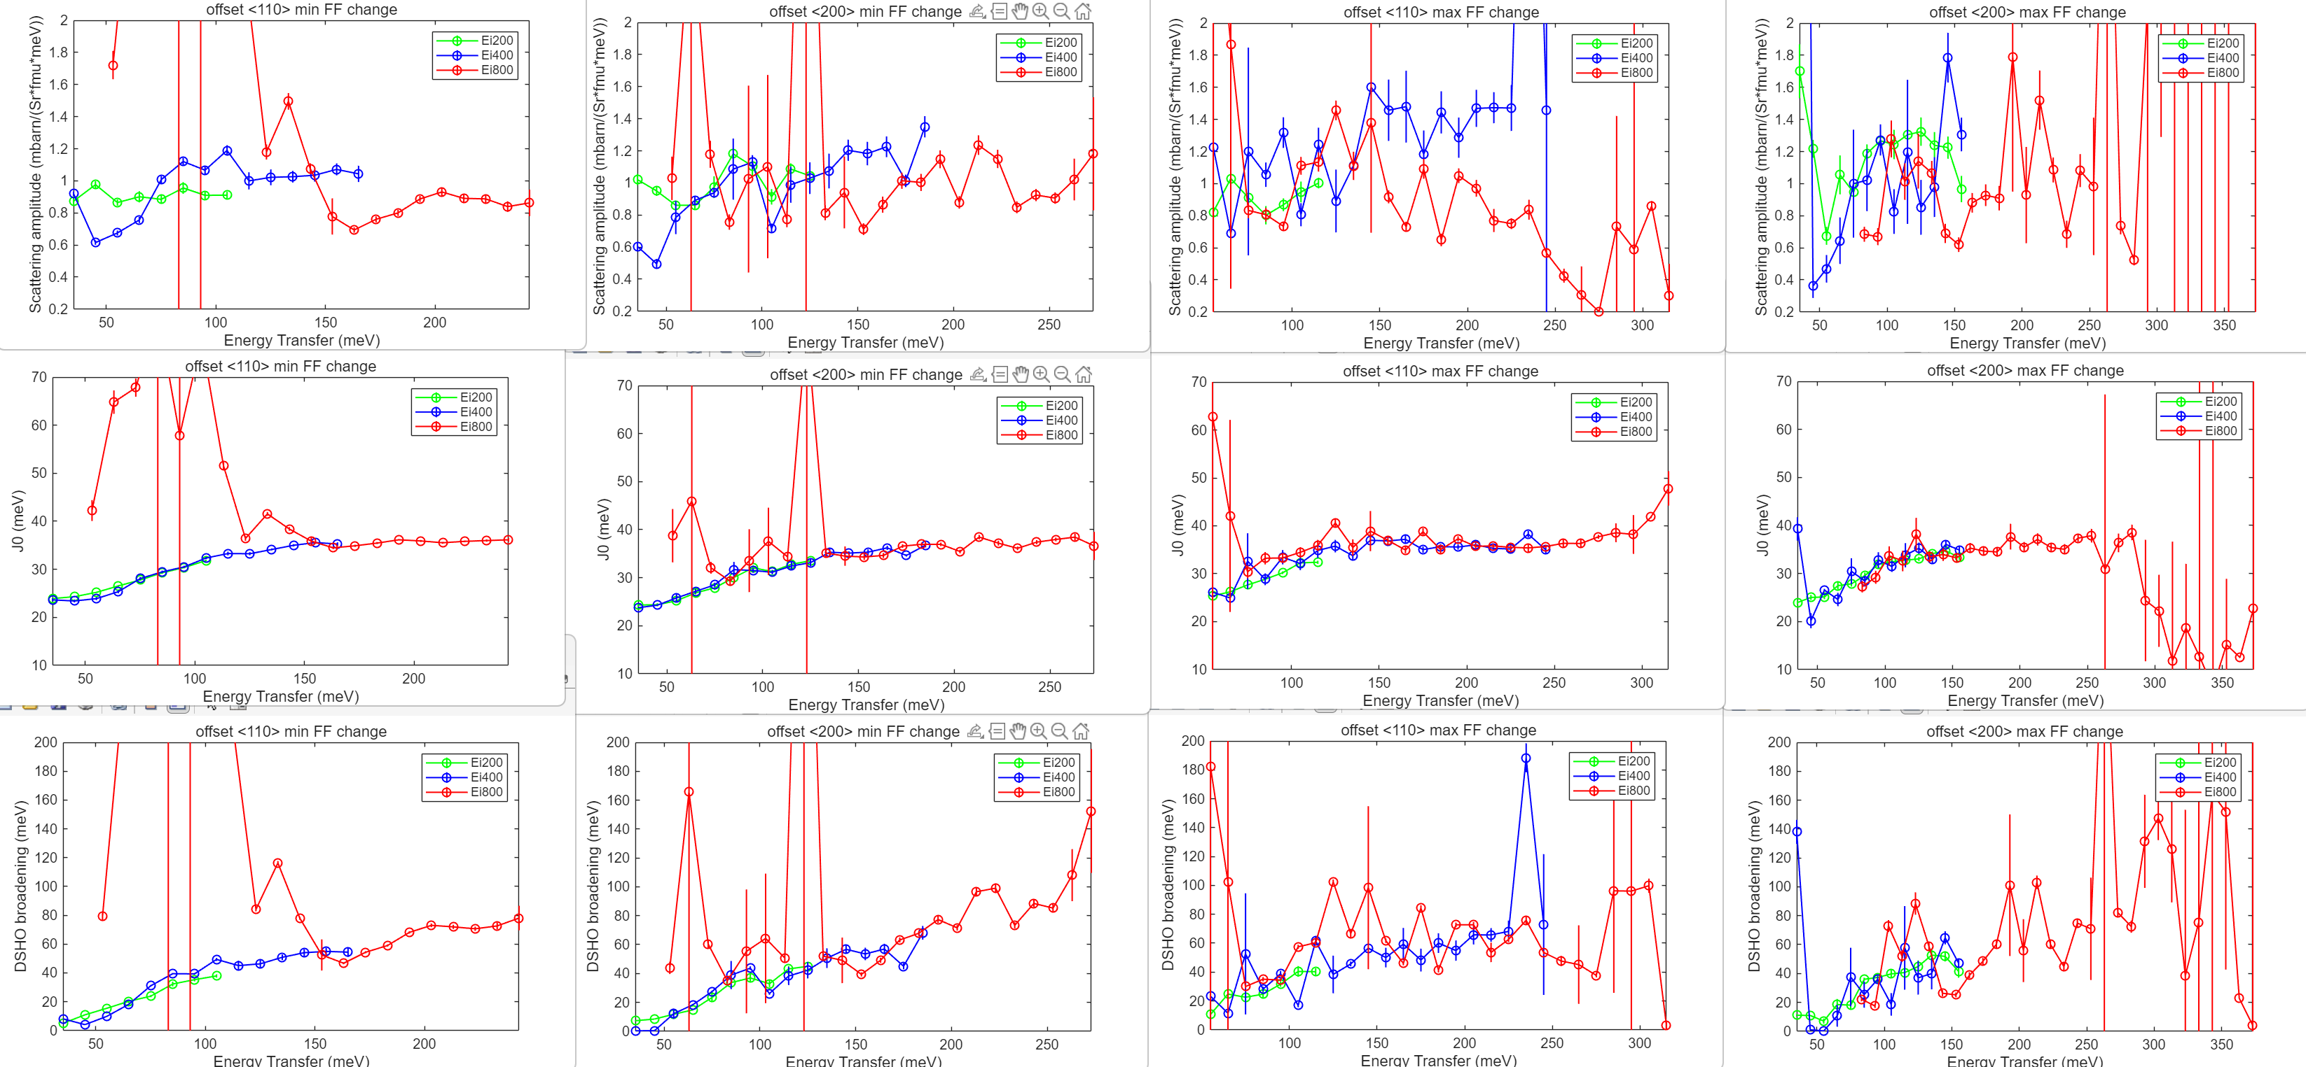
NG

Slide 26
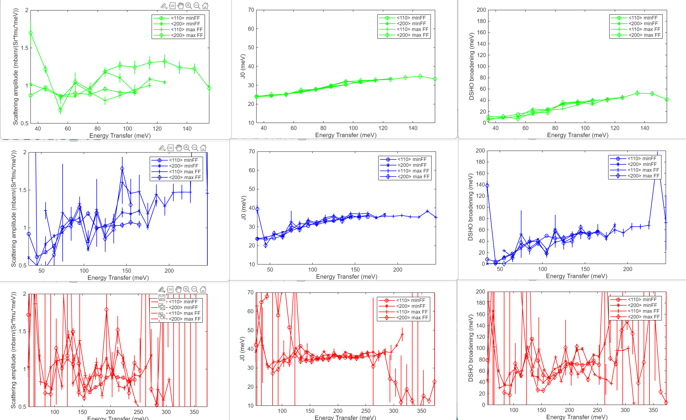
NG

Slide 27
GP
NG

Slide 28
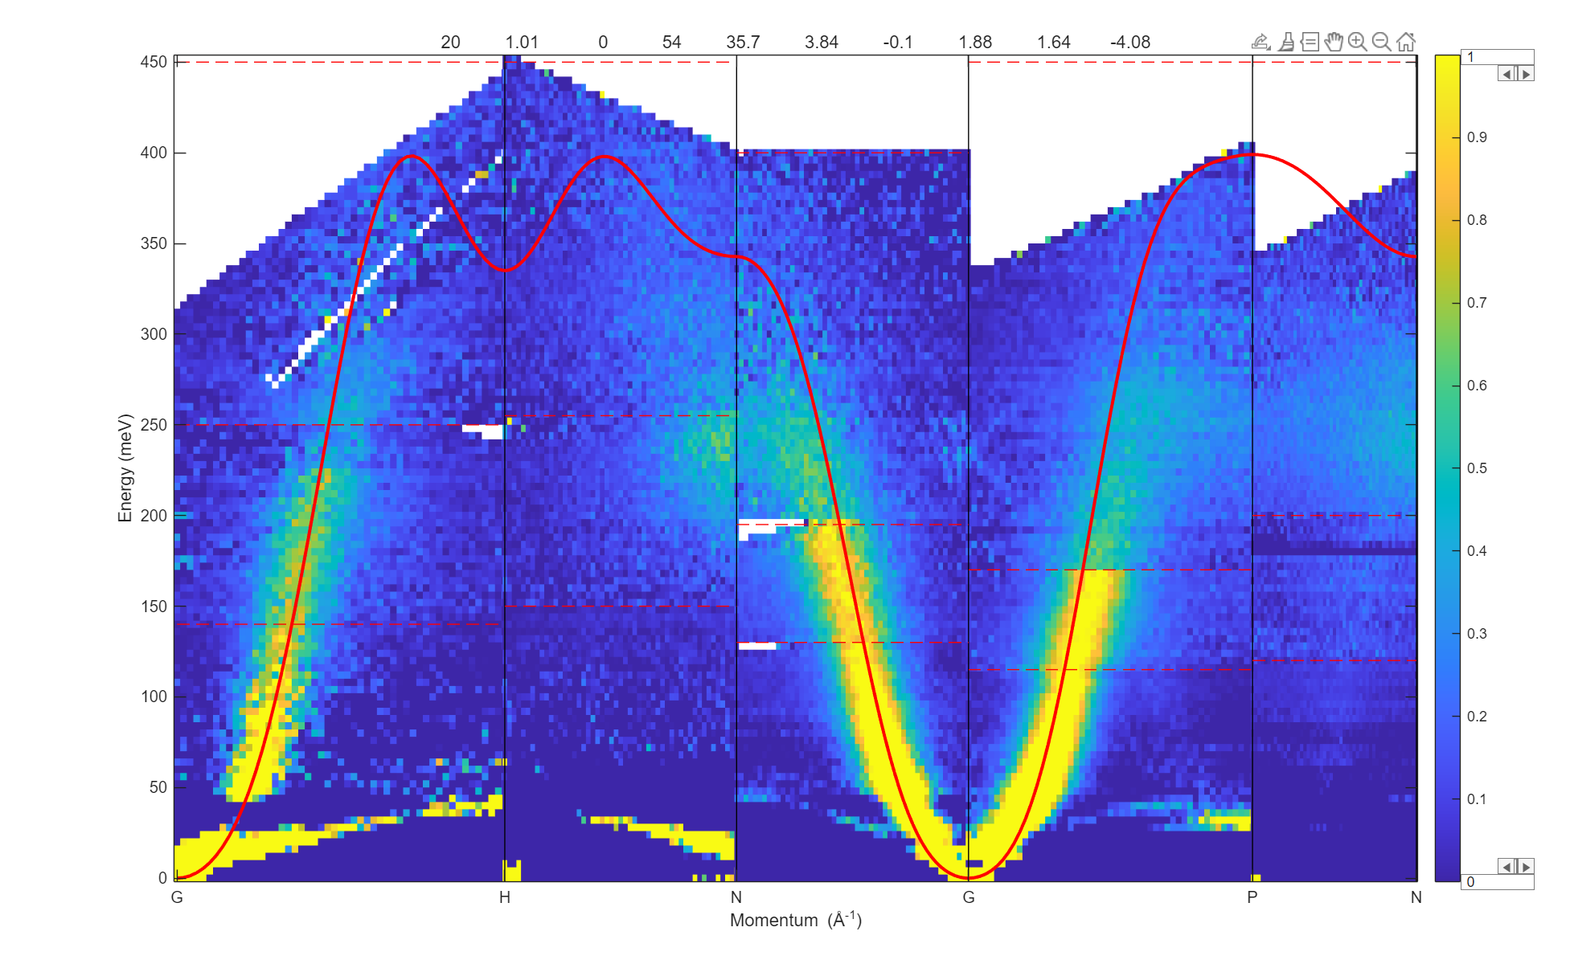

Slide 29
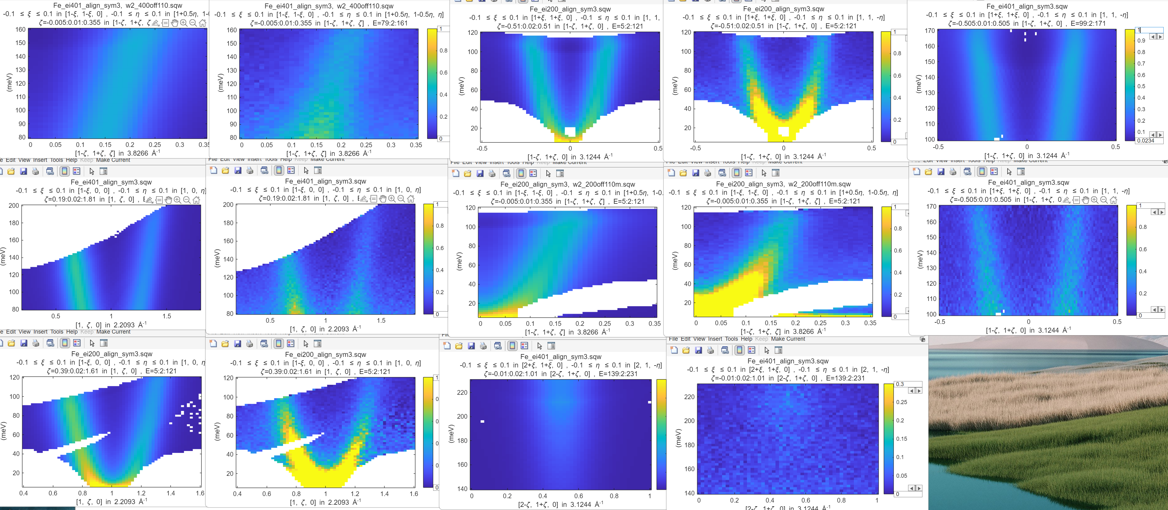
Fitting with 3J, single γ,S
--------------------------------------------------------------------------------
Fit converged; Parameter values (free parameters with error estimates):
--------------------------------------------------------
Foreground parameter values:
----------------------------
1 1
2 8
3 79.37 +/- NaN
4 1.944 +/- NaN
5 0
6 36.61 +/- NaN
7 0 +/- NaN
8 0 +/- NaN
9 0
10 0
Covariance matrix for free parameters:
--------------------------------------
NaN NaN NaN NaN NaN
NaN NaN NaN NaN NaN
NaN NaN NaN NaN NaN
NaN NaN NaN NaN NaN
NaN NaN NaN NaN NaN

Slide 30
Fit quality for the data above (Ei800, fitting to whole cut)

Slide 32
Fitting background quality:
1d cut from masked (blue line) and
unmasked (red line) datasets from
the left.
Fitted bg (amplitude).

Slide 33
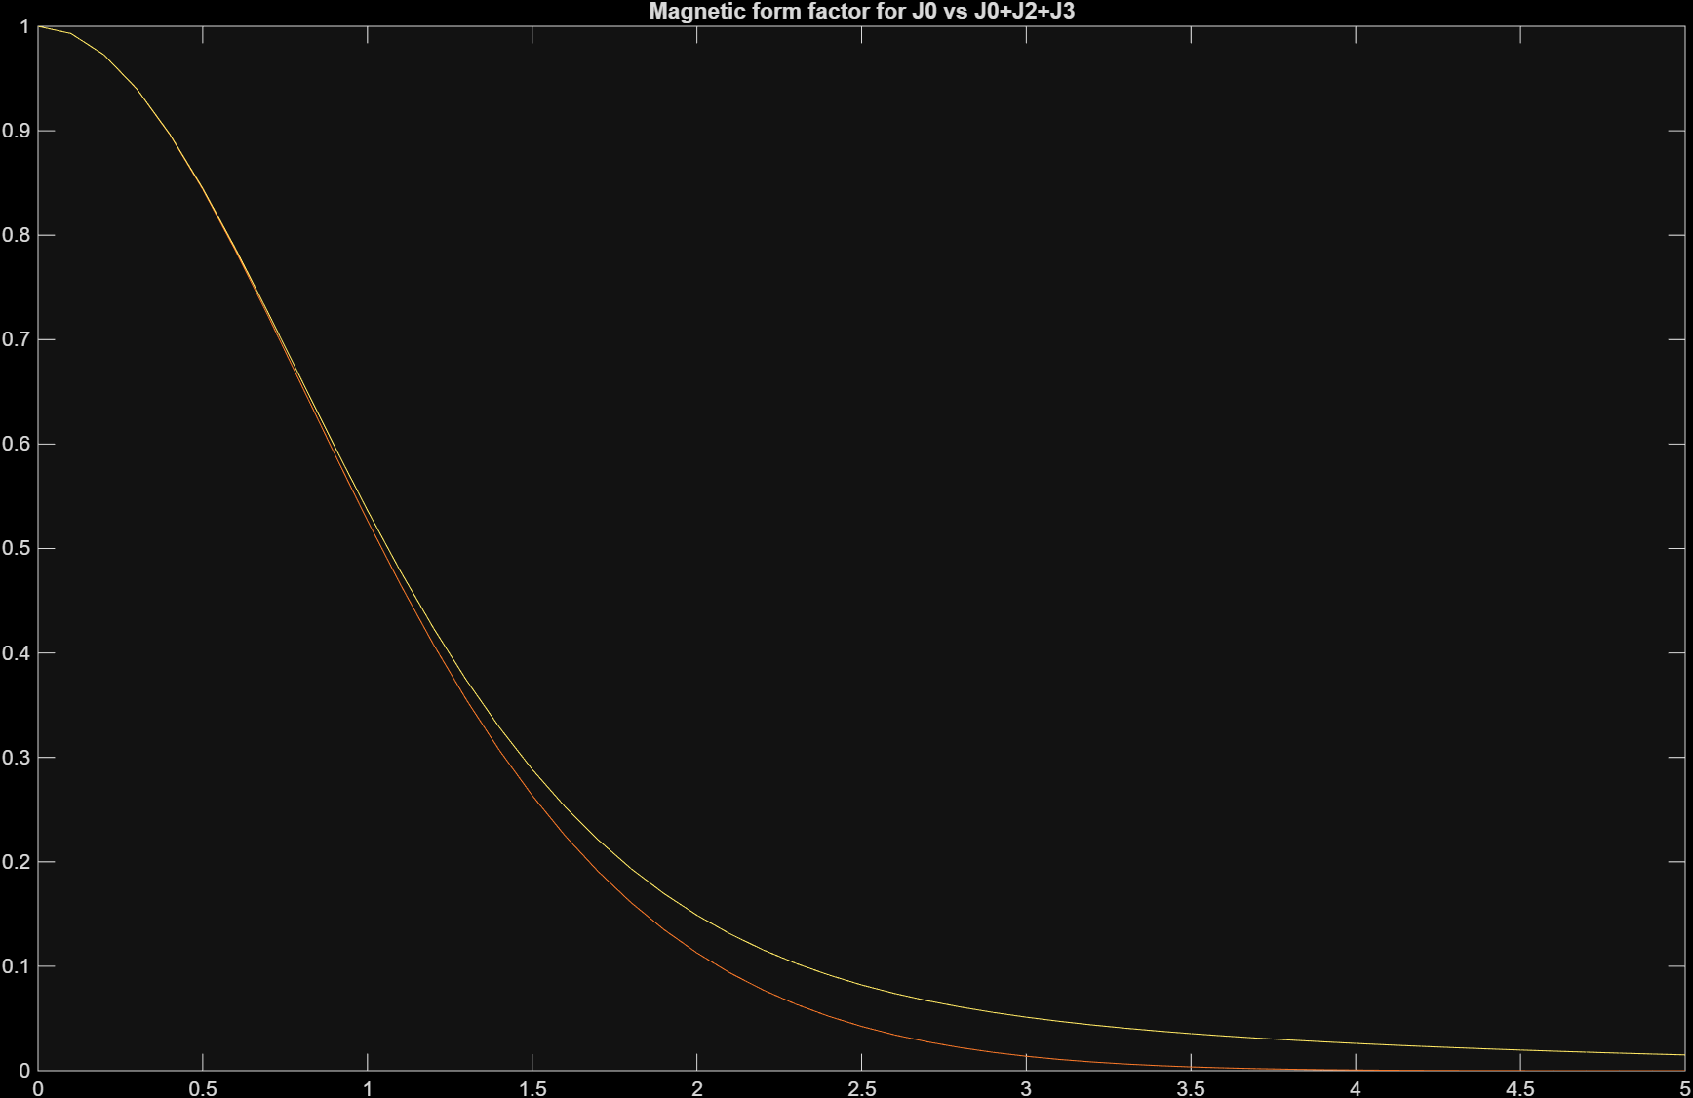
Fitting with form-factor
Fit with J0
Fit with J0+J2+J4 (J6==0)

Slide 35
Comparison between form-factors used in 2017 and in 2026. The result is in 2017 we were using 1moment FF and 2026 – 3 moments.
1moment FF are identical, additional moments provide longer tail.

