Slide 1
Mono-vanadium, 200 mev – resolution and quality estimates

Slide 2
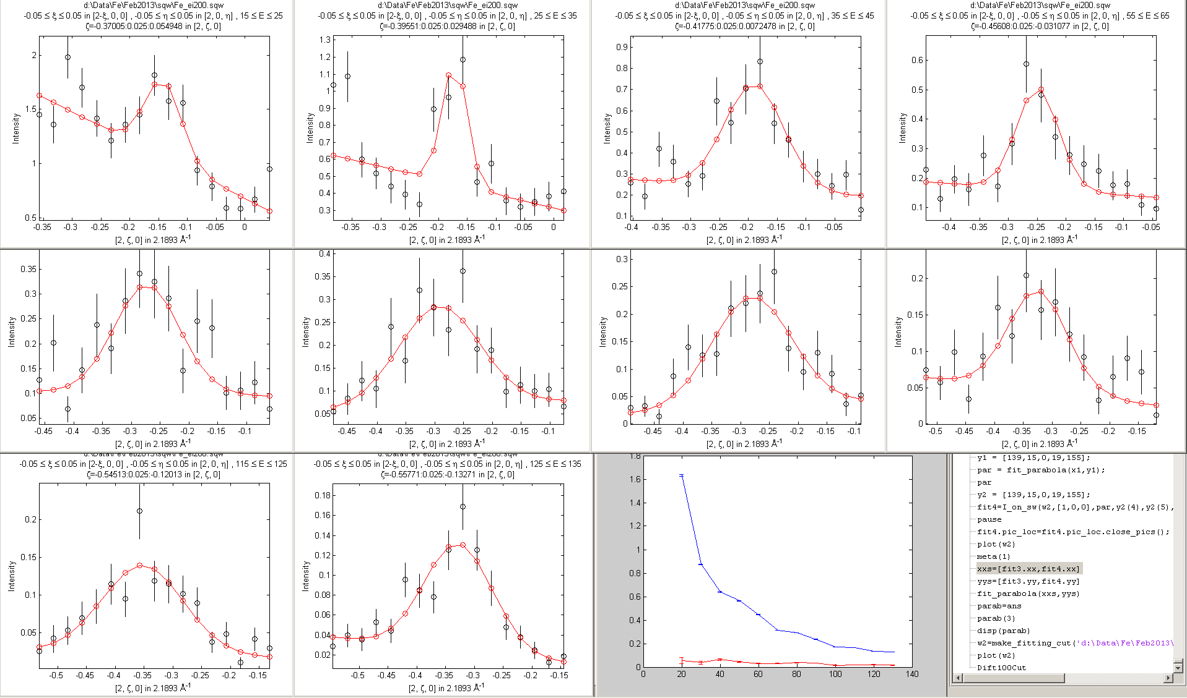
Cut (2,0,0), direction (0,1,0), branch -

Slide 3
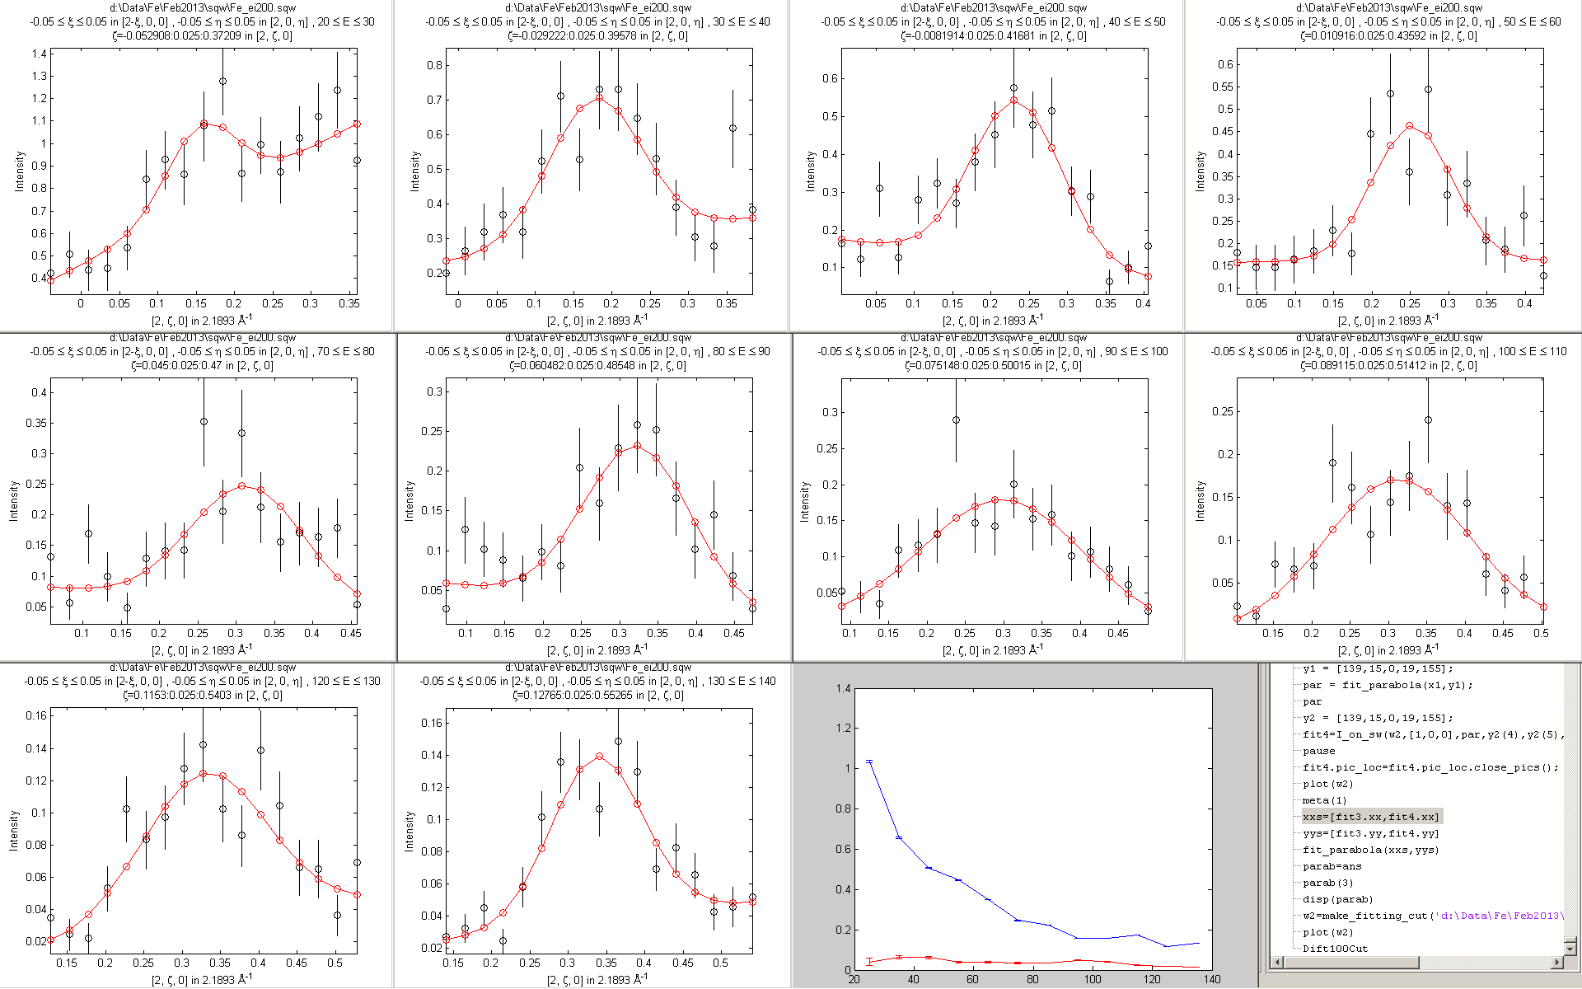
Cut (2,0,0), direction (0,1,0), branch +

Slide 4
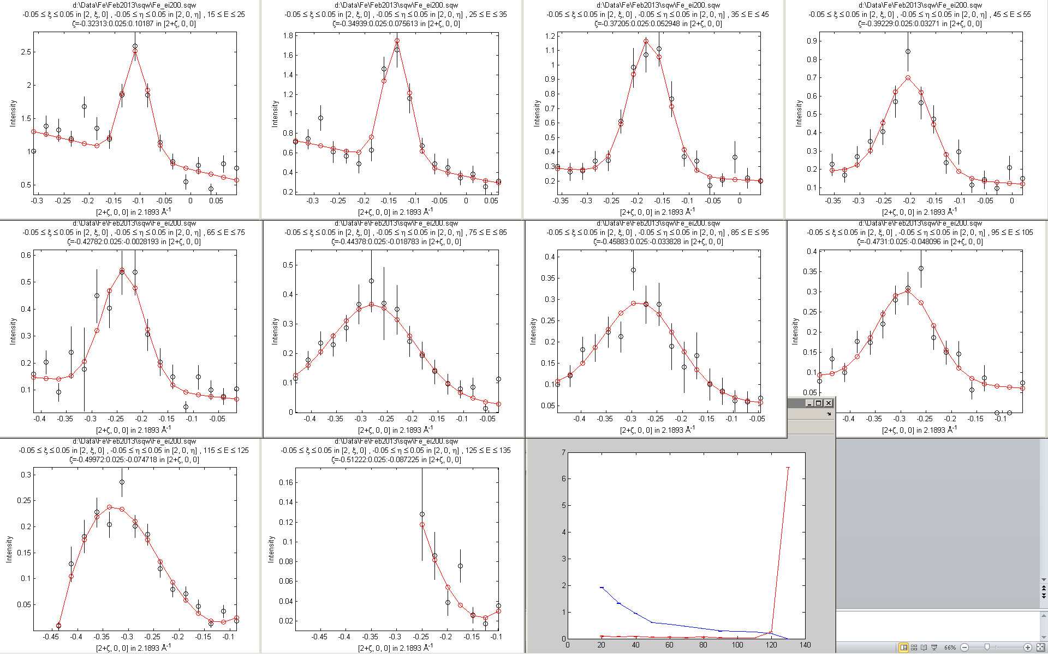
Cut (2,0,0), direction 1,0,0, branch-

Slide 5
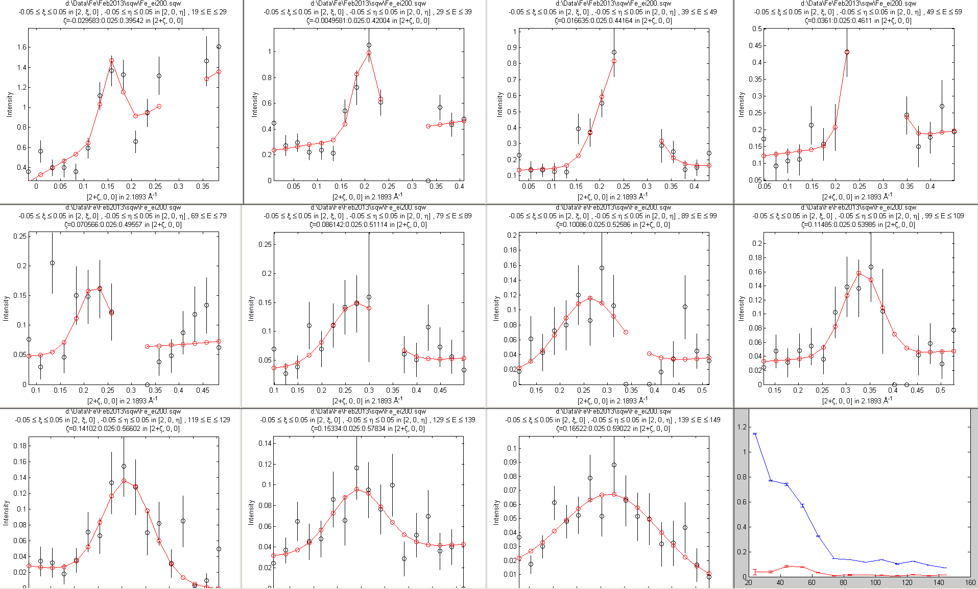
Cut (2,0,0), direction 1,0,0, +branch

