Slide 1
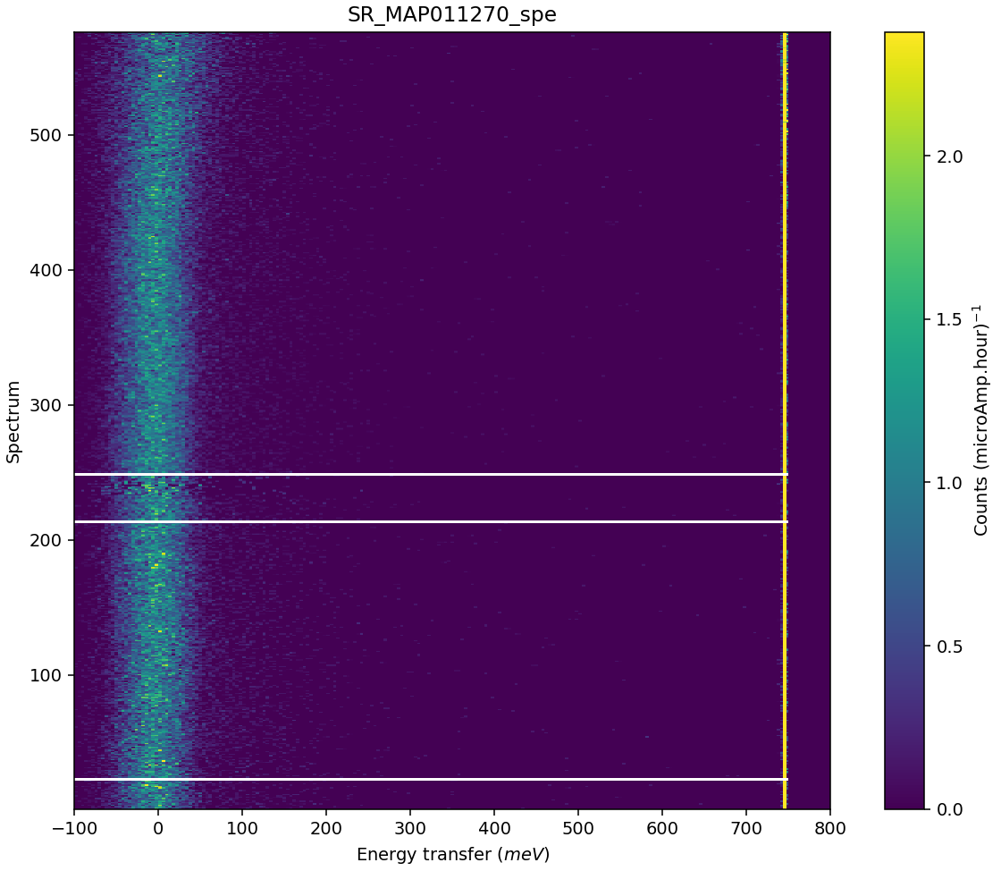
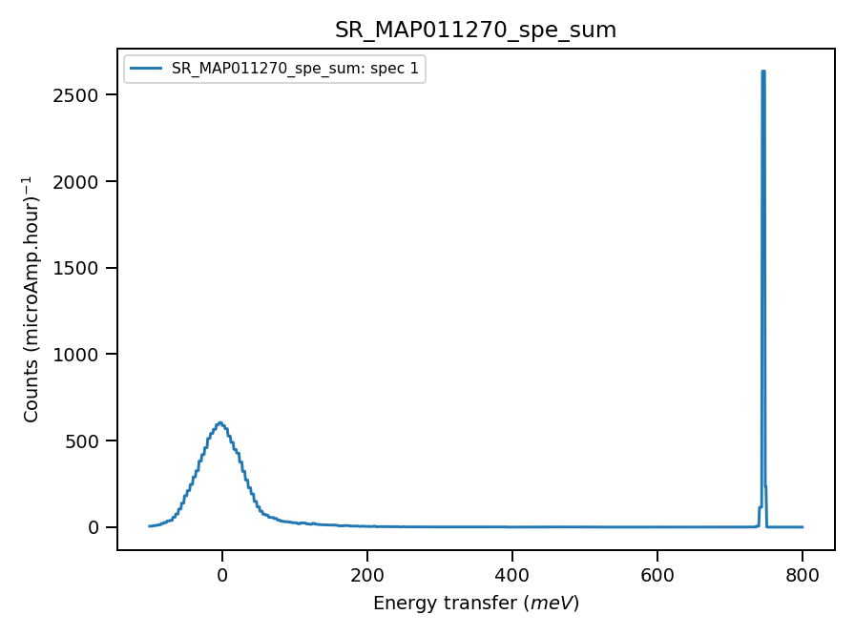
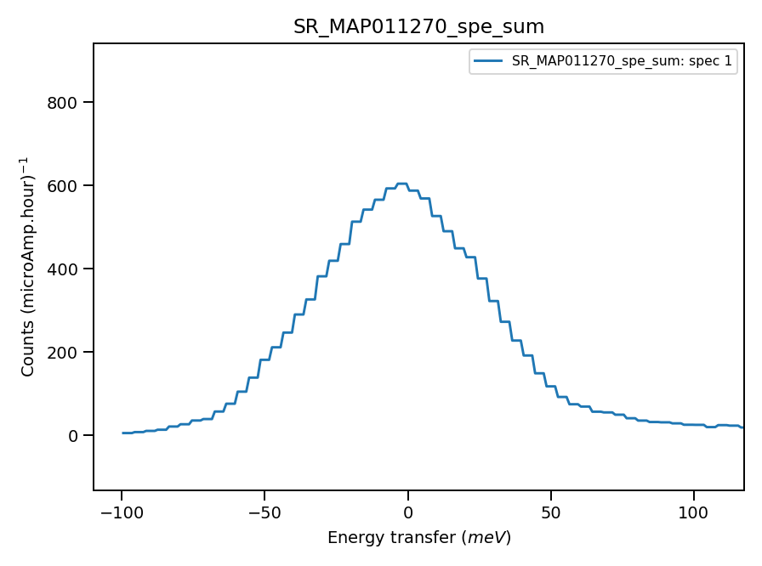
Validate correct incident energy for mono-vanadium run N11270
Some misalignment?
Binning range 735mEv
Correct Ei = 793, so that Ei = 0.01 where

