Slide 1
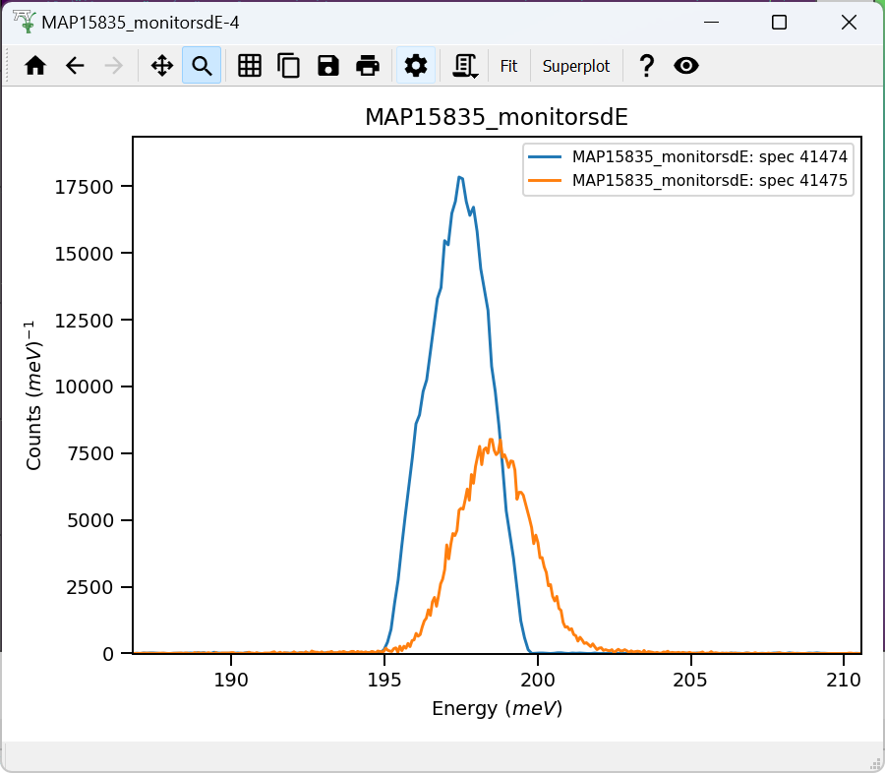
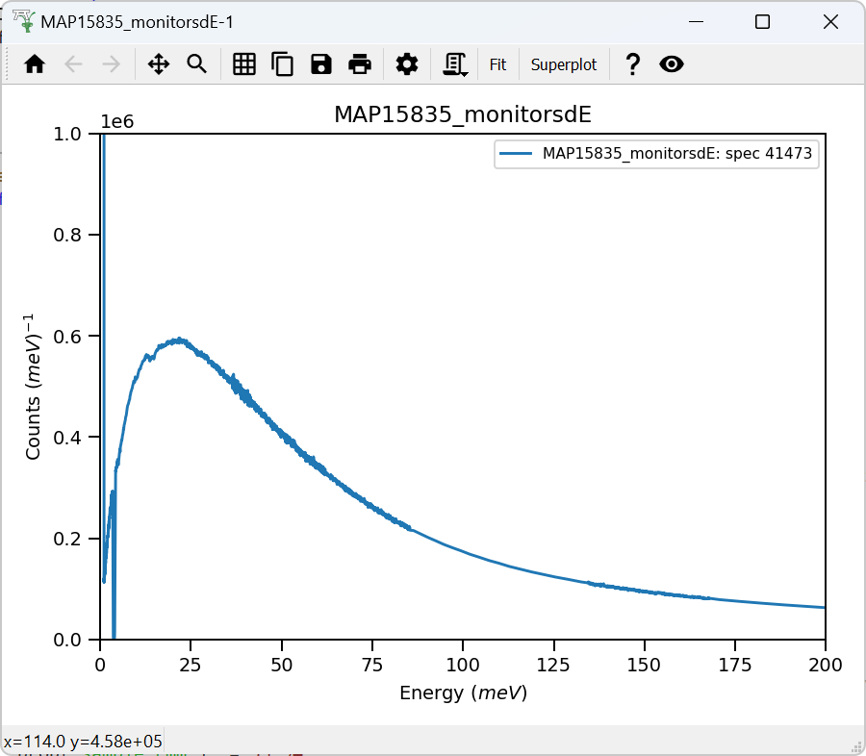
Monitors:
Wrong IDF ?

Slide 2
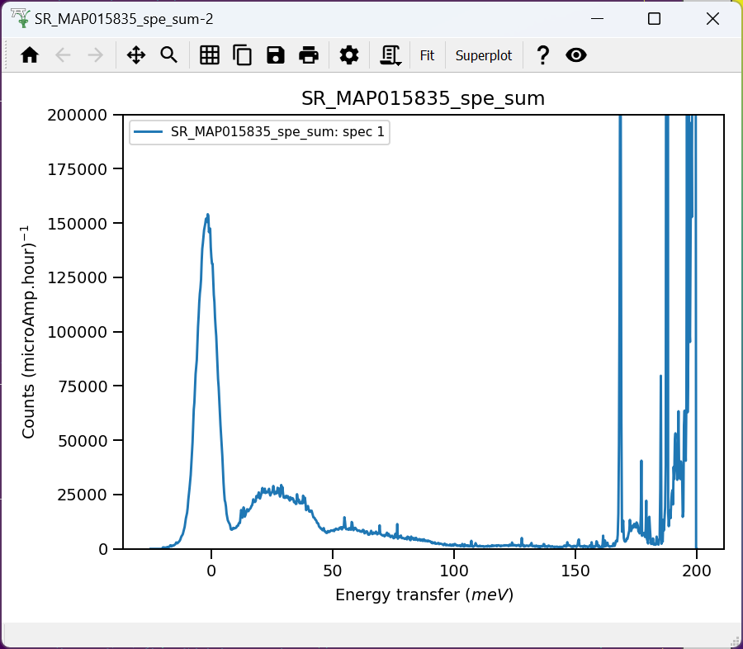
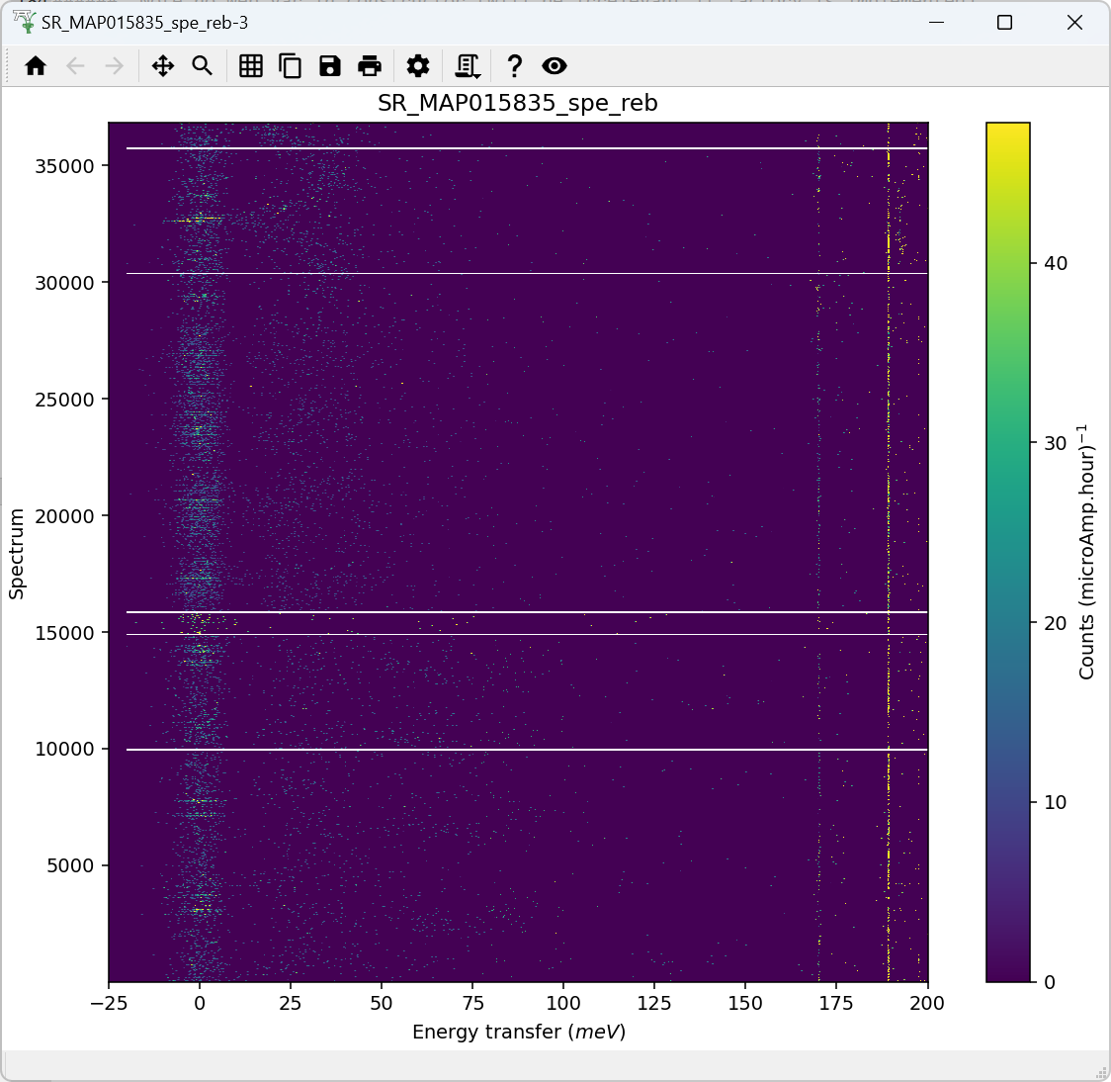
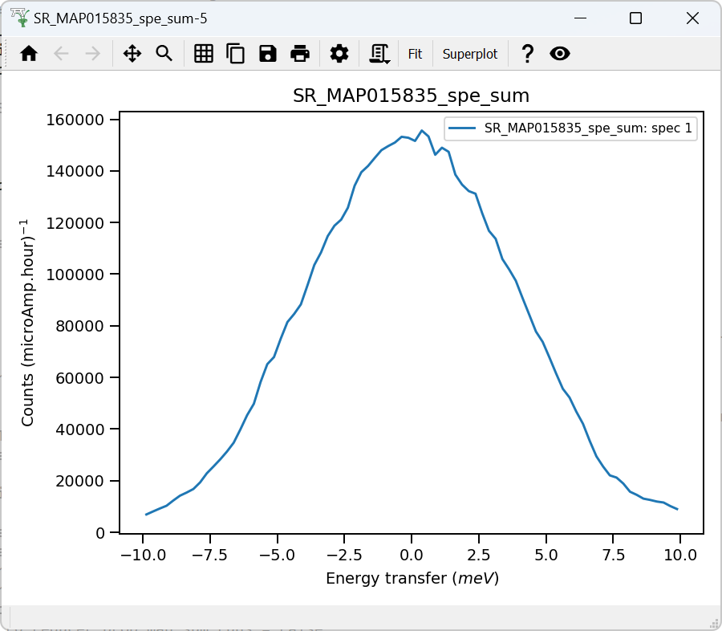

Validate correct incident energy for mono-vanadium run N15532
Chopper peak around 201.2 meV
Binning range 166 meV
$$ΔE_{i}={\int_{−10}^{10}{f\left(e\right)⋅e⋅de}}/{\int_{−10}^{10}{f\left(e\right)⋅de}}$$
Correct Ei = 201.2meV, so that ΔEi = -0.007 where:

