Slide 1
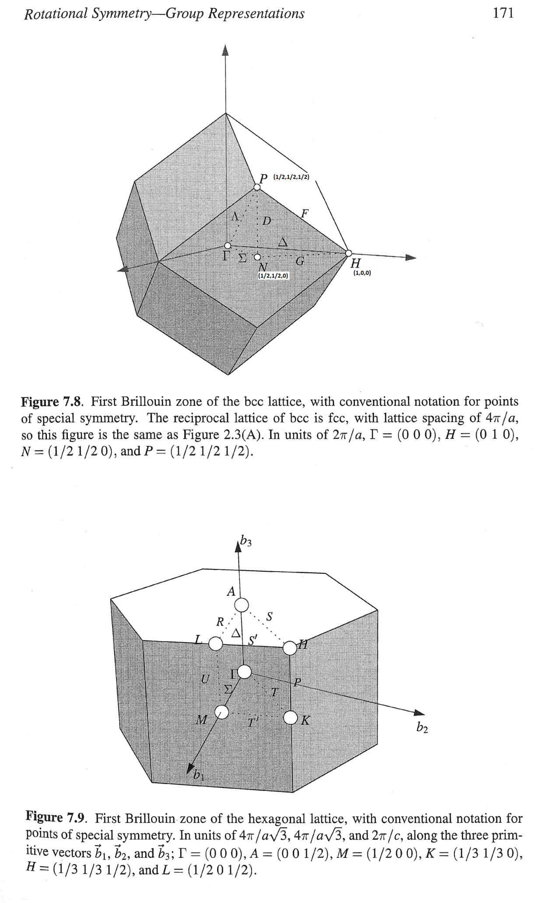
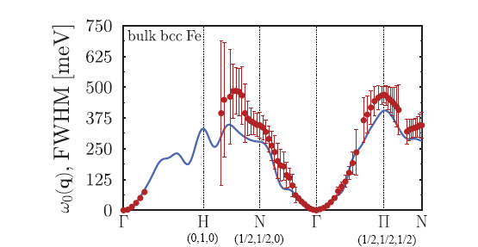
270
255
75

Slide 2
Catching N point (½, ½,0)
Ei=401
Ei=787
dE=200+20
dE=200+20
Ei=787
dE=220+20
dE=220+20
dE=220+20
dE=240+20
dE=240+20
dE=240+20
Π-no
- spur
dE=260+20
dE=260+20
G
dE=260+20
D?
dE=280+20
dE=280+20
dE=360+20
Ei=787
dE=300+20
dE=320+20
dE=340+20
Removed background

Slide 3
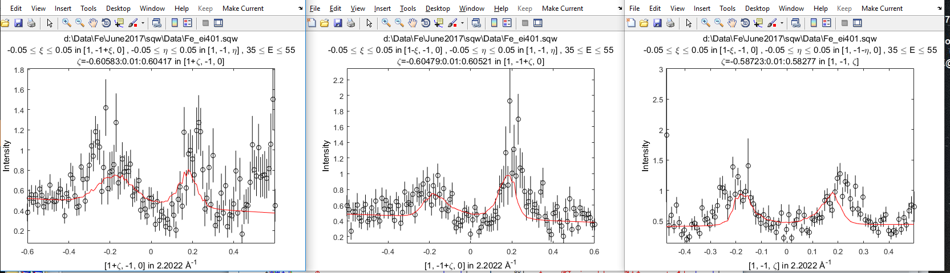
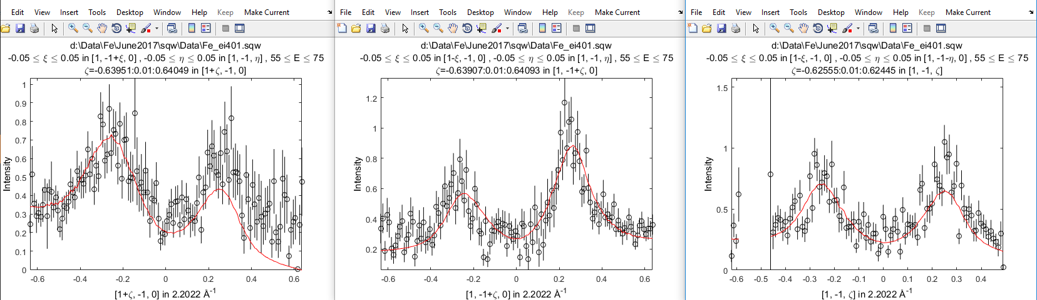
[1,-1,0] fitting with J0
Ei45
Ei65

Slide 4
Lost intensity in GN direction (000->1/2,1/2,0)?
DFT:
Removed bg in [-3-2.5] range, fixed MagFF

Slide 5
Ei=800 overview

Slide 6
Incident Energy ->Ei=401mEv
dE=50
dE=70

Slide 7
dE=90
dE=110

Slide 8
dE=130
dE=150

Slide 9
dE=160
dE=170

