Slide 1
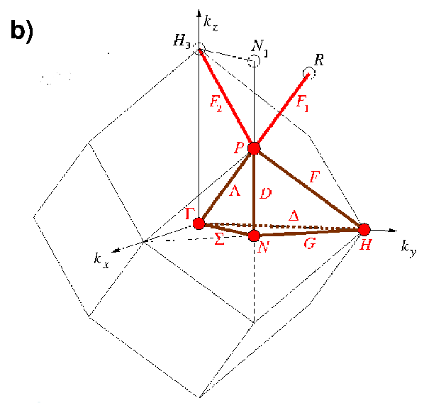
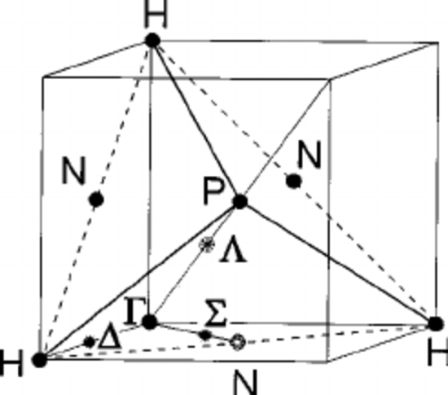
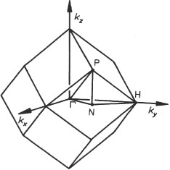
Bcc Brillouin zone
Γ
Δ
N
Δ
H
N
N
N
P
Γ
Δ
Δ
H
N

Slide 2
J0=30 j1=10 j2=2.5
Black: nn
Red: 0, 1
Blue: 0, 2
Mag: 0, 1, 2

