Slide 1
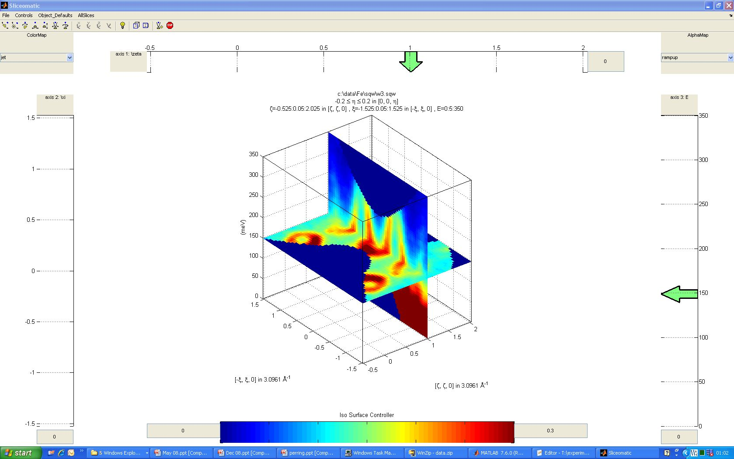
3D itinerant electron ferromagnet - iron
Horace : Software
166g crystal, 186 angles x 45 minutes
>> w = cut_sqw (data_source, proj_110, [0.8,1.2], [-2,0.05,3], [-0.2,0.2], [0,0,450]);

Slide 2
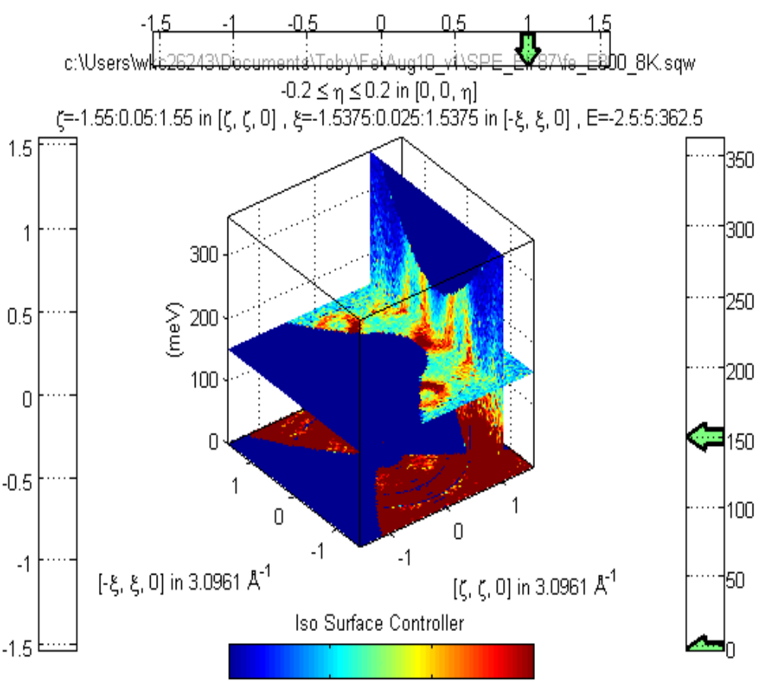
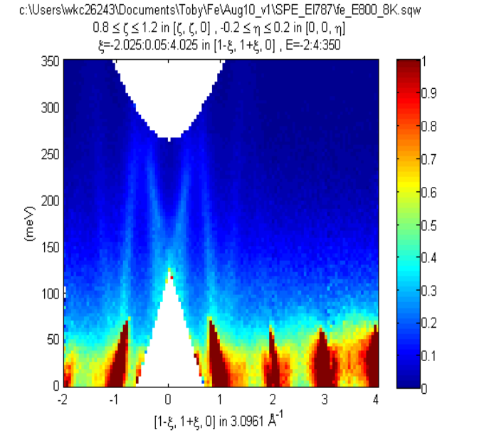
Ei=797meV

Slide 3
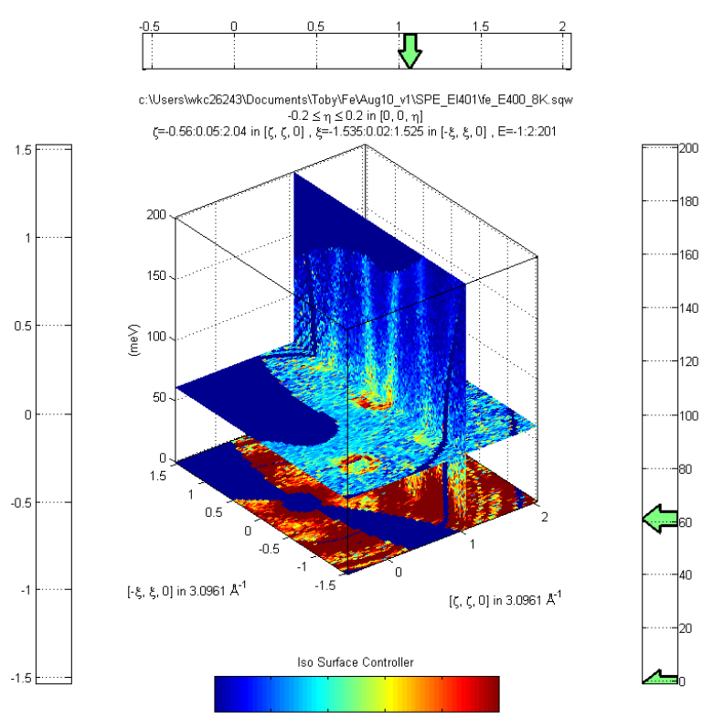
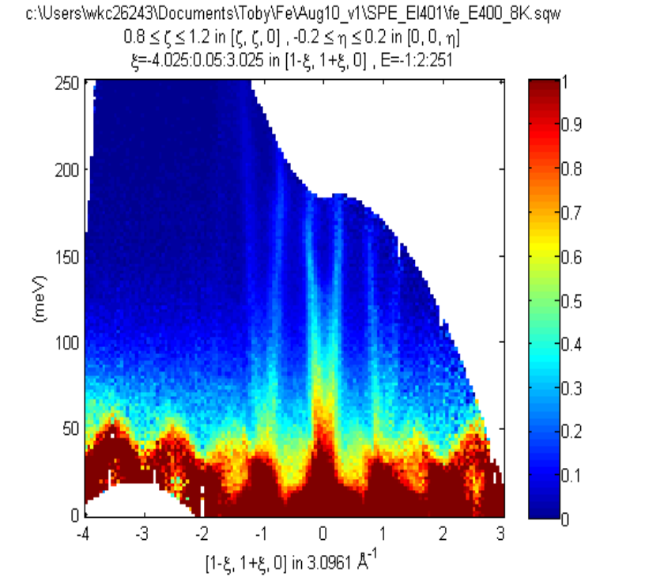
Ei=400meV

Slide 4
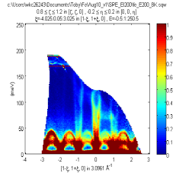
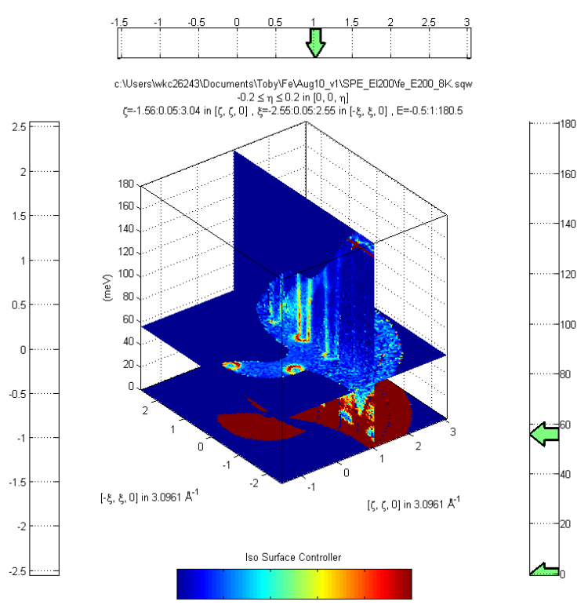
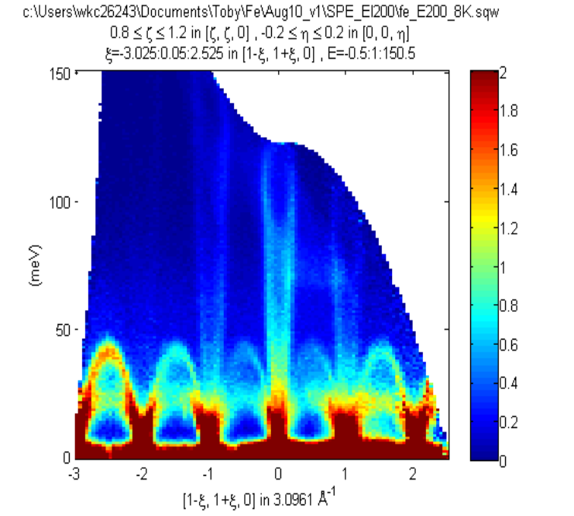
EI=200meV

Slide 5
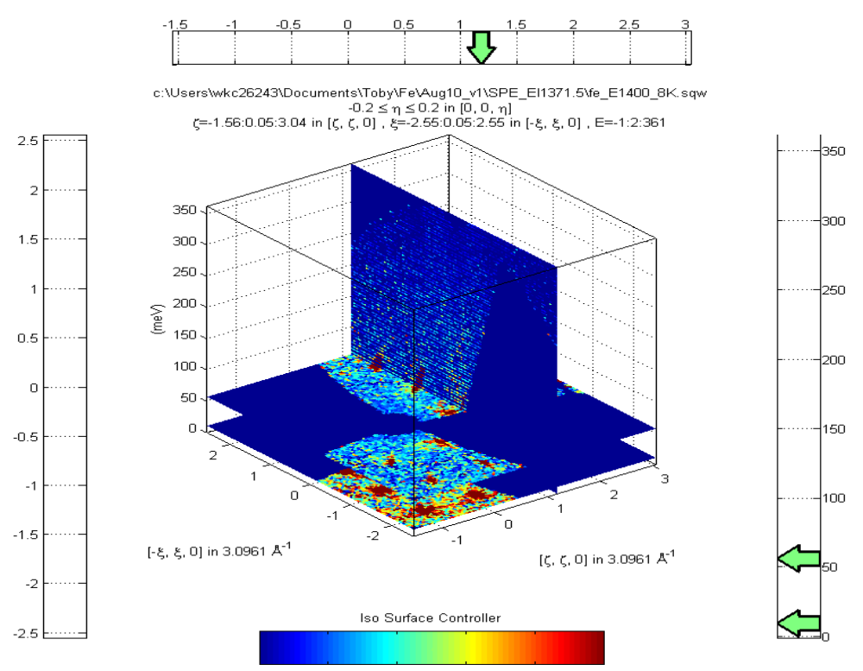
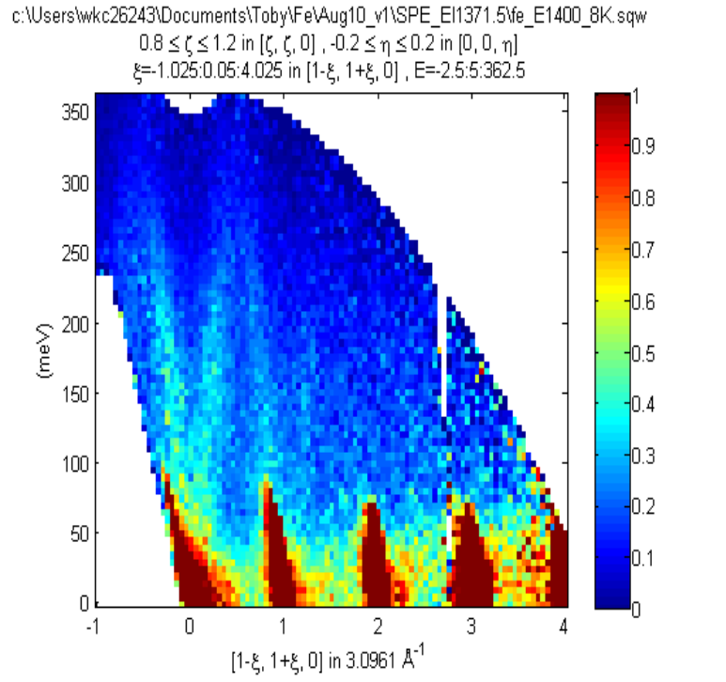
E=1400meV

Slide 6
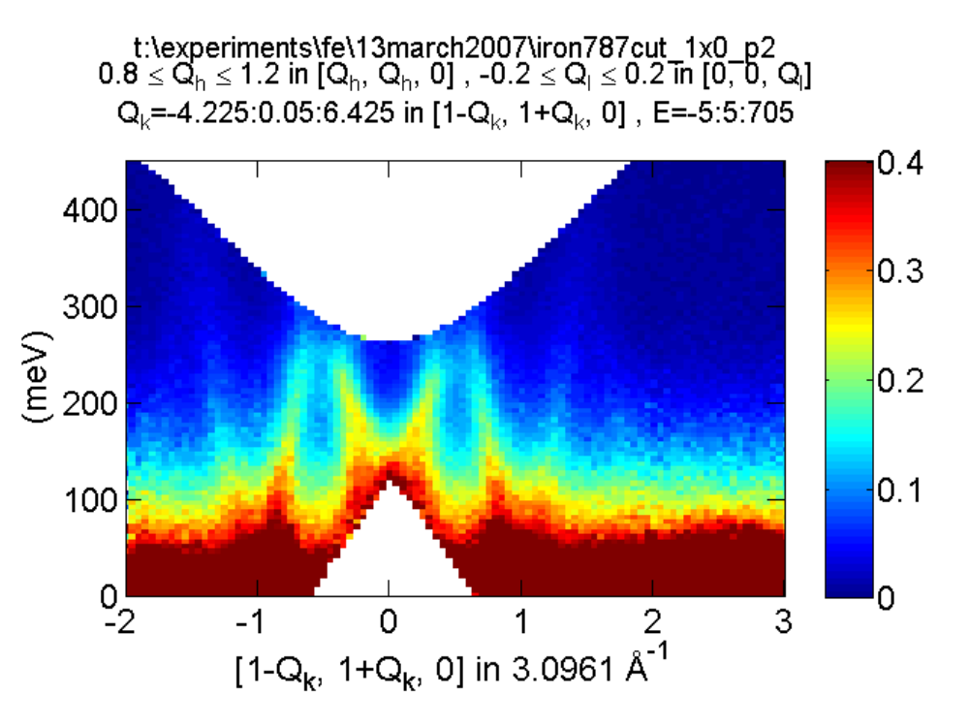
3D itinerant electron ferromagnet - iron
• Estimate of non-magnetic signal
>> wbackcut = cut (w, [2,3], []);
>> wback = replicate( wbackcut, w);
>> wdiff = w - wback;

Slide 7
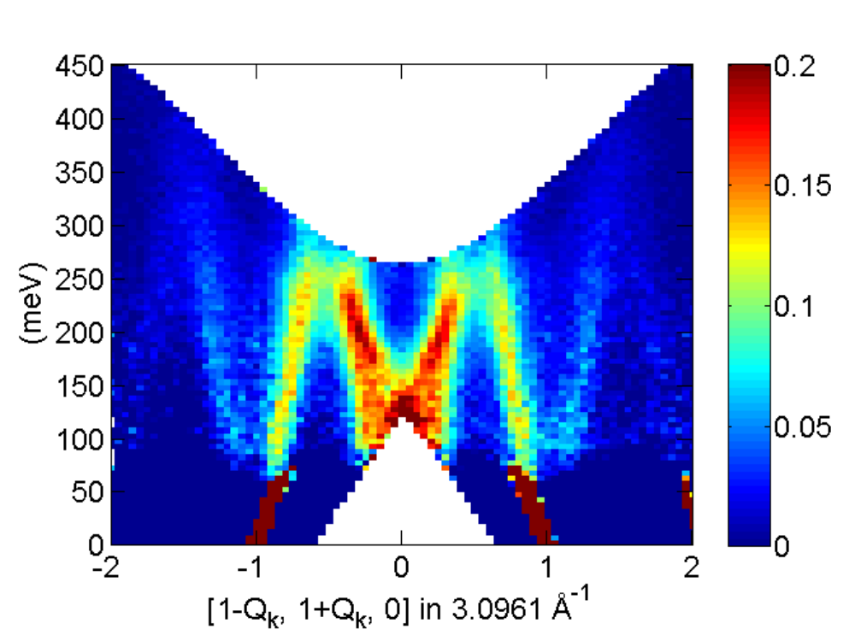
3D itinerant electron ferromagnet - iron
• Correct for magnetic form-factor
>> ff = sqw_eval (wdiff @feformsqr, 0.057);
>> wcor = wdiff / ff;

Slide 8
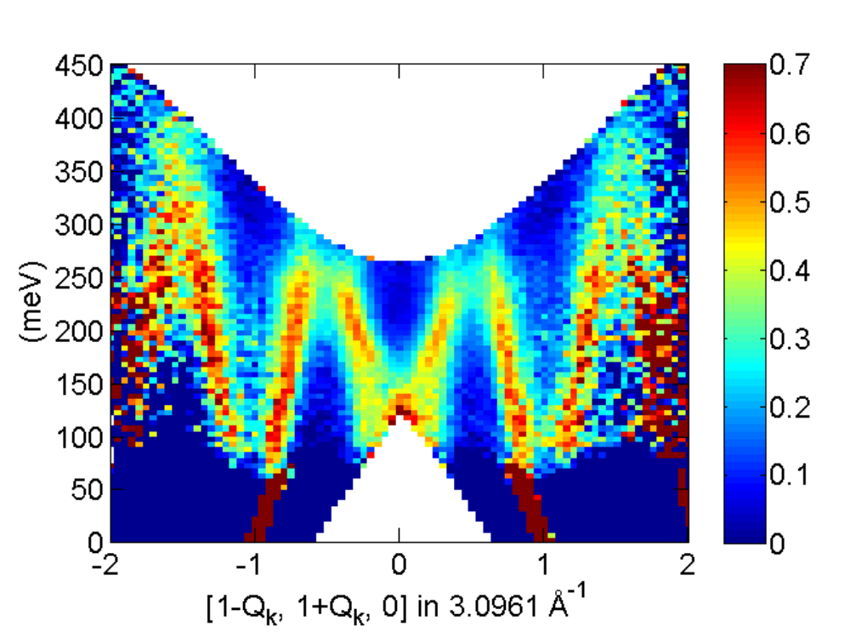
3D itinerant electron ferromagnet - iron
• Smooth to prettify
>> wcor = smooth (wcor)

Slide 9
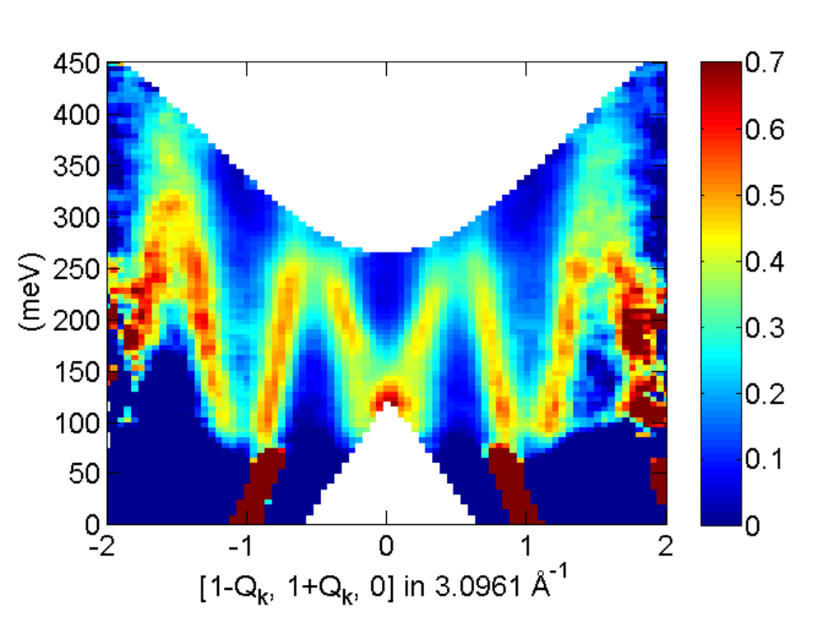
3D itinerant electron ferromagnet - iron
Complete determination of dispersion along (110) direction – extends to 0.4 eV
Along all high symmetry directions to > 0.4 eV transfer
Complete measurement of ALL of S(Q,ε) to >0.4eV

