Slide 1
TD-DFT for spin excitations
Aims of the project
Calculate spin excitation energies (including broadening due to the Stoner continuum)
Compare first principles results with experiments performed at ISIS
Assess to which extent TD-DFT can explain the observed spectra
Provide “computational service” to facility users.

Slide 2
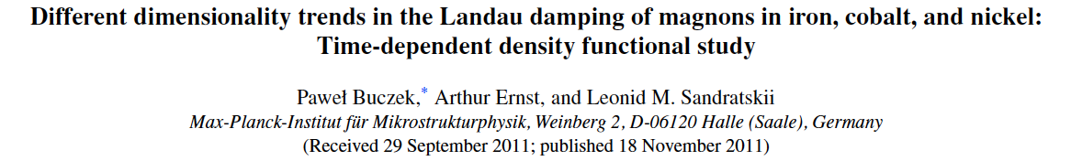
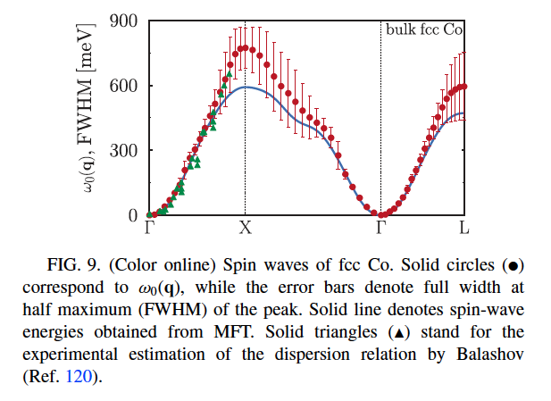
TD-DFT for spin excitations
Magnon excitations from magnetic susceptibility

Slide 3



Magnons from TD-DFT
Dyson equation:
Frequency summation:
k-convolution

Slide 4


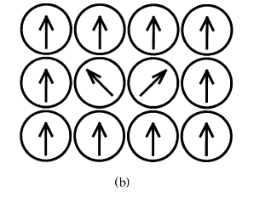
Magnons from the spin Exchange Couplings

Slide 5
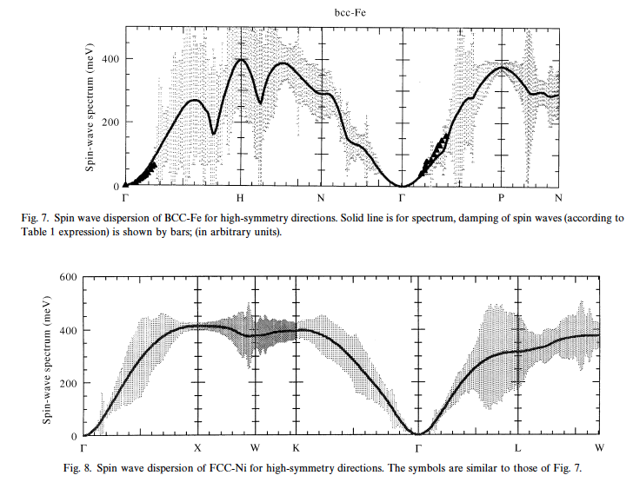
Magnons from the spin Exchange Couplings

Slide 6
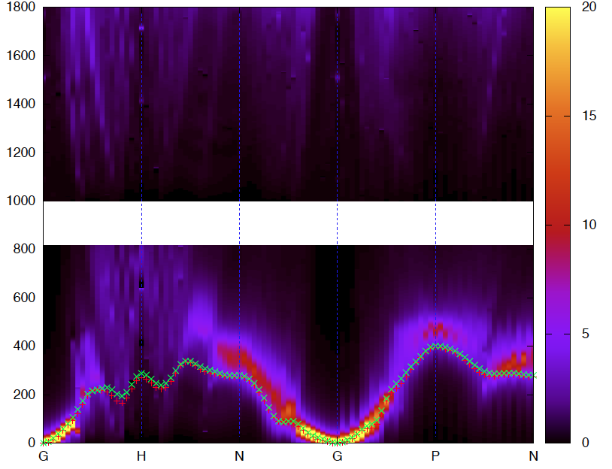
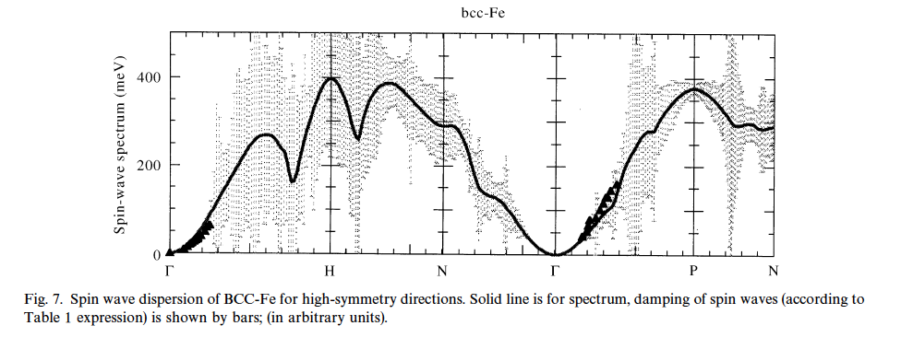
Results: bcc Fe
Remarks:
Good agreement for
small q.
Good agreement for
width of peaks
Discrepancy at ‘H’

Slide 7
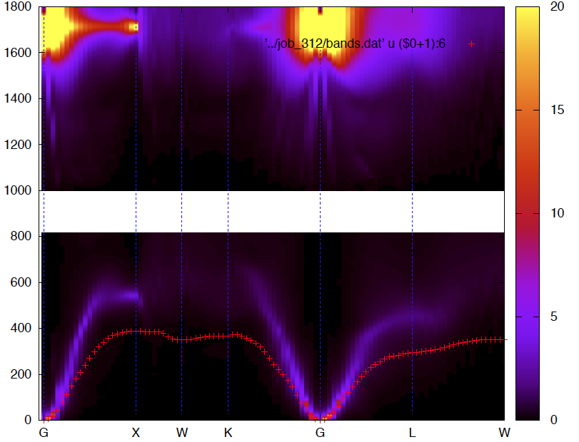
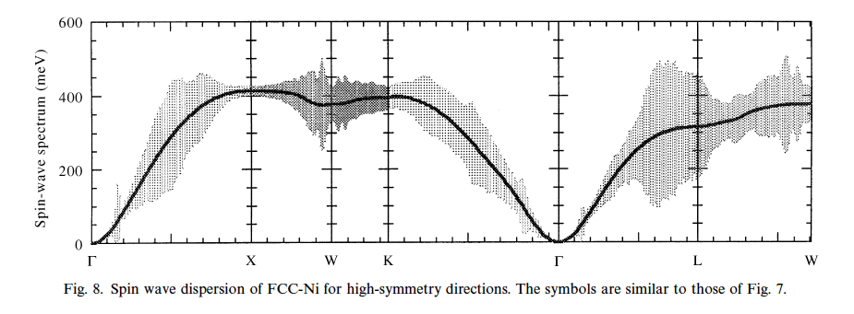
Results: fcc Ni
Remarks:
Good agreement for
small q.
High energy modes
are ’too high’ (??)
Good agreement for
bare magnons.
Stoner excitations
at 0.7 eV

Slide 8
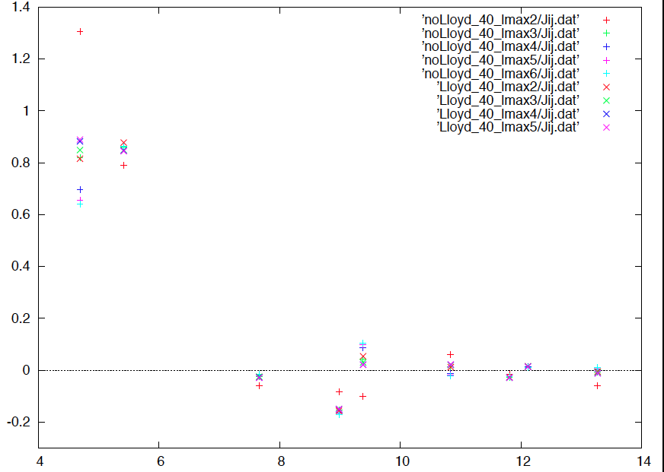
Discussion
Still investigating discrepancies at ‘H’ in Fe.
Results depend strongly on
calculational details.
Old results not converged??
‘X-W-K’ magnons in Ni?
previous calculations neglect real part of magnon
self energy.

Slide 9
Outlook and Actions
Check lmax convergence of susceptibility (Fe, Ni)
Calculate Ni with ELK
Look at different k-points (Toby to send)
Look at MnSi

