Slide 2
High energy magnetic excitations in iron measured throughout the Brillouin zone
Toby Perring Alex Buts
Martin Lueders
Herb Mook

Slide 3
Motivation
Classic itinerant electron ferromagnet
Fe Co Ni
Correlated electron system
Benchmark for calculations of spin dynamics
Magnetism and its dynamics plays a central role in metallic systems with strong e⁻ - e⁻ correlations
Fluctuations mediate superconductivity in cuprates and iron pnictides
Role in QCP
Role in transport properties
Interplay with orbital, electronic and charge d.o.f. in manganites
Dynamical susceptibility at the heart of time-dependent response to external perturbations
Reliable prediction of dynamical susceptibility ➔ understanding in complex systems

Slide 4
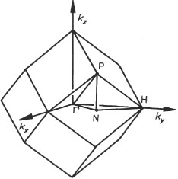
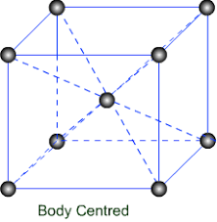
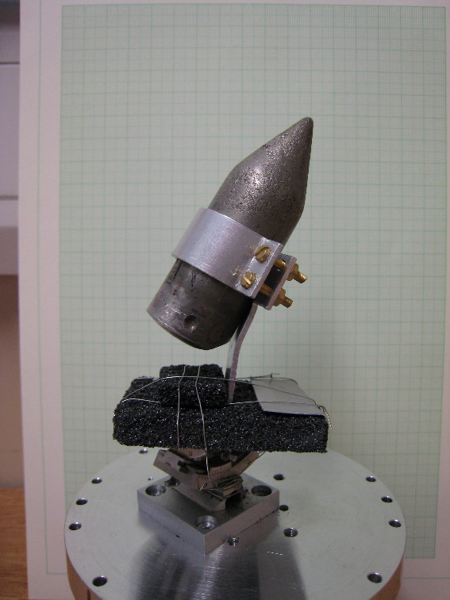
Iron
a = b = c = 2.845 Å
T_{C} = 1043 K
M = 2.2 μ_{B}
⁵⁴Fe – 10at% Si
166 g single crystal

Slide 5
What do we expect?
energy
ε
wavevector
q
Single particle excitations
Collective excitations Magnons
Magnon damping

Slide 6
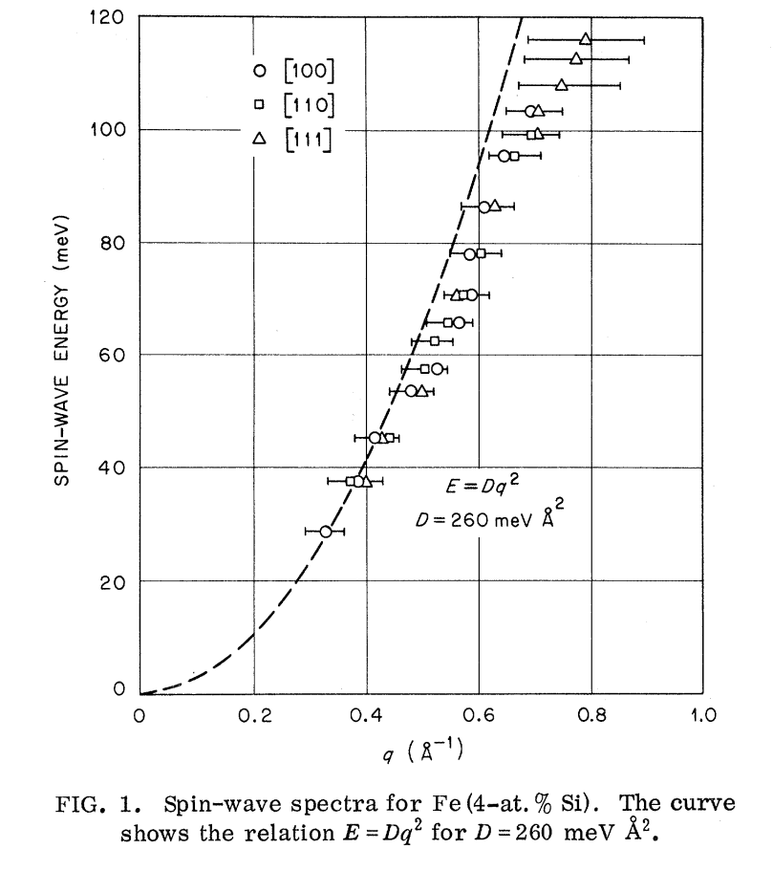
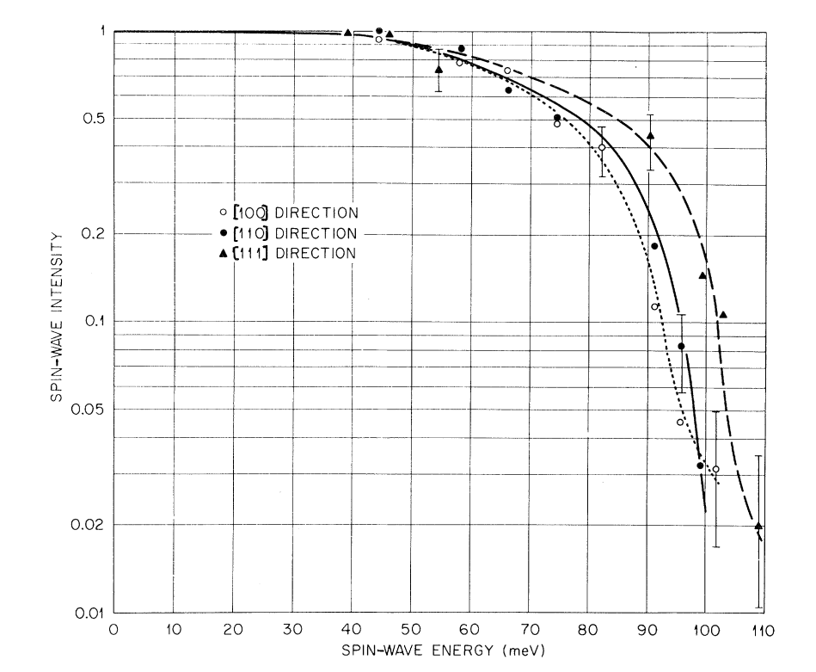
Earlier results pt.I: damping
Dispersion
Spin wave intensity
H. A. Mook & R.M. Nicklow; PRB 7 336 1973 (⁵⁴Fe+4at%Si)

Slide 7
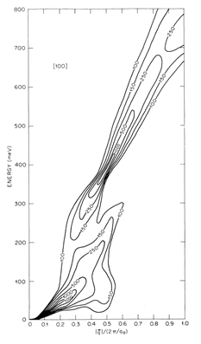
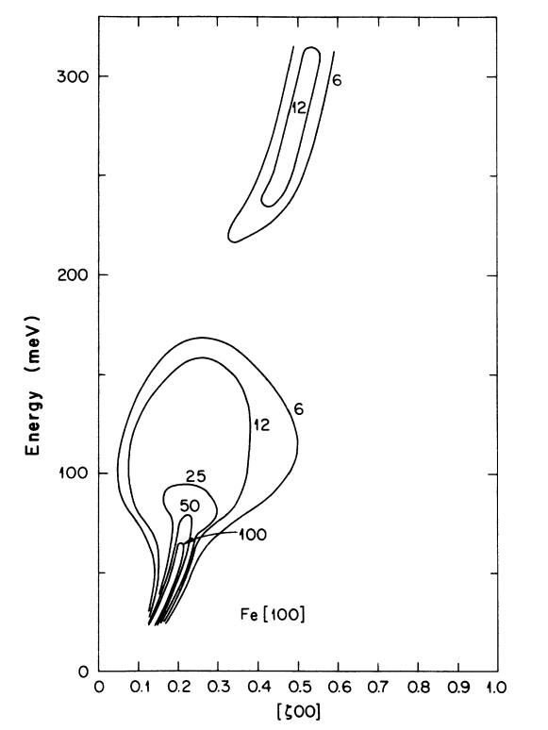
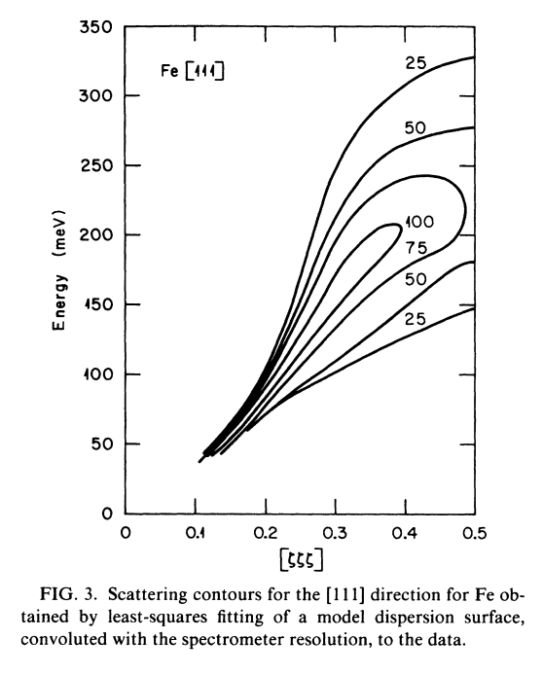
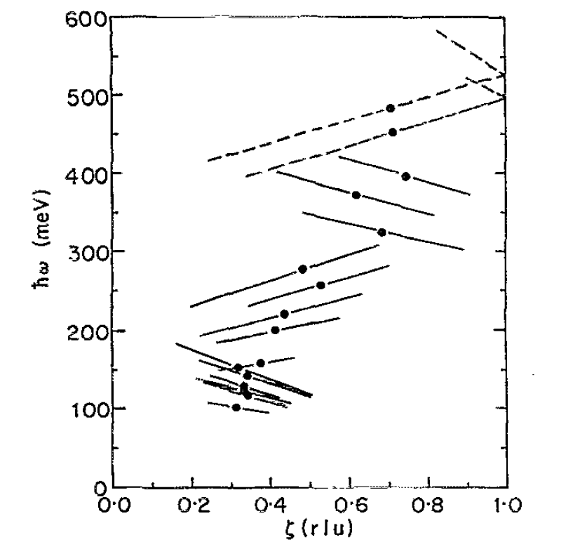
Earlier results pt.II: high energy damping & structure
[100]
[111]
[100]
Triple axis spectrometer:
D. McKenzie Paul et al., PRB 38 580 (1988)
TOF instrument:
T. G. Perring et al., J. Appl. Phys 69 3219 (1991)
Developments in calculation approaches
Development in instrumentation

Slide 8
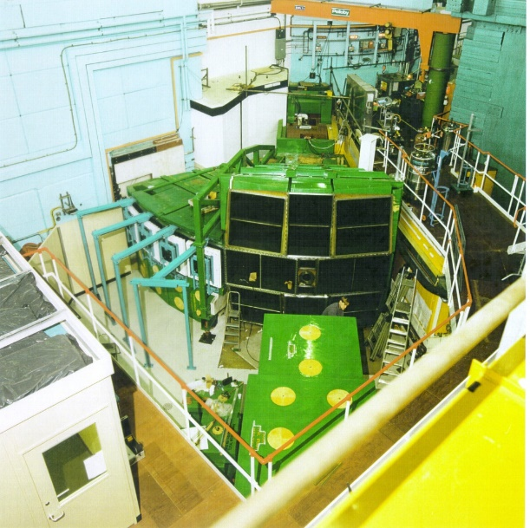
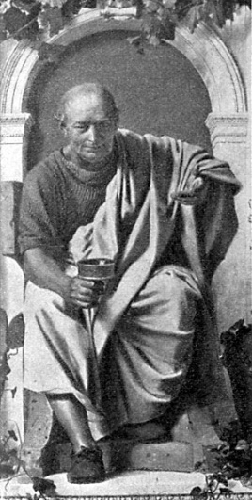
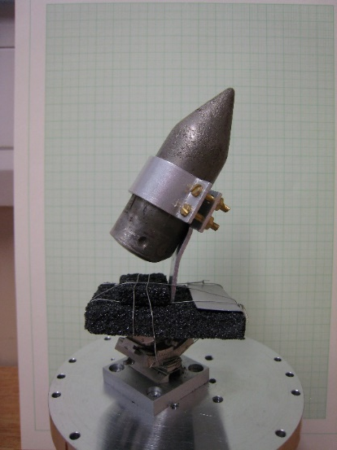
Experiment
MAPS
Horace
+
+
Ei: _
100 meV
200 meV
400 meV
800 meV
1400 meV
≈ 4% ΔE/E energy resolution

Slide 9
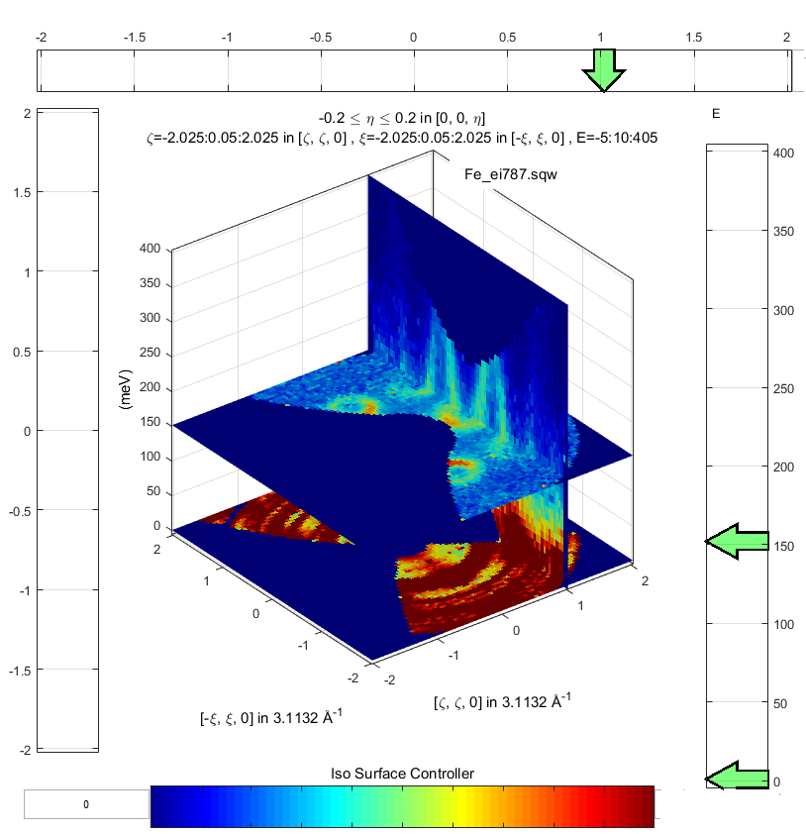
Experiment: data

Slide 10
Experiment: data

Slide 11
Experiment: data overview
[100]
[110]
[111]
No obvious fall-off in intensity as go through 100 meV
No dramatic broadening along [100] above c. 100 meV
No gap at c. 200 meV along [100]

Slide 12
Experiment: data at low energies- resolution effect ?
Effective J
-- Ei 400 meV
-- Ei 200 meV
γ
Heisenberg ferromagnet dispersion relation
Allow for damped simple harmonic oscillator inverse lifetime γ
Least-squares fit with resolution function convolution

Slide 13
Experiment: data at low energies
Intensity
Effective spin S_{eff}
Energy transfer (meV)
H. A. Mook & R.M. Nicklow; PRB 7 336 1973

Slide 14
Experiment: data at low energies
Intensity
Effective spin S_{eff}
Energy transfer (meV)
Damping
Inverse lifetime (meV)
Energy transfer (meV)

Slide 15

Experiment: data at high energies
[1 ,0,0]
[½, ½, ½]
[1 ,0,0]
[½, ½, 0]
D. McKenzie Paul et al., PRB 38 580 (1988)

Slide 16
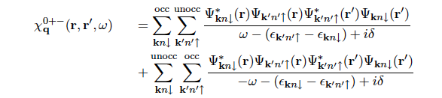

Calculations: Time-dependent DFT
Time dependent density functional theory: in principle exact
Non-interacting susceptibility:
Self-consistency requirement:
induced charge and magnetisation density modifies exchange-correlation potential
Exact linear response with functional derivative of exchange-correlation potential w.r.t. density
Looks like RPA, but there the approximations are ad hoc
Approximations to make tractable (‘KKR all electron’, ‘Atomic Sphere Approximation’, imaginary time with analytic continuation,,,)
BUT time-consuming, & expected to fail for e.g. cuprates
Notes:
The induced charge and magnetization densities described by the Kohn-Sham susceptibility modify the Hartree and exchange-correlation potential

Slide 17
Calculations: QSGW (Questaal)
Many body technique (Quasiparticle self-consistent GW approximation: QSGW)
Effective single particle Hamiltonian based on self-consistent perturbation theory (cf DFT)
LDA – band gaps usually wrong
LDA+U – ad hoc parameter, need not be sufficient
Approach: Non-interacting susceptibility χ₀⁺⁻ ➔ χ⁺⁻
Questaal implementation
Fast: x 100 faster for Fe ➔ full 4D susceptibility χ⁺⁻ (q,ω)
Goal:
benchmark calculation approaches
Provide ‘user service’
Interface with PACE

Slide 18
Experiment: data
Broad areas of agreement:
Well-defined spin waves from Gamma point
‘Dispersion’ fine
Loss of intensity approaching H point (i.e. [1,0,0])
Areas of disagreement:
Energy scale generally stretched by ≈ 1.4
GH (i.e. [100]) damping not observed
P point (i.e. [0.5,0.5,0.5]) loss of intensity
[1 ,0,0]
[½, ½, ½]
[1 ,0,0]
[½, ½, 0]

Slide 19
Experiment: data
[100] direction
[110] direction

Slide 20
Next steps:
Iron analysis:
Resolution convolution on the symmetrised cuts
To what extent is there quantitative agreement
Move to other materials:
Ni (apparently hard: rigid spin approximation may fail)
MnSi
FeSe, cuprates, pnictides…

Slide 21
Summary
Measured the spin dynamics to 0.4 eV in iron
Discrepancies with earlier data from triple axis spectrometer
No observation of intensity above ≈100 meV
Well defined spin waves along [100] to > 300 meV
Moderate agreement with latest calculations
TD-DFT
Quasiparticle self-consistent GW calculations
BUT energy scale and [100] major differences
Work still to be done to complete the analysis

Slide 22
The End

Slide 23
Comparison with calculations
Broad areas of agreement
Energy scale generally stretched

